Slide 1
AHCCCS Update

Slide 2
AHCCCS by the numbers
2,291
KidsCare lives added
8 years
Highest cap increase
1.92 per day
Death opioid/heroin
1,888,000
AHCCCS population
>200
Provider org. join HIE
318,782,391
FY 16 electronic trans.
46 days
Length of Sabbatical

Slide 4
AHCCCS Population as of July 1, 1985 – 2016
.

Slide 5
Historical GF Spend vs Population

Slide 6
AHCCCS GF Budget Requests

Slide 7
Marketplace Enrollment: Arizona

Slide 8
Marketplace Enrollment Growth Rate: Arizona vs. National

Slide 9
2016 Enrollment by Health Plan Type: Arizona vs. National

Slide 10
Marketplace Cohort by Age: 2016

Slide 11
AHCCCS Cap Rate History

Slide 12
Provider Rate Changes (2009-16)
Provider | Change | Provider | Change
Hospital IP | (16-20)% | Emergency | 29.5%
Hospital OP | (8.7)% | NEMT | (11.3)%
NF (EPD) | 2.3% | ASC | 5.6%
Behavioral Health OP | (4.6)% | Dental | (12.5)%
Physician | (13.2)% | FQHC | 37%

Slide 13
AHCCCS VBP Fee Schedule Changes
2014 – Hospital IP – APR-DRG
2015 – MCOs/DFSM pay FQHC full rate
2016 - Hospitals bump for sharing data with HIE and meeting MU2
2016 - SNFs – increase for those above avg with pneumococcal vaccine
2016 - Integrated Clinics- physical health
2016 – stand alone ED – new provider type
2016 – Treat and Refer
Notes:
a

Slide 14
Treat and Refer
Treat and Refer (T&R) Begins on 10/1/16 or CMS Approval – whichever is later
T&R services are not equivalent to emergency services (which can be provided – and MCOs must pay for – without a contract)
T&R services are for non-emergent referrals in response to a 911 call
To be reimbursed by Medicaid:
EMS providers must receive T&R recognition from ADHS (protocol located on their website)
T&R providers must be contracted with our MCOs and in their network to receive reimbursement

Slide 15
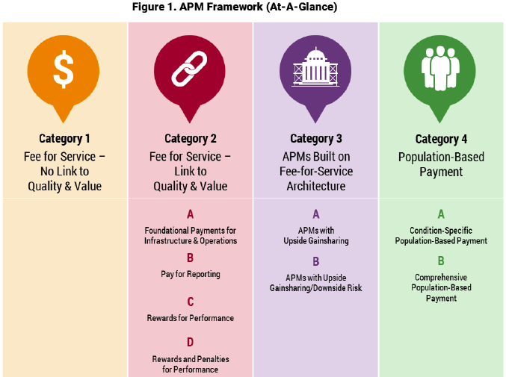
LAN Payment Reform Framework
Notes:
Can we do this one without the boxes/arrows? Concept is ok but leaves out a range of reform types
Done

Slide 16
Network Growth

Slide 17
Network Hospital Participation

Slide 18
Network Provider Participation

Slide 19
Member Engagement - Technology
Engaging Members through Technology: The Contractor shall engage its membership through web based applications. The Contractor shall identify populations who can benefit from web based applications used to assist members with self-management of health care needs such as, chronic conditions, pregnancy, or other health related topics the Contractor considers to be most beneficial to members and the Contractor shall submit an executive summary to AHCCCS, DHCM, Medical Management Unit by December 1, 2016 to include at a minimum:

Slide 20
Member Engagement - continued
a. Criteria for identifying at least 10% of Contractor’s members who can benefit from web based applications,
b. Listing of identified population(s),
c. Description of web applications in development or being utilized to engage members,
d. Strategies used to engage the identified members in the use of the web applications, and
e. Description of desired outcomes"

Slide 21
Provider Revalidation
2016
PT77 Outpatient Clinics = 318
PT31 Physician Osteopath = 1341
PT92 School Based Transport = 95
PT93 School Based Attendant Care = 1183
PT94 School Based Nurse = 210
2017
PT08 Physicians = 12,692

Slide 22
Arizona Coalition for Military Families
resourcecommand.org
Seeking BH provider participation for being identified as a community resource
Requires the completion of a form and a commitment to attend a coalition training on working with the military.
Website similar to 211 type system

Slide 23
Questions?

