Slide 1
Modernizing Arizona Medicaid
Arizona’s Application for a New Section 1115 Demonstration
August 2015

Slide 2
Section 1115 Defined
Section 1115 of the Social Security Acts gives states authority to waive selected Medicaid requirements in federal law
Two types of authority may be requested:
  Waiver of provisions of Section1902
  Expenditure of federal funds under Section 1903
Projects must be budget neutral – i.e. project cannot cost more than it would have without the waiver
New Demonstrations are generally approved for 5 years; Arizona’s waiver has been a 5 year contract

Slide 3
The Waiver Allows Arizona to:
Run its unique Medicaid model built around a statewide managed care system
Provide health care to expanded populations
Serve members enrolled in the Arizona Long Term Care System (ALTCS) in the community rather than more costly institutions
Allow spouses as paid caregivers in ALTCS
Implement administrative practices that increase efficiency

Slide 4
Current Waiver Structure
Federal authorities are granted to the State and detailed through three major sections:
  Waiver List
  Expenditure Authority List
  Special Terms and Conditions
Additional Attachments provide more detail on various programs and guidelines

Slide 5
Arizona’s 1115 Waiver
Arizona’s current waiver scheduled to expire September 30, 2016
Current terms require the State to give notice of its intentions one year in advance
Arizona will submit its letter of intent to apply for a new Demonstration by September 30, 2015

Slide 6
Federal Process
The Centers for Medicare and Medicaid Services (CMS) is the federal agency responsible for oversight of State Medicaid agencies
Arizona must obtain final approval from CMS
The Office of Management and Budget and the Department of Health and Human Services also review waiver proposals
1115 Waivers are approved at the discretion of the HHS Secretary

Slide 7
Arizona’s Application
Arizona’s application for a new 5-year waiver includes:
  Part I: Governor Ducey’s vision to modernize Medicaid: The AHCCCS CARE program
  Part II: The Legislative Partnership
  Part III: DSRIP: Arizona’s Approach
  Part IV: HCBS Final Rule
  Part V: American Indian Medical Home
  Part VI: Building Upon Past Successes
  Part VII: Safety Net Care Pool

Slide 8
Public Comment Process
Five public hearings and tribal consultation are scheduled to seek input
For schedule and how to submit comments, http://www.azahcccs.gov/publicnotices/Downloads/WaiverForumFlyer.pdf
Written comments (by mail or electronic) should be submitted and received no later than September 25, 2015
For more information, http://www.azahcccs.gov/shared/FiveYear.aspx

Slide 9
Part I: Modernizing Arizona Medicaid
The AHCCCS CARE Program
Choice
Accountability
Responsibility
Engagement

Slide 10
AHCCCS Initiatives
“I also believe we are not close to achieving maximum efficiency in our Medicaid program ”
Governor Ducey

Slide 11
AHCCCS Today
Largest Insurer in the State of Arizona
$12.0 billion program
Mandatory Managed Care
Public-Private Partnership
System built on competition and choice
Integrated delivery system–over 60,000 providers
Covers two-thirds of nursing facility days
Covers nearly as many adults as traditionally eligible populations, such as pregnant women, children, elderly, persons with disabilities

Slide 12
Modernizing Arizona Medicaid
Expanding Private Sector Partnerships and Leveraging Today’s Technology to Reinvent AHCCCS
Engage Arizonans
to take charge of their health
Make Medicaid a temporary option
Promote a quality product at the most affordable price

Slide 13
The AHCCCS CARE Program: Requiring Member Contributions
Copays:
  Up to 3% of annual household income
  Members will make monthly AHCCCS CARE payments reflecting copays for services already obtained
  This also removes the burden of collecting the copay by providers at the point of service

Slide 14
Strategic Copays
No Copays
Copay Required
Preventive Services
Wellness
Chronic illness
Persons with Serious Mental Illness
Services obtained at your Primary Care Physician or OB-GYN
Opioids, except cancer and terminal illness
Non-Emergency use of ED
Missed Appointments
Specialist services without PCP referral
Brand name drugs when generic available unless physician determines generic ineffective

Slide 15
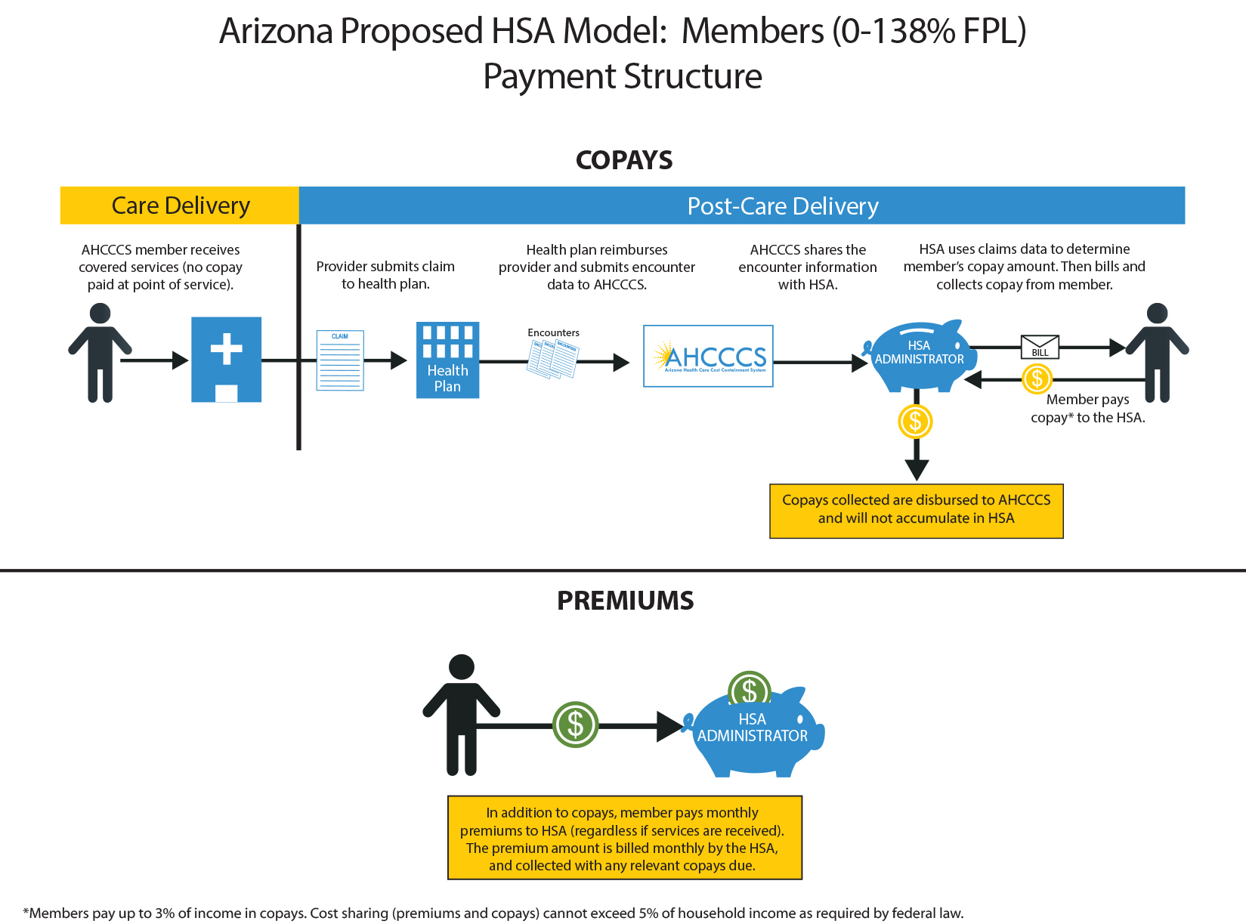

Slide 16
AHCCCS CARE Premiums
Included in the monthly AHCCCS CARE payment
Premium requirement set at 2% of annual household income
Member contributions do not exceed 5% of annual household income

Slide 17
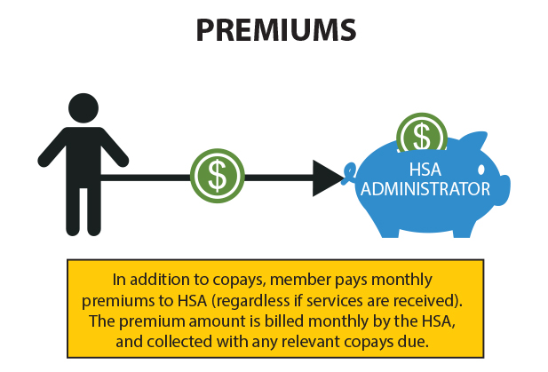

Slide 18
The AHCCCS CARE Account: Giving People Tools to Manage Their Health
Functions like a Health Savings Account
Members must be in good standing to be eligible for the AHCCCS CARE Account by
  Making timely payments
  Participating in AHCCCS Works
  Meeting the Healthy Arizona targets
Employers and the Philanthropic community can make AHCCCS CARE Account contributions

Slide 19
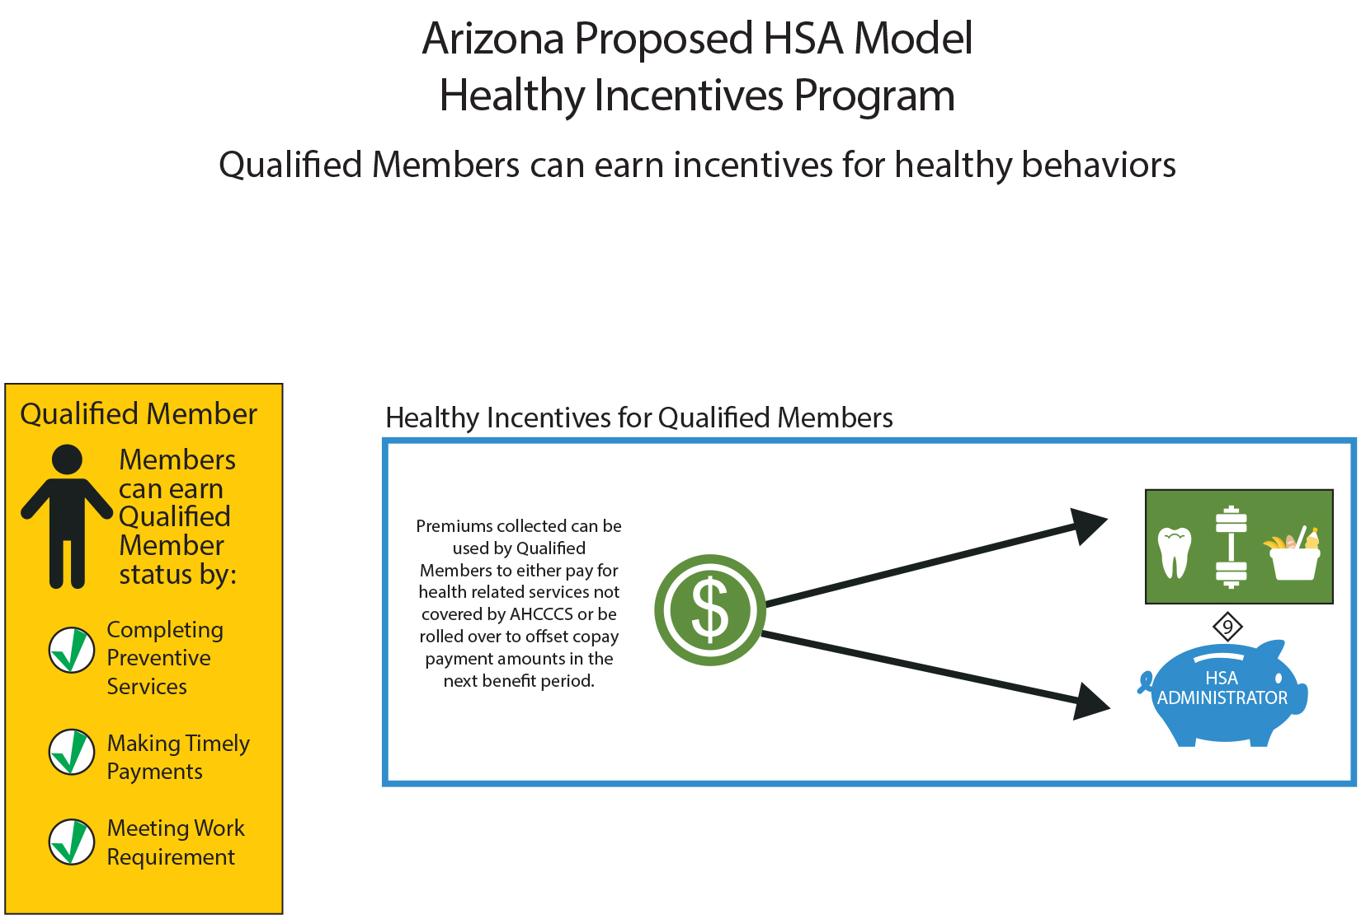

Slide 20
The AHCCCS CARE Account (cont.)
Contributions for premiums go into the AHCCCS CARE Account, which can be used for non-covered services
  Dental
  Vision
  Chiropractic services
  Nutrition counseling
  Recognized weight loss programs
  Gym memberships
  Sunscreen

Slide 21
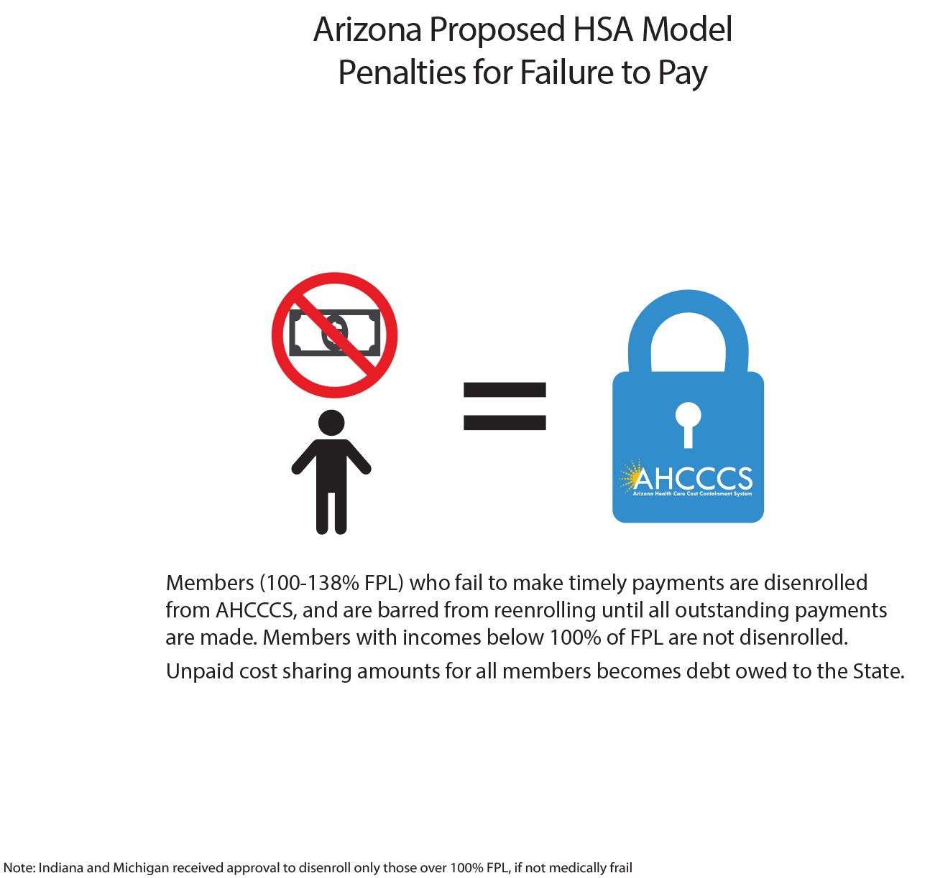

Slide 22

Healthy Arizona:
Promoting Healthy Behaviors
Healthy Arizona is a set of targets
  Promoting wellness: wellness exams, flu shots, glucose screenings, mammograms, tobacco cessation, and others.
  Managing Chronic Disease: such as, diabetes, substance use disorders, asthma.

Slide 23
Healthy Arizona (cont.)
If members meet their Healthy Arizona target, they have the choice of either:
  Reducing their required AHCCCS CARE payments; or
  Rolling unused AHCCCS CARE Account funds over into next benefit year.

Slide 24
AHCCCS Works:
Viewing AHCCCS as a Pit Stop
Supporting Work Incentives:
  Partner with existing employment supports programs to build skills and promote work
  Arizona Department of Economic Security manages numerous programs that provide support to job seekers
  Unused AHCCCS CARE funds roll over into private HSA or AHCCCS CARE account can be maintained when member transitions out of Medicaid

Slide 25
AHCCCS Works (cont.)
Employers will be able to make direct contributions into their employees’ AHCCCS CARE Account that employees can use toward non-covered services
Employer contributions reduce employee’s contribution requirements or help build up funds in their AHCCCS CARE Account that can be used for non-covered services

Slide 26
AHCCCS Works (cont.)
Targeted Participation:
  The Philanthropic community can make contributions for targeted purposes, such as smoking cessation or managing chronic disease
Private sector contributions are tax-deductible

Slide 27
A Modern Approach
  Engaging consumers through technology
  BUILDING
  partnerships to reduce fragmentation
  Improving data analytics for program integrity
  Prioritizing
  quality over quantity

Slide 28
Part II: The Legislative Partnership

Slide 29
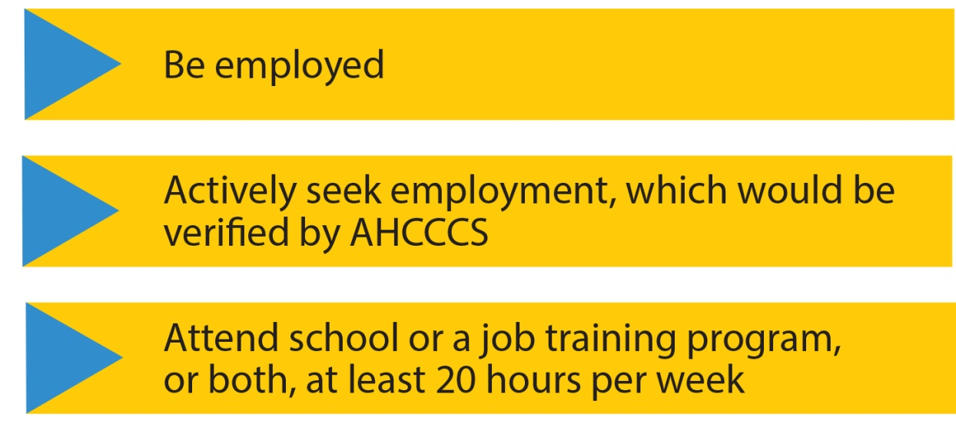
The Requirements: SB 1092
All able-bodied adult* members are required to meet one of the following employment criteria to qualify for AHCCCS:
*Able-bodied adults are individuals who are at least 19 years of age, and are physically and mentally capable of working.

Slide 30
SB 1092 Work Requirement – Exemptions
Exemption for individuals meeting any of the following
  Is at least 19 years of age but is still attending high school as a full‑time student
  Is the sole caregiver of a family member who is under 6years of age
  Is currently receiving temporary or permanent long‑term disability benefits from a private insurer or the government
  Has been determined to be physically or mentally unfit for employment by a health care professional in accordance with rules adopted by the agency

Slide 31
SB 1092 (cont.)
Limit lifetime enrollment to five years
  Begins on effective date of waiver change
  Does not include time during which person is
    Pregnant
    Sole caregiver of family member under 6
    Receiving long-term disability benefits
    At least 19 and still attending high school full time
    Employed full time, meets AHCCCS income eligibility
    Enrolled before age 19
    Former foster child under 26 years of age

Slide 32
SB 1092 (cont.)
Develop cost sharing requirements to deter:
  Non-emergency use of the ED
  Use of ambulance services for non-emergency transportation when not medically necessary
“Able-bodied” means an individual who is physically and mentally capable of working
“Adults” means at least 19 years of age

Slide 33
SB 1475
0-100% FPL:
Premium of 2% of household income
Copay of $8 for non-emergency use of ED for first incident and $25 for each subsequent incident if the person is not admitted to the hospital. No copay if a person is admitted to the hospital by the ED.
Copay of $25 for non-emergency use of ED for first incident and $25 for each subsequent incident if there is a community health center, rural health center or urgent care center within twenty miles of the hospital.

Slide 34
SB 1475 (cont.)
100-133% FPL:
Premium 2% household income
Copay of $25 for non-emergency use of ED if the person is not admitted to the hospital. No copay if a person is admitted to the hospital by the ED.
Copay of $25 for non-emergency use of ED if there is a community health center, rural health center or urgent care center within twenty miles of the hospital.
Exemption from providing non-emergency medical transportation

Slide 35
Part III: Delivery System Reform Incentive Payment (DSRIP)
Arizona’s Approach

Slide 36
DSRIP: Arizona Approach
DSRIP initiatives will focus on:
  Behavioral Health – Physical Health Care Delivery and Payment Integration
  Chronic diseases associated with persons identified as having High Needs/High Costs
  Primary Care models with accountability for population health outcomes
Results of State Innovation Plan will inform additional areas of focus

Slide 37
DSRIP (Cont.)
Performance measures will include:
  Measures of infrastructure development – e.g., participation in Health Information Exchange
  System redesign – e.g., value based payment arrangements to achieve collaboration and integration
  Clinical outcome improvement – e.g., establishing targets for hospital readmission or asthma related hospitalizations
  Population health improvement – e.g., percentage of homelessness among persons with SMI

Slide 38
DSRIP (cont.)
Incentive payment methodology based on milestones and tied to specified measures
Learning collaborative will be established for providers to share best practices, etc.

Slide 39
Part IV: Home and Community Based Services Final Rule
Arizona’s Assessment and Transition Plan

Slide 40
HCBS Final Rule
Final Rule released by CMS 1-16-14
Rule defined what qualifies as HCBS setting
Arizona largely complies; modest changes
HCBS program lives in 1115 Waiver; thus, Assessment and Transition Plan are part of this broader process
Because of specificity to this topic, separate public process
See http://www.azahcccs.gov/hcbs/default.aspx

Slide 41
Part V: American Indian Medical Home

Slide 42
American Indian Medical Home
Health plans provide members with assigned PCP and assistance in managing chronic illness, case management, care coordination
American Indians/Alaska Natives (AI/AN) are exempt from mandatory managed care
Individuals who opt out of managed care receive services on a fee-for-service basis through American Indian Health Program

Slide 43
AI Medical Home (cont.)
To assist Indian Health Services (IHS) and Tribal 638 facilities to offer similar medical home services, AHCCCS is proposing to reimburse qualifying facilities for:
  Primary Care Case Management
  Diabetes Education
  After-hospital care coordination
  24-hour call lines staffed by medical professionals

Slide 44
Part VI: Building upon Past Successes

Slide 45
Arizona’s 1115 Waiver: An Evolution
Modest changes are required as Arizona’s program matures and evolves. Some of these include:
  Technical changes to reflect AHCCCS / Division of Behavioral Health Services merger
  Aligning behavioral health benefits for duals
  Enhancing payments to Critical Access Hospitals
  Adding traditional healing services for AI/AN

Slide 46
Part VII: Safety Net Care Pool Phase Down

Slide 47
Safety Net Care Pool (SNCP):
In April 2012, CMS approved SNCP
Designed to help hospitals manage uncompensated care costs during childless adult enrollment freeze
SNCP served as bridge to 2014 for many hospitals across the State
Program ended on December 31, 2013

Slide 48
SNCP (cont.)
SNCP extended for Phoenix Children’s Hospital (PCH) to address issues unique to freestanding children’s hospitals that did not benefit from adult coverage restoration and expansion
PCH received two one-year extensions of SNCP
Federal process is phasing out these types of programs

Slide 49
SNCP: Transition Plan
AHCCCS requests a 5-year transition reducing SNCP payments from current max of $137 million in 2015 to:
  $117 million in 2016
  $90 million in 2017
  $70 million in FY 2018
  $50 million in 2019
  $25 million in 2020

Slide 50
SNCP: Transition Plan
Arizona is working with PCH to move away from reliance on SNCP through:
  APR-DRG payment methodology
  Raising reimbursement for high-acuity pediatric cases across the board
  Updating method for determining Indirect Medical Education Costs
  Value-Based Purchasing rate differentials

Slide 51

Our Goal: Raise the Standard by Building on Past Success

Slide 52
Questions and Public Comments

Slide 53
Thank You.

