Slide 1
DFSM Tribal ALTCS
1st Quarterly Case Management Supervisory Meeting
Thursday, October 15, 2026

Slide 2

Meeting Reminders
Please mute your computer's microphone and/or phone when not speaking.
Use the chat features to add in comments/questions.
Meetings will no longer be recorded. In-person attendance is strongly encouraged.
Presentation slides will be uploaded to DTB within 1 week post meeting.

Slide 3
Welcome
Agenda Overview
Opening Prayer: PYT ALTCS
Welcome: Rachel Conley, TALTCS Administrator
Mom's Meals: Katie Mednick, Director of Healthcare Partnerships
Quality Management: Shannon Shiver, Program Manager & Lauren Coln, Program Administrator
Ice Breaker
Case Manager Coordination Updates: Amber Heard, TALTCS Program Manager
10-Minute Break
ALF Overview, ALF Calculation, & ALF Agreement: Caitlin Hasper, TALTCS Program Coordinator
Tribal ALTCS Hospital & Urgent Care Notification: Bandana Chetty, EVV Specialist
1.5 Hour Lunch
Fax Submission, Form Completion, Missing Documentations, & Follow-up Emails: Gwendy Yazzie, TALTCS Clinic
AHCCCS Registered Providers – ROPA, ASC, Pending Rates: Vanessa Torrez, TALTCS Clinical Manager
EMCR Refresher: Frank Villarreal, TALTCS Program Coordinator
Operational Review Results: Rachel Conley, TALTCS Administrator
Closing Remarks: Rachel Conley, TALTCS Administrator

Slide 4
Mom's Meals
Katie Mednick, Director of Healthcare Partnerships

Slide 5
Quality Administration Unit
Shannon Shiver & Lauren Coln

Slide 6
Quality Administration Agenda
QM Portal
  Incident, Accident, and Death (IAD) Reporting, Internal Referral Forms (IRF) and Quality of Care (QOC) concerns
  Closing Cases: Case Resolution/ Summary, outcome, and severity
  Updates and Enhancements
Independent Oversight Committee (IOC) Reporting
Seclusion and Restraints (SARs)
DFSM Quality Administration Provider Training Recap
Upcoming Opportunities

Slide 7
QM Portal - Closing Cases, Case Resolution/Summary, and Level of Severity
Shannon Shiver

Slide 8
Quality Management (QM)
Please review your program’s assigned cases (IADs, IRFs) within the QM Portal and disposition cases that are outstanding requiring review.
Please complete a resolution summary with final outcomes, recommendations to the provider as applicable, and case closure status within the QM Portal.
Escalate cases to AHCCCS/DFSM as needed.
If you need any Quality Management assistance with cases assigned or support with the process, please reach out to DFSM.
If you need technology related technical assistance, please submit a ticket through the AHCCCS Solutions Center for ISD support.

Slide 9
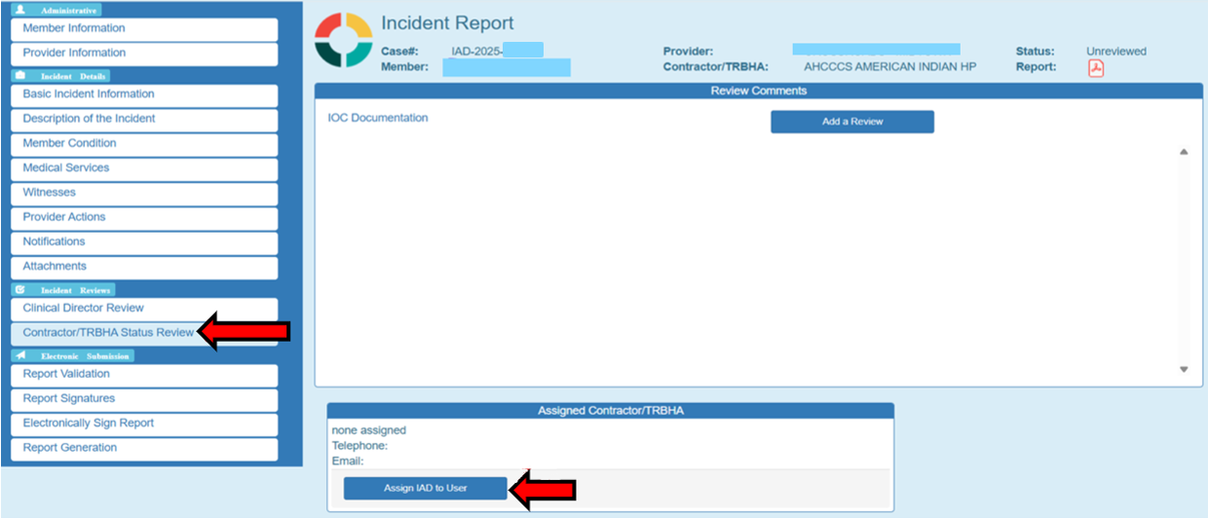
IAD/IRF Case Assignment and Disposition
Notes:
This slide highlights case assignment and disposition to get it out of unreviewed status and assign. Go to the Contractor/TRBHA Status Review, and select "assign IAD to user".

Slide 10
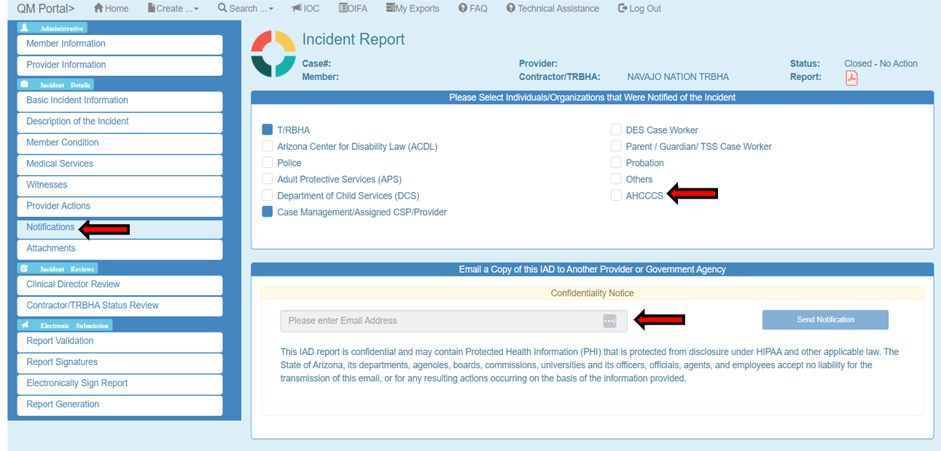
Notification of IAD
Notes:
Next, you select who you want to communicate the case with, whether it be TRBHA, CM entity, AHCCCS etc. You can also directly enter their email address in to send notification.

Slide 11
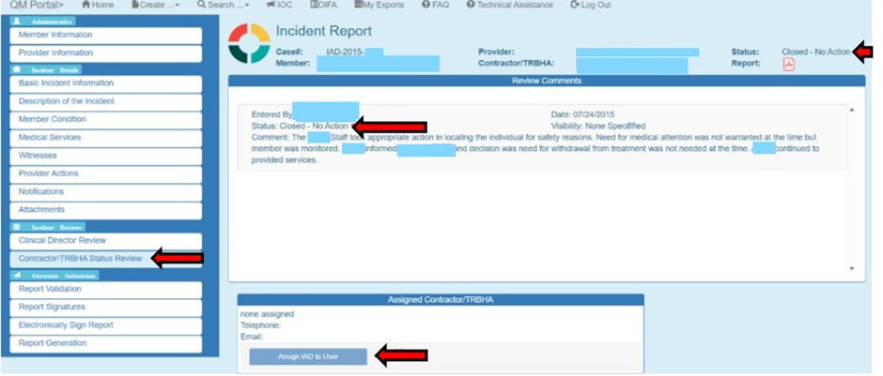
IAD/IRF Case Closure – Making Comments
Notes:
Tip: Use “Member” instead of name. This will help for later redaction needs.
Not all IADs/IRFs are QOCs. Tribal ALTCS can close it out on this screen and mark that it is not a QOC.

Slide 12
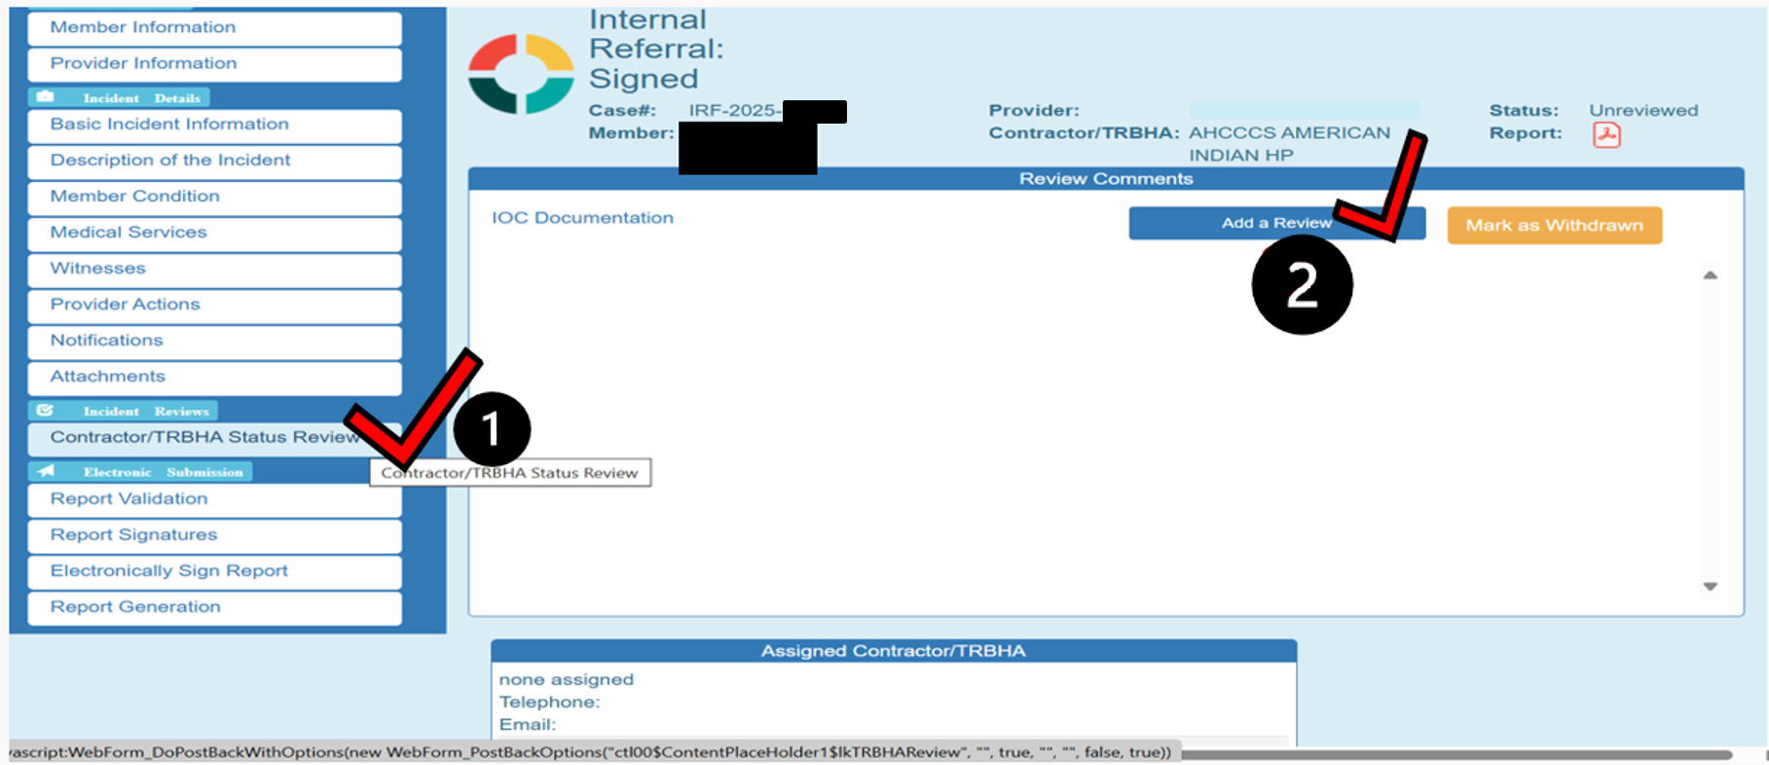
IAD/IRF Close or Create a Quality-of-Care Concern (QOC)
Notes:
How to close an IAD: make sure on the contractor/TRBHA tab, then add review,

Slide 13
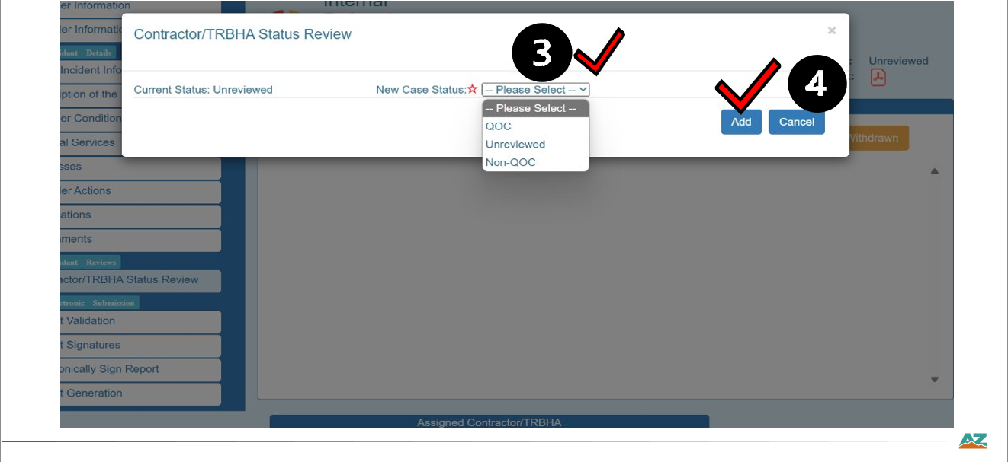
IAD/IRF Close or Create a Quality-of-Care Concern (QOC)
Notes:
Short menu can make into a QOC and add the status to it if you want to make it a QOC. Unreviewed means it will be created and sent to another entity or yourself to add a QOC, or to another entity within your organization and send it over to another plan, program, or entity.

Slide 14
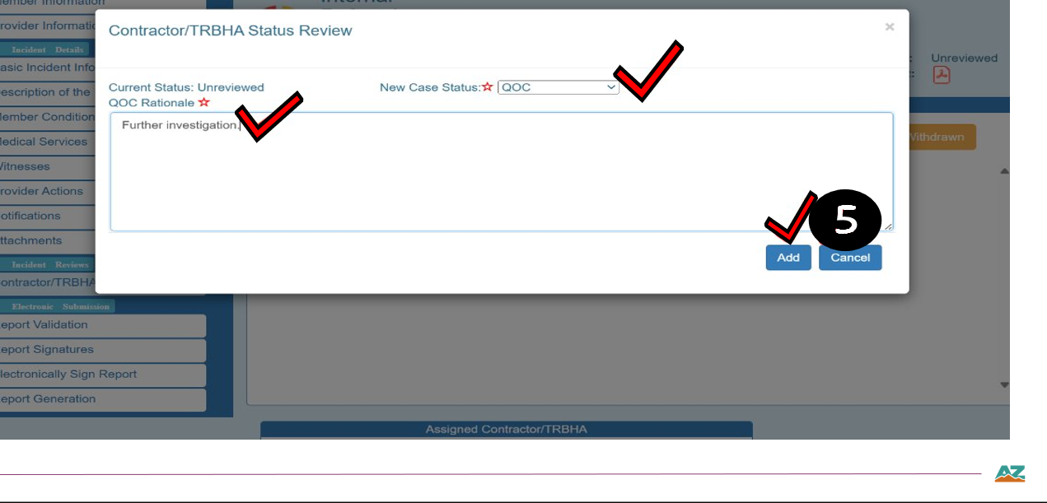
Quality-of-Care Concern (QOC) Investigation
Notes:
QOC case, put notes in, and add to the record.

Slide 15
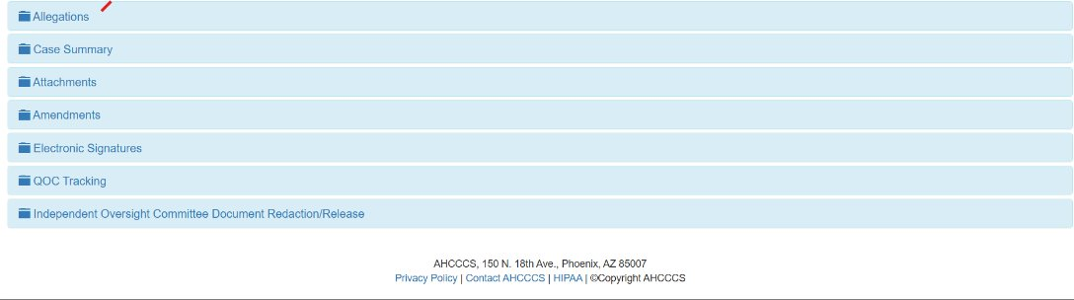
Closing a Quality of Care Concern (QOC)
Notes:
QOC Menu- IAD/IRF will get populated once it becomes a QOC, additional information regarding allegations, what you came up with your case summary, and any amendments, or uploads of documentation. Sometimes providers may add additional items once they see if became a QOC. Electronic signatures will track who looked or signed the case. QOC Tracking of the case will be how it was leveled and the severity of the concern. The IOC redaction/release is where you go to redact the information that needs to go to IOC.

Slide 16
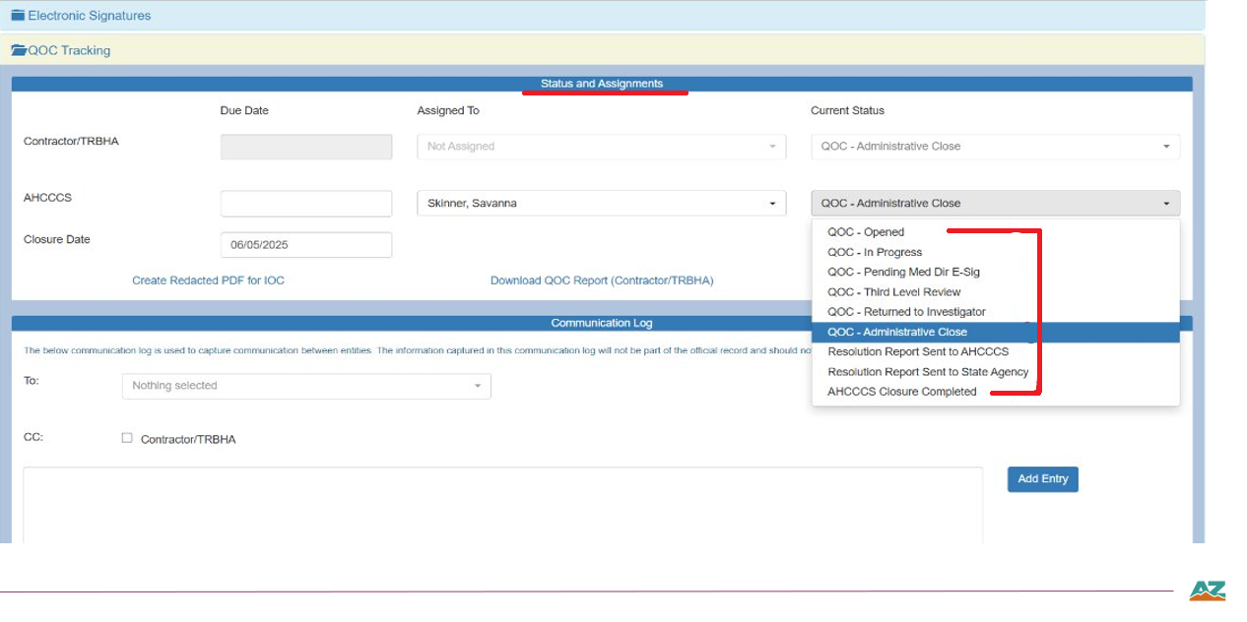
Quality of Care Concern (QOC) - Choose a status
Notes:
In the tracking area: have the drop down menu to choose the QOC status. Add communication. Tracking case, Making notes that will be viewable to the provider. Change status as applicable. Add entry.

Slide 17
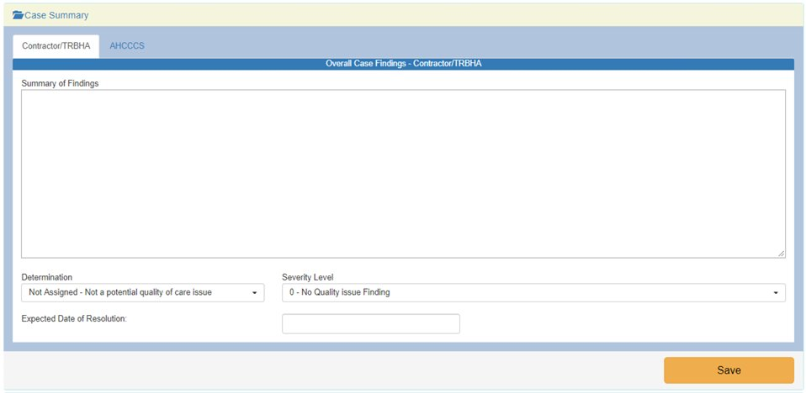
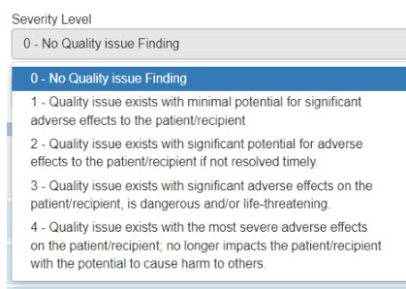
Member Quality of Care Concern (QOC) – Summary, Determination & Severity Level
Summary of Findings
  Summary of allegation, concerns, etc.,
Determination
  Not assigned-Not a potential quality of care issue (no clinical investigation required)
  Substantiated- QOC confirmed (following clinical investigation)
  Unsubstantiated- No QOC issues (following clinical investigation)
  Unable to substantiate- not able to substantiate (following clinical investigation)
Severity Level
Notes:
*Severity levels are now included within AMPM 830, also part of AMPM 960.

Slide 18
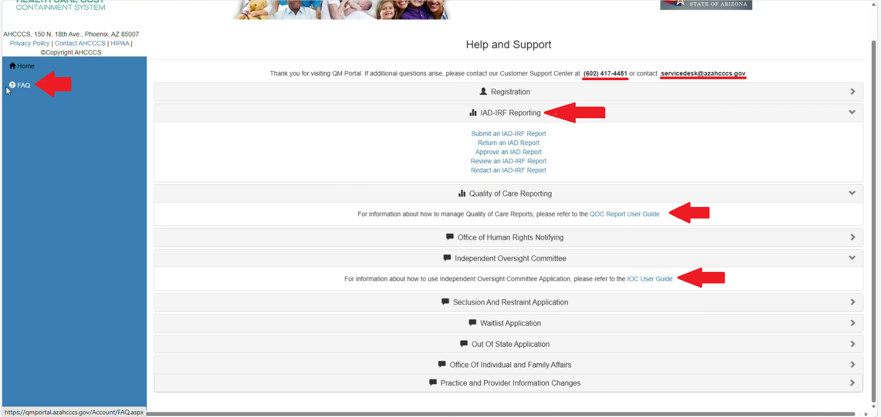
QM Portal Guides
Notes:
QM Portal User Guides for reference materials to support you in various components of the process

Slide 19
Quality Management Portal Updates
New Communication forum for IADs – communicate with the Provider's Author of the case.
Select the 'R' during a search for cases...this will allow the search to capture any reassigned cases.
Remember to redact information for SMI Members, those members on COE/COT, and all kids who experience abuse or neglect.
Periodically check for unreviewed cases for dispositioning.
DFSM QM will create IRF cases for Seclusion/ Restraint (SAR) in the QM Portal for Tribal ALTCS Programs to review.

Slide 20
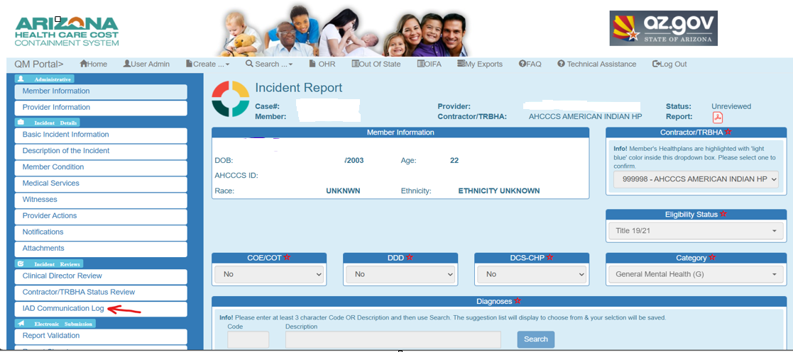
QM Portal Enhancements– Communication Log

Slide 21
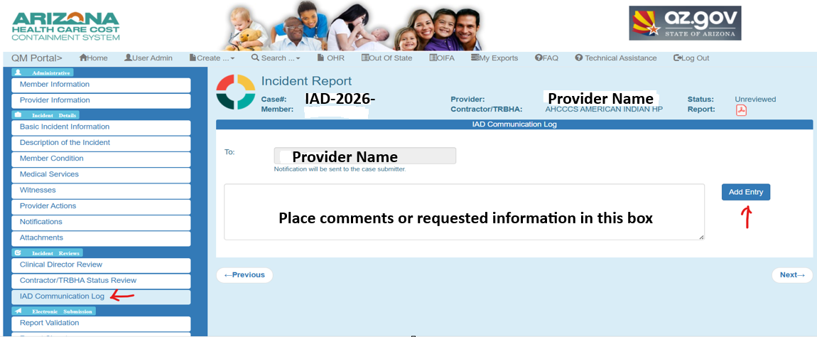
QM Portal Enhancements– Communication Log

Slide 22
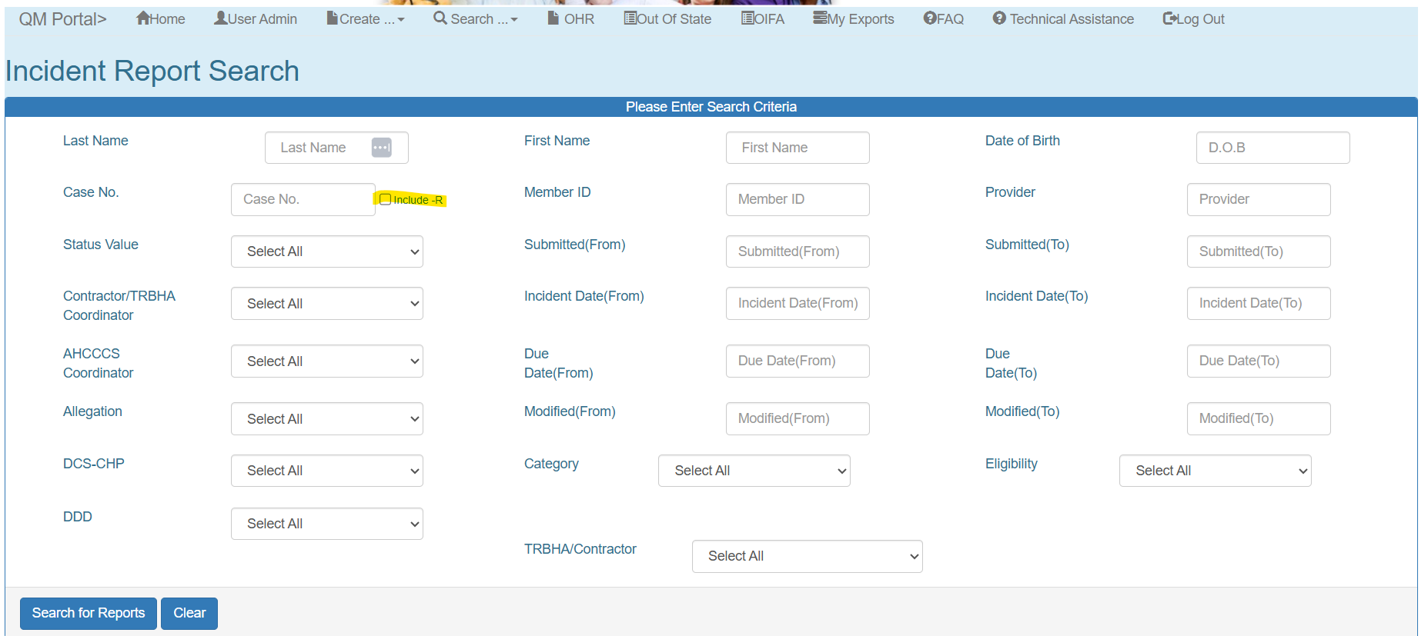
QM Portal Enhancements

Slide 23
Independent Oversight Committee (IOC) and Requirements
Lauren Coln, MSN, RN

Slide 24
Independent Oversight Committee (IOC)
The Arizona Department of Administration (ADOA) oversees the Independent Oversight Committee (IOC)
Per A.R.S. § 41-3803, IOCs are comprised of a group of 7-15 volunteers per each IOC area (Central, Northern, and Southern, AZ)
The Statute requires IOC members have expertise in at least one of the following areas:
  psychology,
  law,
  medicine,
  education, special education,
  social work,
  mental health,
  housing for the mentally ill,
  criminal justice,
  public safety;
  at least two parents of children who receive behavioral health services pursuant to tile 36, chapter 34,
  and at least one member who is a current or former client of the behavioral health system.
Notes:
Speaker Notes
The Independent Oversight Committees, or IOCs, are volunteer community-based committees overseen by the Arizona Department of Administration that provide independent oversight of Arizona’s behavioral health system.
Each IOC includes members with diverse professional expertise, as well as parents of children receiving behavioral health services and individuals with lived experience interacting with the behavioral health system.

Slide 25
Independent Oversight Committee (IOC)
The IOC committee ensures the rights of clients are protected, reviews incidents of possible abuse, neglect or denial of a client’s rights; makes recommendation to the director and the legislature regarding laws, rules, policies, procedures and practices to ensure the protection of clients receiving behavioral health and developmental disability services.
The IOC reviews seclusion and restraints (SARs), Incident, Accident, and/or Death (IADs) reports, Internal Referral Forms (IRFs) and Quality of Care Concerns for members with SMI designation
Reference: 9 A.A.C. 21: CHAPTER 21. ARIZONA HEALTH CARE COST CONTAINMENT SYSTEM (AHCCCS) - BEHAVIORAL HEALTH SERVICES FOR PERSONS WITH SERIOUS MENTAL ILLNESS
  https://apps.azsos.gov/public_services/Title_09/9-21.pdf
Notes:
Speaker Notes
The IOC helps protect the rights of individuals receiving behavioral health services by reviewing reports involving possible abuse, neglect, denial of rights, and other quality of care concerns.
The committee also reviews seclusion and restraint reports, IADs, IRFs, and Quality of Care concerns for members with an SMI designation, and provides recommendations to improve policies, practices, and client protections.

Slide 26
Independent Oversight Committee (IOC) Reporting Requirements
The Administration shall ensure appropriate Independent Oversight Committees (IOC) have access to copies of all reports received according to 9 A.A.C. Chapter (21) (e.g., reports regarding clients who need special assistance, allegations of mistreatment, denial of rights, restraint, and seclusion). This is applicable to all AHCCCS health plans.
Oversight committees are to be provided FFS member information by the assigned health plan or program with any member identifiers redacted to ensure nothing could be connected back to the member (refer to 45 CFR 164.514 (b)(2)(i)).
Notes:
Speaker Notes:
The Administration ensures that Independent Oversight Committees have access to required reports, including those involving allegations of mistreatment, denial of rights, restraint, and seclusion, across all AHCCCS health plans. Information shared with the IOC must be redacted to remove all member identifiers in accordance with federal privacy requirements before submission.

Slide 27
Reporting to Independent Oversight Committees (IOCs): AMPM 830
AHCCCS Independent Oversight Committee (IOC) reporting (behavioral health):
1. The TRBHAs, Tribal ALTCS and DFSM shall provide IAD Reports, IRF reports, and QOC concerns including, but not limited to, reports of possible abuse, neglect or denial of rights involving any behavioral health provider serving members with a Serious Mental Illness (SMI) determination, children, and anyone under court order for either Court Ordered Evaluation (COE) or Court Ordered Treatment (COT), to the IOC assigned to the region in which the IAD/IRF/QOC occurred within three business days of closure.
2. All IADs and IRFs that are triaged as potential QOC concerns shall be incorporated into the QOC record and shall be submitted to the IOC as part of the QOC documentation upon completion of the QOC investigation.
3. TRBHAs, Tribal ALTCS and DFSM shall ensure that all reports provided to the IOCs shall have all Personally Identifiable Information (PII) redacted in accordance with Federal and State confidentiality laws.
Notes:
Speaker Notes
This slide outlines the reporting requirements to the AHCCCS Independent Oversight Committees, or IOCs, for behavioral health services as outlined in AMPM 830.
First, TRBHAs, Tribal ALTCS programs, and DFSM must provide IAD reports, IRF reports, and Quality of Care concerns to the IOC assigned to the region where the incident occurred. This includes reports involving potential abuse, neglect, denial of rights, or other concerns affecting members with an SMI determination, children, and individuals under Court Ordered Evaluation or Court Ordered Treatment. These reports must be submitted within three business days of case closure.
Second, when an IAD or IRF is triaged as a potential Quality of Care concern, it must be incorporated into the QOC record and included with the QOC documentation once the investigation is complete.
All reports submitted to the IOC must have personally identifiable information, or PII, removed. This ensures compliance with federal and state confidentiality requirements and protects member privacy while still providing transparency and oversight.

Slide 28
Reporting to Independent Oversight Committees (IOCs): AMPM 830 (Continued)
4. All Seclusion and Restraint reports shall also be sent to the IOC.
5. Prior to submitting to the IOC, all information shared shall be redacted of any personally identifiable information (PII) in accordance with 45 CFR 164.514(b)(2)(i).
6. All Redacted versions shall be sent to the IOC.
7. TRBHAs, Tribal ALTCS and DFSM shall respond to AHCCCS IOC Manager, OHR, and the IOC to provide additional information if requested. If additional information is requested by the IOC for supplemental or unaltered documentation, or an investigation regarding an AHCCCS member, information shall be submitted to AHCCCS via email at: iocinquiries@azahcccs.gov.
For more information on IOCs please refer to AMPM 960 (III) (E-F) and ARS 41-3804, 41-3802, and AAC R9 Chapter 21; R9-21-105
QM Portal Redaction User Guide: https://qmportal.azahcccs.gov/UserGuides/QuickStart_IAD-IRF_Redaction.pdf
Notes:
Speaker Notes:
This slide continues the reporting requirements and expectations of programs to the IOC as outlined in AMPM 830
All Seclusion and Restraint reports must be submitted to the appropriate IOC. These reports are reviewed as part of the IOC's oversight responsibilities to ensure member rights, safety, and quality of care are maintained.
Before any information is shared with the IOC, all personally identifiable information, or PII, must be removed in accordance with federal privacy requirements, specifically 45 CFR 164.514. Only redacted versions of reports and supporting documentation should be submitted to the IOC.
In some cases, the IOC, the AHCCCS IOC Manager, or the Office of Human Rights may request additional information. When this occurs, TRBHAs, Tribal ALTCS programs, and DFSM are required to respond and provide the requested documentation. If supplemental information, unredacted documentation, or information related to an AHCCCS member investigation is requested, it must be submitted directly to AHCCCS through the designated IOC inquiries email address.
Finally, for those seeking additional guidance on IOC requirements, reporting processes, and statutory authority, refer to AMPM 960, sections III.E through III.F, as well as the applicable Arizona Revised Statutes and Arizona Administrative Code references listed on the slide. These resources provide detailed requirements regarding IOC functions, reporting obligations, and oversight activities.
For staff who need assistance with the redaction process, the QM Portal Redaction User Guide provides step-by-step instructions on how to use the portal's redaction features. This guide is a helpful resource for ensuring compliance with privacy requirements and proper submission procedures.

Slide 29
Seclusion and Restraints (SARs)

Slide 30
Seclusion and Restraints (SARs) in the QM Portal
DFSM uploads SAR reports directly into the QM Portal
  If a program receives a SAR directly, please upload into the QM Portal
  Currently, these are sent by providers to AHCCCS IOC Manager and/or OHR email boxes
  Programs may also be sent SARs, please ensure it is uploaded in the QM Portal if received directly
If a SAR has an associated IAD/IRF/QOC they must be linked in the QM Portal
SARs are also redacted of PII/PHI according to 45 CFR and sent to the IOC as applicable
AMPM 962 Reporting and Monitoring of Seclusion and Restraint
Seclusion and Restraint User Guide
Upcoming Opportunities: Future QM Portal Enhancements and policy updates
Notes:
Speaker Notes
FFS Plans and Programs may see SARs in the QM Portal for their assigned members. If programs receive a SAR directly, please upload into the QM Portal. Any SARs that have an associated IAD/IRF or QOC must be linked in the portal. SARs must be redacted and sent to IOC assignment based on location of where the provider served the member. Future opportunities are being pursued to explore QM Portal enhancements for SAR reports for providers and applicable policy updates.

Slide 31
Resources
QM Portal Redaction User Guide:
  https://qmportal.azahcccs.gov/UserGuides/QuickStart_IAD-IRF_Redaction.pdf
IOC:
  https://ioc.az.gov/
AAC R9-21-104 and R9-21-105
  https://apps.azsos.gov/public_services/Title_09/9-21.pdf
45 CFR 164.514(b)(2)(i) Other requirements relating to uses and disclosures of protected health information.
  https://www.ecfr.gov/current/title-45/subtitle-A/subchapter-C/part-164/subpart-E/section-164.514
AMPM 962 Reporting and Monitoring of Seclusion and Restraint
Seclusion and Restraint User Guide

Slide 32
DFSM Quality Administration Provider Training

Slide 33
DFSM Provider Training: Quality Overview

Slide 34
DFSM Provider Training: Quality Assurance Compliance and Monitoring (CAP/MOC)

Slide 35

Upcoming Learning Opportunities (2026)
FFS Overview of Quality-of-Care Provider Training Overview
  October 27th, 2026, from 10-11:30am
Compliance and Monitoring: CAP/MOC
  November 17, 2026, from 10-11:30 am
Visit AHCCCS FFS Provider Training Website to view and sign up to receive alerts.
The Catalyst Behavioral Health Trainings
    Hosted by Arizona Foundation for Human Service Providers
    16 modules that span a variety of topics
Notes:
FFS Overview of Quality of Care Provider Training October 27, 2026: May sign up on DFSM Provider Training website, sign up through constant contact newsletters, or the direct link on this slide. Stay tuned for upcoming sign up opportunities for the Compliance and Monitoring training that focuses on Corrective Action Plans and Memo of Concerns.
These trainings and more can be found on the DFSM Provider Training website. Please sign up for Constant Contact and Claims Clues Newsletters to receive updates and find out about trainings scheduled.
The Catalyst Behavioral Health Trainings
Hosted by the Arizona Foundation for Human Service Providers in partnership with AHCCCS, this training program provides education and support for both new providers and organizations seeking to strengthen compliance, performance, and service delivery. The program includes 16 modules covering AHCCCS requirements, covered services, documentation, quality management, fraud, waste and abuse prevention, and key clinical, cultural, and regulatory considerations.
Sign up for constant contact via the DFSM Provider Training Website to receive updates on trainings, including the Catalyst BH trainings.

Slide 36
Next Steps and Questions?
Notes:
Please reach out for any support you may need or to schedule a 1:1 technical assistance meeting with us.

Slide 37
Thank you!

Slide 38
Case Manager Coordinator Updates
Amber L. Heard, TALTCS Program Manager

Slide 39
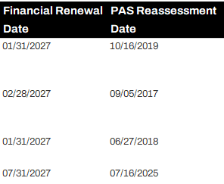
Weekly Projected Overdue Report Updates
The weekly Projected Overdue report is going through some changes and updates. We wanted to bring your attention to the new columns added to the report.
The columns reflect the member’s financial renewal date & PAS Reassessment Date (If applicable)

Slide 40
Request to Review Member Information
We are requesting that all case managers check their member’s CA166 before the end of the year to ensure the member’s address, share of cost, authorized representative etc. are current.
We are also requesting a review of the RP160 to ensure that the member is assigned to the correct health plan as well as making sure if there is a gap in enrollment that the case managers notify the TALTCS team so that we can have it corrected.

Slide 41
Email Reminders
We have been sending out emails on a weekly basis to assist in “cleaning up” outstanding issues as we get closer to the end of the year. We realize that case managers are busy, therefore, we are requesting the updates be made within 7 days of receiving the notification.
We will be following up with outstanding No Service Lines, Invalid Service Placement and actions on Daily Rosters. We appreciate everyone that has responded and provided an update thus far. We are available to assist if there is difficulty in resolving.

Slide 42
Extraordinary Care Review (ECR) Updates
Amber L. Heard, TALTCS Program Manager

Slide 43
What Are We Talking About?
The HCBS Needs Tool (HNT)
  The assessment tool used by case managers to determine if a member may benefit from receiving HCBS, including direct care (attendant care) and/or Habilitation services.
The Extraordinary Care Review (ECR) Process.
  A clinician-based review process for ALTCS children under 18 when parents/legal guardians have concerns about their child’s care needs and the hours assessed on the HNT due to age limitations (direct care & habilitation) and/or services hour caps (Habilitation).

Slide 44
Policy Review/Rule Public Comment Updates
Comment Period 1: Draft Policies were posted and public comment was closed August 30th, 2026.
Comment Period 2: Rule Language
  Mid-September through mid-October 2026 (30 days)
  These will be posted to the AHCCCS website when the time comes; details will follow at a later date.

Slide 45
1620-17A: HCBS Needs Tool (Child Tab)
This exhibit includes the HCBS Needs Tool (HNT) that is used to assess each member’s direct care and habilitation service needs for members under the age of 18.
Remember: services must be extraordinary in nature and medically necessary
  The HNT assesses for care needs that go BEYOND what a parent provides to their child.
  This also means that hours cannot be assessed/paid if the task is something that ta child would need help with at their age, regardless of their abilities.

Slide 46
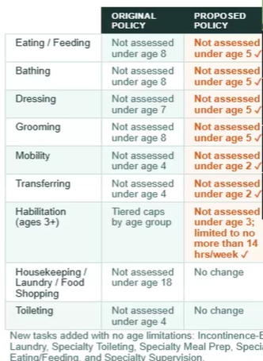
HNT Tasks
Age limits have been adjusted
  Remember-the age limits are “soft” limits, meaning that they can be reviewed/services can be approved based on member’s specific needs.
Additional Specialty services are not subject to age limits have been added.

Slide 47
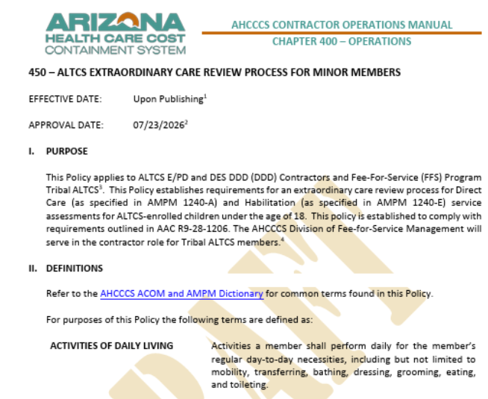
ACOM 450: ALTCS Extraordinary Care Review
The policy establishes a clinician-based review process for ALTCS children under 18 when parents/legal guardians have concerns about their child’s care needs and the hours assessed on the HNT due to age limitations (direct care & Habilitation) and/or service caps(Habilitation).
If it is believed that the child’s needs are above & beyond what the HNT shows due to the age limit & hourly service limit, the ECR is the path to provide additional insight & information for consideration.
Services will not be impacted while an ECR is underway.

Slide 48
When Can an ECR be requested?
An ECR can be requested when a parent/HCDM disagrees with the assessed hours on the HNT because:
    Services/Service hours are limited due to age limitations and/or habilitation service hour limits on the HNT and
    The parent/HCDM believes the child’s unique needs are not adequately accounted for on the HNT due to limitations-meaning they believe their child needs more hours because of their unique needs, conditions and/or behaviors.
  AHCCCS intends to limit the ECR process to one time a year unless:
    The member has a significant change in condition
    The parent/HCDM wants a service/task reviewed that was not previously looked at in an ECR process.

Slide 49
How is an ECR Requested
Tribal ALTCS will establish the process on how to submit the request (currently being developed). We will provide a handout/FAQ for the case manager to provide to the parents/HCDM on how to submit should they meet the requirements.
Parents/HCDMs may choose to submit additional documentation for review/consideration during the ECR process; however, this is not required. Examples, but not limited to:
  Therapy Notes
  Behavioral treatment plans
  IEP

Slide 50
ACOM 450 Timelines:
Assessments using the new HNT must be completed within 90 days of the policy being implemented (December 1, 2026). Case Managers will work to schedule planning meetings as they normally would.
The ECR may be completed within 7 days following the completion of the HNT; However, a 14-day extension may be requested by the parents/HCDM. This would allow up to 21 days to complete the ECR. Services will continue while the ECR is being reviewed. 7 Days is the federal requirement. AHCCCS must meet the timeline outlined by CMS.

Slide 51
What is Tribal ALTCS doing in preparation?
In preparation for the implementation of the ECR process we will provide training virtually with case managers that have children that might be impacted first, due to age of the child. We will then offer the training to case managers at a later date that do not have children on their caseload.
We are currently developing a submission process through AHCCCS Solution Center. This will allow the ECR to be received and reviewed by our medical director. It will also allow the Parent/HCDM to monitor the request and receive the response in real time.
We are still working on a possible template that would assist the submitter should they not know what or how to explain why their child requires the extraordinary care and/or habilitation hours due to cap.
Notes:
. We will offer two trainings a week for two weeks to allow for case specific discussion and guidance.

Slide 52

Knowledge Check 1
The HNT under the bathing section states to not assess for ages under 8 years old. The parent reports that their child requires two adults to complete task.
Would this meet the ECR Criteria?
Answer: Yes!

Slide 53
Knowledge Check 2
On the Child HNT (0-17) It states Do not assess for ages under 18. When completing the HNT the parent reports that they have to clean up for their 6-year-old and that should be considered. Would this meet the criteria for an ECR to be submitted?
Answer: No. This task is an appropriate habilitation goal for transition age youth (age 16+) to support preparation for adulthood.

Slide 54
Questions?

Slide 55
10 Minute Break

Slide 56
Assisted Living Facility (ALF) Placement
Caitlin Hasper, TALTCS Program Coordinator

Slide 57
When Is ALF Placement Appropriate?
For members who cannot safely remain at home but do not require nursing facility placement.
Appropriate for members whose condition is stable and who do not need skilled nursing care or total assistance.
Specialized ALFs are available for members with behavioral health challenges.
AM/PM 1230-A - Assisted Living Facilities
1230-A - Assisted Living Facilities

Slide 58

Assisted Living Facility (ALF) Placement - Rates
Does AHCCCS have a standard FFS rates for ALFs?
No. Typical ALF rates range from $80-$180 per day, depending on the facility.
What is exception?
Behavioral Health Level II facilities charge higher specialty rates, which require prior approval from the TALTCS Nurses.

Slide 59

Assisted Living Facility (ALF) Placement – Other Services
What other services can someone in ALF placement receive?
Members in ALFs generally do not receive additional HCBS services.
Home Health Nursing may be authorized separately when medically necessary.
Services such as DME and transportation may also be authorized separately.

Slide 60
Assisted Living Facility (ALF) Placement -
Room & Board (R&B)
Members must pay monthly Room and Board. AHCCCS does not cover these costs.
Members and representatives must be informed of this responsibility before admission.
The AHCCCS ALF Residency Agreement must be completed, signed, and maintained in the case record. R&B is generally calculated as: Monthly income minus the Personal Needs Allowance (PNA).
The minimum R&B charge is $200 per month.
Members who cannot pay at least $200/month cannot be admitted to an ALF.

Slide 61
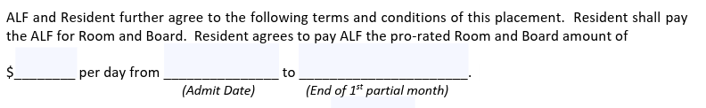
Completing the ALF Agreement
How often must an ALF agreement be updated?
The ALF agreement must be completed once a year. There are times when it might require an update rate change, DAP % increase/decrease, member’s income changes.
The pro-rated portion of the ALF agreement only needs to be completed when a member moves in on any date after the first of the month and when they move out.

Slide 62
ALF Residency Plus Room & Board (R&B) Calculation Sheet
Caitlin Hasper, TALTCS Program Coordinator

Slide 63
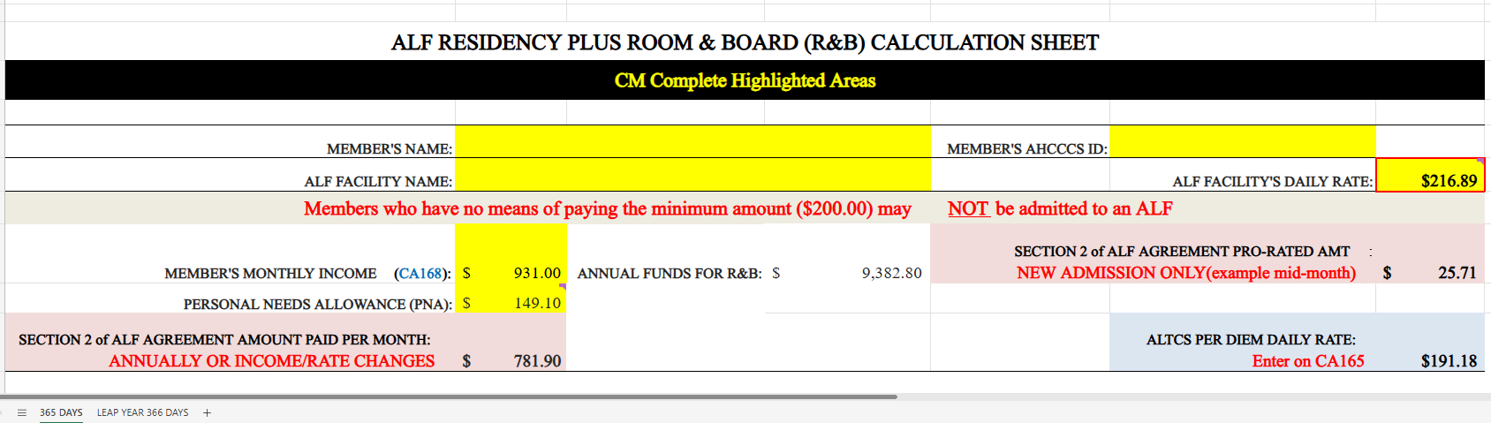
ALF Residency Plus R&B Calculation Changes
We have updated the ALF Calculation sheet and will go into effect before Jan. 2027. On the updated calculation tool, we have reduced the calculation to 365 Days & Leap Year 366 Days. The pro-rated calculation remains on the calculation sheet.

Slide 64
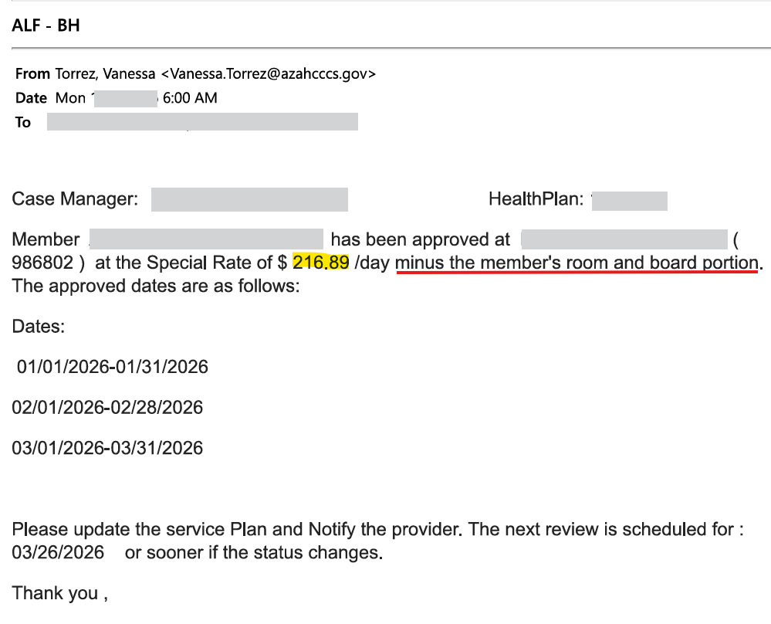
Specialty Rate & Standard Daily Rate
When a Specialty Rate for an ALF is approved, you will utilize the highlighted information for the spreadsheet.
Please be sure to not enter the rate directly on CA165. The approval letter states the rate minus R & B.
Daily Rate is obtained by the case manager form the ALF Provider.

Slide 65
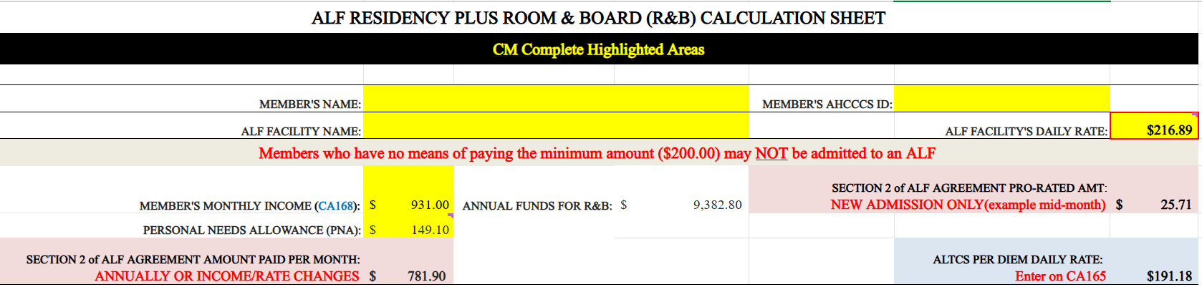
Specialty Rate or ALF Daily rate will be entered on the right-hand side as seen below:

Slide 66
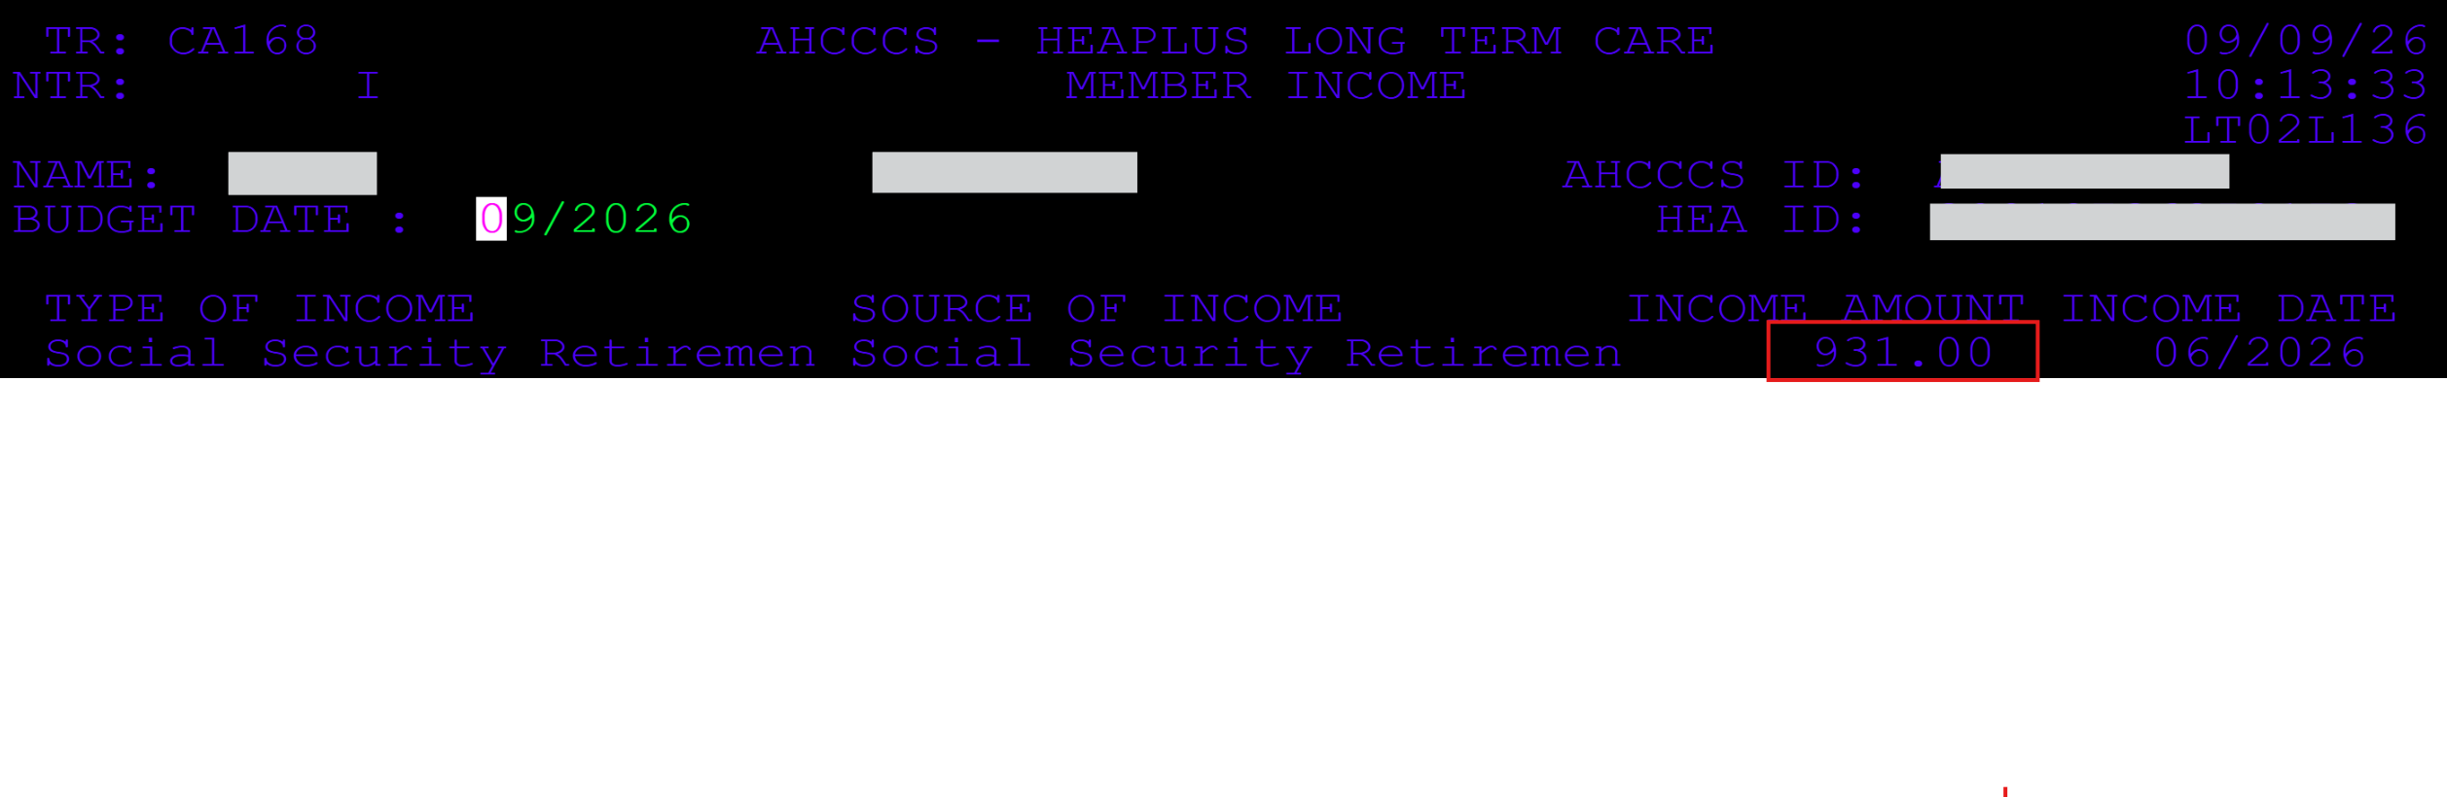
Finding the Income
You can locate in PMMIS on the CA168 screen to obtain the member’s current monthly income.

Slide 67
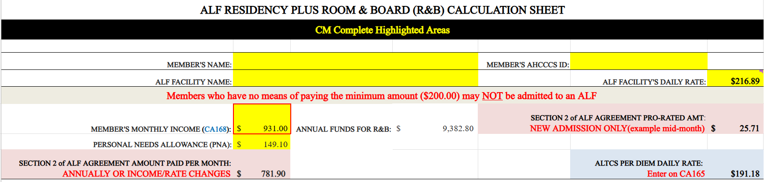

Enter member’s Monthly Income

Slide 68

PNA: Personal Needs Allowance
The PNA is the amount the member keeps for personal needs. It is 15% of the Federal Benefit Rate (FBR) for ALTCS customers. The amount changes at the first of every year.
LINK TO:
FEDERAL BENEFIT RATE FOR PNA AMOUNT

Slide 69
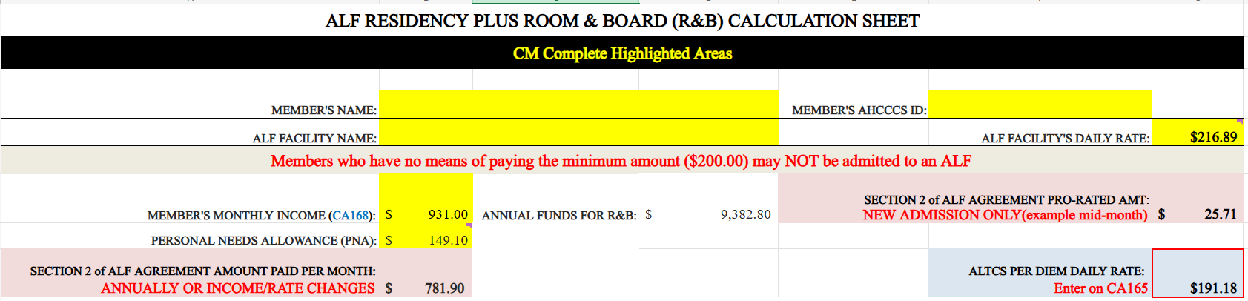
ALTCS Per Diem Daily Rate
Once everything is entered in, the sheet will calculate a total.
The case manager will enter this onto the CA165.

Slide 70
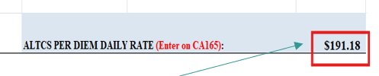
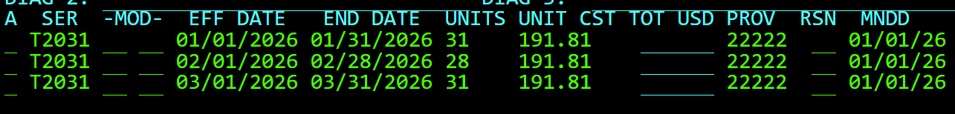
The case manager will then enter the ALTCS Per Diem Daily Rate from the calculation sheet and enter services on CA165-Service Plan
CA165

Slide 71

The Case Manager will also confirm that the placement screen/ CA161 reflects the correct placement code for the dates being entered, residence code and placement reason. Details can be found in:
AHCCCSTutorialGuideForPMMISInterfaceForALTCSCM.pdf

Slide 72
Questions?

Slide 73
Tribal ALTCS Hospital & Urgent Care Notification
Bandana Chetty, EVV Specialist

Slide 74

Health Plan Notification: Important Information for Members
Member Information
Member Name:
AHCCCS ID:
Date of Service:
Facility Name:
Type of Visit: Hospital Admission, Emergency Department, Urgent Care
Expected Discharge Date (if known):

Slide 75
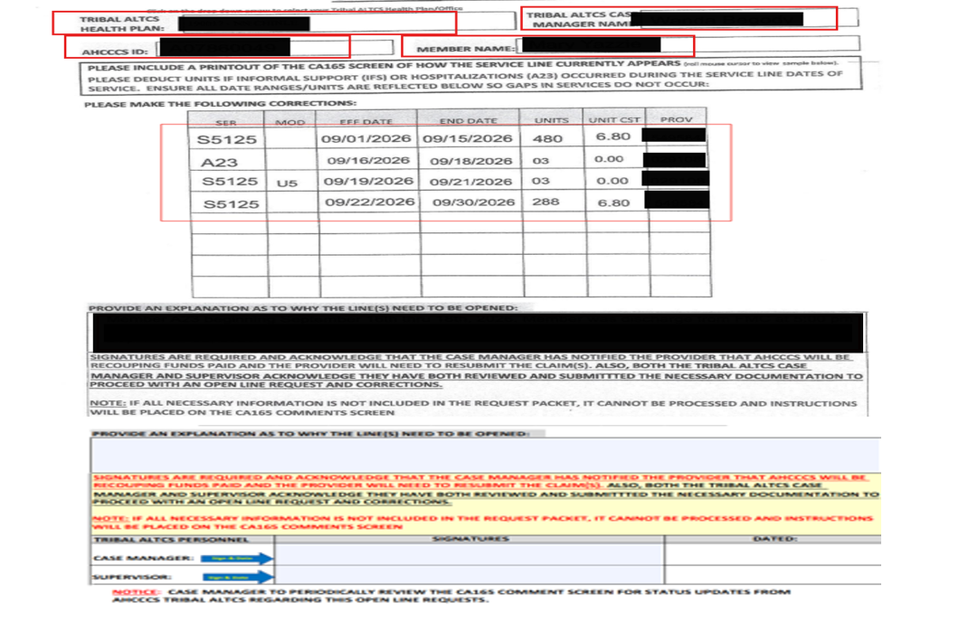
Case Manger Submission For Open Line Request Form
Open Line Request form link:
https://www.azahcccs.gov/shared/Downloads/LTCCaseMan/DigitalToolbox/OpenLineRequestFormTemplate.pdf

Slide 76
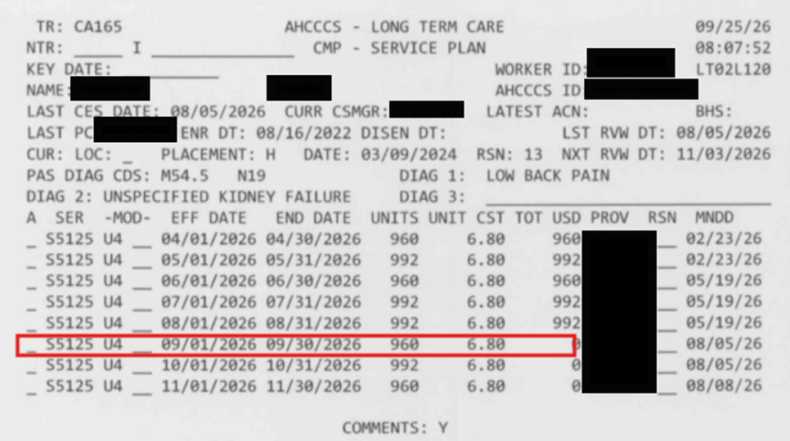
CA165 Screen Print

Slide 77
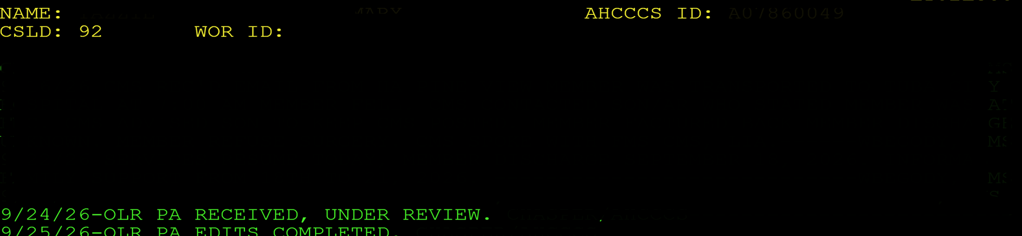
AHCCCS CA165 Comments

Slide 78
Questions?

Slide 79
Lunch – 1:15 Hour

Slide 80
Fax submission, Form completions, Missing documentation (SNF; ALF; DME) & Follow up Emails
Gwendy Yazzie, TALTCS Nurse

Slide 81
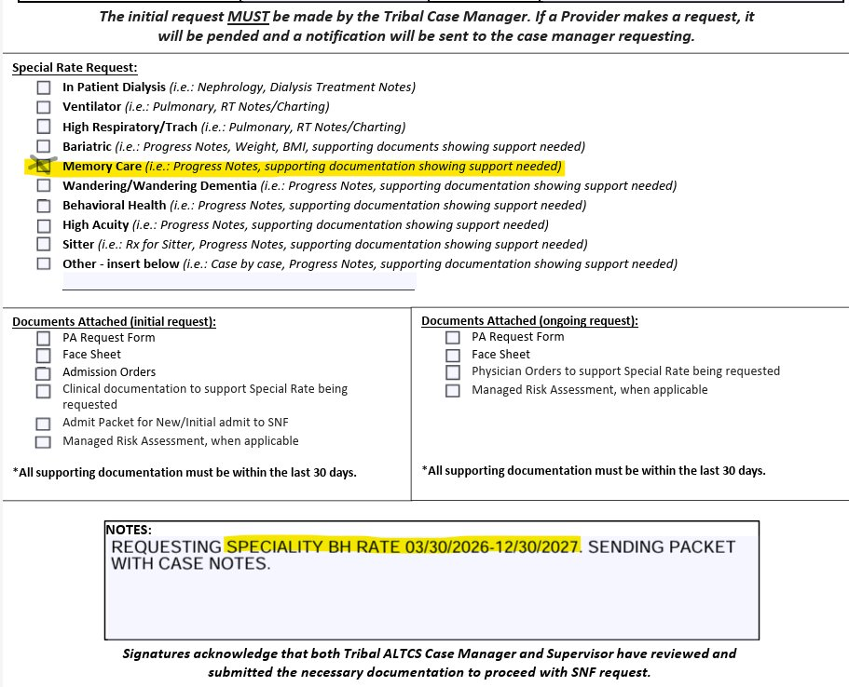
SNF Fax Form
Fax Forms indicates requesting MEMORY CARE. However, in notes, indicates BEHAVIORAL HEALTH.
Double check to verify if provider has MC or BH Rate.

Slide 82
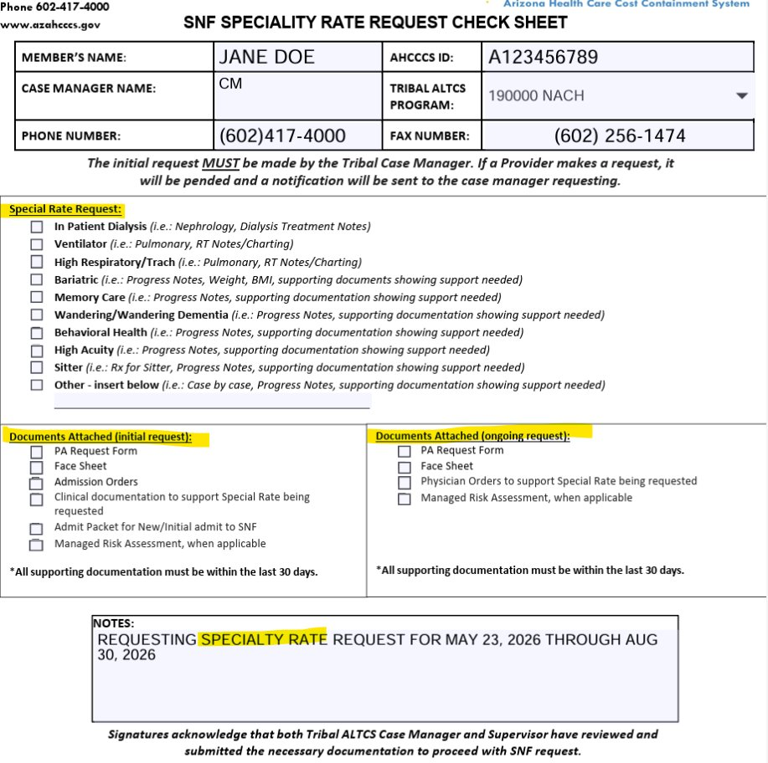
Request is asking for what kind of Specialty Rate?

Slide 83
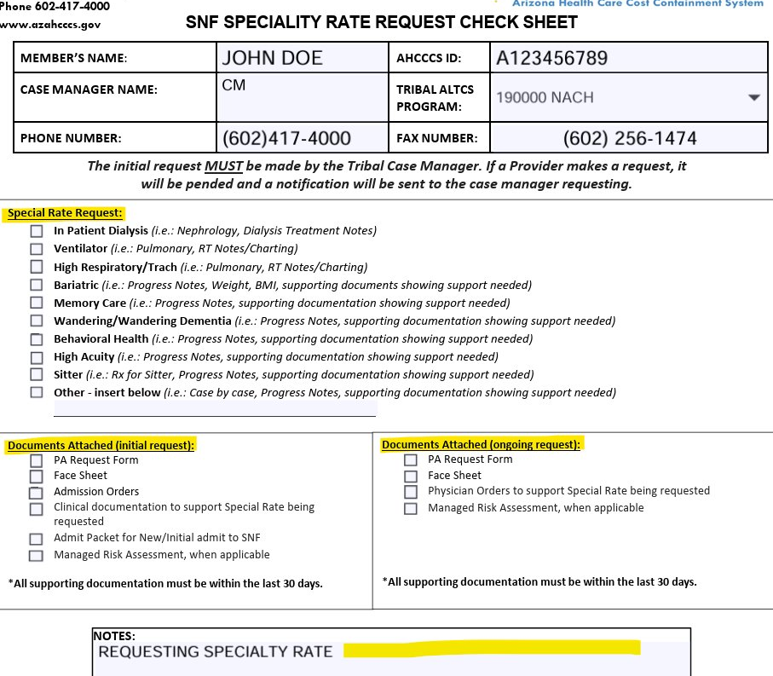
What is being requested?

Slide 84
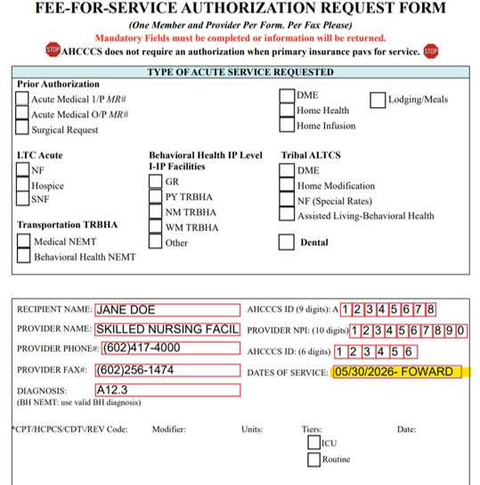
Date of Service (DOS) Dates
Please do not place request FORWARD>>>>
We will only approve month that is being requested & Send back for additional information.

Slide 85
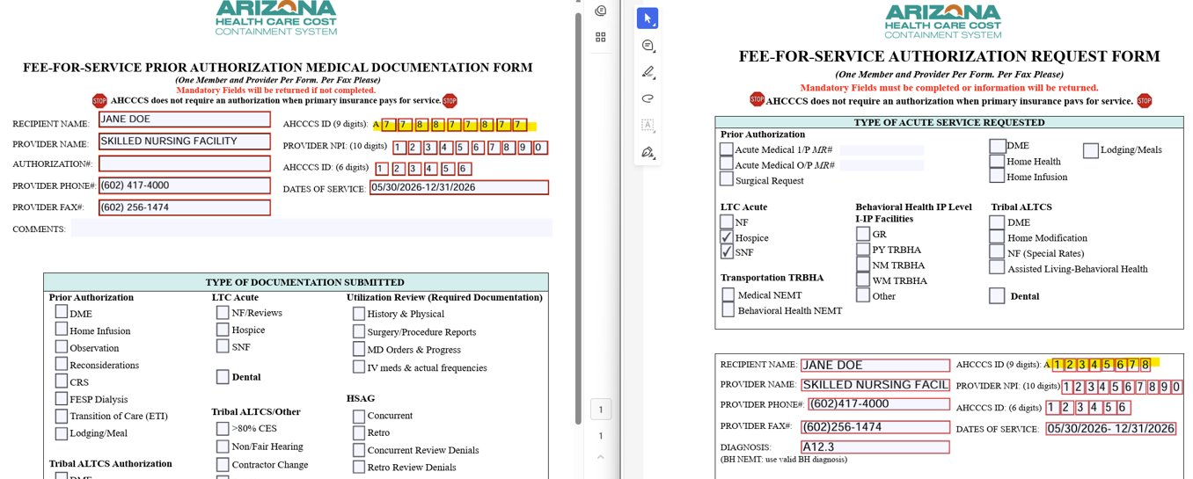
Is there an issue with this request?

Slide 86
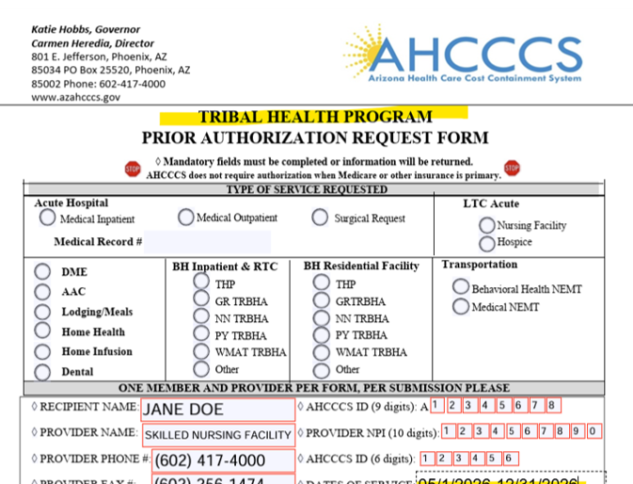
REMINDER:
Please do not use THP Form for TALTCS

Slide 87
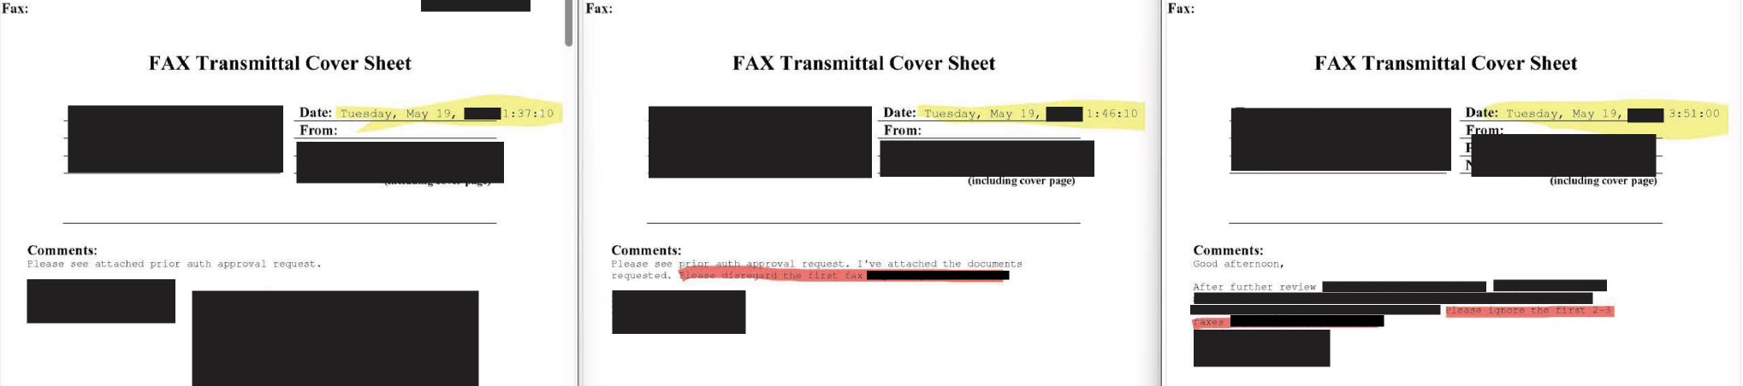
REMINDER:
DO NOT send multiple fax each time information is left out. Gather all information & double check then fax it over.

Slide 88
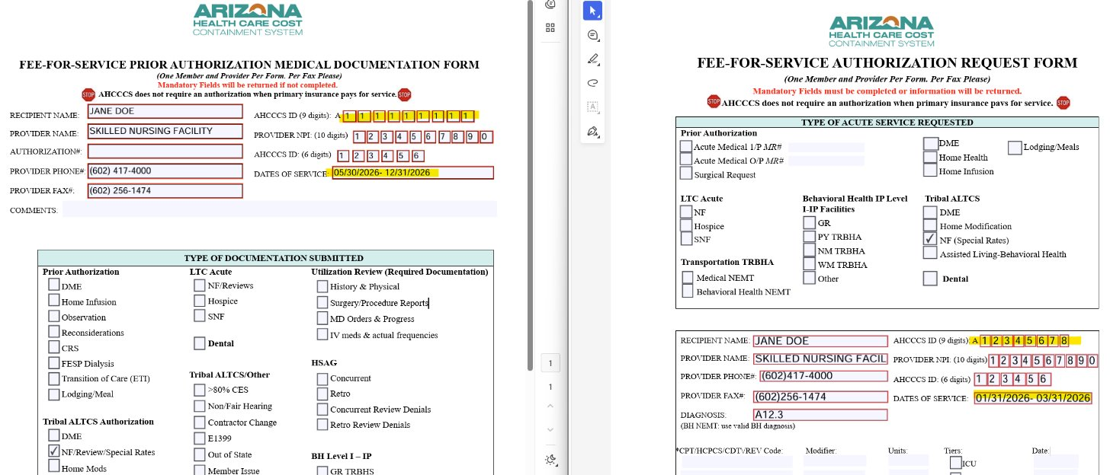
Clarify what needs to be CORRECTED.

Slide 89
Incorrect Fax Submission/Misfiled Request
PA packets are being submitted with Incomplete Cover Sheets causing delays & returns.
  Example: Multiple DME Request are being returned due to misfiles.
  Returned Fax issues lined to missing cover sheet & faxing errors.
Resolution:
  Redistribute updated Fax Submission Instructions.
  Provide Example of Correctly Completed Fax Coversheet.
  Top reasons requests are returned.
  Remind providers, they should no submit directly when policy requires CM submission.

Slide 90
Missing Documentation for PA/SNF/ALF
Requests often require follow up because supporting records are missing.
  BH, RT, HD NOTES​
  Need treatment plan
  Need Provider ID, correct AHCCCS ID
  Need provider to be ROPA Compliant
  Correct DOS Range on All Files
Resolution:
  Checklist: DME, SNF, HM, BHRF, ALF
  Please check to verify information before sending.

Slide 91
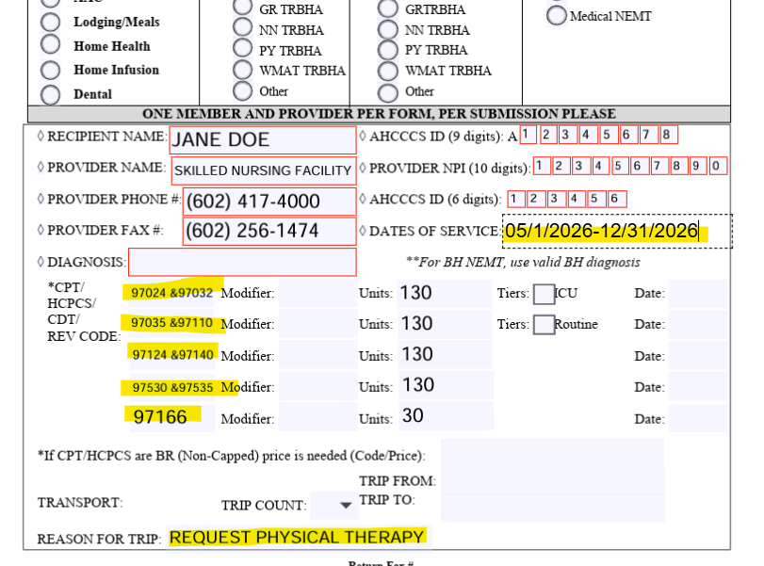
Clarification Request
CM ASK HOW APPROVALS SHOULD BE ENTERED, INTERPRETED, OR REFLECTED ON SERVICE PLAN​, WHAT WOULD BE THE PROVIDER ID FOR SPEECH & LANGUAGE THERAPY? WILL IT BE FOR SNF LOCATION?
​ANSWER: SNF SR IS ALL INCLUSIVE RATE. THERAPY IS INCLUDED NOT SEPERATED FR SPECIALTY RATE. THERAPY – PA NOT REQ'D

Slide 92
Clarification Request
EXAMPLE: I WOULD LIKE CLARIFICATION ON MY MBR SNF SR. IS MY MEMBER BEING APPROVED FOR DIALYSIS RATE ONLY OR IS A BEHAVIORAL RATE INCLUDED? ​
ANSWER: UNFORTUNATLEY, ONLY ONE RATE CAN BE APPLIED FOR THAT SNF. IF PROVIDER PREFERS ONE RATE OVER THE OTHER, THEY MAY REQUEST THE RATE OF THEIR PREFERENCE. BUT BOTH RATES CANNOT BE APPLIED SIMULTANEOUSLY.

Slide 93
Clarification Request
EXAMPLE: I SUBMITTED REQUEST FOR SR FR 04/2026-05/2026. I AM CLARIFYING IF THE DATES ARE CORRECT. PLEASE LET ME KNOW IF I NEED TO RESUBMIT THE REMAINING DATES OF MAY 2026? MBR WAS DISCHARGE LATE MAY BUT IT WAS ANTICIPATED DATE FOR DISCHARGE FOR SNF.
ANSWER: IF PROVIDER IS REQUESTING FOR ENTIRE MAY MONTH; PLEASE PROVIDE SUPPORTING DOCUEMENTATION. IF NEEDING TO MAKE A CORRECTION TO DOS DATE, PLEASE PROVIDE CORRECTION FORMS.

Slide 94
Questions?

Slide 95
AHCCCS Registered Providers - ROPA, ASC, Pending Rates
Vanessa Torrez, Clinical Program Manager

Slide 96
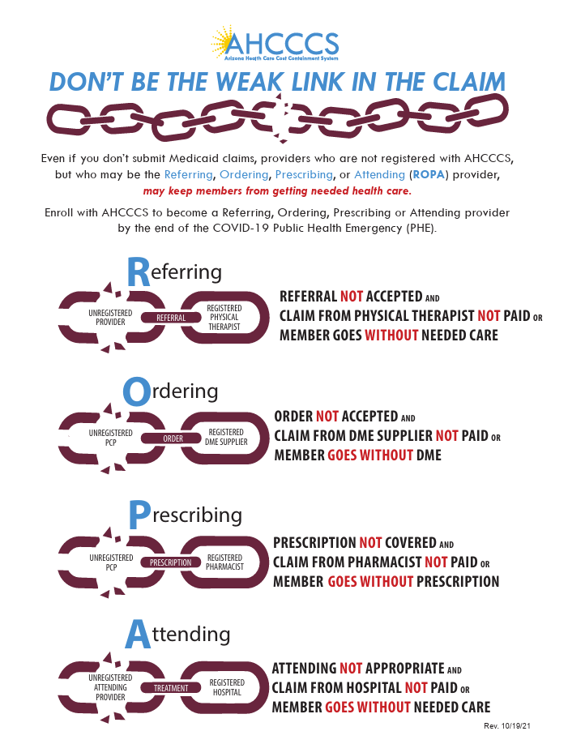
What is ROPA?
ROPA stands for Referring, Ordering, Prescribing, and Attending. AHCCCS requires that providers who refer, order, prescribe, or attend to AHCCCS members are properly registered with AHCCCS, unless an approved exception applies.

Slide 97
ROPA Requirements Tribal ALTCS Case Managers can assist with:
ROPA Requirements Tribal ALTCS Case Managers can assist with:
Verify Provider Registration
Check NPI Information
Coordinate with Service Providers
Follow Tribal ALTCS Authorization Processes
Ensure all referring, ordering, prescribing, and attending providers are registered with AHCCCS or have an approved exception. Use the AHCCCS Provider Enrollment Portal (APEP) or the AHCCCS Provider Search tool.
IF an ordering Provider is not AHCCCS Registered , Prior Authorization Request will be returned.

Slide 98
Key Reminders
ROPA registration helps ensure AHCCCS members receive medically necessary, appropriate, and coordinated care.
Unregistered ROPA providers may impact service authorization and claims payment. Always verify provider registration status before submitting authorizations or referrals.
Confirm the correct National Provider Identifier (NPI) is associated with the registered provider. Use accurate provider
information on authorizations, care plans, and referrals.
Communicate with providers if registration issues could impact authorizations, services, or claims.
Direct Providers to AHCCCS Service Solutions Center to work with DFSM to assist providers to resolve missing or inactive ROPA registration.

Slide 99
Helpful Resource Links:
AHCCCS Provider Enrollment Portal APEP
https://www.azahcccs.gov/APEP
AHCCCS Provider Search Tool
https://ahcccsproviderdirectory.az-apep.gov/OPD/landing.action?request_locale=en
ROPA Information for Providers
https://www.azahcccs.gov/PlansProviders/NewProviders/ROPA.html
Tribal ALTCS Program
https://www.azahcccs.gov/AmericanIndians/LongTermCareCaseManagement/

Slide 100
How to Access the AHCCCS Solutions Center
Online: www.azahcccs.gov and click on "solutions center"
By Email: submit your inquiry through AHCCCS Solutions Center contact form on the Website
Additional Resources:
The AHCCCS Solutions Center is here to support you so together we can improve health outcomes for Tribal ALTCS Members.

Slide 101
Pending Rates
Please be advised that the new rates are currently pending . We appreciate your patience and partnership during this process. Once the rates are finalized and received, the SNF and ALF Specialty Rate approval letters will be generated and distributed immediately.
Please do not send in Duplicates.

Slide 102
Please submit a Service Ticket via
Solutions Center
Avoid contacting team members by direct email.

Slide 103
Questions?

Slide 104
Electronic Member Change Report (EMCR)
Frank Villarreal, TALTCS Case Manager Coordinator

Slide 105
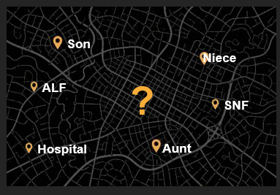
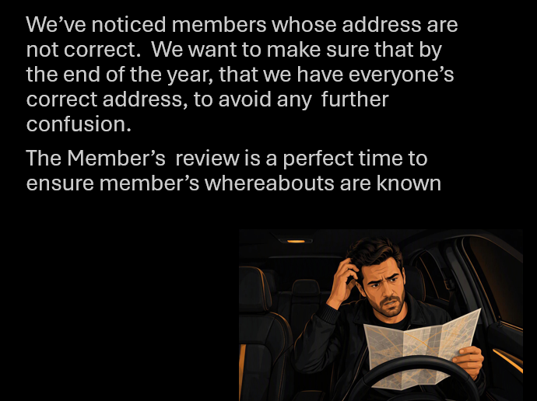
Where is the Member?

Slide 106
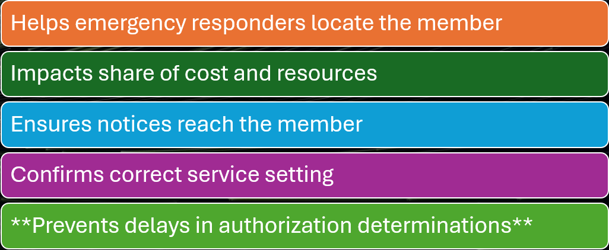
The Importance of Having the Correct Address

Slide 107
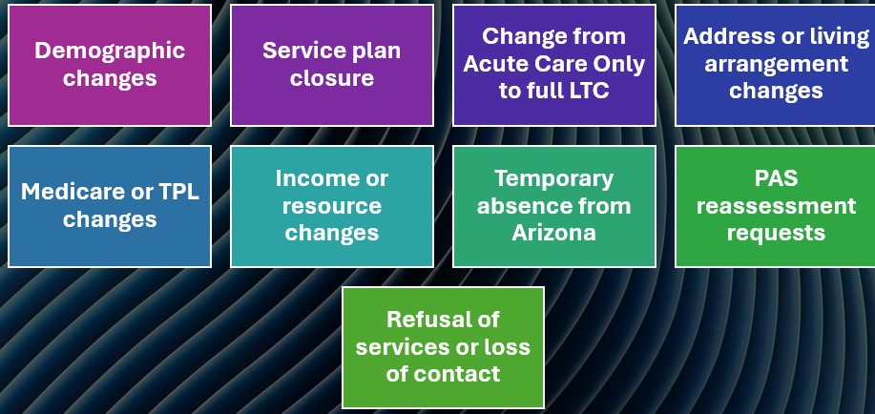
When to Submit an EMCR

Slide 108

How to submit accessing the ALTCS Electronic Member Change Report
The Electronic Member Change Report is accessed via the AHCCCS website at
https://mcr.statemedicaid.us

Slide 109
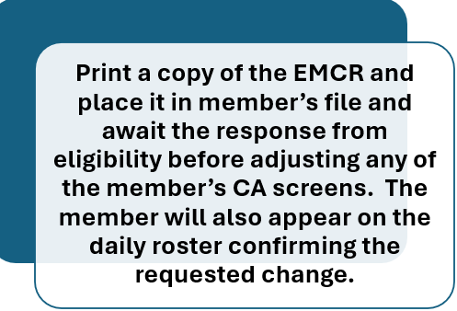
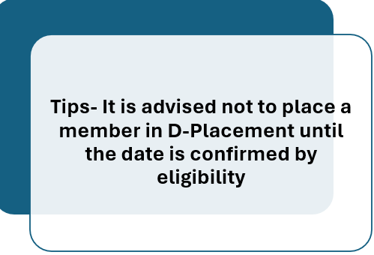
Submitting and EMCR-Continued

Slide 110

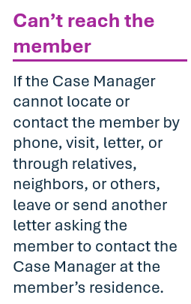
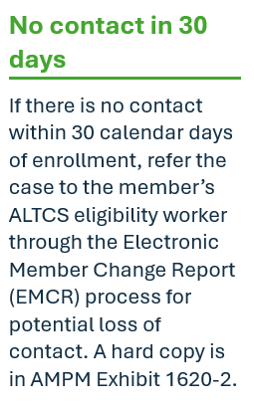
I have no idea where my member is at!

Slide 111
Where to locate Additional Information
Refer to AMPM Exhibit 1620-2 for a hard copy of the ALTCS Member Change Report (MCR) form.
AMPM Exhibit 1620-2 also provides guidelines on circumstances for which an eMCR is needed, and AMPM Exhibit 1620-4 describes and gives examples of member situations for which an Acute Care Only “D” placement is appropriate.

Slide 112
THINGS TO ALWAYS DO… when you have the member’s file open especially between now and the end of the year.
Check member contact information regularly
Review share of cost regularly
Member address is in CA166
Submit an EMCR when the case manager becomes aware of a change

Slide 113
References
Arizona Long Term Care System (ALTCS) Electronic Member Change Request (EMCR) Resources web page located at https://www.azahcccs.gov/PlansProviders/HealthPlans/emcr.html
AHCCCS ALTCS Member Change Report Guide
https://www.azahcccs.gov/PlansProviders/Downloads/ALTCSMCRUserGuide.pdf
AM/PM POLICY-1620-2 ALTCS MEMBER CHANGE REPORT
1620-2. ALTCS MEMBER CHANGE REPORT

Slide 114
That’s All Folks
Questions?

Slide 115
Tribal ALTCS Program Updates & CM Operational Review Summary
Rachel Conley, TALTCS Administrator

Slide 116
ASC Health Plan Registration
ASC Registration Link: https://servicenow.azahcccs.gov/gsp?id=gsp_kb_view&sys_id=50ca428f87e48f90f46f86a7cebb35c0
Health Plan | Status
190025 | Completed
190000 | Completed
190075 | Completed
190083 | Completed
190009 | Completed
190017 | In Process
190091 | NA
190033 | NA

Slide 117
2026 Session– Bill Signed into law with AHCCCS
AZ 2026 SB 1164 related to Changes of Ownership (CHOW) for skilled nursing facilities (NF) and assisted living facilities (ALF).
AHCCCS is currently working on a clear, consistent, and compliant approach for SB 1164
  ALTCS; providers; change of ownership impacts the following: Provider Enrollment, Contracting, Claims Processing, Payment Continuity, Contractors/FFS HPs, and Related Operational workflows.

Slide 118
CHOW Notification Process
AHCCCS will provide notification to all AHCCCS health plans when AHCCCS receives a CHOW application from an NF or ALF provider. These notifications are intended to provide advance awareness of pending NF and ALF ownership transitions and support timely coordination among affected stakeholders.
Contractors/FFS Programs will be notified as CHOW applications are received. The goal is to provide:
    Early awareness
    Support timely coordination
    Help minimize disruptions to contracting, payment and rate setting
    Continuity of care and minimize potential member disruptions during ownership transitions.

Slide 119
2025-2026
Case Management Operational Review
The CM Operational Review demonstrated that several Tribal ALTCS programs have developed strong case management practices and processes that support compliance with operational requirements.
Two programs, Tribal ALTCS Program 1 and Tribal ALTCS Program 3, achieved exceptional overall compliance scores of 98% and 97%, respectively, reflecting consistent performance across nearly all review areas and indicating mature operational oversight and adherence to established standards.
Additional programs demonstrated solid performance with opportunities for targeted improvement. Tribal ALTCS Program 8 achieved an overall compliance score of 89%, placing it at the upper end of Substantial Compliance, while Tribal ALTCS Program 7 obtained 77%, and Tribal ALTCS Program 6 achieved 75%. These results suggest that foundational processes are in place; however, focused corrective actions in lower-performing review elements could help these programs move into Full Compliance.

Slide 120
2025-2026
Case Management Operational Review
The review also identified programs requiring more comprehensive operational improvements. Tribal ALTCS Program 2 achieved 69%, and Tribal ALTCS Program 5 achieved 59%, placing both programs in the Partial Compliance category. These findings indicate variability in performance across multiple case management functions and highlight the need for enhanced monitoring, staff training, and process standardization to improve consistency and compliance outcomes.
The most significant opportunity identified during the review was Tribal ALTCS Program 4, which received an overall compliance score of 49%, placing it in the Non-Compliance category. This score suggests systemic challenges across several operational review areas and may warrant a focused quality improvement plan, increased technical assistance, closer oversight, and ongoing monitoring to achieve compliance expectations.

Slide 121
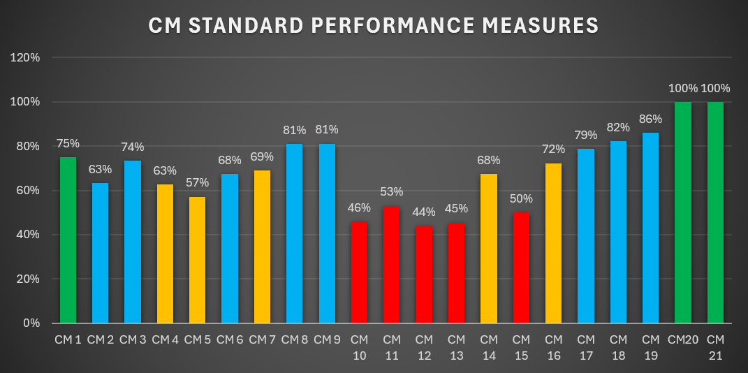
2025-2026
Case Management Operational Review
Across all participating programs, several review elements showed consistently strong performance. CM elements 20 and 21 achieved average scores of 100%, while CM elements 18 and 19 scored approximately 82% and 86%, demonstrating statewide strengths in these operational requirements. Conversely, CM elements 10, 11, 12, 13 and 15 reflected some of the lowest average scores, ranging from approximately 44% to 53%, indicating common areas where additional training, process improvement, and compliance oversight may be beneficial across multiple Tribal ALTCS programs.

Slide 122
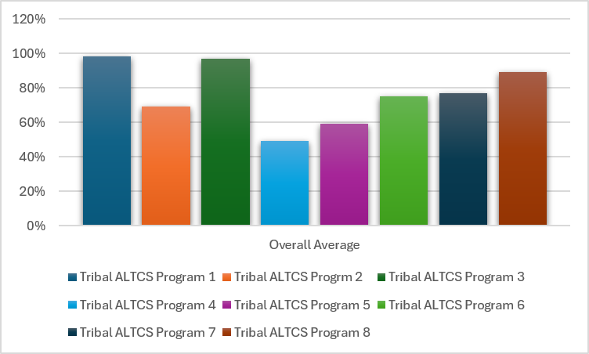
Overall Performance
The review findings indicate that while several Tribal ALTCS programs are performing at or near full compliance, there remains an opportunity to strengthen consistency program wide by sharing best practices from high-performing programs, providing targeted technical assistance to programs with lower scores, and focusing quality improvement efforts on the case management elements that demonstrated the greatest compliance challenges.

Slide 123
Program Compliance Performance
The CM Operational Review revealed a wide range of compliance performance among Tribal ALTCS programs.
  Two programs achieved Full Compliance (97%-98%)
  Three programs achieved Substantial Compliance (75%-89%)
  Two programs achieved Partial Compliance (59%-69%)
  One program was identified as Non-Compliant (49%).
  The review highlighted strong performance in several case management requirements while identifying common opportunities for improvement in CM elements 10 through 13.
  Overall, the results support targeted quality improvement efforts, technical assistance, and the sharing of best practices to strengthen operational performance and ensure consistent compliance across all Tribal ALTCS programs.​

Slide 124
Closing Remarks
Rachel Conley, TALTCS Administrator

