Slide 1
Home and Community Based Settings (HCBS) Rules
Employment Services Public Forum
August 28, 2015

Slide 2
Housekeeping Items
Restroom location
Sign in Sheet
Informational handout
Presentation available on www.azahcccs.gov/hcbs
Format for Today’s Presentation
HCBS Rule Presentation - AHCCCS
Comment Slips – note slide number
Request to Speak

Slide 3
Agenda
Arizona’s Medicaid Program
HCBS Rules Orientation
Systemic Assessment and Transition Plan - Draft
Center - Based Employment
Group - Supported Employment
Person - Centered Planning

Slide 4
Arizona’s Medicaid Program

Slide 5
Arizona’s Medicaid Program
1115 Waiver
Managed Care Organization (MCO) Model
Arizona Long Term Care System (ALTCS)
Least restrictive setting
Guiding and governing principles
Placement rates
Specialized settings

Slide 6
Placement Rates – June 2015
Setting | Members | % of Membership
Own Home | 39,362 | 68%
Assisted Living Facility | 6,028 | 11%
Group Home | 2,832 | 5%
Developmental Home | 1,333 | 2%
Total of HCBS Placements | 49,555 | 86%
Skilled Nursing Facility | 7,247 | 13%
Other | 602 | 1%
ICF/ID | 129 | .2%
Behavioral Health Residential Facility | 95 | .2%
Total of Institutional Placements | 8,073 | 14%
Total | 57,628 | 100%

Slide 7
Intent of the HCBS Rules
Purpose
Enhance the quality of HCBS
Provide protections to participants
Assure full access to benefits of community living
Receive services in the most integrated setting
Receive services to the same degree of access as individuals not receiving HCBS
Scope
Licensed settings
Residential and Non-Residential

Slide 8
Arizona’s Opportunity
New standard set of basic rights afforded to all members
Reinforce priority of serving members in the least restrictive setting
Formalize new priority to ensure members are actively engaged and participating in their communities

Slide 9
HCBS Rules

Slide 10
Settings that are not Home and Community Based
A nursing facility
An institution for mental disease
An Intermediate Care Facility for individuals with intellectual disabilities
A hospital
Any other locations that have the qualities of a institutional setting, as determined by the Secretary

Slide 11
Assessed Settings
Residential Setting:
Assisted Living Facilities (Home, Center, Adult Foster Care)
DDD Group Homes
DDD Adult & Child Developmental Homes
Behavioral Health Residential Facilities
Non-Residential Settings
Adult Day Health
DDD Day Treatment and Training Programs
DDD Center - Based Employment Programs
DDD Group - Supported Employment Programs

Slide 12
Settings that are Presumed to have Qualities of an Institution
Any setting that is located in a building that is also a publicly or privately operated facility that provides inpatient institutional treatment
Any setting that is located in a building on the grounds of, or immediately adjacent to, a public institution
Any other setting that has the effect of isolating individuals receiving Medicaid HCBS from the broader community of individuals not receiving Medicaid HCBS.

Slide 13
Rules
The setting is integrated in and supports full access to the greater community, including opportunities to
seek employment and work in competitive integrated settings,
engage in community life,
control personal resources, and
receive services in the community to the same degree of access as individuals not receiving Medicaid HCB services.

Slide 14
Rules
The setting is selected by the individual from among setting options including
non-disability specific settings
an option for a private unit in a residential setting.
The setting options are identified and documented in the person-centered service plan and are based on the individuals needs, preferences, and, for residential settings, resources available for room and board.
Ensures individual rights of privacy, dignity and respect, and freedom from coercion and restraint

Slide 15
Rules
Optimizes , but does not regiment, individual initiative, autonomy and independence in making life choices including but not limited to, daily activities, physical environment, and with whom to interact
Facilitates individual choice regarding services and supports and who provides them.

Slide 16
Systemic Assessment and Transition Plan

Slide 17
Systemic Assessment
Review and evaluation of standards and requirements for setting types
Arizona Revised Statutes
Arizona Administrative Code
AHCCCS and MCO Policy
AHCCCS Contracts with MCOs
MCO contracts with providers

Slide 18
Why a Systemic Assessment?
All services are provided under the 1115 Wavier authority
Licensing rules create uniform standards across settings
Working knowledge and understanding of the operations for each setting type
Important to assess the “system” and not just providers

Slide 19
Systemic Assessment - Process
Assessed each specific rule requirement for each setting type
Answered the question “What is culturally normative for individuals not receiving Medicaid HCBS?”
Utilized exploratory questions provided by CMS

Slide 20
Systemic Assessment - Process
Only captures what is outlined on paper
The HCBS Rules may be implemented in practice
Site specific assessments will be implemented as part of the Transition Plan
Includes policies that are not specific to the setting type (i.e. role of the Case Manager)

Slide 21
Systemic Assessment - Findings
All setting types currently do not comply with all of the HCBS Rules and, therefore, require remediation strategies to come into compliance

Slide 22
Systemic Assessment - Findings
Compliant – The minimum standards of the rule requirements have been met
Compliant with Recommendations – The minimum standards of the rule have been met and, in addition, it was determined that a remediation strategy was in order to exceed the standards and meet the intent of the rule
Partial Compliance – Some of the minimum standards of the rule requirements were met
Not Compliant – The minimum standards of the rule requirements were not met

Slide 23
Systemic Assessment - Findings
Setting | Compliant | Compliant with Recommendations | Partial Compliance | Not Compliant | Totals
Residential Settings
Assisted Living Facilities | 5 | 3 | 6 | 1 | 15
Group Homes | 5 | 5 | 5 |  | 15
Adult and Child Developmental Homes | 6 | 4 | 5 |  | 15
Behavioral Health Residential Facilities
Residential Total | 16 (36%) | 12 (26%) | 16 (36%) | 1 (2%) | 45
Non-Residential Settings
Adult Day Health Facilities | 1 |  | 4 | 4 | 9
Day Treatment and Training Programs | 2 | 2 | 4 | 1 | 9
Center-Based Employment Programs | 2 | 1 | 4 | 2 | 9
Group-Supported Employment Programs | 7 | 2 |  |  | 9
Non-Residential Total | 12 (33%) | 5 (14%) | 12 (33%) | 7 (20%) | 36
Grand Totals | 28 (35%) | 17 (20%) | 28 (35%) | 8 (10%) | 81

Slide 24
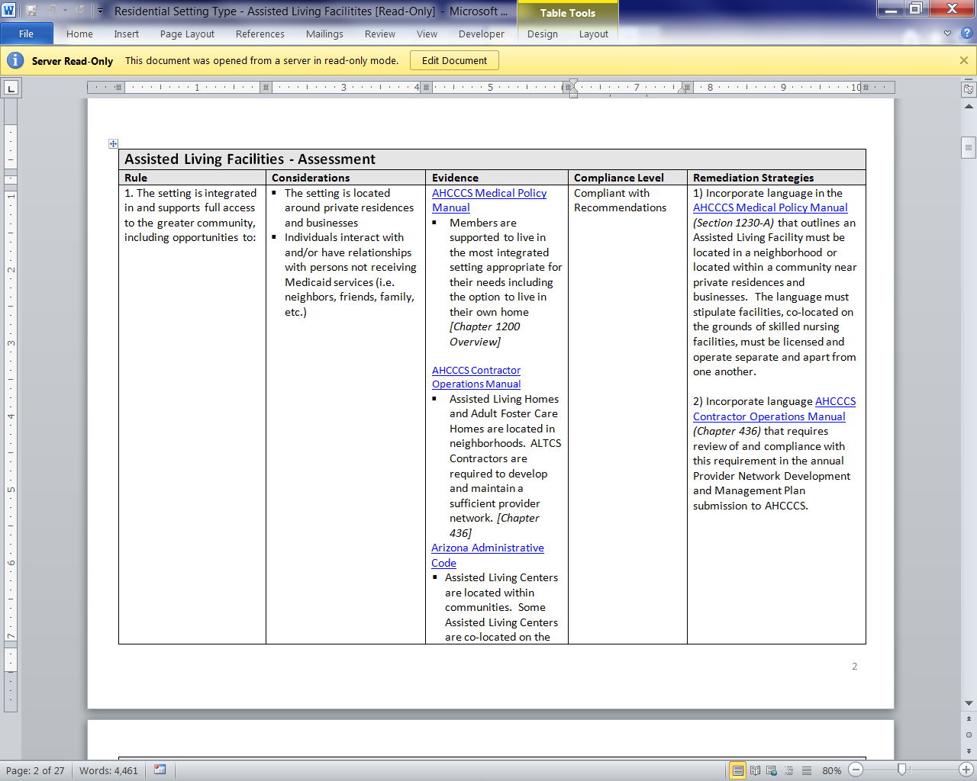
Sample Assessment

Slide 25
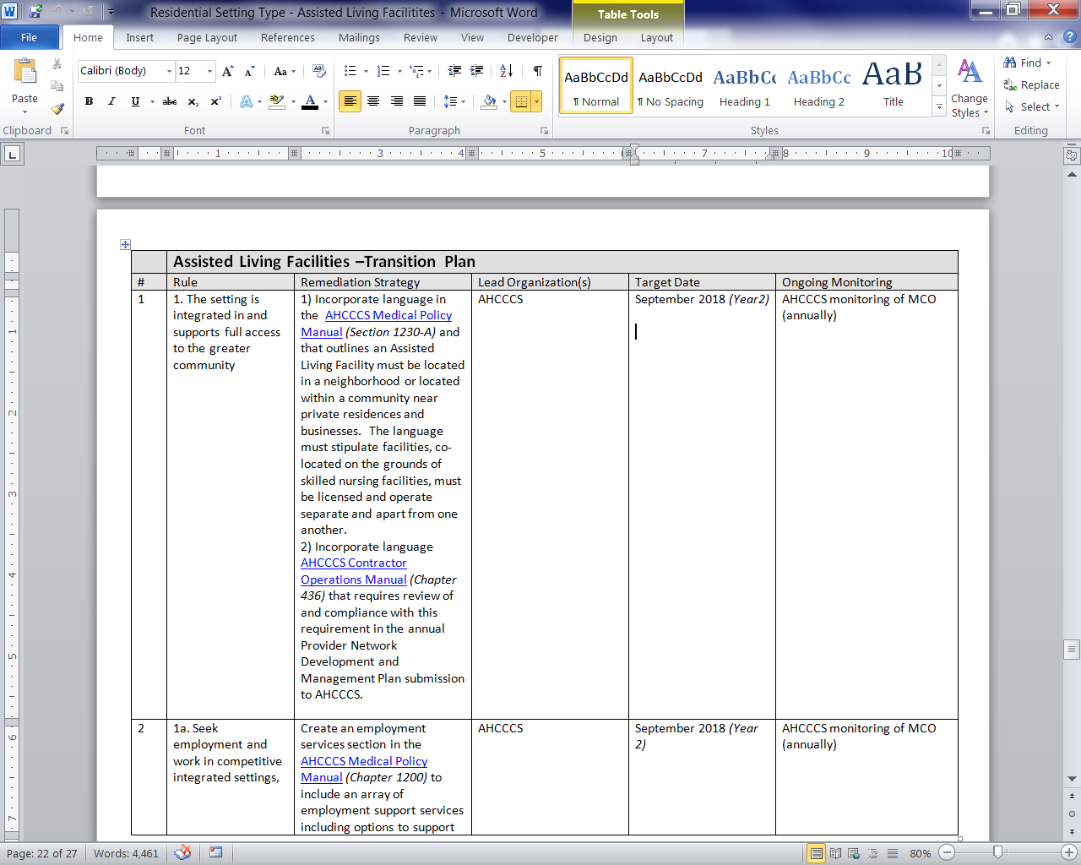
Sample Transition Plan

Slide 26
General Transition Plan – All Setting Types
Each year is focused on a specific area
Three-pronged approach to ensuring the transition plan is implemented within the specified timeframes
Plans
Public
Reports

Slide 27
Year One - Orientation
Year One – [October 2016 – September 2017]
1. | Facilitate tours of each setting type for the workgroup members
2. | Develop and implement communication plan for members and providers
2a. | Develop and disseminate member and family member educational materials
2b. | Develop and implement setting type provider training
2c. | Develop website with information for all stakeholders

Slide 28
Year Two- Policy & Contract Revisions
Year Two – [October 2017 – September 2018]
1. | Implement policy changes to AHCCCS policy
1a. | Implement policy changes outlined in setting type transition plans
1b. | Develop and implement general language in policy regarding HCBS Rule compliance including adding the HCBS Rules as basic rights afforded to all members.
2. | Implement changes to DES/DDD policy outlined in setting type transition plans
3. | Amend the AHCCCS provider participation agreements to include a requirement for providers to be compliant with the HCBS Rules
4. | Amend DES/DDD contracts per the contract revision remediation strategies outlined in the setting type transition plans
5. | Amend MCO contracts to institute a requirement that prior to contracting with an HCBS provider, the provider must be in compliance with the HCBS Rules

Slide 29
Year Three- Monitoring Tools & Processes
Year Three – [October 2018 – September 2019]
1. | Institute HCBS Rules standards into the operational review audits of the MCOs
2. | Develop provider setting type compliance self- assessment tool
3. | Revise current MCO monitoring tools for providers
4. | Develop reports and reporting processes for MCOs to report site-specific setting compliance with the HCBS Rules
5. | Develop processes for disseminating and analyzing member experience surveys

Slide 30
Year Three- Monitoring Tools & Processes
AHCCCS Monitoring of the MCOs
Incorporate new compliance standards into operational reviews
MCOs will report site-specific setting compliance to AHCCCS
MCO Monitoring of the Providers
Revise current monitoring tool
Incorporate provided self-assessments
The Member Experience
Member surveys
Case management
Member interviews become part of the monitoring process

Slide 31
Year Four- Technical Assistance
Year Four – [October 2019 – September 2020]
1. | MCOs monitor all HCBS providers and provide technical assistance for noted deficiencies to HCBS Rules’ compliance
2. | MCOs report site-specific setting compliance with the HCBS Rules

Slide 32
Year Five- Compliance
Year Five – [October 2020 – September 2021]
1. | MCOs monitor all HCBS providers and issue corrective action plans for noted deficiencies to HCBS Rules’ compliance
2. | MCOs report site-specific setting compliance with the HCBS Rules

Slide 33
Center-Based Employment Current Proposed Option

Slide 34
Pre-Vocational Facility-Based Service
Provision of individualized services and supports
Focus of the service is on preparing people to transition into an integrated work environment (i.e. group or individual services and supports)

Slide 35
Pre-Vocational Facility-Based Service
Integration
Service
Location
Work
Goal

Slide 36
Pre-Vocational Facility-Based Service: Goal
Members must have an employment goal for community-based employment (group or individual supported)
At a minimum, annual readiness assessment conducted for community-based employment.
If the member is not ready for the next step, goals are developed to address barriers.
The duration of the service is defined by the PCP team
Specific outcomes are outlined to be achieved

Slide 37
Pre-Vocational Facility-Based Service: Location
The setting is located in the community among other private businesses, retail businesses, etc. in an effort to facilitate integration with the greater community.

Slide 38
Pre-Vocational Facility-Based Service: Work
Paid or volunteer work becomes the medium for work skill development

Slide 39
Pre-Vocational Facility-Based Service: Integration
Members are interacting and working alongside individuals without disabilities
Incorporation of peers without disabilities in the pre-vocational setting
Career exploration/planning and/or support to participate in volunteer positions
Inviting in subject matters experts in the community to teach members how to prepare for and be successful in the workplace (i.e. preparing for an interview, hygiene in the workplace, the use of natural supports, etc.)
Developing products and services that are prepared in facility, but sold or provided out in the general community (i.e. selling baked goods at a farmer’s market).

Slide 40
Pre-Vocational Facility-Based Service: Expanded Service Scope
Experiential learning and career exploration
Support to learn about, prepare for and obtain volunteer work as a medium for skill development
Transportation and mobility training
DB101 and Work Incentive Consultation

Slide 41
Center-Based Employment Additional Option

Slide 42
Additional Option – Integrated Center-Based Employment Settings
Integration
Service
Location
Work
Enrollment Cap

Slide 43
Group – Supported Employment

Slide 44
Group - Supported Employment –What will be different?
Expanded scope of service
Vocational/job related discovery or assessment
Work Incentive Consultation
Career advancement services
Transportation training and planning

Slide 45
Note: Employment Services
Transition Plan – Year One
Undertake a process to evaluate and re-design the current continuum of employment supports and services in an effort to ensure members have the opportunities to participate in either work or other activities that support them to make contributions to their communities.

Slide 46
Person – Centered Planning
State’s assessment and corresponding transition plan with PCP requirements were separate and apart from each setting type
PCP requirements outlined in both Section 2402 (a) of the Affordable Care Act and the HCBS Rules
HCBS Rules discuss the PCP in two contexts
Setting options must be identified and documented in the PCP and based upon an individual’s needs and preferences
Any limitation of an individual’s access to basic rights for health and safety reasons must be assessed and monitored in the PCP

Slide 47
Person – Centered Planning
Assessment and Transition Plan Goals
Develop safeguards against unjustified restrictions of member rights
Ensuring members have the information and supports to maximize member-direction and determination
Create alignment across the program to monitor MCO implementation and member progress with personal goals

Slide 48
Person – Centered Planning - Assessment
Many of the requirements are implemented in practice, but not formally outlined as required practices in AHCCCS policy
MCOs utilize different strategies to implement the process and different methods to document the information
There are new elements to the PCP preparation, process, forms, implementation and monitoring that need to be instituted.

Slide 49
Person – Centered Planning – Transition Plan
Year Two (September 2018)
Develop uniform policy and forms
Develop a model to sustain a cadre of volunteer certified PCP facilitators
Year Three (September 2019)
Develop methods to monitor and evaluate implementation and progress
Develop and pilot competency-based Case Manager training

Slide 50
Person – Centered Planning – Transition Plan
Year Four (September 2020)
Implement Case Manager training
Train and certify cade of PCP facilitators
Year Five (September 2021)
Create cadre of PCP facilitators and implement procedures
Implement methods to monitor and evaluate implementation and progress

Slide 51
Public Comment Period (August 2015)
Statewide public forums
Public comment
Written correspondence (email or mail)
Check the AHCCCS website regularly for updates
www.azahcccs.gov/HCBS

Slide 52
Public Comment - Assessment
Is the systemic assessment accurate?
Does it contain the appropriate references to statutes, rules, policies, contracts, etc.?
Is the compliance level reflective of the evidence provided?
Compliant
Partial Compliance
Compliant with Recommendations
Not-Compliant
What are some themes of compliance that may be implemented in practice and not reflected in the systemic assessment?

Slide 53
Public Comment Transition Plan - Setting Type
Does the remediation strategy directly address the compliance issue?
Is the timeline for the remediation strategy appropriate and realistic?
Is the proposed monitoring method the most effective way to ensure ongoing compliance?

Slide 54
Thank You

