Slide 1
Health Plan Identifier - HPID
Presented by Lisa Savicki
October 15,2013

Slide 2
Background for Health Plan Identifiers
The ACA, the Seven Standards and Conditions and MITA all support reducing healthcare administration costs through increased interoperability and standards.
Similar in concept to the NPI for providers, the Health Plan Identifier (HPID) is designed to enhance the coordination of benefits, quality and performance measurement and HIX roster management of health plans by uniquely identifying health plans during electronic transactions.
Through the use of unique HPID’s, the industry is expected to save an estimated at $1.3 billion to $4.6 billion over a 10-year span.
.

Slide 3
What is a Health Plan Identifier?
An HPID is a standard unique, non-intelligent 10-digit numeric identifier whose 10th digit is a check digit which must be used by a Health Plans who are Controlling Health Plans (CHP) to identify themselves vs. using their current proprietary IDs.
Similar to the NPI Subparts, this rule allows for Health Plans to have more than one HPID. Health plans, including State Medicaid Agencies, property and casualty insurers and worker’s compensation plans, request their HPIDs at their chosen level of business.

Slide 4
Controlling vs. Subhealth Plans
Health plans come in two categories:
Controlling Health Plan (CHP)
"A health plan that controls its own business activities, actions or policies; or is controlled by an entity that is not a health plan; and if it has a subhealth plan(s) exercises sufficient control over the subhealth plan(s) to direct its/their business activities, actions, or policies.“ CHPs are required to obtain and use an HPID. They may select their level of enumeration.
Subhealth Plan (SHP)
"A health plan whose business activities, actions, or policies are directed by a controlling health plan.“ SHPs are encouraged, but not required, to obtain and use an HPID.

Slide 5
HPID vs. OEID
In the same way that there are typical (NPI) and atypical (API) providers, there are typical health plans (HPID) and other entities (OEID).
NPI HPID
API OEID
An "other entity" may obtain an OEID if it needs to be identified in HIPAA transactions, is not eligible for an HPID or NPI and is not an individual. Examples of these entities may be clearinghouses, third party administrators or transaction vendors.
The OEID is issued and obtained in the same manner as the HPID.

Slide 6
Timing of the HPID
Activity | Date
CMS proposed rules for using Health Plan ID (HPID) and Other Entity ID (OEID) in standard electronic transaction | 04/17/2012
Effective date of Final Rule | 11/05/2012
Large Health Plans must attain HPID | 11/05/2014
Small Health Plans must attain HPID | 11/05/2015
Covered Entities must use HPID in standard transactions | 11/07/2016
Health & Life Sciences Industry Growth University - HP Internal and Confidential
Notes:
6

Slide 7
How to obtain an HPID
HPIDs are requested and issued via the Health Insurance Oversight System (HIOS) through the Health Plan and Other Entity Enumeration System (HPOES) website. This creates a single, authoritative, online database of registered Health Plan Identifiers. HPIDs will be available either in a downloadable listing or via direct access via public data bases.
In order to obtain access to the Health Plan and Other Entity Enumeration System (HPOES) website to request Health Plan ID you must first register on the Health Insurance Oversight System (HIOS) in order to receive a user name. This is open to anyone, not just a health plan.
https://insuranceoversight.hhs.gov/H
If you have an existing HIOS account you will be automatically granted access to the HPOES and you should be/or have received your user ID, password and link to HPOES

Slide 8
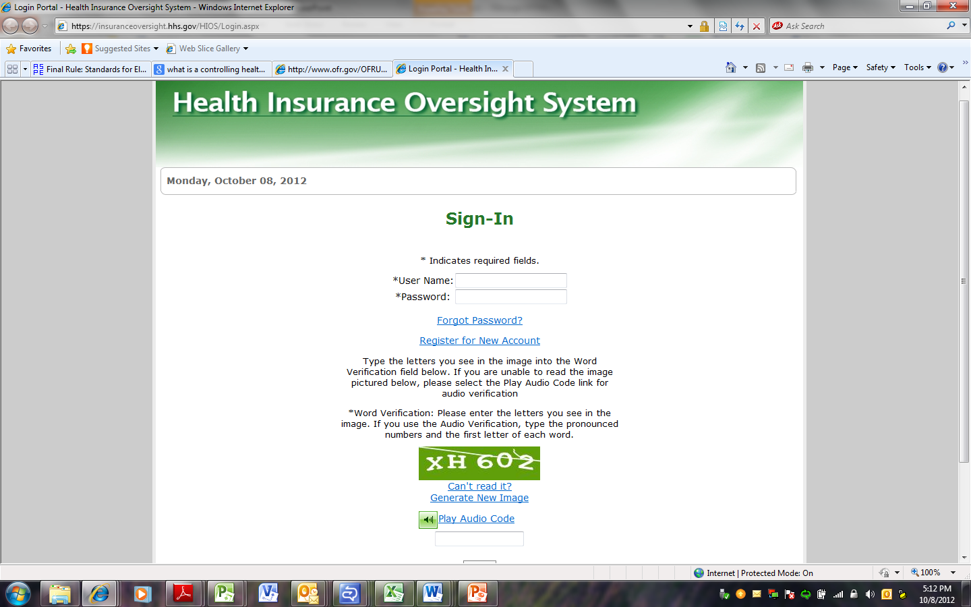
Choose to register for a New Account if you are a first time user of the HIOS application.

Slide 9
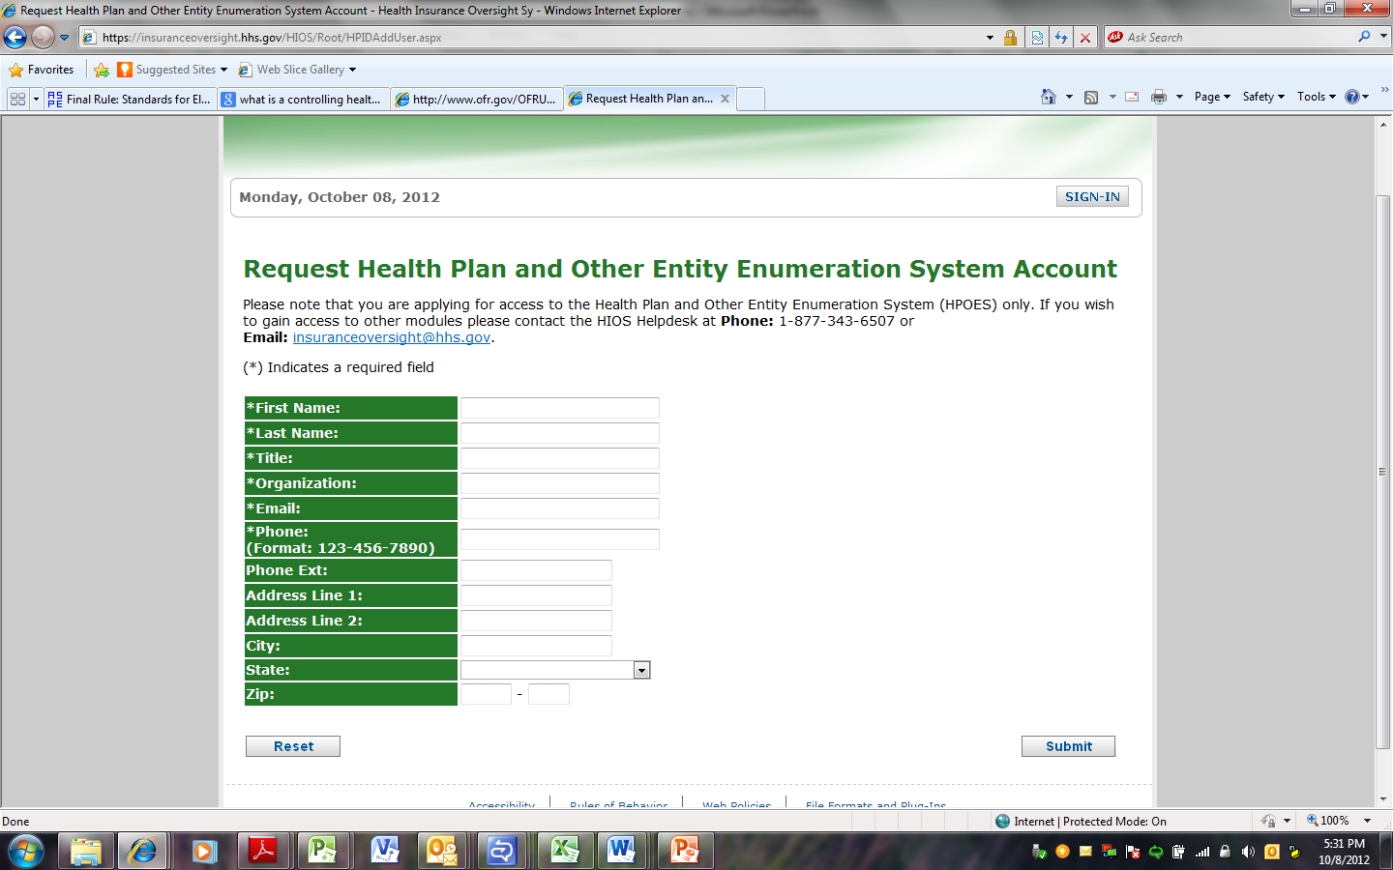
Complete the HPOES Request form’s fields.

Slide 10
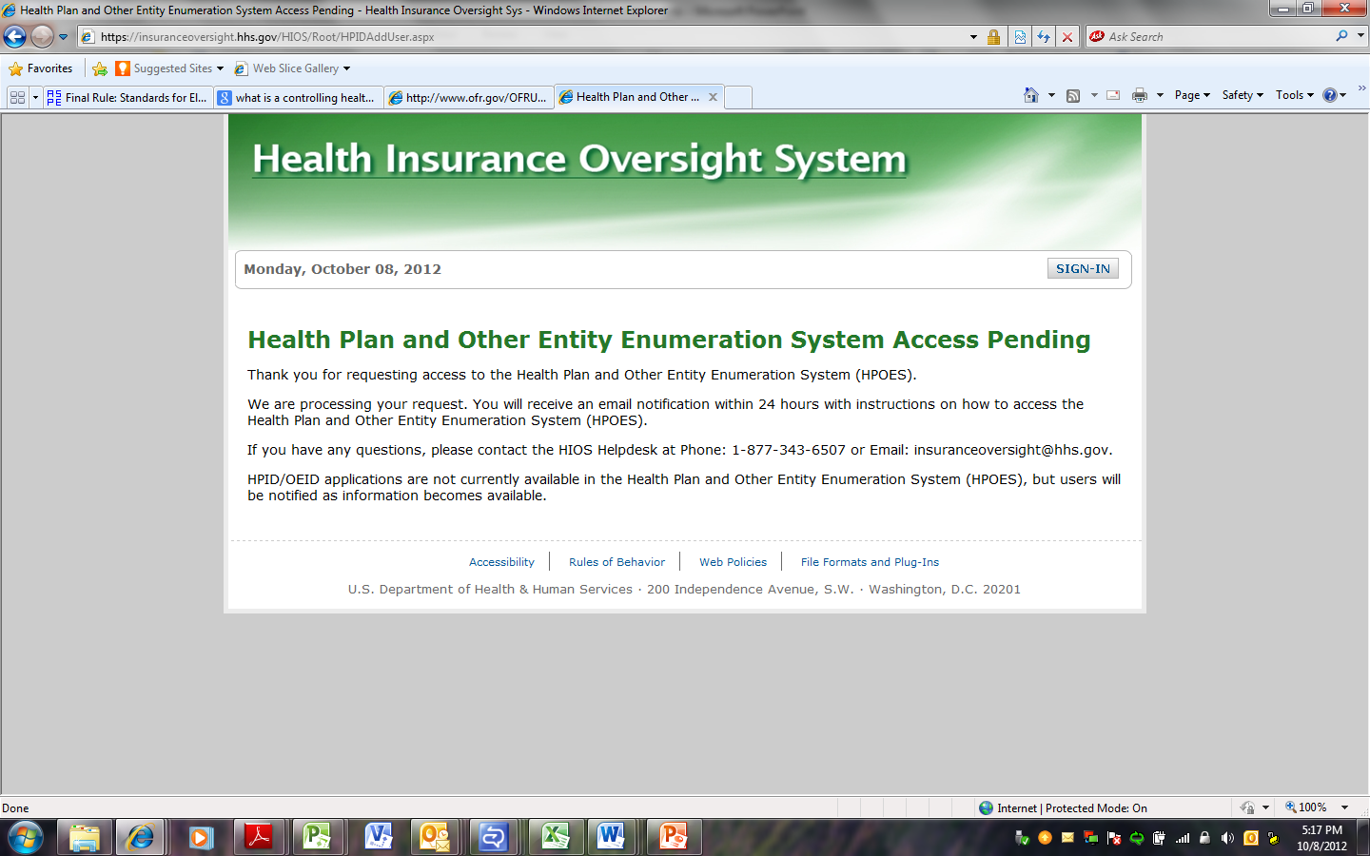
Once you have completed the registration form the you will receive the following response from HIOS

Slide 11
Confirmation Notification
Your user account has been created.
You can access the Health Insurance Oversight System at https://insuranceoversight.hhs.gov/ and login using the login credentials provided below.
The account has been set up based on the information that was provided on the Health Plan and Other Entity Enumeration System (HPOES) registration page. You will be required to change your password at the time of your initial logon.
HPID/OEID applications are not currently available in the Health Plan and Other Entity Enumeration System (HPOES), but users will be notified as information becomes available.
.

Slide 12
How many HPIDs do I need?
In the final rule, the government left it up to the plans to determine how many HPIDs will be needed or said another way, how to enumerate.
Suggestions have been made to enumerate to the individual benefit level, by state, by product or even as high as company level. For a State Medicaid Agency, this might be at the agency, department or program level.
There may be greater benefits to enumerate to the lowest level but there may be greater costs to define and manage the business at that level whereas at a higher level, the cost may be less but so are the benefits.

Slide 13
Who Benefits from using an HPID?
It is a win-win for both providers and health plans.
Health plans may use the HPIDs in their internal files to facilitate processing of healthcare transactions with improved efficiencies.
May assist in the routing and receipt of Coordination of Benefits claims. The provider could potentially have their patient’s member ID tied to their health plan IDs knowing specifically the plans to be used for COB.
Health plans would only receive claims for their members for COB potentially reducing the number of denials generated for “no plan coverage”.
Identify health plans in electronic health records (EHRs).
Public health data reporting.
A cross-reference in health care fraud and abuse files and program integrity files.

Slide 14
Potential Other Uses
Similar to the level of enumeration, the usages of the HPID are not constrained to HIPAA transactions. This fosters additional individual usages to be determined and built upon.
One such potential would be to print the HPID on the member’s id cards facilitating additional eligibility benefits and claim routing functionality.
Standardized IDs is forecasted to increase the use of electronic transactions. The 270/271 Eligibility for example, having the ids tied to the member would allow accurate plan benefit inquiry detail and response.

Slide 15
Suggested Phases to the Road of Compliance
Discovery Phase: HPID level of enumeration and their usages need to be determined.
Coding Phase: IT makes the necessary coding changes to support the business rules/processes of the HPID.
Testing Phase: Internal validation of code changes and external testing with providers/clearinghouses and health plans.
Implementation Phase: Full system and process integration of HPID.

Slide 16
Questions?
Dates to remember
Start now requesting access to HPOES
11/5/2014 Large health plans must have their HPIDs
11/5/2015 Small health plans must have their HPIDs
11/7/2016 All health plans must use their HPIDs

