Slide 1

Introduction to HIE & 42 CFR Part 2
Chase Millea, In-House Counsel & Privacy Office
August 6, 2019

Slide 2
Agenda
Introduction to Health Current HIE
HIE Services
Relevant Statutes and Regulations
Access to Data Covered Under 42 CFR Part 2

Slide 3

Arizona’s HIE Collaboration
Community Providers
Labs
Health Plans
Hospitals
Public Health
ACOs
Others

Slide 4

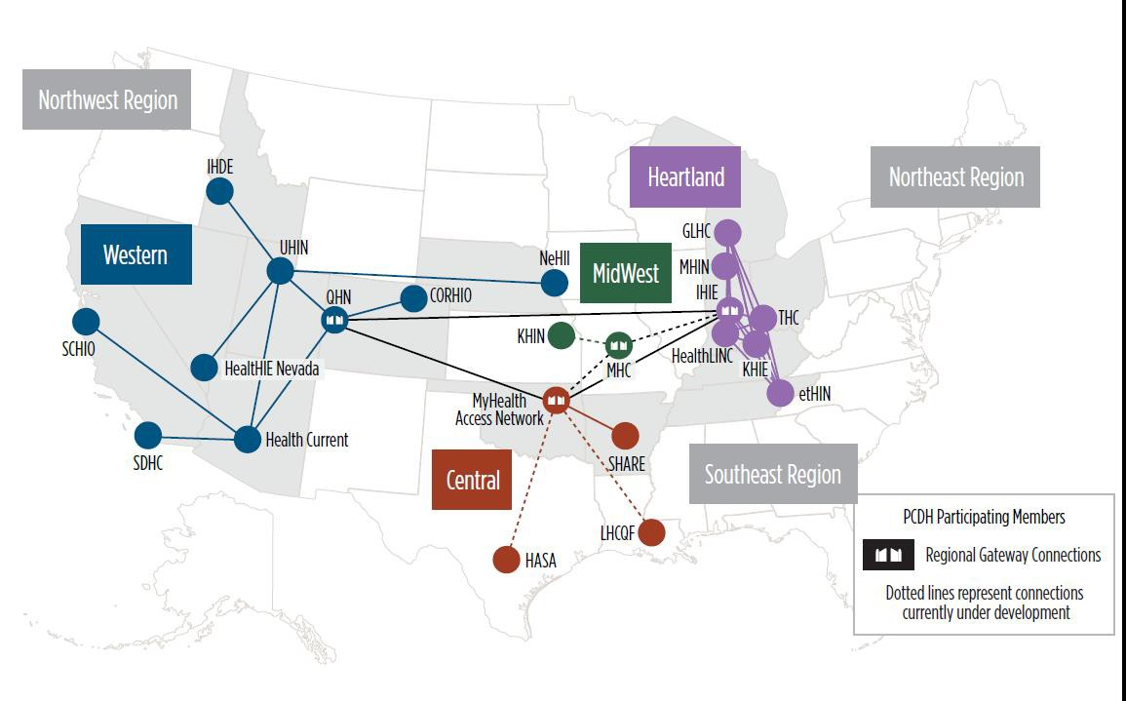
7
P
atient Centered Data Home™ (PCDH) National Map

Slide 5
HIE Services
Alerts
Alerts are sent to designated clinicians or individuals based upon a patient panel.
  Types of Information Available: Physical health information. May also include behavioral health information.
Direct Email
Direct Email is a HIPAA compliant, secure email account that provides the means for registered users to exchange patient protected health information with other DirectTrust-certified email accounts. Direct Email is often used to receive Alerts.
Types of Information Available: Physical health information. May also include behavioral health information and with appropriate patient/member consent, substance abuse treatment information.
Portal
The Portal provides secure web-based access that allows selected patient/member data to be viewed online.
  Types of Information Available: Physical health information. May include behavioral health information and with appropriate consent, treatment information.

Slide 6
HIE Services
Data Exchange
Data Exchange involves electronic interfaces between patient tracking systems and the HIE. Data exchange services include:
  Bidirectional Exchange
  Unidirectional Exchange
  Types of Information Available: Physical health information. May include behavioral health information and with appropriate consent, treatment information.
  Clinical Summary
  A Clinical Summary is a comprehensive Continuity of Care Document (CCD) containing up to 90 days of the patient’s/member’s most recent clinical and encounter information. Clinical Summaries include:
  Automated Clinical Summary
  Query/Response Clinical Summary
  Patient Centered Data Home™ (PCDH) Clinical Summary
  Types of Information Available: Physical health information. May also include behavioral health information.

Slide 7
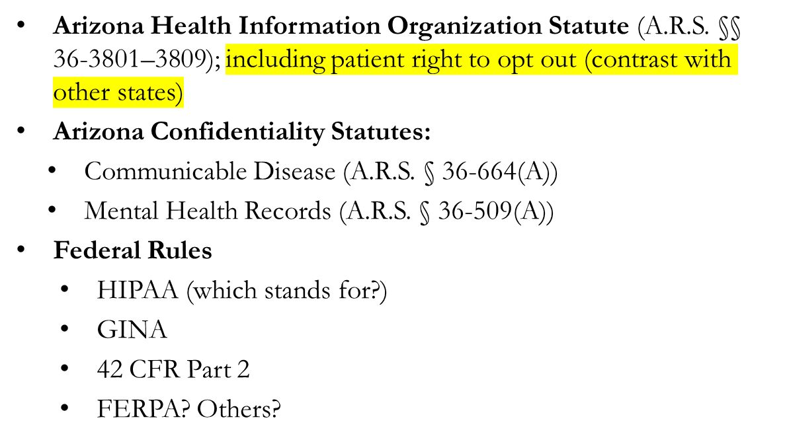
Relevant Statutes/Regulations

Slide 8
What is Part 2 Data?
Part 2 only applies to:
Protected health information (PHI) that
Identifies a person as having (or having had) a substance use disorder (SUD) directly, by reference to publicly available information, or through verification of such identification by another person; AND . . . .
Originates from a “federally-assisted” “program” (Part 2 Program)

Slide 9
Health Current Privacy Approach
Arizona HIO Law
No Data Accessible if Individual Opts Out
Physical Health and General Behavioral Health Data
Generally Accessible by Participant Authorized Users
Part 2 and Behavioral Health Data That Cannot be Separated
Accessible by Participant Authorized Users with Patient’s Written Consent

Slide 10
Controlling Access to Part 2 Data
Identification and separation of Part 2 data
Role-based access to Part 2 “site”
Patient written consent required to view individual’s records
    Obtained at point of care
    Must use Health Current Part 2 Consent Form
    Participant will designate a Consent Manager to upload to HIE
Medical emergency (“break the glass”) access

Slide 11


Restriction on Redisclosure
Lawful recipients of Part 2 data about a patient may not redisclose information “that identifies a patient as having or having had a substance use disorder… ” without the patient’s written consent (42 C.F.R. Part 2 § 2.32)

