Slide 1
Technical Consortium
July 22, 2025

Slide 2
Welcome
David Rudnick Introduction

Slide 3
EVV 2.0
Effective 10/1/2025-Aggregator inhouse
Testing for MCO’s will begin 8/25/2025
No change to MCO reports you review now
No change to claims/encounters submissions to AHCCCS
Need to ensure you can log into ServiceNow-information will be coming
Training and manuals will be coming out
No change to MCO claims file to new Aggregator platform
Method of submission will not change; API/SFTP will be the same- new link/path will be provided

Slide 4
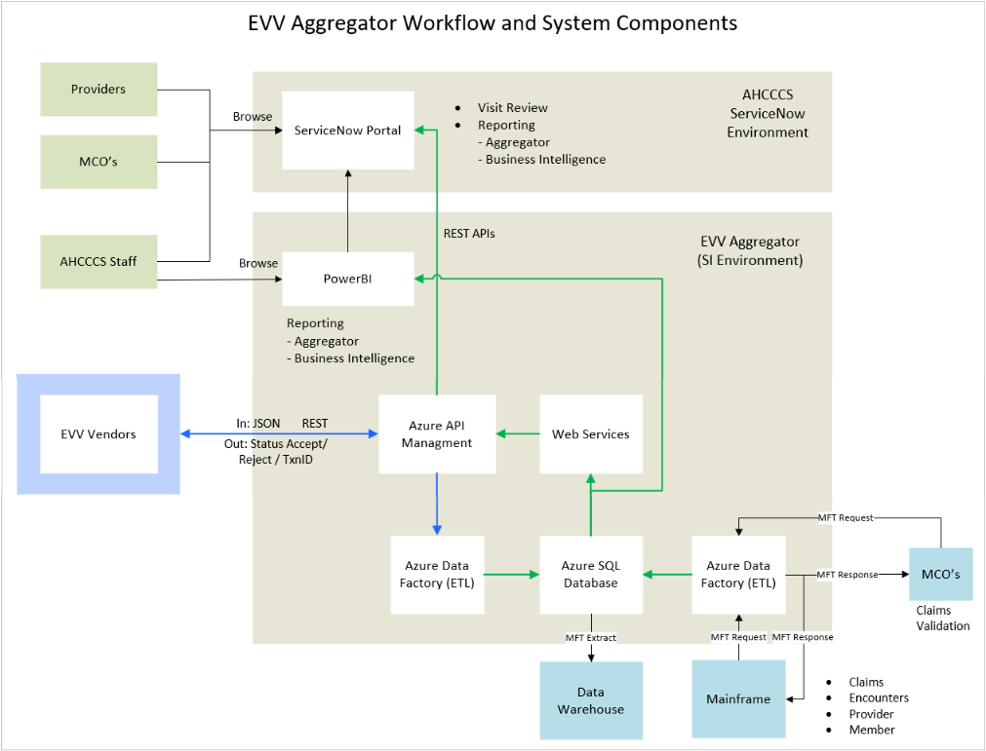

Slide 5
DAP Automation Phase 2
Effective 10/1/2025
Automation of PR050/PR058 (except for IHS/638 providers – Claims Only)
Creation of new Reference Table-RF689
Update of table RF687 to add claims/encounters or both
ShareInfo REFER07 file will have D1 for RF687 and D2 for RF689
As always you can participate in testing which will be open in August timeframe
Information was sent out on 7/8/2025 and on 7/17/2025
Stay Toned: We are getting a very recent update that we may have a potential DAP Indicator change: could be added or removed and as soon as we know we will let you know.

Slide 6
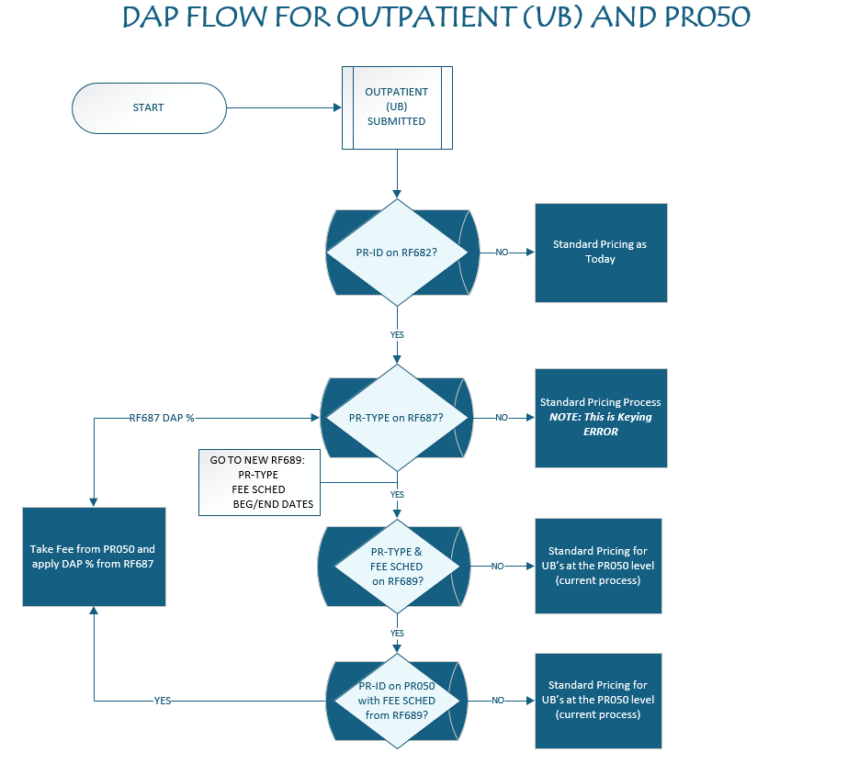

Slide 7
SED Process Change
Effective 7/24/2025
SED Data will now be a part of the DUGLess and entered by the provider
The SMI portal will be updated to remove all indicators of SED
Output reports to your MFT folders will be changed to only contain SMI members – communication sent out on 7/9/2025

Slide 8
Recent and Upcoming System Changes
H051 PARTICIPATING PROVIDER NPI NOT PROVIDED OR INVALID - TYPES 05,77,IC
The promotion (February 2025) made within the edit logic to allow this header level error to be overridden did not work on H051 errors on encounters with additional errors at the line level, e.g., Z300. As a result, only those encounters pending for H051 are adjudicating, the others are re-pending. ISD is working on a fix.

Slide 9
Recent and Upcoming System Changes Cont.
U262 HOSPICE HOME CARE UNITS EXCEED 1 PER DAY
AHCCCS promoted a logic enhancement (December) to allow the billing of Service Intensity Adjustment (SIA) rate for G0299/G0300 CPT codes. It appears that the promotion has caused additional pends for DOS range for multiple units on one line on panel 5 of the encounter. ISD is reviewing for corrections.

Slide 10
Recent and Upcoming System Changes Cont.
Valid Billing Provider ID – Edits P406/P375
Service dates and received on/after 7/24/2025. These edits will ensure that the Billing Provider's Tax ID submitted is valid within our system and that the Rendering Provider ID is correctly associated with the Billing Provider ID.
All Form Types. Soft Edit for 6 months-Soft Edit Report file: AC3E072.SOFT.HPXXXXXX.YYMMDD.TXT
Communication sent on 4/8/2025
P406 - BILLING PROVIDER TAX ID IS MISSING OR INVALID
Ensure the submitted Billing Tax ID matches the Tax ID of PR015 Address Type P - Pay-To Address(es) listed under the corresponding Billing Provider's Medicaid ID in our system.
If the Tax ID is found, the system will check whether the Date of Service on the encounter falls within the Tax ID’s active period
If any of these conditions are not met, a P406 error will be generated, and the system will not proceed to P375 validation
If the encounter successfully passes P406 validation, it will then move to the P375 logic

Slide 11
Recent and Upcoming System Changes Cont.
Valid Billing Provider ID – Edits P406/P375 Cont…
P375 - SERVICE PROVIDER/GROUP AFFILIATION NOT FOUND
Verify that the Billing Provider ID is listed under the Rendering/Servicing Provider ID on PR045 - Provider Billing Associations Table
Service Begin Date is greater than or equal to the begin date in the Provider Association table.
If any of these conditions are not met, a P375 error will be generated
Reminder-want providers to clean these up prior to the edit going hard
Issue with PR015 – could be several solutions, however most common is to fix in APEP.
Issue with PR045 – in APEP have the service provider associated to the Billing provider

Slide 12
Recent and Upcoming System Changes Cont.
Compound Drug Level of Effort
This is to capture the data for compounding drugs based on their level of difficulty.
Capture in the NCPDP file and store the data from 474-8E (DUR/PPS Level of Effort) in the Claims and Encounters by utilizing the Received Values table (RFC07 - LOE)
For data reporting purposes
Targeted 10/1/2025

Slide 13
Recent and Upcoming System Changes Cont.
Same Day Disallow – Supports the Fraud, Waste and Abuse efforts.
AHCCCS has published Same Day Disallow information that restricts certain BH services that can be received on the same day - https://www.azahcccs.gov/PlansProviders/MedicalCodingResources.html
To accomplish this:
CL184- BH Similar Services – This table has the following fields: PRI HCPCS; SEC HCPCS, Different Provider Exception Indicator, Effective Begin Date, and Effective End Date.
This will be in the ShareInfo – REFER09 D1 – BHS Similar Services
Targeted for 11/20/2025

Slide 14
Recent and Upcoming System Changes Cont.
Same Day Disallow Cont…
The claims/encounter system will read this table (CL184) and if it finds the two HCPCs received on the same date of service, it will deny/pend the claim/encounter for either the two services not being allowed on the same day or the two services not being allowed by the same provider on the same day.
No promote date has been established and you will receive communication once I have it.

Slide 15
Recent and Upcoming System Changes Cont.
Age bypass for anaphylactic drug
AHCCCS has updated the codes 95165, 95144, 95115 and 95117 to only go up to age 20. If someone is over the age of 21, and has one of the diagnosis codes below, then we will allow the claim/encounter to bypass the edit S370 and process. No promote date yet and communication will be sent.
T56.91XA 0 TOXIC EFFECT OF UNSP METAL, ACCIDENTAL (UNINTENTIONAL), INIT
T59.2X4A 0 TOXIC EFFECT OF FORMALDEHYDE, UNDETERMINED, INIT ENCNTR
T61.91XA 0 TOXIC EFFECT OF UNSP SEAFOOD, ACCIDENTAL, INIT
T63.421A 0 TOXIC EFFECT OF VENOM OF ANTS, ACCIDENTAL, INIT
T63.441A 0 TOXIC EFFECT OF VENOM OF BEES, ACCIDENTAL, INIT
T63.451A 0 TOXIC EFFECT OF VENOM OF HORNETS, ACCIDENTAL, INIT
T63.461A 0 TOXIC EFFECT OF VENOM OF WASPS, ACCIDENTAL, INIT
T65.91XA 0 TOXIC EFFECT OF UNSP SUBSTANCE, ACCIDENTAL, INIT
T78.00XA 0 ANAPHYLACTIC REACTION DUE TO UNSPECIFIED FOOD, INIT ENCNTR
T78.00XD 0 ANAPHYLACTIC REACTION DUE TO UNSPECIFIED FOOD, SUBS ENCNTR
T78.00XS 0 ANAPHYLACTIC REACTION DUE TO UNSPECIFIED FOOD, SEQUELA
T78.02XA 0 ANAPHYLACTIC REACTION DUE TO SHELLFISH (CRUSTACEANS), INIT
T78.02XD 0 ANAPHYLACTIC REACTION DUE TO SHELLFISH (CRUSTACEANS), SUBS
T78.03XA 0 ANAPHYLACTIC REACTION DUE TO OTHER FISH, INITIAL ENCOUNTER
T78.04XD 0 ANAPHYLACTIC REACTION DUE TO FRUITS AND VEGETABLES, SUBS
T78.05XD 0 ANAPHYLACTIC REACTION DUE TO TREE NUTS AND SEEDS, SUBS
T78.09XA 0 ANAPHYLACTIC REACTION DUE TO OTH FOOD PRODUCTS, INIT ENCNTR
T78.1XXA 0 OTH ADVERSE FOOD REACTIONS, NOT ELSEWHERE CLASSIFIED, INIT
T78.1XXD 0 OTH ADVERSE FOOD REACTIONS, NOT ELSEWHERE CLASSIFIED, SUBS
T78.1XXS 0 OTH ADVERSE FOOD REACTIONS, NEC, SEQUELA
T78.2XXD 0 ANAPHYLACTIC SHOCK, UNSPECIFIED, SUBSEQUENT ENCOUNTER

Slide 16
Future System Enhancements
MES Modernization
EDMS migration from Docuware to SharePoint.
Utilizing ServiceNow for workflow or portal interface.
Refactor project and testing for UAT.

Slide 17
Future System Enhancements
CAA- Consolidated Appropriations Act (CAA) Juvenile Justice Requirements and Targeted Case Management.
Effective 10/1/2025
Claims only; no impact to encounters for initial implementation
AHCCCS will provide targeted case management (T1017) to incarcerated youth and former foster care adults up to age 26.
Existing providers will be providing T1017 and will be added as an exception to the provider’s profile.
Pay claims for providers who are allowed to bill for T1017 when the member is enrolled in CTYPRI.

Slide 18
Future System Enhancements
Referring; Ordering; Attending - ROA (FFS)
Effective 8/1/2025
Claims only
If the ROA’s provider's NPI is registered with AHCCCS or on table RF7C6, the claims edit will be bypassed, otherwise the edit will be applied.
Pharmacy coming a later phase
TIG new Facelift
We are working on updating the how the TIG looks
Will be coming: CTYPRI information, EVV Information: Medicare/DSNP information.

Slide 19
Point of Contacts:
TCUInquiry@azahcccs.gov – Business Member Liaison team: SMI, State Only and Member questions; enrollment questions/corrections
TCURequests@azahcccs.gov – Business Technical team: EDI File questions/concerns/issues; PMMIS in general questions
HEAPlus- Phone Number 602-542-5802
Encounters Liaison - for Encounter Questions

Slide 20
Future Topics

Slide 21
Questions ?

Slide 22
Thank you.

