Slide 1
CMS Interoperability Rule meeting-MCO group
July 14, 2020
Lori Petre
Alexa Kaumaya
Tom Heiser

Slide 2
Purpose of Meeting
Overview of CMS Interoperability Rules
Understanding MCO involvement in the deliverables
Strategy of implementing the requirements
Timeline discussion

Slide 3
Agenda
Vision of HHS for Consumer Control of Information
Summary of Interoperability Rule
Health plan Requirements
Timelines
CMS Cost Estimates
Resources
Next Steps

Slide 4
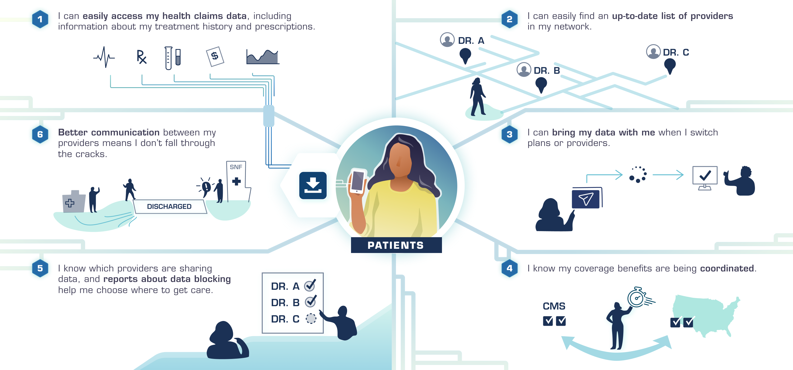
How might Interoperability impact me?

Slide 5
Interoperability and Patient Access Final Rule
The Interoperability and Patient Access final rule (CMS-9115-F) delivers on the Administration’s promise to put patients first, giving them access to their health information when they need it most and in a way they can best use it.
As part of the Trump Administration’s MyHealthEData initiative, this final rule is focused on driving interoperability and patient access to health information by liberating patient data using CMS authority to regulate Medicare Advantage (MA), Medicaid, CHIP, and Qualified Health Plan (QHP) issuers on the Federally-facilitated Exchanges (FFEs).
This rule finalizes new policies that give patients access to their health information and moves the healthcare system toward greater interoperability.

Slide 6
Interoperability and Patient Access Final Rule Cont.
These new policies include:
Section III -Patient Access Application Programming Interface (API) (applicable 7/01/2021)
Section IV- Provider Directory Application Programming Interface (API) (applicable 7/01/2021)
Section V- Payer-to-Payer Data Exchange (applicable January 1, 2022)
Section VII- Improving the Dually Eligible Experience by Increasing the Frequency of Federal-State Data Exchanges (applicable April 1, 2022)
Section VIII - Public Reporting and Provider Information Blocking (applicable late 2020)-provider responsibility
Section IX - Provider Digital Contact Information (applicable late 2020)-provider responsibility
Section X- Admission, Discharge, and Transfer (ADT) Event Notifications (applicable spring 2021)-provider responsibility

Slide 7
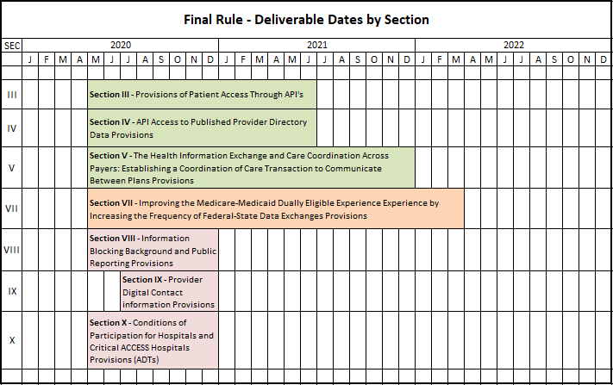
Interoperability Timeline
Notes:
Susan

Slide 8
Section III: Patient Access API
By July 1, 2021 Medicaid/CHIP State Agencies and Managed Care Organizations need to:
Implement a Patient Access API that permits third-party applications to retrieve, with the approval and at the direction of a Medicaid/CHIP eligible individual,
Adjudicated claims data, including provider remittances and beneficiary cost-sharing data;
Encounter data from capitated providers (does not include encounter data from MCOs, PIHPs, or PAHPs as they are required to establish their own Patient Access API);
Clinical data, including laboratory results (but only if maintained by the payer), and
Information about covered outpatient drugs.

Slide 9
Section III: Patient Access API Cont.
•Establish monitoring processes to ensure the API is operating as planned. For example, ensuring authentication and authorization protocols are followed
•Establish criteria to evaluate whether allowing a third-party app to connect or remain connected to the API would present an unacceptable level of risk to the security of PHI on your system
•Prepare data for transmission:
•Data from January 1, 2016 needs to be available
• Current data needs to be ready to transmit one business day after a claim is processed, including claims for payment decisions that were appealed or are in process of appeal
•API technology must conform to the technical standards set by ONC

Slide 10
Section IV: Provider Directory API
•By July 2021, a Provider Directory API must be accessible via a public facing digital endpoint on a Managed Care Organization’s website
•Information must include Provider names, addresses, phone numbers, and specialties
•Must also conform with ONC Technical Standards
•This information is already publicly available, therefore authentication and authorization protocols do not apply

Slide 11
Section III and IV – CMS API Cost Estimates
CMS COST ESTIMATES to IMPLEMENT (per organization, i.e., each health plan/payer)
Estimated total of 16,800 hours of work per organization to implement both Patient Access and Provider Directory APIs
See Section XII.C.2 of CMS final rule for discussion
Further information also available at Section XIII.B.1 (Table 11)
Estimated timeline to implement: Not less than 6 months (minimum)
CMS COST ESTIMATES to MAINTAIN (per organization, i.e., each health plan/payer)
Estimated total of 1,710 hours of work per organization per year to maintain both Patient Access and Provider Directory APIs
FHIR server, and necessary patient data,
Capability and security testing

Slide 12
Section V: Care Coordination Across Payers
Background-EFFECTIVE JANUARY 1, 2022
Promote payer-to-payer PHI/EHR data exchanges, on members’ request
5 year historical data set, same time period(s) as Section III: Patient Access API requirements
Can be coordinated through state/regional Health Information Exchanges
Purpose
Enhance care coordination capabilities by payers for all enrollees, including dual eligibles.
Notes:
Tom/team and ISD

Slide 13
Section V:Care Coordination Across Payers Cont.
Final Actions
Payers to incorporate the data received into the enrollee’s record. Language “with the approval and at the direction” of the enrollee versus “at the request” of the enrollee to align with the language used for the API requirements.
Payers only obligated to send data received from another payer in the electronic format
Use “payer” instead of “health care plan” to clarify that requirements obligations apply to affected payers.
Starting January 1, 2022, affected payers to exchange data with a date of service on or after January 1, 2016 meeting the requirements of this section which the payer maintains. Payers only have to prepare an initial historical set of data for sharing via this payer-to payer data exchange policy that is consistent with the data set to be available through the Patient Access API per section III. of this final rule.

Slide 14
Project Resources
CMS Interoperability and Patient Access final rule
ONC 21st Century Cures Act

Slide 15
Next Steps

Slide 16
Questions? Email: lori.petre@azahcccs.gov

Slide 17
Thank you for your work on this important project!

