Slide 1

MCO Engagement
Routine EVV Technical Discussions
  Initial conversation to determine scope and cadence or ongoing group and MCO 1- 1 technical meetings

Slide 2






EVV Project Timeline
6/14/19 – 1/21/20
Business Rules
Technical Design
Customization Request Design
1/22/20 – 6/15/20
System Integration Testing
UAT
Testing Validation
Initiation & Planning
Analysis & Design
Configuration & Development
Testing
Implementation
6/11/19 – 2/20/20
Kick-Off Meeting
Project Strategy
Project Documentation
12/23/19 – 4/2/20
System Configuration
Configuration Validation
Initial Deployment
6/30/20 – 9/22/20
Sys Deployment
Go Live
Training
Device Delivery
2

Slide 3









MCO Timeline
 | 2020
 | 12/29 | 1/5 | 1/12 | 1/19 |  | 1/26 |  | 2/2 | 2/9 | 2/16 | 2/23 | 3/1 | 3/8 | 3/15 | 3/22 | 3/29 | 4/5 | 4/12 | 4/19 | 4/26 | 5/3 |  | 5/10 | 5/17 | 5/24 | 5/31 |  | 6/7
Kick Off Call 1/7/20
Connectivity Test 1/6 – 1/23
 |  |  | 1/6 – 1/23
System Testing 1/24 – 5/27
 |  |  |  |  |  |  |  |  |  |  |  |  |  |  | 1/24 – 5/27
State File Structure Testing |  |  |  |  |  | 1/24 – 2/21
MCO Connectivity Testing |  |  |  |  | 1/24 - 3-31
State App Load Testing |  |  |  |  |  |  |  |  |  |  |  |  |  |  |  |  | 3/31 – 4/21
MCO File Structure Testing |  |  |  |  |  |  |  |  |  |  |  |  |  |  |  |  |  | 3/31 – 4/28
MCO App Load Testing |  |  |  |  |  |  |  |  |  |  |  |  |  |  |  |  |  |  |  |  |  | 5/6 – 5/27
UAT Testing 5/6 – 5/27 |  |  |  |  |  |  |  |  |  |  |  |  |  |  |  |  |  |  |  |  |  |  | 5/6 – 5/27
20
21

Slide 4

MCO Deliverables
Tech Design Review Meeting: 1/7
Tech Design Distribution: 1/9
Kickoff
Connectivity Form Distribution: 1/9
Connectivity Selection & Testing Starts (SFTP/API): 1 /6
Deadline for Connectivity Selection & Testing: 1/24
System Integration Testing: 1/24
UAT Testing: 5/6
Dev/Test
MCO Code Deployment to Production: 6/16
Deploy

Slide 5

Service Authorizations
CMS must certify the system to ensure that it meets all the requirements of the 21st Century Cures Act and certain functionality.
The certification is outcomes based and one of the elements pertains to the prevention of fraud, waste and abuse
  Use of an EVV System to avoid payment for unauthorized or unapproved services.
  Ensure linkage between authorized provider, service, units and visits
5

Slide 6

Questions, Comments, Concerns?
What outstanding questions/concerns do you have at this point?
How can AHCCCS further support your engagement and completion of deliverables?
How can AHCCCS further support your engagement of the provider network?

Slide 7

1/17/20 Meeting Action Items
Provide updated Authorization File Layouts
  New file layouts will be sent by Lori Petre by 1/24 along with a clarification on the medical necessity determination date.
Create document to outline parameters for the medical necessity determination date
  AHCCCS will draft and submit to MCOs and provider cohort for reivew
Combine MCO training efforts with the AHCCCS/Sandata Training Plan
  AHCCCS will approach Sandata with the request and follow up with MCO’s
  Develop a list and strategy to notify MCO’s of providers who have completed EVV training to support provider engagement

Slide 8

1/17/20 Meeting Action Items:
Schedule meeting with MCO’s to discuss the Communication Plan
  MCO’s will receive invitations the week ending 2/14
Work with Sandata to identify a single source clearinghouse
  AHCCCS will approach Sandata with the request and follow up with MCOs
Work with Sandata to identify a “hard” start date for providers to initiate the use of the system.
  AHCCCS will approach Sandata with the request and follow up with MCOs
Consider revisions to the FFS EVV portal so that it can be used by all MCO’s
  This idea will be discussed further during the MCO technical calls

Slide 9
1/17/20 Meeting Action Items
EVV scenario where member is dually covered. How will authorization work for members with the same MCO for both Medicare and Medicaid and different MCOs?
o Will be discussed during the MCO technical calls
EVV Coordination of Benefits scenario. Is EVV required for Medicare Services? What if the primary insurance does not require EVV Authorization?
  Will be discussed during the MCO technical calls
Discuss the possibility of MCOs collaborating to align which services will require PA and which services do not
  Will be discussed during the MCO technical calls

Slide 10

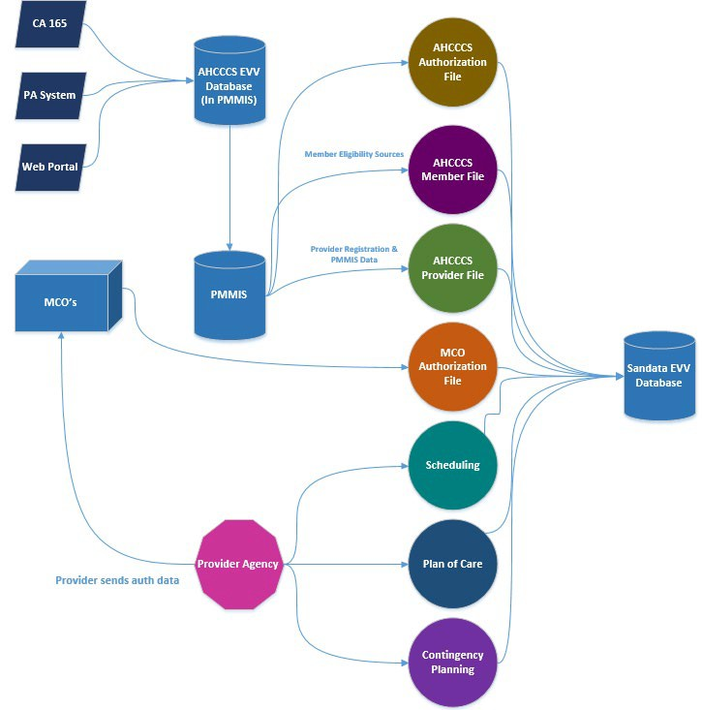
EVV Data Flow
20

Slide 11
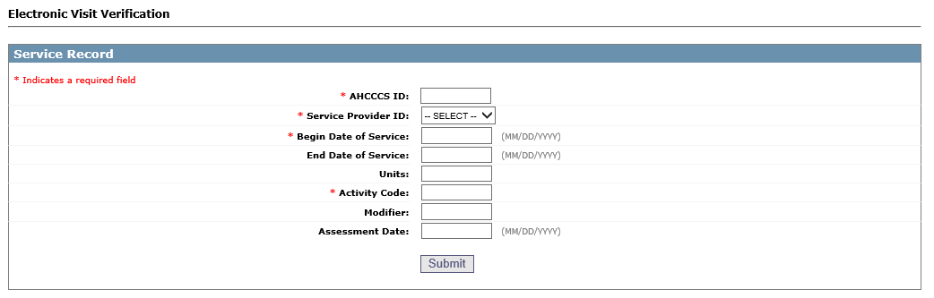
Electronic Visit Verification Example

Slide 12
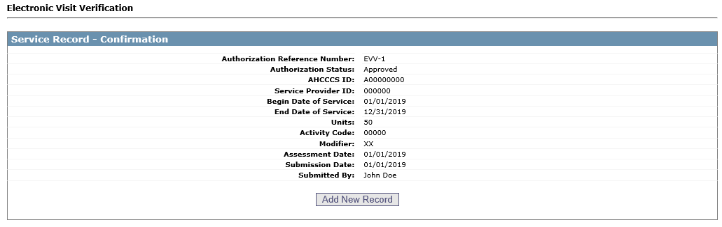
Electronic Visit Verification Example
12

