Slide 1
Annual AHCCCS Reinsurance Workshop
RI Contract Year 42
Presented by Tracy Thomas and Mercedes Hernandez – Wednesday, October 18th, 2023

Slide 2
Agenda
Welcome and Introductions
Review Reinsurance Manual Changes for 10/01/2023
Transplant Contracts Changes effective 10/01/2023
Transplant Contracts – Looking forward
Discussion
Recaps
Reminders
Questions

Slide 3










Introductions

Slide 4
Reinsurance Manual Changes
Added 8 New High-Cost Specialty Drugs to BIO Case Type Covered Services:
  Amvuttra (effective 10/01/2022)– Treatment for Polyneuropathy associated with hereditary transthyretin-mediated amyloidosis.
  Gamifant (effective 10/01/2022)– Treatment for primary hemophagocytic lymphohistiocytosis (HLH) in adult and pediatric (newborn and older) patients with refractory, recurrent or progressive disease or intolerance to conventional HLH therapy.
  Gattex (effective 10/01/2023) – Treatment of short bowel syndrome in adults and pediatric patients ≥1 year of age who are dependent on parenteral support.
  Skyclarys (effective 10/01/2023)– Treatment of Friedreich ataxia in adults and adolescents ≥16 years of age.
  Skysona (effect 10/01/2022)– Cerebral Adrenoleukodystrophy
  Sohonos (effective 10/01/2023) – Treatment for reduction in the volume of new heterotopic ossification in adults and children aged 8 years and older for females and 10 years and older for males with fibrodysplasia ossificans progressiva.
  Vyjuvek (effective 10/01/2023) – Treatment of wounds in patients ≥6 months of age with dystrophic epidermolysis bullosa with mutation(s) in the collagen type VII alpha 1 chain (COL7A1) gene.
  Zynteglo (effective 10/01/2022) - Treatment of beta thalassemia in adult and pediatric patients who require regular red blood cell transfusions.

Slide 5
Reinsurance Manual Changes
Deductible of all Regular ACC, ACC-RBHA, DCS/CHP RAC, and Regular LTC Cases has increased to $150,000

Slide 6
Reinsurance Manual Changes
High-Cost Specialty Drug (BIO) Medicare Language Addition (Let's break this down)
  Under Medicare drug claims are covered under Medicare Part B or Part D
  Many of the High- Cost Specialty Drugs (BIO) are covered by Medicare depending on how they are administered.
  When a drug is administered at home or self-administered, the drug is not covered under Medicare Part B and should be billed to the member’s Medicare Part D plan.
  When a drug is physician-administered at the office or administered in an infusion center, then the drug, if listed under Medicare Part B, is billed to the Medicare Part B plan.
  The Medicare Part B plan reimburses the provider 80% of the cost of the drug and AHCCCS and its MCO Contractors are responsible for up to 20% of the remaining cost.
  The primary payment from Medicare plus the secondary payment (up to) 20% may not be greater than if AHCCCS had been the primary payer for the entire claim.

Slide 7
Reinsurance Manual Changes
Heart CAD/VAD stages where the member is not bridge to transplant and later is determined to be bridge to transplant:
  Notify AHCCCS MM within 30 days of device insertion
  Reinsurance will be available 90 days retroactively
Claims dispute language added – “MCOs should make every attempt to settle claims disputes with providers in a timely manner. In circumstances where claims dispute extends longer than a contract year, MCOs should report this information to the Reinsurance Supervisor along with dollar amount in dispute.”

Slide 8
Transplant Contract Changes
Transplant Contract Rates increased by 3.72%

Slide 9
Transplant Contract Changes
  Remove CAD/VAD as separate contract types and add bridge to transplant language to HRT and PHT case types.
  Corrected Yescarta and Tecartus CAR-T language per AHCCCS Pharmacy Director, Suzanne Berman.
  Correct Multiple Donor Search Language in MD Andersen PAL, PHA, ALO and HAP; Mayo PAL, PHA, ALO and HAP; PCH PAL, PHA; Scottsdale Shea ALO and HAP
  Banner Tucson Carvykti CAR-T Contract effective 6/12/2023
  Removed Lucille Packard Evaluation language that limited Evaluations to 1 or 2 days.

Slide 10
Transplant Contracts - Looking Forward
We are working on new contracts with multiple facilities both in –state and out of state including two new CAR-T drug contracts.
Currently working on issues regarding State Only Transplants, ST1 and ST2.

Slide 11
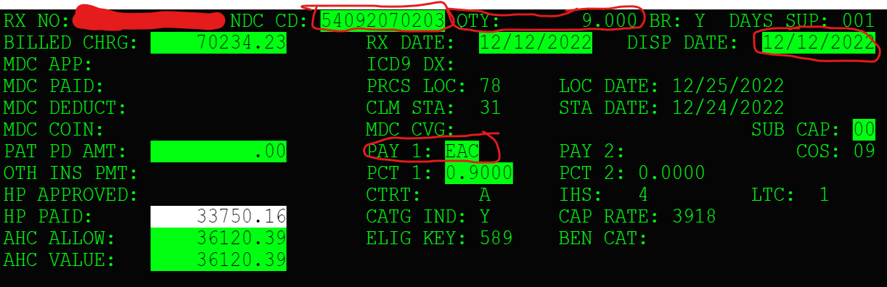
Discussion
  Reinsurance Drug AHCCCS Allowed Pricing on Form C (example)
    Find Drug in RF321 by NDC you will need from CRN:
      NDC (NDC CD), The Dispense Date (DISP DATE), Quantity (QTY), Pay 1 Code (PAY 1) – to determine which drug schedule to use in the RF321

Slide 12
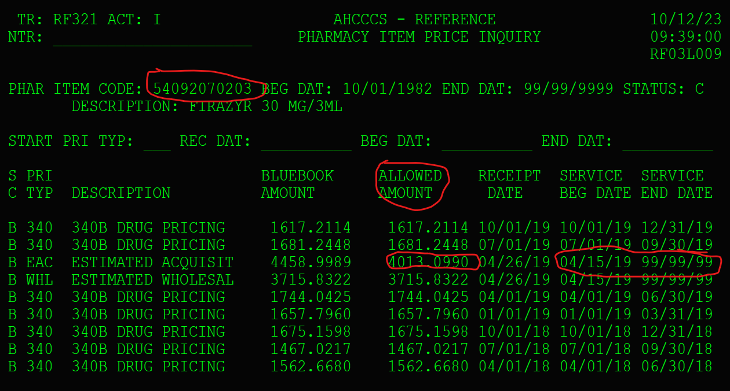
Discussion
  Locate drug rate in ALLOWED AMOUNT column per drug schedule (PAY 1) and per service date the and find the per unit rate

Slide 13
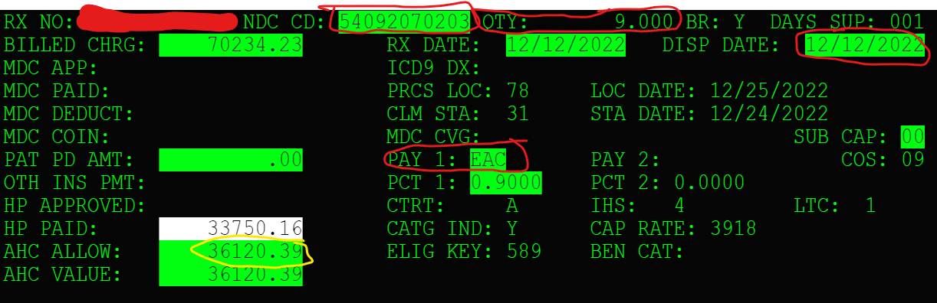
Discussion
Calculate AHCCCS Allowed
  EAC Rate from Schedule X Quantity + $2.50 Dispense fee = AHCCCS Allowed
  so
  $4013.0990 X 9 + $2.50 = $36,120.39

Slide 14
Recaps
Transferring funds from regular case to High Dollar over $1,000,000 case when a CRN's dollars must be split to balance the regular case at $1,000,000.
  This occurs when an entire CRN cannot be transferred because it will bring the regular case to below $1,000,000.
  Request transfer of all CRNs up to the $1,000,000 case total.
  Designate the CRN the funds will be transferred from and the amount to be transferred to the Catastrophic case in the Reinsurance Action Request form.
  The transferred amount will be seen in the CATSTR AMT $ field on the High Dollar $1,000,000 case.
On Zolgensma BIO/CRB cases this CRN Dollar split is particularly important due to the high dollar nature of Zolgensma claims.

Slide 15
Recaps
CAR-T Drugs are only reinsured if performed inpatient. They must also be encountered as inpatient with only the drug code to be reinsured.
In some cases, CAR-T can be performed outpatient. If they are performed outpatient, they are paid outside the transplant contract and not reinsured but rolled into capitation.
Interim inpatient stays where there has been a change of managed care organization (MCO) during the stay can be reinsured if MCO has member on end date of service of stay. See AHCCCS APR-DRG Payment System Design Payment Policies - section 5.
Transplant Outlier Stage submissions must include Transplant Stage Invoice Coversheets of all AHCCCS reimbursed stages that are part of the Outlier per RI Manual.
Let Reinsurance know when you submit a stage where the payment encounter has both the stage payment and an outlier payment.

Slide 16
Reminders
The billing for pre-transplant hospital stays follows section 31 in APR-DRG Payment System Design Payment Policies found on the AHCCCS Website.
Total Body Irradiation is authorized by AHCCCS MM and billed as a separate TBI Case type.

Slide 17
Reminders
Shore up Transplant stage dates that extend into following contract year.
Delete stages that are not in the correct contract year of the case.
Delete inactive stages or activate stages and shore up dates that extend into the following contract year.
Not doing these things can create a lot of work for you and AHCCCS Reinsurance since CRNs that are not part of a stage can associate in error. This can require Reinsurance Action Requests and CRN transfers to correct which are very time consuming.

Slide 18
Reminders
Non-contracted Transplant types or Transplants performed at non-contracted facilities
AHCCCS must review all transplants at non-contracted facilities or for non-contracted case types.
The Letter of Agreement (LOA) for these cases must be received and reviewed by AHCCCS before the case can be created in PMMIS.

Slide 19
More Reminders
A room and board rev code must be on the first line of UBs for them to be reinsured.
Please review your cases in PMMIS before submitting Reinsurance Action Requests and Transplant submissions.
Please use correct forms for submitting for reinsurance (e.g., Reinsurance Action Requests, Case Creation Form, Catastrophic or Transplant CRN Transfer Forms).
Complete forms completely.
Submit your SNF Grids ASAP if you haven't already.

Slide 20
More Reminders
SNF Rates should have the DAP included in rates.
Do not forget to monitor your cases over $1,000,000 so you can request to receive enhanced reinsurance.
Do not forget to request your catastrophic cases timely, (i.e., HEM, VON, GCC, BIO).
Do not forget to review your aged Transplant report AHCCCS Reinsurance provides monthly.

Slide 21
Reminders - Continued
There is no Transplant Reinsurance for Kidney Transplants as they are capitated.
All Transplant providers must be registered.
Notwithstanding the denial of reinsurance by AHCCCS, the Contractor is responsible for payment of claims for all services approved by the Contractor.

Slide 22
AHCCCS
Health Plans
Hospitals

