Slide 1
HEAplus Maintenance and Operations RFP
PRE-PROPOSAL CONFERENCE
Solicitation # YH20-0001
February 6th, 2020
Meggan LaPorte, MSW CPPO
AHCCCS Chief Procurement Officer

Slide 2
General Information
Sign-in Sheet for Attendees
Agenda
  Introduction, Purpose, Procurement Schedule
  RFP Submission process
  RFP Contents
  Evaluation
  Questions

Slide 3
RFP Prevails
  The RFP is the “Source of Truth” for all information regarding this procurement
  Any verbal response is not considered binding; respondents are encouraged to submit any question formally in writing
  Written Questions due Friday, Feb 7 on the Q&A form
  Answers to Questions will be made available on the website in the form of a Solicitation Amendment

Slide 4
Purpose of the RFP
The purpose of this RFP is to solicit proposals from Offerors experienced in maintaining, operating, and enhancing highly-integrated (multiple eligibility programs) Affordable Care Act (ACA)/Medicaid Eligibility and Enrollment (E&E) systems. The Awarded Contractor will be responsible for maintenance and operations of the HEAplus E&E system with development as needed if new initiatives arise from a State or Federal level.

Slide 5
Term of Contract
Contract Term:
  Intent is to award single contract
  Initial term is three (3) years with two (2) one-year options to extend, not to exceed a total contracting period of five (5) years
  All contract extensions options shall be through contract amendment, and shall be at the sole option of AHCCCS
  Contract amendments, including extension options, are subject to approval by the Centers for Medicare and Medicaid Services (CMS) and Food and Nutrition Services (FNS)

Slide 6
Anticipated Procurement Schedule
Activity | Date
RFP Release | January 17, 2020
Pre-Proposal Conference | February 6, 2020
Offeror Questions Due | TOMORROW February 7, 2020 5pm
Deadline to request access to SFTP server | THURSDAY, March 12, 2020
Offeror’s Proposals Due | TUESDAY, March 24, 2020 3pm
Contingent RFP Award (Subject to change) | June 23, 2020
Final RFP Award (Subject to change) | August 28, 2020
Services Start Date | October 1, 2020* *Unless otherwise changed in writing by AHCCCS
  The dates are subject to change.

Slide 7
Submission of your Proposal
The RFP is located on the AHCCCS public website
The Bidders library is linked from this site
The SFTP is secure and available to potential Offerors
The Offeror shall submit its proposal to the AHCCCS SFTP server in accordance with Exhibit D - Proposal Submission Instructions
Failure to follow the prescribed format for submission may result in AHCCCS determining that the submission is non-responsive
  Take note of page limits and fonts and borders
Proposals are due on:
Tuesday, March 24, 2020 at 3:00 PM Arizona Time

Slide 8
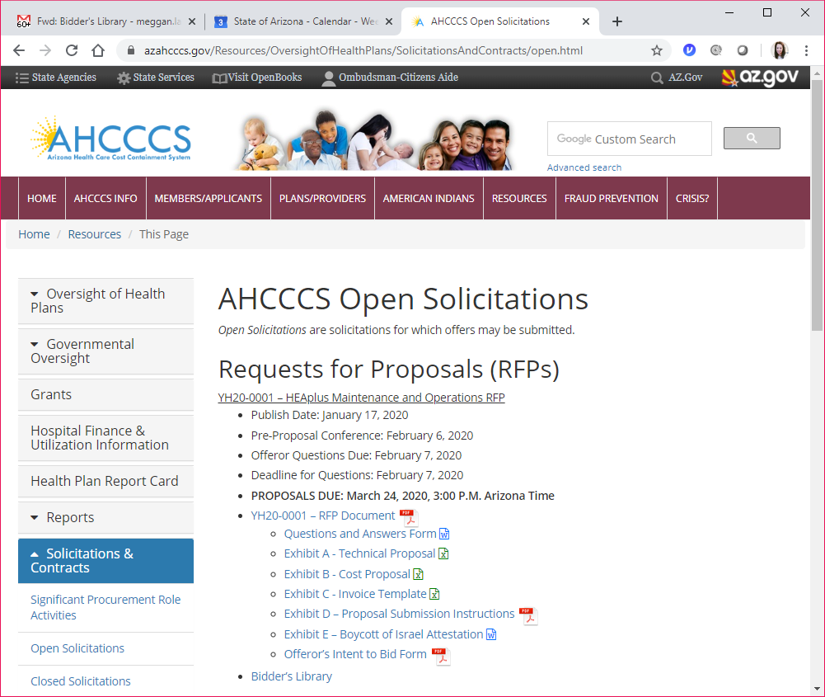
AHCCCS Public Website
AHCCCS will post Solicitation Amendments here.

Slide 9
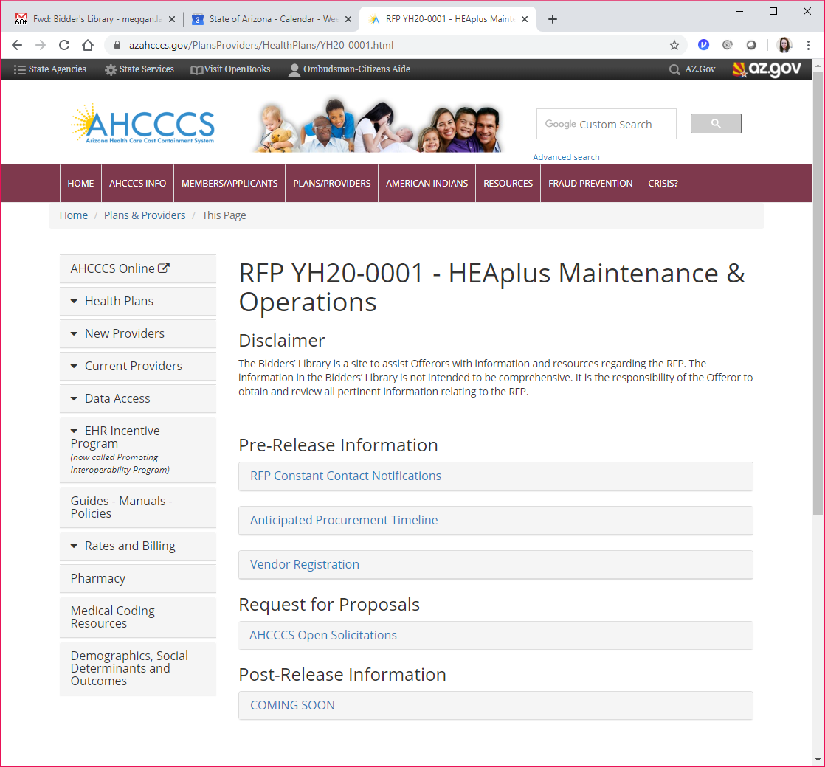
Bidder’s Library
After award, AHCCCS will post the Procurement File here.
Sign up for Constant Contact Notifications.

Slide 10
SFTP Server
The AHCCCS SFTP server
  To share sensitive background information with prospective Offerors; and
  As the required location for submission of proposals.
The deadline to request access : March 12, 2020

Slide 11
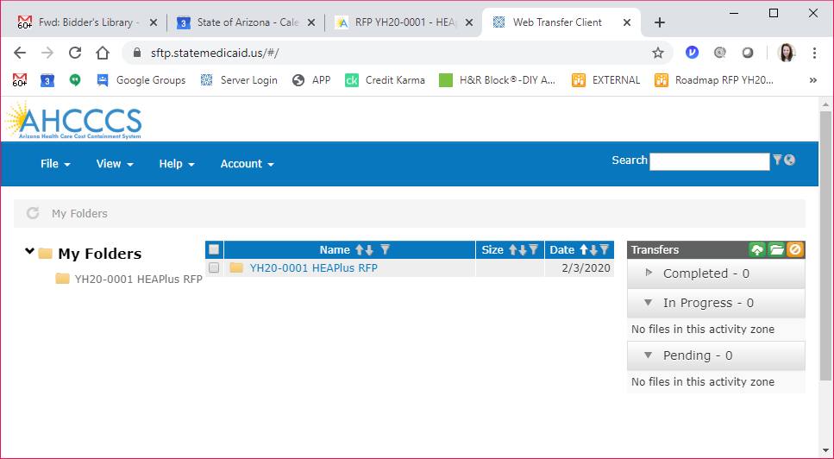
SFTP Server (cont.)

Slide 12
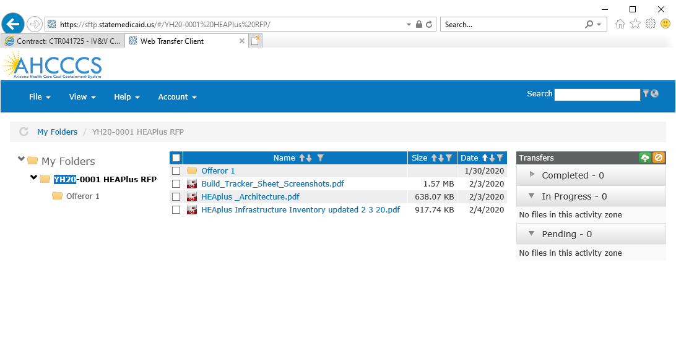
SFTP Server (cont.)
You should only see your company name here

Slide 13
Proposal Preparation
Please use the templates provided for Technical and Cost
Do not alter any templates
Use the file naming conventions when loading to SFTP
Submit all questions concerning this solicitation via email using the AHCCCS Q&A form found on the AHCCCS website by Friday February 7, 2020 5:00 PM to
procurement@azahcccs.gov

Slide 14
Proposal & Naming Conventions
  PART A
      A1 Transmittal Letter <Offeror’s Name>
      A2 Signed Offer and Acceptance Page <Offeror’s Name>
      A3 Signed Solicitation Amendment(s) <Offeror’s Name>
  PART B
      B1 Narrative Experience and Expertise <Offeror’s Name>
      B2 Narrative Methodology <Offeror’s Name>
      B3 Technical Proposal <Offeror’s Name>
      B4 Cost Proposal <Offeror’s Name>
  PART C
      C1 Intent to provide insurance <Offeror’s Name>
      C2 Legal Analysis for Confidential/Proprietary (if applicable) <Offeror’s Name>
      C3 Attestation of Boycott of Israel
      C4 Exceptions to any part of solicitation (if applicable) <Offeror’s Name>

Slide 15
Submission Confirmation
I.T. will confirm your ability to upload & download to the SFTP server well before due date
Proposal must be fully uploaded by 3pm on due date
RECOMMEND TO UPLOAD PRIOR TO ACTUAL DUE DATE
Procurement will confirm receipt of proposal received
Confirmation does not mean the proposal meets the submission requirements

Slide 16
Transmittal Letter
Brief summary of the Offeror’s ability to supply the requested services defined in the RFP
Statement indicating the Offeror’s willingness to provide the services subject to the terms and conditions set forth in the RFP
Signature of a person authorized to commit the Offeror to its representations
Principal point of contact
Summary of distinct portions of the proposal requested to be kept confidential

Slide 17
Mandatory Requirement
The Contractor must have a minimum of five (5) combined years of experience in maintaining, operating, and enhancing a highly-integrated (multiple eligibility programs) Affordable Care Act (ACA) /Medicaid eligibility and enrollment system
Indicate Conformation on Exhibit A Technical Proposal

Slide 18
Narrative Proposal - Experience/Expertise
Please use the structure and section headers as defined in Section 6.2 Narrative Proposal of the RFP
  Company History/Background and Experience
  Proposed Key Staff
Limited to 15 pages

Slide 19
Narrative Proposal – Methodology
Please use the structure and section headers as defined in Section 6.2 Narrative Proposal of the RFP
Address ALL sections
No inferences or assumptions will be made
No points will be assigned to contingent language such as “we are exploring”
Limited to 25 pages

Slide 20
Technical Proposal – Exhibit A
Please use the template provided
4 tabs:
  Action Required: Mandatory Qualifications, Requirements, SLAs
  Deliverables Table contains the monthly SLA penalties
The Offeror must acknowledge acceptance or denial of all requirements in Exhibit A – Technical Proposal, by responding in the column with a heading of “Agree?” (Column E)
  “Yes” means the Offeror agrees to comply with the requirement and “No” means the Offeror will not comply with the requirement

Slide 21
Cost Proposal – Exhibit B
Please use template provided
  Cost will be Scored
    Maintenance
    Operations
    Transition (Start Up)
    Automated Testing Tool
  Cost must be provided but will NOT be Scored
    Transition (Disengagement)
    Online Knowledge Management System
    Reporting Region

Slide 22
Evaluation Criteria
Proposals will be evaluated based upon the proven ability of the Offeror to satisfy the requirements in a cost-effective manner
The evaluation factors are listed in their relative order of importance. Any proposals not meeting the Mandatory Requirements will be disqualified
  Adherence to Mandatory Requirements – Pass/Fail
  Experience/Expertise
  Methodology
  Cost

Slide 23
Questions?
Reminder that verbal responses are not binding nor do they alter the RFP
Offerors are encouraged to submit questions formally in writing by Friday, Feb. 7 at 5:00pm

Slide 24
Contact
Meggan LaPorte
Chief Procurement Officer
AHCCCS
Email: procurement@azahcccs.gov
Phone: (602) 417-4538

