Slide 1
AHCCCS
February 20, 2013

Slide 2
AHCCCS Update
Trends
Governor’s Medicaid Coverage Proposal
RFP Update
Other Issues
30 Years of Medicaid Innovation
Our first care is your health care
Arizona Health Care Cost Containment System

Slide 3
FY 2013 Spending
3

Slide 4
AHCCCS Capitation Trends

Slide 5
Growth in National Health Expenditures and
Gross Domestic Product (GDP), 1985-2011
March 2001-
November 2001
Recession
July 1990-
March 1991
Recession
December 2007-June 2009
Recession
Annual Percent change
Calendar Years
SOURCE: Centers for Medicare & Medicaid Services, Office of the Actuary, National Health Statistics Group, U.S Department of Commerce, Bureau of Economic Analysis and National Bureau of Economic Research, Inc.
30 Years of Medicaid Innovation
Our first care is your health care
Arizona Health Care Cost Containment System

Slide 6
Medicaid: Growth in Enrollment and Total, Federal, and State & Local Expenditures, 2007 – 2011
SOURCE: Centers for Medicare & Medicaid Services, Office of the Actuary, National Health Statistics Group.
30 Years of Medicaid Innovation
Our first care is your health care
Arizona Health Care Cost Containment System
Notes:
6

Slide 7
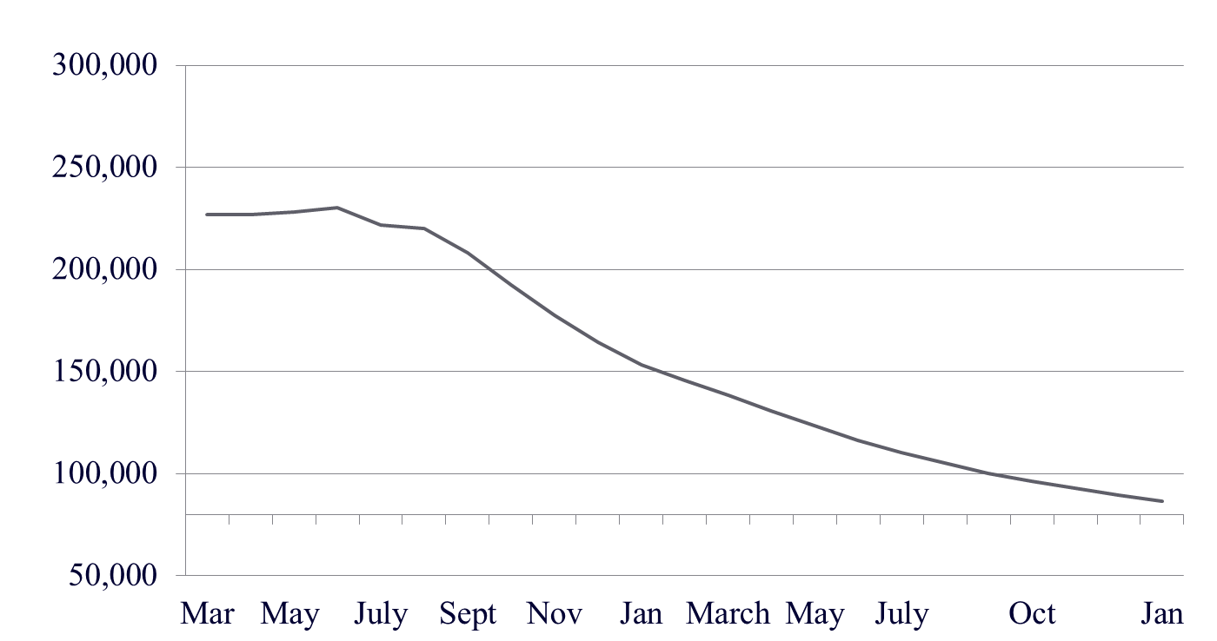
Childless Adult Population
7

Slide 8
Childless Adult Expenditure Data
Diagnosis | Members | Cost
Injuries/Trauma | 65,095 | $163 m
Heart - circulatory | 53,087 | $147 m
Digestive system disease | 52,921 | $112 m
Cancer | 18,766 | $76 m
Diabetes and kidney disease | 28,981 | $49 m
Respiratory Disease | 73,047 | $85 m
30 Years of Medicaid Innovation
Our first care is your health care
Arizona Health Care Cost Containment System

Slide 9
Governor’s Medicaid Decision
30 Years of Medicaid Innovation
Our first care is your health care
Arizona Health Care Cost Containment System

Slide 10
AHCCCS Coverage
In her State of the State Governor Brewer called for the legislature to restore Proposition 204 coverage and provide coverage up to 133%
This would provide coverage for about 300,000 statewide (about 30,000 American Indians)
Proposal would provide about $1.7 billion in federal funds to support healthcare in AZ
30 Years of Medicaid Innovation
Our first care is your health care
Arizona Health Care Cost Containment System

Slide 11
Medicaid and ACA Populations
400%
~
~
~
~
~
~
Medicare
100%
100%
100-133% FPL Estimated 57,000 to enroll
67%
67%
67%
67%
67%
67%
85%
Percentage of costs paid by federal government
30 Years of Medicaid Innovation
Our first care is your health care
Arizona Health Care Cost Containment System

Slide 12
Relatively Minor Tweak to Populations Already Covered by Arizona Voters
30 Years of Medicaid Innovation
Our first care is your health care
Arizona Health Care Cost Containment System

Slide 13
Local Medicaid Efforts
Item | Local Match | Federal Match
Safety Net Care Pool Maricopa | $36.7 million | $70.2 million
Safety Net Care Pool UMC & PCH | $77.2 million | $147.8 million
Phoenix Provider Tax | $109.0 million | $208.6 million
Total | $222.9 million | $426.6 million
These efforts end on 12/31/13

Slide 14
Medicaid Expansion Funding Impacts
 | FY 2014 | FY 2015 | FY 2016
State Match Increase | $27 million | $154 million | $105 million
Provider Assessment | ($82 million) | ($256 million) | ($224 million)
Increase in Existing Premium Tax | ($7 million) | ($34 million) | ($36 million)
Net Impact on GF | ($62 million) | ($136 million) | ($155 million)
Federal Match | $337 million | $1.556 billion | $1.712 billion

Slide 15
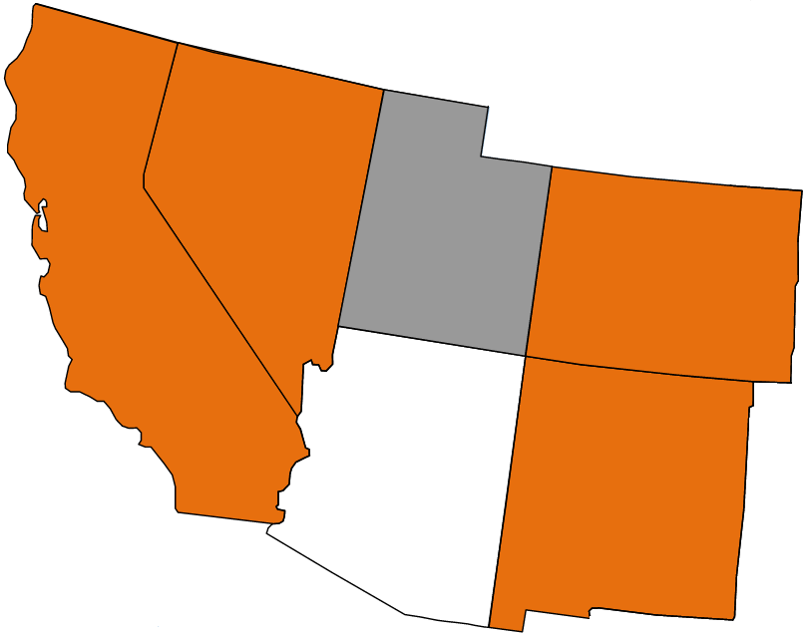
Expanding will Maintain Arizona’s
Economic Competitiveness
Almost all of Arizona’s neighboring states are expanding
Not expanding will expose Arizona to uncompensated care costs that will impact the cost and quality of care
This cost will hurt Arizona in economic competition with other states
Taxes from non-expanding states will fund Medicaid growth in expanding states creating a wealth shift
Expanding
Undecided
Expanding
Expanding
Expanding
30 Years of Medicaid Innovation
Our first care is your health care
Arizona Health Care Cost Containment System

Slide 16
AHCCCS Prop 204 Restoration and Medicaid Coverage
Honor the will of the Voters – twice have approved coverage for low income Arizonans – up to 100%
Keeps Arizona Economically competitive – Arizona families and businesses have to support uncompensated care – states that expand Medicaid have competitive advantage
Protect rural, safety net and healthcare infrastructure - AHCCCS is an integrated system and the impact of a continued freeze will be dramatic on the delivery system all Arizonans enjoy
AHCCCS part of sustainability solution – Healthcare financing is a national policy dilemma that requires a federal solution – AHCCCS is nationally recognized system and similar efficiency levels should be achieved elsewhere
Achieve healthier Arizona – New England Journal of Medicine found AHCCCS expansion saved lives and coverage also supports lower costs of care for patients
30 Years of Medicaid Innovation
Our first care is your health care
Arizona Health Care Cost Containment System

Slide 17
Population Fiscal Summary (FY 16)
Population | FPL | Est. # | State Cost | Total
Children 6-18 | 100-133 | 44,000 | $33 m | $124 m
Eligible not enrolled | 0-133 | 137,000 | $225 m | $656 m
Childless Adult Restoration | 0-100 | 154,000 | $170 m | $1.4 B
Childless Adult not previously enrolled | 0-100 | 33,600 | $37 m | $306 m
Optional Parent Expansion | 100-133 | 42,000 | $0 | $289 m
Optional Childless Adult Expansion | 100-133 | 18,000 | $0 | $165 m
30 Years of Medicaid Innovation
Our first care is your health care
Arizona Health Care Cost Containment System
17
17
17
17
17

Slide 18
Medicaid Coverage Protections
Circuit Breaker – proposal includes requirement that if federal funding decrease below 80% for childless adults coverage terminates
Funding Source –
  Executive proposal includes hospital assessment to cover state costs associated with Prop 204
  Replace City of Phoenix assessment
  Consultant Retained (Navigant)
  NF Assessment passed last year
Pursue payment modernization opportunities

Slide 19
AHCCCS is part of the Solution
Conservative managed care principles based on competition and choice
“Gold Standard” for managed care
Error rates well below national average
Quality performance measures above national averages
#1 ranking nationally for Medicaid Developmentally Disabled program – United Cerebral Palsy 2012 Report
High member satisfaction – less than 3% switch plans
Strong Competition to participate in the program
One of the highest rates of community placement nationally for those at risk of institutionalization
National leader in Integrated delivery system for Dual eligible
Very strong provider participation rates

Slide 20
Legislative Reaction
30 Years of Medicaid Innovation
Our first care is your health care
Arizona Health Care Cost Containment System

Slide 21
Other ACA Updates
Recent Eligibility Rule released – comments due soon
Work on Health E-Arizona continues
Working to determine interface requirements and costs with FFE
Working with DES on staff and consumer training for post 1-1-14 world

Slide 22
Exchange Timeframes
September 2012: Essential Benefits decision
December 2012: Governor deferred to Federal Exchange – 25 states in this model
January 2013: HHS Secretary Certifies Exchange
July 2013: Systems Readiness Testing
October 2013: Exchange enrollment begins
January 2014: Exchange coverage begins
January 2015: Exchange must be self-sustaining through user fees, assessments or other funding sources
30 Years of Medicaid Innovation
Our first care is your health care
Arizona Health Care Cost Containment System

Slide 23
Triple Crown Procurements
October 1, 2013 start date for potentially 5 years
Maricopa RBHA – $5 billion plus
Statewide Acute Care – roughly $33 billion (with expansion)
CRS Program - $1.0 billion

Slide 24
Maricopa RBHA RFP
5 Responders to RFP – Magellan – United – Cenpatico – Mercy Maricopa Integrated – Partners in Integrated Health
RFP includes care coordination with information moving between AHCCCS plans and RBHAs
DHS and AHCCCS are collaborating on readiness reviews and member transition plan – leveraging best experiences of both
Winning plan will also receive utilization information

Slide 25
Duals Demonstration Update
AHCCCS submitted Demonstration Proposal to CMS for:
  ALTCS EPD –1-1-14 – Existing Contractors – Statewide
  Maricopa Members with SMI – 1-1-14
  Acute Care Members – 1-1-14 – Statewide
GOAL: 1-1-14 - 100,000 dual eligible individuals will be in an integrated plan
AHCCCS on Dual Track for Duals – If no Demo plans must be SNPs
Recent Letter on web to CMS stating concerns – decision by April
  January 1, 2014 cannot slip
  What happens in 3 years – path forward
  Capitation Rates – Supplemental Benefits
Sending letter to HCBS members - unaligned

Slide 26
RFP Milestone Dates
Activity | Date
RFP Issued | November 1, 2012
Prospective Offerors’ Conference and Technical Interface Meeting | November 9, 2012
First Set of Technical Assistance and RFP Questions Due | November 14, 2012
RFP Amendment Including Responses to RFP Questions Issued On or Before | November 27, 2012
Second Set of Technical Assistance and RFP Questions Due | December 10, 2012
Second Amendment Including Responses to RFP Questions Issued On or Before | December 19, 2012
Proposals Due by 3:00 p.m. Arizona time | January 28, 2013
Contracts Awarded On or Before | March 22, 2013
Readiness Reviews Begin On or After | April 1, 2013
New Contracts Effective | October 1, 2013
26
26
26
26
26

Slide 27
AHCCCS Payment Modernization
Plan Integration –
ALTCS Shared Savings Proposals
Acute Plans – Shared Savings RFP Requirements
Inpatient APR DRG
Start seeking more stakeholder input
Asked specific questions as part of RFP on payment strategies

Slide 28
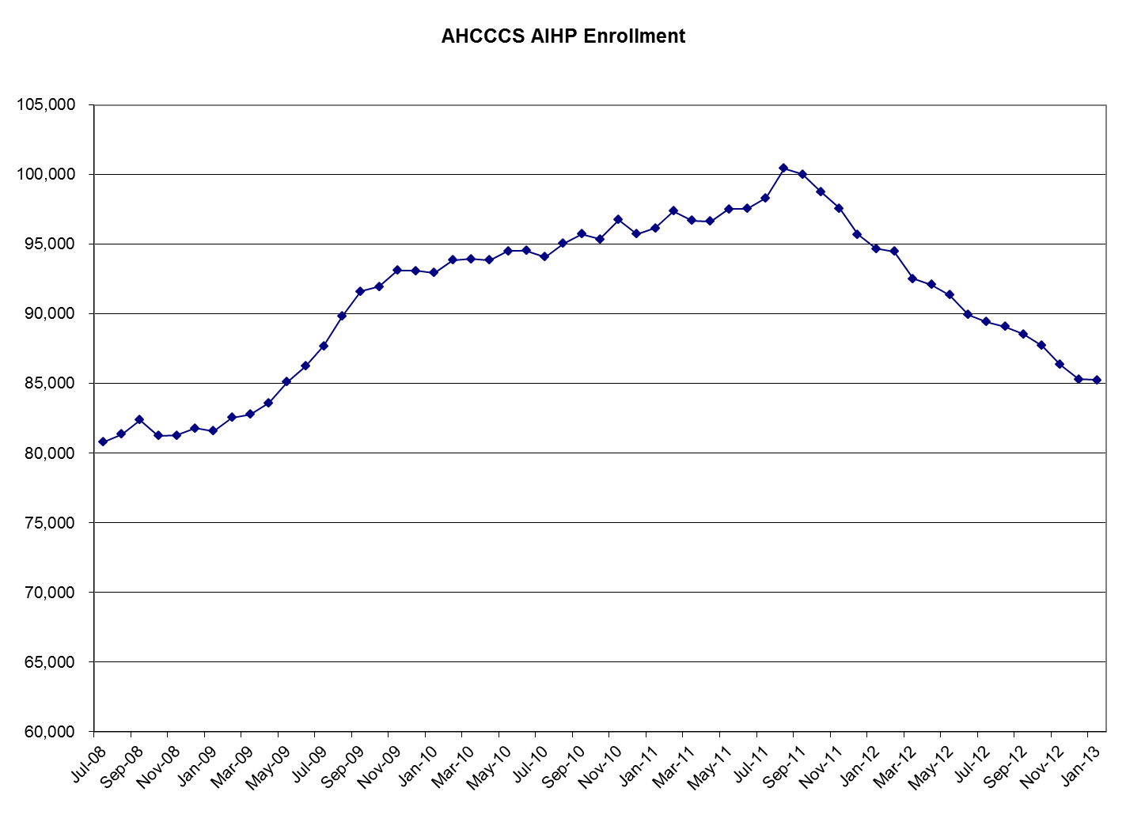
30 Years of Medicaid Innovation
Our first care is your health care
Arizona Health Care Cost Containment System

Slide 29
DFSM Care Coordination Strategies
Care Management Coordinator Goal - Improve health outcomes by reducing readmissions and increase use of primary care services
AHCCCS working with 3 populations Post IP stay
Long Term Care – contacting tribal case manager (1,053 in non I.H.S/638 facility last year)
Newborns – contacting moms to coordinate pediatric visit (1,213 born in 9 non I.H.S/638 facilities last year)
Diabetic Patients – connecting member back to I.H.S & 638 system
Looking to share utilization data with Health plans
Notes:
1,213 American Indians were born in 9 non I.H.S and 638 facilities during past year
1,053 American Indian Long Term Care members had an inpatient stay in non I.H.S and 638 facilities last year
Goal - Improve health outcomes by reducing readmissions and increase use of primary care services

Slide 30
AHCCCS GME Funding

Slide 31
AHCCCS Sunset
  Sunset Audit Process – See handout
      TPL/COB – “AHCCCS processes help meet federal and state requirements…” - minimal findings
      Eligibility – “findings of a 1.1% error rate are commendable …particularly when compared to the …national eligibility error rate of 6.7%” (AHCCCS response)
      Medicaid Fraud – “AHCCCS has processes in place to detect Medicaid fraud and abuse but should continue to enhance its training and data analysis”
    Sunset Factors – “Auditors’ analysis of the sunset factors found strong performance by AHCCCS with regard to many of these factors”
  Next Step – Legislation making way through process

Slide 32
AHCCCS Staffing Levels

Slide 33
Other Issues
NF Assessment – In progress
HIT payment – Exceed $100 m to date
KidsCare II > 25,000
State Trainings
  7 State Training through NAMD – another session early summer
    Maine – NE – NM – DC – Utah – IN - VI
  California – CMS –
  SC – PA – FL - AL

Slide 34


