Slide 1
AHCCCS Update

Slide 2
AHCCCS Coverage
In her State of the State Governor Brewer called for the legislature to restore Proposition 204 coverage and provide coverage up to 133%
This would provide coverage for about 300,000 statewide
Proposal would provide about $1.7 billion in federal funds to support healthcare in AZ
Circuit Breaker – proposal includes requirement that if federal funding decrease below 80% for childless adults coverage terminates
Funding Source – Executive proposal includes hospital assessment to cover state costs associated with Prop 204 – Replace City of Phoenix assessment
30 Years of Medicaid Innovation
Our first care is your health care
Arizona Health Care Cost Containment System

Slide 3
Who are the Childless Adults
Diagnosis Group | Estimated Patient Numbers Using December 2013 Projected Enrollment (63,212)
Infectious (E.G. HIV, Hepatitis) | 13,870
Cancer | 4,701
Metabolic diseases and immunity disorders (Diabetes) | 16,684
Blood and Blood-forming organs (Anemia, hemophilia) | 2,590
Mental Illness | 17,309
Nervous System and Sense Organ Diseases | 18,232
Heart and Circulatory System Diseases | 17,254
Respiratory Diseases | 21,082
Kidney Diseases | 15,084
Injury and Poisoning | 16,196
Patient Numbers forecasted based on caseloads prior to the Impact of the Enrollment Freeze and Estimated Patient Numbers for December 2013. Includes only examples and is not an exhaustive list of AHCCCS payments. Additional information on this study is available at www.azahcccs.gov.
30 Years of Medicaid Innovation
Our first care is your health care
Arizona Health Care Cost Containment System
3

Slide 4
Impact to Arizonans
Working Childless Adult age 55 – “I was born and raised in Arizona, lived here all my 55 years. I have worked and raised a family. I have come down with Hep C and if I don’t get treatment I will die. I can’t work full time any longer because of my illness. I can’t afford treatment. I guess I don’t have a choice but to die thanks to this state I have called home all my life. Still working part time paying into the system, just waiting to die.”
14 County Sheriffs sent a letter on Feb 11th – “Deputies in the field are also seeing the impacts of the untreated mental health conditions among those who no longer qualify for AHCCCS/Medicaid. Formerly stable people with mild to moderate mental health disorders are taxing the resources of deputies, often unnecessarily…“Making AHCCCS/Medicaid services more accessible to more Arizonans who are struggling economically will benefit the communities as a whole, as well as public safety in general. Thus we support your proposal…”
30 Years of Medicaid Innovation
Our first care is your health care
Arizona Health Care Cost Containment System
4

Slide 5
State Only Childless Adult Program
Fiscal Year | Legislative Estimates | AHCCCS/OSPB Estimates
FY 2014 | $118 million | $200 million
FY 2015 | $181 million | $353 million
FY 2016 | $137 million | $310 million
Three-Year Total | $436 million | $863 million
30 Years of Medicaid Innovation
Our first care is your health care
Arizona Health Care Cost Containment System
5

Slide 6
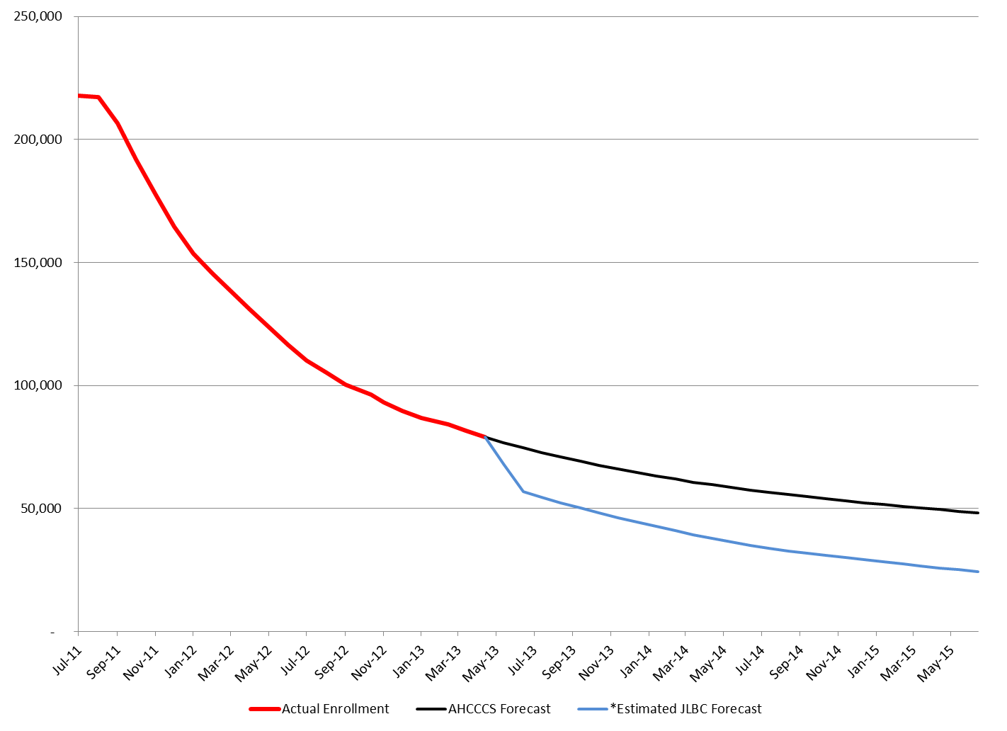
State only Program
30 Years of Medicaid Innovation
Our first care is your health care
Arizona Health Care Cost Containment System
6

Slide 7
AHCCCS Prop 204 Restoration and Medicaid Coverage
Honor the will of the Voters – twice have approved coverage for low income Arizonans – up to 100%
Keeps Arizona Economically competitive – Arizona families and businesses have to support uncompensated care – states that expand Medicaid have competitive advantage
Protect rural, safety net and healthcare infrastructure - AHCCCS is an integrated system and the impact of a continued freeze will be dramatic on the delivery system all Arizonans enjoy
AHCCCS part of sustainability solution – Healthcare financing is a national policy dilemma that requires a federal solution – AHCCCS is nationally recognized system and similar efficiency levels should be achieved elsewhere
Achieve healthier Arizona – New England Journal of Medicine found AHCCCS expansion saved lives and coverage also supports lower costs of care for patients
30 Years of Medicaid Innovation
Our first care is your health care
Arizona Health Care Cost Containment System

Slide 8
Policy Options
Options | Lives covered | GF Impact (FY 14-16) | Federal $ available | Prop 204 Vote Honored
Governor’s Proposal | 300,000 | $(100) m savings | $4.1 billion | Yes
Continued Freeze (assume state only) | 63,000 and shrinking | $850 m plus cost | $0 | No
Terminate Coverage 1-1-14 | 0 (63,000 lose coverage) | $0 | $0 | No
30 Years of Medicaid Innovation
Our first care is your health care
Arizona Health Care Cost Containment System
8

Slide 9
AHCCCS Future Strategies

Slide 10
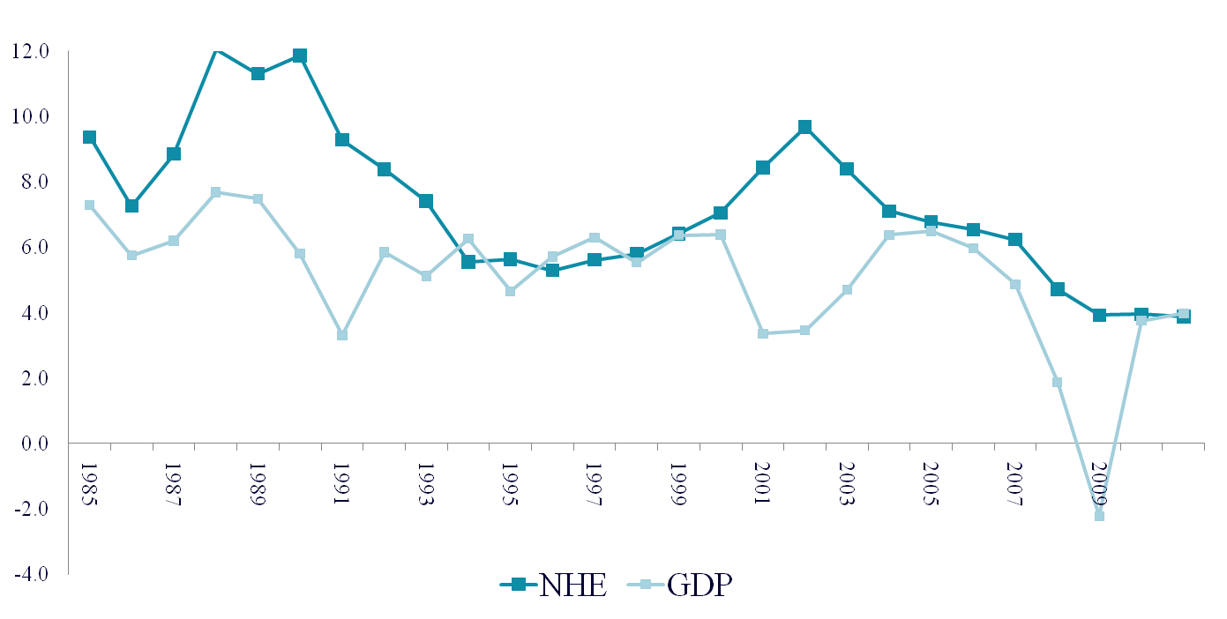
Growth in National Health Expenditures and
Gross Domestic Product (GDP), 1985-2011
March 2001-
November 2001
Recession
July 1990-
March 1991
Recession
December 2007-June 2009
Recession
Annual Percent change
Calendar Years
SOURCE: Centers for Medicare & Medicaid Services, Office of the Actuary, National Health Statistics Group, U.S Department of Commerce, Bureau of Economic Analysis and National Bureau of Economic Research, Inc.
30 Years of Medicaid Innovation
Our first care is your health care
Arizona Health Care Cost Containment System
10
Notes:
10

Slide 11
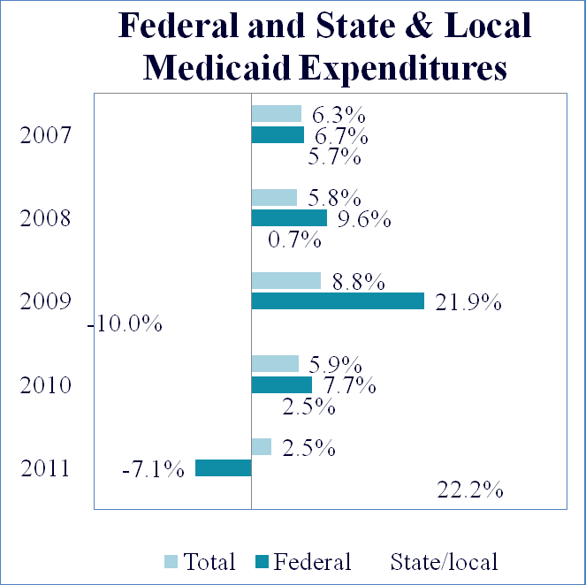
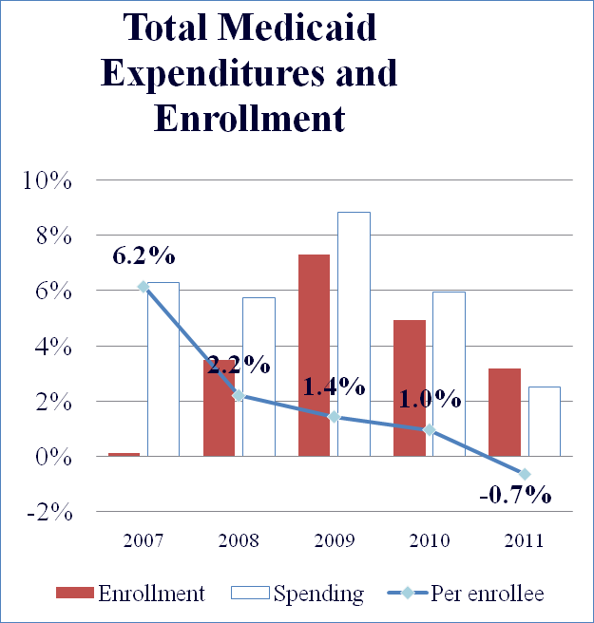
Medicaid: Growth in Enrollment and Total, Federal, and State & Local Expenditures, 2007 – 2011
SOURCE: Centers for Medicare & Medicaid Services, Office of the Actuary, National Health Statistics Group.
30 Years of Medicaid Innovation
Our first care is your health care
Arizona Health Care Cost Containment System
11
Notes:
11

Slide 12
Percent of Gross Domestic Product
Source: Congressional Budget Office, The Long-Term Budget Outlook, June 2010, revised August 2010

Slide 13
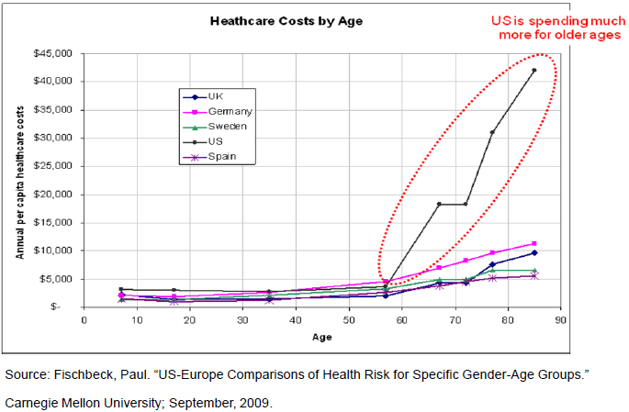
What’s Wrong With This Picture?
Notes:
Paul Fischbeck from Carnegie Mellon assembled this data. Researchers seem to agree the data is accurate, but don’t have a common viewpoint on why this occurs. There is some concensus that our health condition is worse entering age 65 but we are better than other countries at overcoming lifestyle choices we made earlier in life, in particular obesity. Another view is more primary care and fewer specialists and hospitals in other developed countries

Slide 14
Regardless of ACA Decisions- Unsustainable System
Institute of Medicine - $750 Billion in “Waste”
  $210 B Unnecessary Procedures
  $130 B Inefficient Care
  $190 B Excess Admin
  $105 B Inflated Prices
  $55 B Prevention Failures
  $75 B Fraud
IOM Solutions – Science and Informatics – Engage and Empower Patients – Align Incentives – Transparency – Culture of Leadership and Learning

Slide 15
U.S. Healthcare System
System – an assemblage or combination of things or parts forming a complex or unitary whole
Care delivery has become increasingly fragmented, leading to coordination and communication challenges for patients and clinicians.
Improved patient engagement is associated with better patient experience, health, and quality of life and better economic outcomes, yet patient and family participation in care remains limited.
The prevailing approach to paying for health care, based predominantly on individual services and products, encourages wasteful and ineffective care.

Slide 16
Where have we been?
Administered largest cuts (percentage) of any Medicaid system nationally
Preserved the core
  Services for members
  Providers in the system
  Plans wanting to compete for AHCCCS business
  Administrative capacity to manage the program
Managed Triple Crown Process

Slide 17
Where are we going?
AHCCCS Strategic Direction
Implement Governor’s Coverage Proposal
Develop strategies that leverage the AHCCCS Managed Care Model to bend the cost curve and improve health care outcomes
Recognize many strategies currently being pursued nationally have been implemented in Arizona
  Managed care for long term care population
  Home and community based placement
  Dual member alignment

Slide 18
Help shape the future of AHCCCS

Slide 19
AHCCCS Goals
Bend the cost curve while improving the delivery and coordination of care
Pursue continuous quality improvement
Reduce fragmentation in healthcare through integrating delivery systems
Maintain core organizational capacity, infrastructure and workforce

Slide 20
Goal 1 - Bending the cost curve
Achieve Program Integrity Plan goals
Implement ALTCS/Acute shared savings requirements
Establish robust payment modernization stakeholder input opportunities
Evaluate and potentially adopt Medicare-like payment strategies targeting quality and aligning incentives
Commit Executive level resources towards substantive system payment modernization

Slide 21
PI Strategies
Establish collaborative constructive CMS partnership for data/resources
  Medicare Investigation data
  Medicare Part A, B, D
  Streamline and improve numerous federal entities involved in audit process
  Streamline/coordinate provider screening
Work with CMS on new PI efforts with Exchange and ACA
NEMT Task Force
Work with plans on continued efforts

Slide 22
Goal 2- Pursue continuous quality improvement
Promote and evaluate access to care
Improve measures for populations served through integrated delivery system
Achieve statistically significant improvements on PIPs
Achieve statistically significant improvement on quality measures
Leverage American Indian care management program to improve outcomes

Slide 23
Success of PIPs
Measure | Years | Baseline | Final
Influenza vaccine refusal | 2007-12 | 59.4% | 36.2%
Report vaccines to ASIIS | 2005-08 | 74.2 | 88.2
3-8 year old dental visits | 2003-08 | 52.2 | 65.4
HBA1C | 2001-04 | 60.8 | 79.5
Advanced Directives | 2008-10 | 41.8 | 64.7
Appropriate pharmacological therapy - asthma | 2006-10 | 81.1 | 96.3

Slide 24
Goal 3-Reduce fragmentation in healthcare through integrating delivery systems
Align and integrate model for CRS, SMI and dual eligible members
Build care coordination opportunities in the AHCCCS system
Build analytics into actionable solutions
Leverage HIT investments to create more data flow in healthcare delivery system

Slide 25
Triple Crown Procurements
October 1, 2013 start date for potentially 5 years
Maricopa RBHA – $5 billion plus – Integrated System for members with SMI
Statewide Acute Care – roughly $33 billion (with expansion)
CRS Program - $1.0 billion – Integrate program
Competition - Rates down 2.8% - roughly $100 m in year 1
Total 3 bid protests – 2 RBHA – 1 acute
Transition – 171,000 members – Maricopa RBHA
Integration results much broader – Maricopa RBHA - CRS

Slide 26
Future Integration Opportunities
Greater AZ RBHA
  Engage in stakeholder/community dialogue
  Further integration for members with SMI?
  Opportunities for Children? CMDP? GMH/SA?
CRS
  Engage in stakeholder dialogue
  Determine timing and opportunity for members with a Developmental Disability
  Ability to establish choice option?
Continue to pursue opportunities to share data

Slide 27
Duals Demonstration Update
May 2012 AHCCCS submitted Demonstration Proposal to CMS for:
  ALTCS EPD – Maricopa Members with SMI - Acute Care
GOAL: 1-1-14 - 100,000 dual eligible in an integrated plan
RFP Dual Track for Duals – If no Demo plans must be SNPs
January 2013 letter to CMS stating concerns – decision by April
  January 1, 2014 cannot slip - What happens in 3 years – path forward
  Capitation Rates
April letter to CMS withdrawing from demonstration
State will pursue other alignment initiatives –
  Leverage DSNP model – work with other states NAMD
  Member education
  Evaluate integration of BH services for GM/SA – 2014 or 2015
  Leverage Medicare part A, B, D and D-SNP data

Slide 28
Care Coordination Opportunities
Medicare Data – Parts A, B, C and D
Behavioral health encounter data moving to AHCCCS plans
Physical health encounter data moving to RBHAs
Other encounter data shared for non-integrated members – DD – CRS – CMDP
Medicaid and Exchange member churn?
Data on I.H.S and 638 facility usage

Slide 29
HIT Adoption
Arizona use of E.H.Rs
  2007-2009 – 45%
  2009-2011 - 52%
  2012 – 78%
E-trends 2011 to 2012
  % of new/renewal prescriptions e-RX 34% to 61%
  % of physicians actively e-RX 48%-57%
  % of hospitals sharing electronic care summaries with unaffiliated providers 26%-56%

Slide 30
Health Information Technology
E.H.R Incentive Payment Systems – Medicare almost $100 m
Medicaid HIT Payments – $122 m to date
  1,633 Eligible providers - $34.0 m
  79 hospitals $88 m
Objectives
Participate with plans in Health Information Network of AZ as the entity moves toward implementation
Move majority of providers through MU continuum
Work on pilot opportunities for American Indian HP
Determine strategies around continued adoption for E-prescribe which may include reimbursement incentives/penalties

Slide 31
Data Analytics
Agency recently completed upgrade of data warehouse tools
Goal - Develop strategies to build data analytic capacity, determine best way to leverage data to create information and expand role to thought leader in use of Medicaid data analytics
Strategies
Enhance training efforts to better leverage tools through agency
Establish workshops by external experts to develop capacity of agency to leverage resources
Expand tools to cover Quality measures and HEA + requirements

Slide 32
Goal 4 - Maintain core organizational capacity, infrastructure and workforce
Strengthen and achieve information system security and compliance
Implement mandated IT infrastructure modifications
Continue to recruit and retain engaged workforce dedicated to the AHCCCS mission
Pursue continued deployment of electronic solutions to reduce healthcare admin burden

Slide 33
IT Support
Strategies
Continue developing culture of constant discipline around security of data/information
Implement recommendations from consultants
Move infrastructure to ADOA
Implement ICD-10 – other mandates
Continue system refresh
Leverage additional opportunities with Hawaii
Need to start thinking about future of PMMIS

Slide 34
Employee Engagement and Results
30% workforce is Virtual Office
4.7 engaged employees per 1 disengaged – statewide average is 1.6 employees
2013 Employee Survey Overall
19 Up (8 questions over 2011) – 7 Down
Top 3
98.1% - I respect and value members of my team
97.1% - I believe in the AHCCCS mission
94.7% - I understand clearly what is expected from me
92.4% are proud to be an AHCCCS employee

Slide 35
HEA + ACA Eligibility Changes
AHCCCS currently receives roughly 40% of applications through Web
ACA Eligibility Strategies
By October 1, 2013 – implement Phase I of HEA + including MAGI requirements and FFM interface
By 12-31-15 Implement HEA + Phase II integrating other systems like ACE
Manage new joint governance with DES
Stabilize system and work to meet customer expectations
Ensure timely availability of system data

Slide 36
Value of MCO – Positioned to put SYSTEM into Healthcare System
Integration and alignment of all services for frail dual members provides opportunity to leverage full potential of MCOs -
Leverage Data and turn to knowledge/information
Seamless transition of care across settings
Health Risk assessment tools
Clinical support analytics, predictive modeling and care management staff to address
Work with providers in getting them actionable data
Serves as single entity accountable for outcomes of member

Slide 37
MCO Expectations – continue evolution
Manage RFP transitions seamlessly
Continue health homes expansion
Leverage data, tools and capabilities for providers to take action
Maximize care management potential offered through integration and alignment – evaluate outcomes
Generate improved member outcomes through engaging member/family
Improve provider experience
Shift payment emphasis to align incentives with outcomes

Slide 38
Six month progress updates
Meet individually with plans every six months with AHCCCS executives to establish dialogue
Evolving agenda
Update on RFP commitment
Update on payment modernization opportunities
Evaluate quality measures
Evaluate any operating issues
Provide update on system innovations and strategies that are being deployed to move system forward
Update on network challenges/opportunities
Update on leveraging new care coordination data

Slide 39


