Slide 1
AHCCCS Pharmacy and Therapeutics Committee
January 25, 2023

Slide 2
Welcome and Introductions
Suzanne Berman, RPh, AHCCCS Pharmacy Director
  October 19, 2022 - P&T Minutes Review and Vote

Slide 3
Retrospective Drug Utilization Review
(Retro-DUR) Proposals
Amanda Kiriakopoulos, PharmD
FFS Medicaid Associate Director, Clinical Consulting, OptumRx

Slide 4
Retro-DUR Process

Slide 5
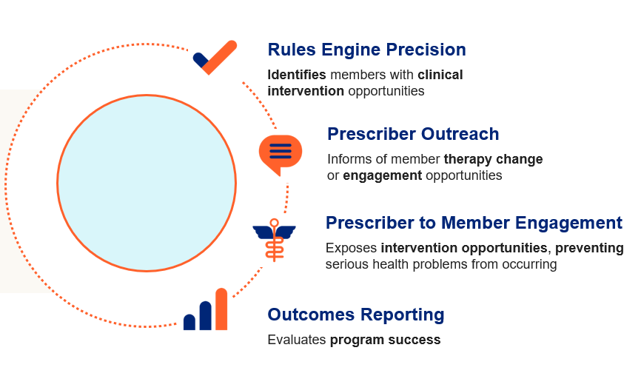
Retro-DUR Process
Prescriber outreach via near real-time fax
  72 hours after claim identified and maintained
Letters suppressed for four months
Retro-DUR call center available for questions and discussion

Slide 6
Retro-DUR Proposal #1
Insulin Therapy Without Blood Glucose Testing Supplies

Slide 7
Retro-DUR Proposal – Insulin Therapy Without Blood Glucose Testing Supplies
American Diabetes Association states that glucose monitoring is the key to achieving glycemic targets especially in patients utilizing insulin and prone to hypoglycemia¹
Monitoring blood glucose can guide medical management through:
  Diet
  Exercise
  Medication therapy
  Prevention of hypoglycemic episodes¹
Better glycemic control leads to better overall patient outcomes and decreased patient mortality¹
1. American Diabetes Association. Glycemic Targets: Standards of Medicaid Care in Diabetes – 2021. https://care.diabetesjournals.org/content/44/Supplement_1/S73. Accessed January 2023.

Slide 8
Retro-DUR Proposal – Statistics
Claims data for members with a claim for insulin therapy were reviewed from November 1, 2021 – November 30, 2022
During the reporting period, 6,350 unique members were identified as an insulin therapy utilizer
  Of those, 1,607 members did not have blood glucose testing supplies claims during the reporting period
  75% of patients utilizing blood glucose testing supplies while on insulin therapy

Slide 9
Patients Utilizing Insulin Therapy Without Blood Glucose Testing Supplies Retro-DUR Rule Properties
Member demographics
  All ages
  Both genders
All prescriber types
Insulin therapy without a claim for blood glucose testing supplies in the past year
Negating diagnoses (within the past 365 days)
  None
Negating drug therapy (claims within the past 180 days)
  None
Outcomes measures
  Blood Glucose testing supplies added to therapy

Slide 10
Retro-DUR Proposal #2
Diabetic Patients Not Utilizing Statin Therapy

Slide 11
Retro-DUR Proposal – Diabetic Patients Not Utilizing Statin Therapy
The American College of Cardiology/American Heart Association (ACC/AHA) recommend the use of moderate-intensity statins in patients 40 to 75 years of age with diabetes mellitus and an LDL-C level of >/-70mg/dL without ASCVD risk¹
  In patients 50-70 years with multiple ASCVD risk factors, it is reasonable to utilize high-intensity statin therapy²
High-intensity statins are recommended for patients with diabetes and atherosclerotic cardiovascular disease²
Combination therapy of statin with niacin or fenofibric acid is generally not recommended¹
1. Grundy SM, Stone NJ, Bailey AL, et al. 2018 AHA/ACC/AACVPR/AAPA/ABC/ACPM/ ADA/AGS/APhA/ASPC/NLA/PCNA guideline on the management of blood cholesterol: a report of the American College of Cardiology/American Heart Association Task Force on Clinical Practice Guidelines. 10 Nov 2018. https://doi.org/10.1161/CIR.0000000000000625, Circulation. 2019;139:e1082–e1143.
2. American Diabetes Association. Cardiovascular Disease and Risk Management: Standards of Medical Care in Diabetes – 2021. 04 Dec 2020. https://doi.org/10.2337/dc21-S010, Diabetes Care. 2021; 44(Supplement_1):S125-S150.

Slide 12
Retro-DUR Proposal – Statistics
Claims data for members with a claim for insulin therapy were reviewed from November 1, 2021 – November 30, 2022
During the reporting period, 16,343 unique members were identified as utilizing diabetic therapy
  Of those, 8,937 members did not have statin therapy claims during the reporting period
  Only 45% of diabetic patients (patients utilizing diabetic therapies) utilizing statin therapy

Slide 13
Diabetic Patients Not Utilizing Statin Therapy Retro-DUR Rule Properties
Member demographics
  Ages 39 - 74
  Both genders
All prescriber types
Diabetic Therapy without statin or combination product therapy
Negating diagnoses (within the past 365 days)
  None (as medical claims not received)
Negating drug therapy (claims within the past 180 days)
  Clomiphene
Outcomes measures
  Statin therapy added

Slide 14
Amanda Kiriakopoulos, PharmD –
FFS Medicaid Associate Director, Clinical Consulting
Amanda.Kiriakopoulos@optum.com

Slide 15
Magellan Class Reviews
Classes for Review: Non-Supplemental Rebate Class Review
Androgenic Agents
Antidepressants, Other
Antidepressants, SSRIs
Antivirals, Topical
Bone Resorption Suppression and Related Agents
Bronchodilators, Beta Agonists
Colony Stimulating Factors
Enzyme Replacement, Gaucher Disease
Erythropoiesis Stimulating Proteins
Hypoglycemics, Alpha Glucosidase Inhibitors
Hypoglycemics, Metformins
Hypoglycemics, SGLT2s
Immune Globulins
Oncology, Oral – Hematologic
Ophthalmics, Anti-inflammatory/Immunomodulators
Otic Antibiotics
PAH Agents, Oral and Inhaled
Thrombopoiesis Stimulating Agents
Ulcerative Colitis

Slide 16
Magellan Drug Class Reviews
Hind Douiki, Pharm.D.
and
Jonas Terry, Pharm.D.

Slide 17
Androgenic Agents

Slide 18
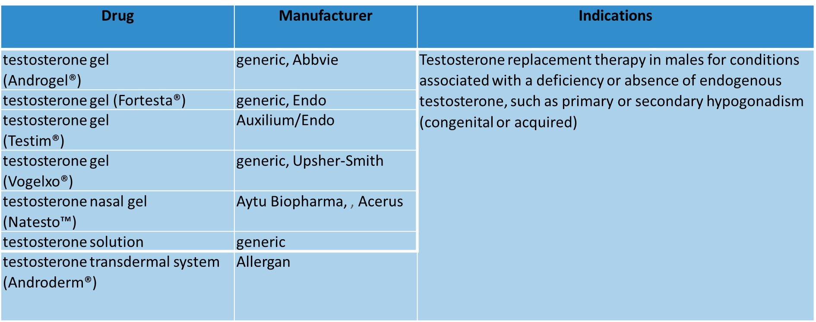
Androgenic Agents

Slide 19
Androgenic Agents
Male hypogonadism is caused by insufficient production of testosterone and characterized by low serum concentrations
Hypogonadism may present as testosterone deficiency, infertility, or both
Transdermal delivery of testosterone is appealing to some patients as it is convenient to use and eliminates frequent office visits often required by injectable testosterone
The 2002 treatment guidelines for hypogonadism published by the American Association of Clinical Endocrinologists (AACE) advise that testosterone replacement therapy can enable the patient to function in a more normal manner and decrease the risk of future associated problems

Slide 20
Androgenic Agents
The 2018 Endocrine Society (ES) treatment guidelines for hypogonadism recommend a diagnosis of hypogonadism be made only if the patient has symptoms of testosterone deficiency, with clear and consistently low serum testosterone (T) levels
Serum testosterone, hematocrit, and prostate cancer risk should be monitored during the first year of treatment
The ES provides advantages and disadvantages of each formulation, but no preference for any testosterone replacement product is provided
Choice of formulation should be based on patient preference and drug pharmacokinetics, adverse effect profile, treatment burden, and cost

Slide 21
Androgenic Agents
The 2018 American Urological Association (AUA) provides a treatment algorithm for evaluating and managing testosterone deficiency
Topical and injectable formulations can be considered without preference for one product over another
In 2020, the American College of Physicians (ACP) published a clinical guideline on testosterone treatment for adult men with age-related low testosterone to improve sexual function
They recommend against initiating testosterone therapy for improvement of energy, vitality, physical function, or cognition in men with age-related low T

Slide 22
Androgenic Agents
In May 2009, FDA issued a safety alert for testosterone gel products due to reports of children experiencing adverse effects after unintended exposure to testosterone through contact with individuals being treated with these agents
As a result, all gel and solution products carry a boxed warning on virilization of children following secondary exposure
The FDA issued a warning that prescription testosterone products are approved only for men who have low testosterone levels caused by certain medical conditions

Slide 23
Androgenic Agents
In 2015 the FDA stated that there is a possible increased cardiovascular risk associated with testosterone use
In response, AACE/American College of Endocrinology (ACE) issued a position statement indicating that the correlation of cardiovascular risk may be due to low testosterone serving as a marker of cardiovascular disease rather than testosterone supplementation as a causative facto
The gel and solution formulations of testosterone have demonstrated a lower incidence of adverse reactions related to administration compared to the patches
All testosterone products are Schedule III controlled substances

Slide 24
Androgenic Agents
Product Update:
The FDA has reported AbbVie will be discontinuing certain NDCs for brand-name Androderm in the strengths of 2 mg/day and 4 mg/day
The other NDCs for these strengths will remain available

Slide 25
Antidepressants, Other

Slide 26
Antidepressants, Other
Drug | Manufacturer | Major Depressive Disorder (MDD) | Generalized Anxiety Disorder (GAD) | Social Anxiety Disorder (SAD) | Panic Disorder | Other Indications
bupropion HBr (Aplenzin®) | Valeant/Bausch | X | -- | -- | -- | --
bupropion HCl ER (Forfivo XL®) | generic*, Almatica | X | -- | -- | -- | --
bupropion HCl ER (Wellbutrin® XL) | generic, Valeant/Bausch | X | -- | -- | -- | prevention of major depressive episodes associated with seasonal affective disorder
bupropion HCl IR | generic | X | -- | -- | -- | --

Slide 27
Antidepressants, Other
Drug | Manufacturer | Major Depressive Disorder (MDD) | Generalized Anxiety Disorder (GAD) | Social Anxiety Disorder (SAD) | Panic Disorder | Other Indications
bupropion HCl SR (Wellbutrin® SR) | generic, GlaxoSmithKline | X | -- | -- | -- | --
desvenlafaxine ER base | Ranbaxy/Sun | X | -- | -- | -- | --
desvenlafaxine succinate ER (Pristiq®) | generic, Wyeth/Pfizer | X | -- | -- | -- | --

Slide 28
Antidepressants, Other
Drug | Manufacturer | Major Depressive Disorder (MDD) | Generalized Anxiety Disorder (GAD) | Social Anxiety Disorder (SAD) | Panic Disorder | Other Indications
duloxetine (Cymbalta®) | generic, Eli Lilly | X | X | -- | -- | diabetic peripheral neuropathic pain; fibromyalgia; chronic musculoskeletal pain
duloxetine delayed-release (Drizalma Sprinkle™) | Sun | X | X | -- | -- | diabetic peripheral neuropathic pain; fibromyalgia; chronic musculoskeletal pain

Slide 29
Antidepressants, Other
Drug | Manufacturer | Major Depressive Disorder (MDD) | Generalized Anxiety Disorder (GAD) | Social Anxiety Disorder (SAD) | Panic Disorder | Other Indications
esketamine‡ (Spravato™) | Janssen | X treatment-resistant depression (TRD); depressive symptoms with acute suicidal ideation or behavior | -- | -- | -- | --
‡ Esketamine (Spravato) is a Schedule III controlled substance. The effectiveness of esketamine in preventing suicide or reducing suicidal death has not been demonstrated; its use does not preclude the need for hospitalization, when clinically needed, regardless of patient symptom improvement following an initial dose. Esketamine is not approved as an anesthetic agent; its safety and efficacy as such has not been demonstrated.

Slide 30
Antidepressants, Other
Drug | Manufacturer | Major Depressive Disorder (MDD) | Generalized Anxiety Disorder (GAD) | Social Anxiety Disorder (SAD) | Panic Disorder | Other Indications
isocarboxazid (Marplan®) | Medilink/ Validus | X 2nd line therapy | -- | -- | -- | --
levomilnacipran (Fetzima®) | Allergan/Forest | X | -- | -- | -- | --
mirtazapine tablet and ODT (Remeron®; Remeron SolTab) | generic, Merck/Organon | X | -- | -- | -- | --

Slide 31
Antidepressants, Other
Drug | Manufacturer | Major Depressive Disorder (MDD) | Generalized Anxiety Disorder (GAD) | Social Anxiety Disorder (SAD) | Panic Disorder | Other Indications
nefazodone | Teva | X | -- | -- | -- | --
phenelzine (Nardil®) | generic, Pfizer | X 2nd line therapy | -- | -- | -- | --
selegiline (Emsam®) | Mylan Specialty | X | -- | -- | -- | --
tranylcypromine (Parnate®) | generic, Concordia | X 2nd line therapy | -- | -- | -- | --

Slide 32
Antidepressants, Other
Drug | Manufacturer | Major Depressive Disorder (MDD) | Generalized Anxiety Disorder (GAD) | Social Anxiety Disorder (SAD) | Panic Disorder | Other Indications
trazodone | generic | X | -- | -- | -- | --
venlafaxine besylate (Venlafaxine Besylate ER) | Almatica | X | X | -- | -- | --
venlafaxine | generic | X | -- | -- | -- | --
venlafaxine ER capsule (Effexor XR®) | generic, Pfizer/Viatris | X | X | X | X | --

Slide 33
Antidepressants, Other
Drug | Manufacturer | Major Depressive Disorder (MDD) | Generalized Anxiety Disorder (GAD) | Social Anxiety Disorder (SAD) | Panic Disorder | Other Indications
venlafaxine ER tablet (Venlafaxine ER) | generic, Trigen | X | -- | X | -- | --
vilazodone HCl (Viibryd®) | Allergan | X | -- | -- | -- | --
vortioxetine (Trintellix®) | Takeda | X | -- | -- | -- | --

Slide 34
Antidepressants, Other
As far as prevalence, in 2019 about 8.4% of the adult population in the US, which translates to about 21 million adults have reported experiencing depression
The prevalence of depression among adolescents (ages 12 to 17 years) in 2020 was estimated to be 4.1 million
Generalized anxiety disorder (GAD) and social anxiety disorder (SAD) affect about 6.8 million and 15 million adult Americans, respectively
It is estimated that panic disorder will affect 4.7% of adults in the US during their lifetime
Per the 2016 American College of Physicians (ACP) guidelines, treatment with either CBT or second-generation antidepressants for major depressive disorder (MDD) is recommended

Slide 35
Antidepressants, Other
The 2008 WFSBP guidelines recommend SSRIs, SNRIs, and pregabalin as first-line therapies for the treatment of anxiety, obsessive-compulsive, and post-traumatic stress disorders in primary care
The 2009 American Psychiatric Association (APA) treatment guidelines recommend SSRIs, SNRIs, TCAs, and benzodiazepines as first-line pharmacotherapy for panic disorder
Treatment-resistant depression (TRD) occurs in approximately 20% to 30% of patients with MDD

Slide 36
Antidepressants, Other
Non-SSRI antidepressants are used as first-line therapy in children in the presence of comorbidities, such as attention-deficit/hyperactivity disorder (ADHD), where bupropion may be more effective than an SSRI
All antidepressants have a boxed warning regarding suicidality in children, adolescents, and young adults
Tranylcypromine (Parnate) carries a boxed warning informing that excessive consumption of foods or beverages that contain significant amounts of tyramine can precipitate hypertensive crisis

Slide 37
Antidepressants, Other
Esketamine (Spravato) carries a boxed warning for risk of dissociation and sedation after administration as well as abuse and misuse
Use of esketamine (Spravato) requires enrollment in the Spravato REMS program
Pharmacotherapy should be selected based on adverse event profiles, co-morbidities, drug interactions, pharmacokinetics, patient preference, cost, and historical patient response
For GAD, the International Consensus Group on Depression and Anxiety (ICGDA) recommends SSRIs, SNRIs, TCAs, and CBT as first-line treatments

Slide 38
Antidepressants, Other
When response is inadequate with trial of a first-line therapy, strategies for treatment include maximizing the dose, switching to another class or another drug within the class, combination therapy, augmentation, or other nonpharmacologic therapy
The Endocrine Society recommends SSRIs, SNRIs, gabapentin, or pregabalin for moderate to severe vasomotor symptoms (VMS) in patients with contraindications to hormone therapy or who choose not to use hormone therapy
The American College of Obstetricians and Gynecologists (ACOG) also states SSRIs, SNRIs, clonidine, and gabapentin are effective alternatives to hormone therapy for the treatment of VMS related to menopause

Slide 39
Antidepressants, SSRIs

Slide 40
Antidepressants, SSRIs
Drug | Mfr | MDD | GAD | SAD | Panic Disorder | PTSD | OCD | PMDD | Bulimia Nervosa | VMS
citalopram (Celexa®) | generic, Allergan | X | -- | -- | -- | -- | -- | -- | -- | --
escitalopram (Lexapro®) | generic, Allergan | X (≥ 12 years) | X | -- | -- | -- | -- | -- | -- | --
fluoxetine | generic, Alvogen | X (≥ 8 years) | -- | -- | X | -- | X (≥ 7 years) | -- | X | --
fluoxetine (Prozac®) | generic, Dista | X (≥ 8 years) | -- | -- | X | -- | X (≥ 7 years) | -- | X | --

Slide 41
Antidepressants, SSRIs
Drug | Mfr | MDD | GAD | SAD | Panic Disorder | PTSD | OCD | PMDD | Bulimia Nervosa | VMS
fluoxetine (Sarafem®) | generic, Actavis/ Allergan | -- | -- | -- | -- | -- | -- | X | -- | --
fluoxetine ER | generic | X | -- | -- | -- | -- | -- | -- | -- | --
fluvoxamine | generic, ANI | -- | -- | -- | -- | -- | X (≥ 8 years) | -- | -- | --
fluvoxamine ER | Dr. Reddy’s | -- | -- | -- | -- | -- | X | -- | -- | --

Slide 42
Antidepressants, SSRIs
Drug | Mfr | MDD | GAD | SAD | Panic Disorder | PTSD | OCD | PMDD | Bulimia Nervosa | VMS
paroxetine HCl (Paxil®) | generic, Apotex | X | X | X | X | X | X | -- | -- | --
paroxetine HCl controlled release (Paxil® CR) | generic, Apotex | X | -- | X | X | -- |  | X | -- | --
paroxetine mesylate (Brisdelle®) | generic, Sebela | -- | -- | -- | -- | -- | -- | -- | -- | X

Slide 43
Antidepressants, SSRIs
Drug | Mfr | MDD | GAD | SAD | Panic Disorder | PTSD | OCD | PMDD | Bulimia Nervosa | VMS
paroxetine mesylate (Pexeva®) | Sebela | X | X | -- | X | -- | X | -- | -- | --
sertraline capsules | Almatica | X | -- | -- | -- | -- | X (≥ 6 years) | -- | -- | --
sertraline tablets, oral solution (Zoloft®) | generic, Pfizer | X | -- | X | X | X | X (≥ 6 years) | X | -- | --

Slide 44
Antidepressants, SSRIs
SSRIs are generally considered first-line therapy for their FDA-approved indications due to improved tolerability, lower lethality in overdose, safety in cardiovascular disease, and lesser incidence of weight gain
SSRIs have comparable efficacy and adverse event profiles for their FDA-approved indications
SSRIs are preferred as a first medication trial for OCD and are recommended first-line medications for the treatment of PTSD
For social anxiety disorder, the ICGDA expert panel guidelines recommend SSRIs as first-line therapy

Slide 45
Antidepressants, SSRIs
The 2020 American Academy of Child and Adolescent Psychiatry (AACAP) recommend SSRIs are first-line agents for the treatment of anxiety disorders in children 6-18 years old
Fluoxetine (Prozac) is the only SSRI medication approved by the FDA for the treatment of bulimia and has been shown to reduce the episodes of binge-eating and purging behavior, and their chance of relapse
The American Association of Clinical Endocrinologists (AACE) states that therapeutic trials of SSRIs and possibly other nonhormonal medications (e.g., clonidine, gabapentin) may be considered for the relief of menopausal symptoms in women with no specific contraindications
Paroxetine mesylate (Brisdelle) is the only SSRI approved to treat VMS

Slide 46
Antivirals, Topical

Slide 47
Antivirals, Topical
Drug | Manufacturer | Indication
acyclovir cream (Zovirax®) | generic, Valeant | Treatment of recurrent herpes labialis (cold sores) in immunocompetent adults and children 12 years of age and older
acyclovir ointment (Zovirax®) | generic, Valeant | Management of initial genital herpes and in limited non-life-threatening mucocutaneous herpes simplex virus infections in immunocompromised adult patients
acyclovir/ hydrocortisone (Xerese®) | Valeant | Early treatment of recurrent herpes labialis (cold sores) to reduce the likelihood of ulcerative cold sores and to shorten the lesion healing time in adults and children 6 years of age and older
docosanol (Abreva®) | generic, GlaxoSmithKline | Treatment of cold sores/fever blisters on the face or lips in adults and children 12 years of age and older to shorten healing time and duration of symptoms
penciclovir (Denavir®) | Mylan | Treatment of recurrent herpes labialis (cold sores) in adults and children 12 years of age and older

Slide 48
Antivirals, Topical
In the US, about 48% of people aged 14 to 49 years have serologic infection with HSV-1 and 12% are seropositive for HSV-2
The HSV-1 and HSV-2 viruses become reactivated secondary to certain stimuli including fever, upper respiratory infection, physical or emotional stress, ultraviolet light exposure, and axonal injury
Topical antiviral medications are used for the treatment of an active lesion and should be started during the prodrome phase, characterized by perioral tingling, itching, and redness, to be most beneficial
Overall, acyclovir, penciclovir, and docosanol for herpes labialis treatment only provide modest benefit if used very early in the prodrome phase

Slide 49
Antivirals, Topical
Compared to placebo, treatment has reduced lesion healing time by approximately 0.75 to 1.5 days in clinical trials
Left untreated, herpes labialis may take up to 10 days or more to heal
According to studies, all products are effective in treating herpes labialis and provide symptom relief, such as decreased lesion count, lesion size, pain, and healing time compared to placebo
The 2021 Centers for Disease Control and Prevention (CDC) sexually-transmitted infections (STI) recommendations for genital herpes state oral antiviral therapy is preferred over topical antiviral therapy

Slide 50
Bone Resorption Suppression and Related Agents

Slide 51
Bone Resorption Suppression and Related Agents
Drug | Manufacturer | Indication(s)
Bisphosphonates
alendronate (Binosto®) | Mission, Ascend | Treatment and prevention of osteoporosis in postmenopausal women Treatment to increase bone mass in men with osteoporosis
alendronate (Fosamax®) | generic, Merck, Organon | Treatment and prevention of osteoporosis in postmenopausal women Treatment to increase bone mass in men with osteoporosis Treatment of glucocorticoid-induced osteoporosis in men and women receiving glucocorticoids in a daily dosage equivalent of 7.5 mg or greater of prednisone and who have low bone mineral density Treatment of Paget’s disease of bone in men and women
alendronate/ vitamin D (Fosamax® Plus D) | Merck, Organon | Treatment of osteoporosis in postmenopausal women Treatment to increase bone mass in men with osteoporosis

Slide 52
Bone Resorption Suppression and Related Agents
Drug | Manufacturer | Indication(s)
etidronate | generic | Treatment of Paget’s disease of bone Prevention and treatment of heterotopic ossification following total hip replacement or spinal cord injury
ibandronate (Boniva®) | generic, Roche | Treatment and prevention of osteoporosis in postmenopausal women
risedronate (Actonel®) | generic, Actavis/ Allergan | Treatment and prevention of osteoporosis in postmenopausal women Treatment to increase bone mass in men with osteoporosis Prevention and treatment of glucocorticoid-induced osteoporosis in men and women who are either initiating or continuing systemic glucocorticoids in a daily dosage equivalent of 7.5 mg or greater of prednisone for chronic diseases Treatment of Paget’s disease of bone in men and women

Slide 53
Bone Resorption Suppression and Related Agents
Drug | Manufacturer |  | Indication(s)
risedronate delayed-release (Atelvia®) | generic, Actavis/ Allergan |  | Treatment of osteoporosis in postmenopausal women
Others
abaloparatide (Tymlos®) | Radius Health | Radius Health | Treatment of osteoporosis in postmenopausal women who are at high risk for fractures

Slide 54
Bone Resorption Suppression and Related Agents
Drug | Manufacturer | Indication(s)
denosumab (Prolia®) | Amgen | Treatment of osteoporosis in postmenopausal women at high risk for fracture, defined as a history of osteoporotic fracture, or multiple risk factors for fracture, or in patients who have failed or are intolerant to other available osteoporosis therapy Treatment of osteoporosis associated with newly initiated or sustained systemic glucocorticoid therapy in men and women at high risk for fracture. Treatment of bone loss in men with prostate cancer on androgen deprivation therapy Treatment of bone loss in women undergoing breast cancer therapy with adjuvant aromatase therapy Treatment to increase bone mass in men diagnosed with osteoporosis and a high fracture risk who have failed or are intolerant to other potential therapies

Slide 55
Bone Resorption Suppression and Related Agents
Drug | Manufacturer | Indication(s)
raloxifene (Evista®) | generic, Eli Lilly | Treatment and prevention of osteoporosis in postmenopausal women Reduction in risk of invasive breast cancer in postmenopausal women who either have osteoporosis or are at high risk for invasive breast cancer
romosozumab-aqqg (Evenity®) | Amgen | Treatment of osteoporosis in postmenopausal women at high risk for fracture, defined as a history of osteoporotic fracture, or multiple risk factors for fracture; or patients who have failed or are intolerant to other available osteoporosis therapy
teriparatide* | Alvogen | Treatment of osteoporosis in postmenopausal women who are at high risk for fracture Increase of bone mass in men with primary or hypogonadal osteoporosis who are at high risk for fracture Treatment of men and women with osteoporosis associated with sustained systemic glucocorticoid therapy at high risk for fracture
* Approved via an abbreviated approval pathway under a 505(b)(2) application that relied, in part, on safety and efficacy data for Eli Lilly’s teriparatide (Forteo)

Slide 56
Bone Resorption Suppression and Related Agents
Drug | Manufacturer | Indication(s)
teriparatide (Forteo®) | Eli Lilly | Treatment of osteoporosis in postmenopausal women who are at high risk for fractures Increase of bone mass in men with primary or hypogonadal osteoporosis who are at high risk for fractures Treatment of men and women with osteoporosis associated with sustained systemic glucocorticoid therapy at high risk for fracture
Calcitonins
calcitonin-salmon | generic | Treatment of postmenopausal osteoporosis in females greater than 5 years postmenopause when alternative treatments are not suitable. Fracture reduction efficacy has not been demonstrated

Slide 57
Bone Resorption Suppression and Related Agents
Approximately 10 million Americans have a diagnosis of osteoporosis, and an additional 43 million have low bone mass, placing them at increased risk for this disease
The American Association of Clinical Endocrinologists (AACE) and American College of Endocrinology (ACE) clinical practice guidelines for the diagnosis and treatment of postmenopausal osteoporosis (2020 update) recommend alendronate, risedronate, zoledronic acid, and denosumab as initial therapy for most patients at high risk of fracture
Per the AACE/ACE, teriparatide, abaloparatide, denosumab, romosozumab, or zoledronic acid should be considered for patients unable to use oral therapy and as initial therapy for patients at especially high fracture risk

Slide 58
Bone Resorption Suppression and Related Agents
According to the American College of Physicians’ (ACP) published update in 2017 for the treatment of low bone density and osteoporosis to prevent fractures in men and women, pharmacologic treatment to reduce the risk for hip and vertebral fractures in women with known osteoporosis and treatment should occur for 5 years
ACP recommends against using menopausal estrogen or estrogen with progesterone or raloxifene for osteoporosis treatment in women
Regarding therapy in men, the ACP recommends that clinicians offer treatment with bisphosphonates to reduce the risk of vertebral fractures in those with clinical osteoporosis

Slide 59
Bone Resorption Suppression and Related Agents
According to the American College of Rheumatology’s (ACR) 2017 updated guidance on managing glucocorticoid-induced osteoporosis in adults and children, treatment should include optimal calcium and vitamin D intake and lifestyle changes consistent with good bone health
ACR’s recommendations on antiresorptive treatment are based on individual patient characteristics, including fracture risk, age, and special populations
In patients with moderate to high risk of fracture, oral bisphosphonates are generally recommended as first-line therapy, per ACR; subsequent treatments may include IV bisphosphonates, teriparatide, denosumab, and raloxifene

Slide 60
Bone Resorption Suppression and Related Agents
The Endocrine Society 2020 guidelines on osteoporosis recommends pharmacologic therapy for postmenopausal women at high risk of fracture, especially those with recent fracture
These patients should be treated initially with a bisphosphonate or denosumab to reduce fracture risk; however, ibandronate is not recommended to reduce the risk of nonvertebral or hip fracture
For postmenopausal women with a very high risk of fracture, these guidelines recommend starting with either teriparatide or abaloparatide for up to 2 years of treatment before switching to a bisphosphonate or denosumab to maintain bone density

Slide 61
Bone Resorption Suppression and Related Agents
The 2020 ES guidance also included Evenity, which was concluded to be a potential treatment option for select postmenopausal women at very high risk of fracture, but patients should be carefully evaluated due to the serious potential cardiovascular events
After completing a course of romosozumab-aqqg, it is recommended that patients receive treatment with antiresorptive therapies to maintain gains in bone density and reductions in fracture risk
Raloxifene, calcitonin, and hormone replacement therapy are only recommended if patients are not appropriate candidates for treatment with bisphosphonates or denosumab

Slide 62
Bone Resorption Suppression and Related Agents
The North American Menopause Society (NAMS) updated their recommendations for osteoporosis prevention and management in postmenopausal women
In addition to nonpharmacologic treatments, supplements, and lifestyle modifications, the pharmacologic treatment should be based on the current BMD and fracture risk
Raloxifene is recommended for the treatment of postmenopausal osteoporosis in women with a low risk of hip fracture, an elevated risk of breast cancer, and low risk of stroke and VTE

Slide 63
Bone Resorption Suppression and Related Agents
Bisphosphonates to reduce fracture risk in women with postmenopausal osteoporosis
Denosumab for women with postmenopausal osteoporosis, including those at high risk of fracture
Osteoanabolic therapies in women at very high risk of fracture, including those with prior/recent fractures, very low BMD (T-score below −3.0), and those who sustain fractures or lose BMD while taking anti-remodeling therapy

Slide 64
Bone Resorption Suppression and Related Agents
Product Guideline:
Allergan has made a business decision to discontinue Actonel 30 mg tablets. Generic formulations remain available
FDA announced investigation into the risk of severe hypocalcemia with serious outcomes, including hospitalization and death, in patients with advanced kidney disease on dialysis treated with denosumab (Prolia)
Until a final recommendation is made by the FDA, patients should not stop Prolia without advice from their HCP
Providers should advise dialysis patients of risks with Prolia and perform frequent blood calcium monitoring

Slide 65
Bronchodilators, Beta Agonist

Slide 66
Bronchodilators, Beta Agonist
Class Overview: Long-Acting Agents
aformoterol tartrate - (Brovana Solution)
formoterol fumarate - (Perforomist Solution)
olodaterol HCl - (Striverdi Respimat)
salmeterol xinafoate - (Serevent Diskus)

Slide 67
Bronchodilators, Beta Agonist
Class Overview: Nebulized Agents
albuterol sulfate - (AccuNeb; albuterol neb soln 0.63mg & 1.25mg, 2.5mg/0.5ml, 2.5mg/3ml & 5mg/ml)
levalbuterol HCl – (levalbuterol neb soln; levalbuterol neb soln conc; Xopenex Neb Soln)

Slide 68
Bronchodilators, Beta Agonist
Class Overview: Oral Agents
albuterol sulfate - (albuterol ER, syrup & tablet)
metaproterenol sulfate - (metaproterenol syrup & tablet)
terbutaline sulfate - (terbutaline)
Class Overview: Short-Acting Agents
albuterol sulfate - (ProAir Digihaler; ProAir HFA; ProAir Respiclick; Proventil HFA; Ventolin HFA)
levalbuterol tartrate - (Xopenex HFA)

Slide 69
Bronchodilators, Beta Agonist
Prevalence and incidence of asthma in the U.S. continues to rise, affecting approximately 8% of adults and 7% of children, as of 2019
It is estimated that the number of Americans with a COPD diagnosis is approximately 16 million
Beta₂-agonist bronchodilators are used for the treatment and prevention of bronchospasm associated with asthma, prophylaxis of exercise-induced bronchospasm (EIB), and in the treatment of Chronic Obstructive Lung Disease (COPD)
Mainstay of asthma therapy is the use of inhaled corticosteroids (ICS) alone or in combination with long-acting beta₂-agonists (LABAs) as controller medications

Slide 70
Bronchodilators, Beta Agonist
These agents lead to improvements in symptoms, reducing the need for short-acting beta₂-agonists (SABAs) for quick relief
Due to the increased risk of severe exacerbations with regular or frequent use, short-acting beta agonist (SABA)-only treatment is no longer recommended
For most asthma patients, treatment can be initiated with an as-needed low dose ICS-formoterol, daily low dose ICS, or low dose ICS taken whenever a SABA is taken

Slide 71
Bronchodilators, Beta Agonist
Delivery system selection as well as the patients’ ability to properly use the device are important factors in the clinical success of bronchodilator therapy
Metered dose inhalers (MDIs) are pressurized spray inhalers, available in suspension and solution
Spacer chambers may be used with most MDIs to make them easier to use and help deliver a greater amount of medicine to the airway
Dry-powder inhalers (DPIs) are breath-actuated devices that release the medicine in the form of a dry powder upon inhalation

Slide 72
Bronchodilators, Beta Agonist
Nebulizers, may be the only viable alternative delivery system for certain children and those unable to use inhalers due to the inability to synchronize breaths and device actuation
Some delivery devices, (like Respimat devices), are not breath-activated, but still require coordination of actuation and inhalation
Oral dosage forms of albuterol are less utilized than the inhaled forms due to systemic beta-adrenergic stimulation, especially in patients sensitive to these effects, such as those with cardiovascular disease
Levalbuterol has similar efficacy to albuterol and there are no significant differences in adverse effects

Slide 73
Bronchodilators, Beta Agonist
In May 2019, the FDA removed the boxed warning from the labeling for indacaterol (Arcapta Neohaler), arformoterol (Brovana), formoterol (Perforomist), and olodaterol (Striverdi)
The warning remains in the labeling of salmeterol (Serevent Diskus) - a boxed warning about a small, but significant, increased risk of life-threatening asthma episodes or asthma-related deaths when used as monotherapy

Slide 74
Bronchodilators, Beta Agonist
The 2021 GINA guidelines offer a control-based management plan which adjusts treatment through a continuous cycle of assessment and review of the patient’s response to therapy as it relates to symptom control, future risk of exacerbations, and side effects
They describe 2 treatment tracks: Track 1 and Track 2
In Track 1, the reliever is as-needed low dose ICS-formoterol
In Track 2, the reliever is an as-needed SABA, which is the alternative approach when Track 1 is not an option or is not preferred for patient-specific reasons

Slide 75
Bronchodilators, Beta Agonist
The 2022 GOLD guidelines place a great focus on the assessment of inhaler technique and adherence to improve therapeutic outcomes
The NAEPP Expert Panel Report-3 (EPR-3) report released in 2007 by the National Heart, Lung, and Blood Institute (NHLBI) also recommends a similar classification of asthma severity and control, to guide in the initiation and adjustment of therapy, respectively
A focused update to these guidelines was released in 2020
As needed ICS with formoterol is recommended instead for patients 5 to 11 years of age at steps 3 and 4 (as low-dose or medium-dose, respectively); a SABA is recommended as an alternative
For combinations of an ICS and a LABA for patients ≥ 5 years of age, the group states a single inhaler is preferable

Slide 76
Bronchodilators, Beta Agonist
In August 2020, Choosing Wisely, an initiative of the American Board of Internal Medicine (ABIM), released guidance for the management of pediatric asthma based on information from the American Academy of Pediatrics
They recommend a thorough evaluation of medication adherence, technique, and device appropriateness prior to stepping up asthma therapy in this patient population
The guidance recommends against the use of LABA/ICS combination inhalers as initial therapy in pediatric patients with intermittent or mild persistent asthma
They state that typically a single agent, such as a low-dose ICS or leukotriene modifier, is sufficient to maintain asthma control

Slide 77
Bronchodilators, Beta Agonist
In 2020, the American Thoracic Society (ATS) released additional guidelines for the pharmacologic management of COPD
The panel strongly recommends the use of dual LABA/LAMA therapy over LABA or LAMA monotherapy in COPD patients who complain of exercise intolerance or dyspnea
In patients who complain of dyspnea or exercise intolerance despite dual therapy with LABA/LAMA, the ATS suggests triple therapy (ICS/LABA/LAMA) in patients with a history of ≥ 1 exacerbations requiring hospitalization, oral steroids, or antibiotics in the past year

Slide 78
Bronchodilators, Beta Agonist
The ATS recommends against maintenance oral corticosteroid therapy in patients with frequent and severe exacerbations while on optimal therapy
For patients receiving triple combination therapy who experience no exacerbations over the course of 1 year, the ATS suggests that ICS therapy may be discontinued

Slide 79
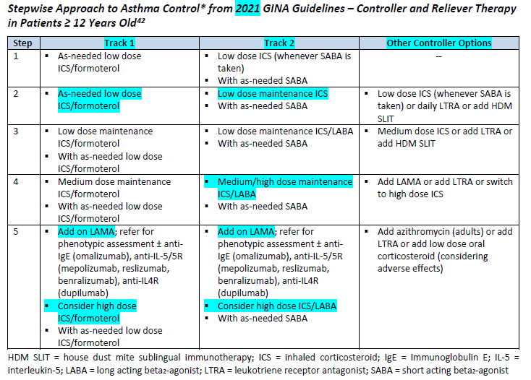
Bronchodilators, Beta Agonist

Slide 80
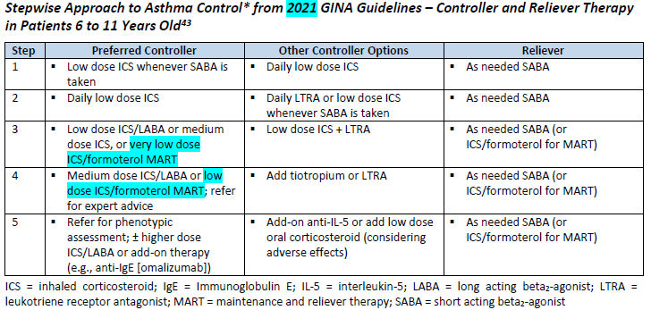
Bronchodilators, Beta Agonist

Slide 81
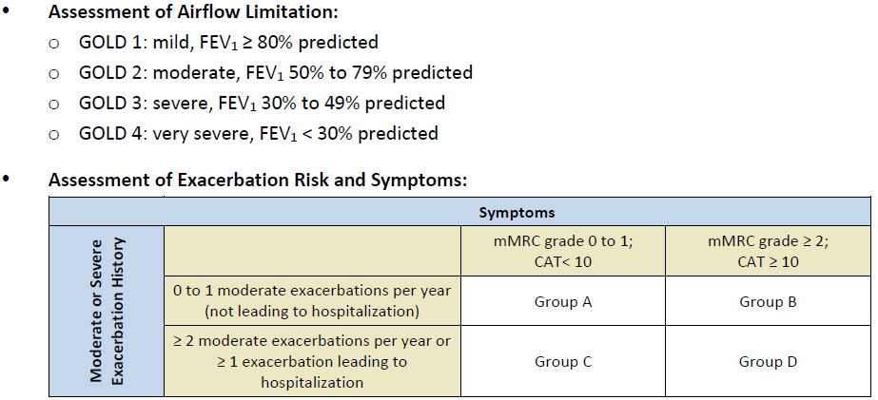
Bronchodilators, Beta Agonist
2022 GOLD Guidelines:

Slide 82
Colony Stimulating Factors

Slide 83
Colony Stimulating Factors
Drug | Manufacturer | Cancer Patients Receiving Myelo-suppressive Chemotherapy | Acute Myeloid Leukemia (AML) Patients Receiving Chemotherapy | Bone Marrow Transplant (BMT) | Peripheral Blood Progenitor Cell Collection and Therapy | Severe Chronic Neutropenia | Hematopoietic Syndrome of Acute Radiation Syndrome
filgrastim (Neupogen®) | Amgen | X | X | X | X | X | X
filgrastim-aafi (Nivestym™) | Pfizer | X | X | X | X | X | --
filgrastim-ayow (Releuko®) | Amneal | X | X | X | -- | X | --
filgrastim-sndz (Zarxio®) | Sandoz | X | X | X | X | X | --
pegfilgrastim (Neulasta®) | Amgen | X | -- | -- | -- | -- | X
ª In cancer patients receiving BMT to reduce duration of neutropenia and febrile neutropenia

Slide 84
Colony Stimulating Factors
Drug | Manufacturer | Cancer Patients Receiving Myelo-suppressive Chemotherapy | Acute Myeloid Leukemia (AML) Patients Receiving Chemotherapy | Bone Marrow Transplant (BMT) | Peripheral Blood Progenitor Cell Collection and Therapy | Severe Chronic Neutropenia | Hematopoietic Syndrome of Acute Radiation Syndrome
pegfilgrastim-apgf (Nyvepria™) | Pfizer | X | -- | -- | -- | -- | --
pegfilgrastim-cbqv (Udenyca™) | Coherus | X | -- | -- | -- | -- | --
pegfilgrastim-jmdb (Fulphila™) | Mylan | X | -- | -- | -- | -- | --

Slide 85
Colony Stimulating Factors
Drug | Manufacturer | Cancer Patients Receiving Myelo-suppressive Chemotherapy | Acute Myeloid Leukemia (AML) Patients Receiving Chemotherapy | Bone Marrow Transplant (BMT) | Peripheral Blood Progenitor Cell Collection and Therapy | Severe Chronic Neutropenia | Hematopoietic Syndrome of Acute Radiation Syndrome
pegfilgrastim-bmez (Ziextenzo™) | Sandoz | X | -- | -- | -- | -- | --
Pegfilgrastim-pbbk (Fylnetra®) | Amneal | X | -- | -- | -- | -- | --
sargramostim (Leukine®) | Sanofi/ Partner | -- | X | X | X | -- | X
tbo-filgrastim (Granix®) | Cephalon/ Teva | X | -- | -- | -- | -- | --

Slide 86
Colony Stimulating Factors
Colony stimulating factors (CSF) are hematopoietic growth factors that have been shown to decrease the likelihood of chemotherapy-induced neutropenic complications and to improve relative chemotherapy dose intensity
Prophylactic CSF use can reduce the severity, risk, and duration of febrile neutropenia and decrease rates of infection
Filgrastim (Neupogen), filgrastim-aafi (Nivestym), filgrastim-ayow (Releuko), filgrastim-sndz (Zarxio), pegfilgrastim (Neulasta), pegfilgrastim-apgf (Nyvepria), pegfilgrastim-cbqv (Udenyca), pegfilgrastim-jmdb (Fulphila), pegfilgrastim-bmez (Ziextenzo), pegfilgrastim-pbbk (Fylnetra) and tbo-filgrastim (Granix) are granulocyte colony-stimulating factors (G-CSF)

Slide 87
Colony Stimulating Factors
Sargramostim (Leukine) is a granulocyte-macrophage colony stimulating factor (GM-CSF)
The administration frequency of pegfilgrastim and its biosimilars may be viewed as more favorable since these only require a single SC injection per chemotherapy cycle; whereas filgrastim products and sargramostim (Leukine) administration require daily subcutaneous injection
Several biosimilars to the originator products, filgrastim (filgrastim-aafi, filgrastim-sndz, and filgrastim-ayow) and pegfilgrastim (pegfilgrastim-cbqv, pegfilgrastim-bmez, pegfilgrastim-apgf, pegfilgrastim-jmdb, pegfilgrastim-apgf, and pegfilgrastim-pbbk ) are now available

Slide 88
Colony Stimulating Factors
The v2.2022 NCCN practice guidelines for hematologic growth factors indicate Subcutaneous filgrastim, tbo-filgrastim, and pegfilgrastim have a category 1 recommendation that they prophylactically reduce the risk of febrile neutropenia
the guidelines advise caution should be used with prophylactic use of G-CSFs administered with chemotherapy and radiation concurrently
Sargramostim is no longer recommended for prophylactic use in patients with solid tumors receiving myelosuppressive chemotherapy

Slide 89
Colony Stimulating Factors
The guidelines note that a biosimilar is a biological product that is highly similar to the FDA-approved originator product with very small, clinically inactive differences but no difference in efficacy, safety, or purity
NCCN states limited data suggest that patients can alternate between the originator product and the biosimilar without any clinically meaningful differences regarding efficacy or safety
Due to their recent approvals, pegfilgrastim-apgf (Nyvepria), filgrastim-ayow (Releuko), and pegfilgrastim-pbbk (Fylnetra) were not addressed by NCCN in their v1.2022 guidance

Slide 90
Colony Stimulating Factors
NCCN guidelines recommend that high-risk patients receive prophylactic CSF regardless of the intent of treatment
For intermediate-risk patients, NCCN recommends individualized consideration of CSF based on the likelihood of developing febrile neutropenia, consequences of developing febrile neutropenia, and the implications of interfering with chemotherapy treatments
NCCN does not recommend the routine use of CSF in patients with low risk of developing febrile neutropenia
The guidelines advise against use of G-CSFs within 14 days after receipt of chimeric antigen receptor-modified T cell (CAR-T) therapy

Slide 91
Gaucher Disease

Slide 92
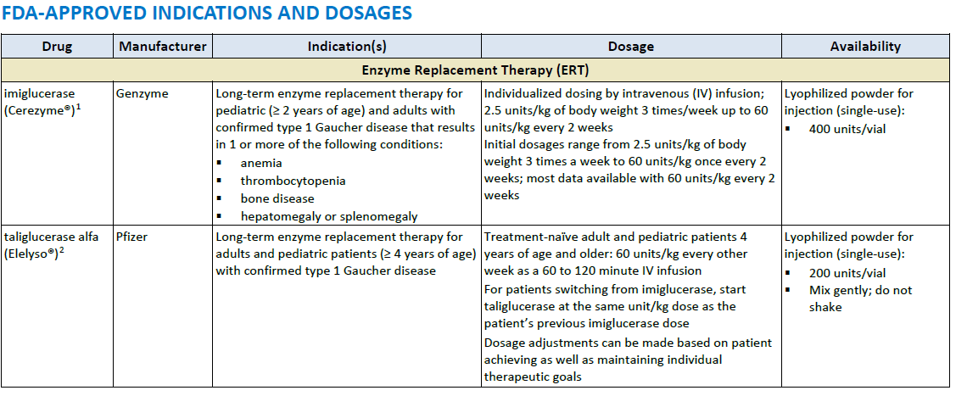
Gaucher Disease

Slide 93
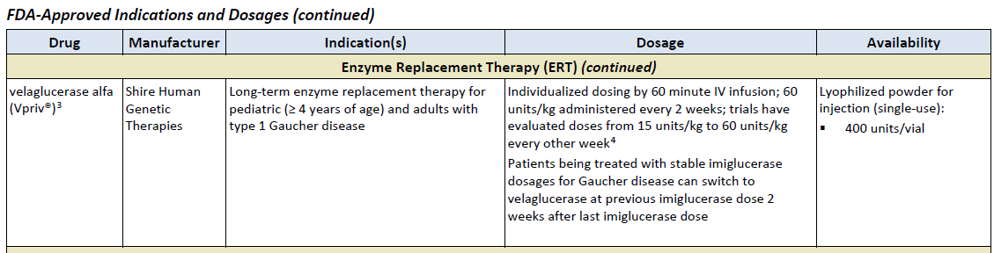
Gaucher Disease

Slide 94
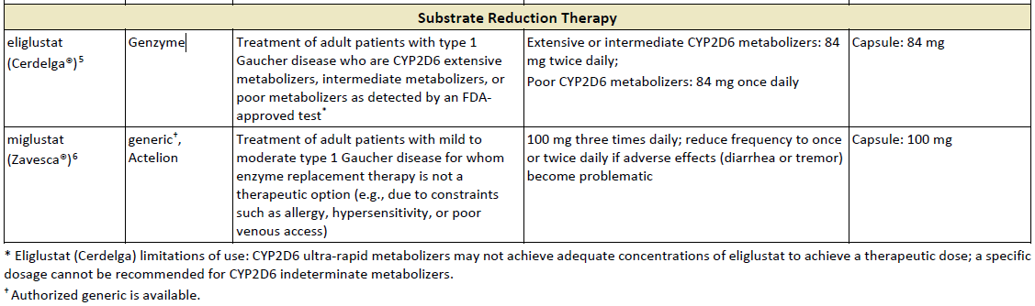
Gaucher Disease

Slide 95
Gaucher Disease
Gaucher disease (GD) is an autosomal recessive condition caused by deficiency of glucocerebrosidase
This deficiency results in abnormal accumulation of glycolipids in cell lysosomes, which can lead to skeletal disease , anemia, hemorrhage, thrombocytopenia, splenomegaly, hepatomegaly, and growth retardation
All IV enzyme replacement therapy (ERT) agents, imiglucerase (Cerezyme), velaglucerase alfa (Vpriv), and taliglucerase alfa (Elelyso) are forms of the enzyme glucocerebrosidase, whereas oral substrate reduction therapy (SRT) agents, eliglustat (Cerdelga) and miglustat (Zavesca), function as competitive and reversible inhibitors of the enzyme glucosylceramide synthase

Slide 96
Gaucher Disease
The International Collaborative Gaucher Group (ICGG) Gaucher Registry guidelines developed from a consensus of international experts recommend ERT for symptomatic pediatric patients and for those with severe disease
Treatment should be individualized as response may vary
Treatment is life-long, and therapy interruptions are not recommended
Anaphylaxis has been reported in patients treated with taliglucerase
The use of miglustat has been limited due to toxicity
Data demonstrate that Cerezyme use is not associated with an increased risk of major birth defects, miscarriage, or other adverse maternal or fetal outcomes

Slide 97
Erythropoiesis Stimulating Proteins

Slide 98
Erythropoiesis Stimulating Proteins
Drug | Manufacturer | FDA-Approved Indications
darbepoetin (Aranesp®) | Amgen | Treatment of anemia associated with chronic kidney disease (CKD) including patients on dialysis and patients not on dialysis Treatment of anemia in patients with non-myeloid malignancies where anemia is due to the effect of concomitant myelosuppressive chemotherapy and, upon initiation, a minimum of 2 additional months chemotherapy is planned Darbepoetin is not indicated for patients receiving myelosuppressive therapy when the anticipated outcome is cure or in in whom anemia can be managed by transfusion Darbepoetin is not indicated for use in patients receiving hormonal agents, therapeutic biologic products, or radiotherapy unless receiving concomitant myelosuppressive chemotherapy Darbepoetin is not indicated as a substitute for red blood cell (RBC) transfusion in patients who require immediate correction of anemia Darbepoetin use has not been demonstrated in controlled clinical trials to improve quality of life, fatigue, or patient well-being

Slide 99
Erythropoiesis Stimulating Proteins
Drug | Manufacturer | FDA-Approved Indications
luspatercept-aamt (Reblozyl®) | Celgene | Treatment of anemia in adult patients with beta thalassemia who require regular red blood cell (RBC) transfusions Treatment of anemia failing an erythropoiesis stimulating agent and requiring ≥ 2 RBC units over 8 weeks in adult patients with very low- to intermediate-risk myelodysplastic syndromes with ring sideroblasts (MDS-RS) or with myelodysplastic/myeloproliferative neoplasm with ring sideroblasts and thrombocytosis (MDS/MPN-RS-T) Luspatercept-aamt is not indicated for use as a substitute for RBC transfusions in patients who require immediate correction of anemia

Slide 100
Erythropoiesis Stimulating Proteins
Drug | Manufacturer | FDA-Approved Indications
PEG-EPO (Mircera®) | Roche/Vifor | Treatment of anemia associated with chronic renal failure (CRF) in adult patients on dialysis and adult patients not on dialysis Treatment of anemia associated with CRF in pediatric patients 5 to 17 years of age on hemodialysis who are converting from another ESA after their hemoglobin level was stabilized with an erythropoiesis stimulating agent (ESA) PEG-EPO use has not been demonstrated in controlled clinical trials to improve quality of life, fatigue, or patient well-being PEG-EPO is not indicated for treatment of anemia in patients receiving cancer chemotherapy PEG-EPO is not indicated as a substitute for red blood cell (RBC) transfusion in patients who require immediate correction of anemia

Slide 101
Erythropoiesis Stimulating Proteins
Drug | Manufacturer | FDA-Approved Indications
rHuEPO (Epogen®) | Amgen | Treatment of anemia associated with CRF including patients on dialysis and patients not on dialysis to decrease the need for red blood cell (RBC) transfusion Treatment of anemia related to therapy with zidovudine (≤ 4,200 mg per week) in HIV-infected patients with endogenous serum erythropoietin levels of ≤ 500 m Units/mL Treatment of anemia in patients with non-myeloid malignancies where anemia is due to the effect of concomitant myelosuppressive chemotherapy and, upon initiation, hemoglobin < 10 g/dL and there is a minimum of 2 additional months of planned chemotherapy Indicated to reduce the need for allogenic RBC transfusion among patients with perioperative hemoglobin > 10 to ≤ 13 g/dL who are at high risk for perioperative blood loss from elective, noncardiac, nonvascular surgery rHuEPO is not indicated for use in patients receiving hormonal agents, therapeutic biologic products, or radiotherapy unless receiving concomitant myelosuppressive chemotherapy rHuEPO is not indicated for patients receiving myelosuppressive therapy when the anticipated outcome is cure or in whom anemia can be managed by transfusion rHuEPO is not indicated as a substitute for red blood cell (RBC) transfusion in patients who require immediate correction of anemia rHuEPO is not indicated in patients undergoing cardiac or vascular surgery rHuEPO is not indicated for patients who are willing to donate autologous blood pre-operatively rHuEPO use has not been demonstrated in controlled clinical trials to improve quality of life, fatigue, or patient well-being
rHuEPO (Procrit®) | Amgen (distributed by Janssen)

Slide 102
Erythropoiesis Stimulating Proteins
Drug | Manufacturer | FDA-Approved Indications
rHuEPO-epbx (Retacrit®) | Pfizer (Hospira) | Treatment of anemia associated with CKD including patients on dialysis and patients not on dialysis to decrease the need for red blood cell (RBC) transfusion Treatment of anemia due to zidovudine administered at ≤ 4,200 mg per week in HIV-infected patients with endogenous serum erythropoietin levels of ≤ 500 mUnits/mL Treatment of anemia in patients with non-myeloid malignancies where anemia is due to the effect of concomitant myelosuppressive chemotherapy and, upon initiation, there is a minimum of 2 additional months of planned chemotherapy Reduce the need for allogeneic RBC transfusions among patients with perioperative hemoglobin > 10 to ≤ 13 g/dL who are at high risk for perioperative blood loss from elective, noncardiac, nonvascular surgery Epoetin alfa-epbx is not indicated for use in patients receiving hormonal agents, therapeutic biologic products, or radiotherapy unless receiving concomitant myelosuppressive chemotherapy Epoetin alfa-epbx is not indicated for patients receiving myelosuppressive therapy when the anticipated outcome is cure or in in whom anemia can be managed by transfusion Epoetin alfa-epbx is not indicated as a substitute for RBC transfusion in patients who require immediate correction of anemia Epoetin alfa-epbx is not indicated in patients undergoing cardiac or vascular surgery Epoetin alfa-epbx is not indicated for patients who are willing to donate autologous blood pre-operatively Epoetin alfa-epbx use has not been demonstrated in controlled clinical trials to improve quality of life, fatigue, or patient well-being

Slide 103
Erythropoiesis Stimulating Proteins
Anemia affects over 3 million Americans as it is a result of numerous diseases, as well as adverse effects of treatments
Erythropoietin is a glycoprotein produced in the kidneys that stimulates red blood cell production from bone marrow
The updated American Society of Clinical Oncology (ASCO) and the American Society of Hematology (ASH) joint clinical practice guidelines for the use of ESAs in patients with cancer recommend minimizing ESA use, particularly in patients with malignancy being treated with curative intent

Slide 104
Erythropoiesis Stimulating Proteins
The National Comprehensive Cancer Network (NCCN) guidelines state that erythropoiesis stimulating agents (ESAs) are associated with an increased risk of thrombosis, decreased survival, and shortened time to tumor
Therefore, it is advised to use the lowest ESA dose possible to maintain hemoglobin (Hb) levels sufficient to avoid blood transfusions
ESAs should not be administered outside of the treatment period

Slide 105
Erythropoiesis Stimulating Proteins
ESAs may be offered to patients with chemotherapy-associated anemia whose cancer treatment is not curative in intent and whose hemoglobin level is < 10 g/dL
The guideline recommends against the use of ESAs for the treatment of anemia associated with malignancy in patients who are not receiving concurrent myelosuppressive chemotherapy, except for patients with lower risk of myelodysplastic syndrome to avoid transfusions
Therapy with Epogen/Procrit, Mircera, and Aranesp for CKD should not exceed target hemoglobin of greater than 11 g/dL

Slide 106
Erythropoiesis Stimulating Proteins
The ASCO and ASH Update Committee maintains that all ESAs are equivalent with respect to effectiveness and safety
The international Kidney Disease: Improving Global Outcomes (KDIGO) group 2012 guidelines state that each ESA is effective in achieving and maintaining target Hb levels
Patients with endogenous serum erythropoietin levels ≤ 500 mUnits/mL, and who are receiving a dose of zidovudine ≤ 4,200 mg/week, may respond to rHuEPO therapy
Patients with endogenous serum erythropoietin levels > 500 mUnits/mL do not appear to respond to rHuEPO therapy

Slide 107
Erythropoiesis Stimulating Proteins
In 2011, the FDA published a safety communication regarding a more conservative dosing approach to ESAs in patients with CKD due to increased risks of cardiovascular (CV) events
Retacrit is the first FDA-approved biosimilar to Epogen/Procrit; Retacrit is neither considered interchangeable with nor does it carry the same indications as the reference products
Luspatercept-aamt (Reblozyl) is the first FDA-approved erythroid maturation agent, which reduces patient transfusion burden by regulating late-stage RBC maturation
It is approved for the treatment of anemia in adult patients with beta thalassemia who require regular red blood cell transfusions

Slide 108
Hypoglycemics, Alpha-Glucosidase Inhibitors

Slide 109
Hypoglycemics, Alpha-Glucosidase Inhibitors
Class Overview:
acarbose – Precose, acarbose
miglitol – Glycet, miglitol

Slide 110
Hypoglycemics, Alpha-Glucosidase Inhibitors
Indicated as adjunct to diet and exercise to improve glycemic control in patients with type 2 diabetes
Miglitol is more potent than acarbose on a milligram-to-milligram basis
Alpha glucosidase inhibitors only have a modest effect on lowering HbA1c by about 0.4 to 0.7 percent
Alpha glucosidase inhibitors are relatively safe but GI side effects (e.g., bloating, flatulence, diarrhea) limit their use

Slide 111
Hypoglycemics, Metformins

Slide 112
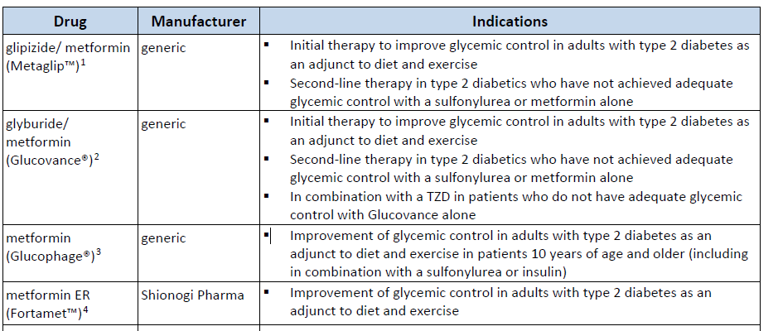
Hypoglycemics, Metformins
PRODUCT LIST AND FDA-APPROVED INDICATIONS

Slide 113
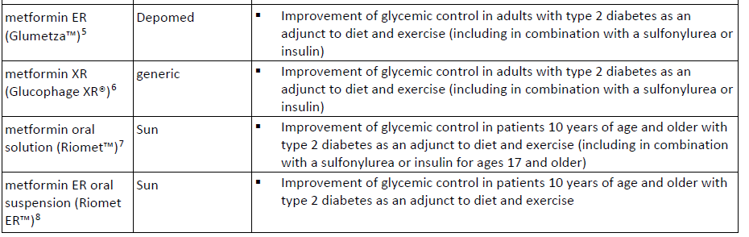
Hypoglycemics, Metformins
PRODUCT LIST AND FDA-APPROVED INDICATIONS

Slide 114
Hypoglycemics, Metformins
Per the 2020 American Diabetes Association (ADA) Standards of Medical Care in Diabetes, metformin is recommended as initial therapy for the treatment of T2DM, along with lifestyle interventions at the time of diagnosis, unless metformin is contraindicated.
The American Association of Clinical Endocrinologists (AACE) and American College of Endocrinology (ACE) clinical practice guidelines recommend metformin as first-line therapy, and as the highest recommended agent among all anti-hyperglycemic medications for monotherapy.
The American College of Physicians’ (ACP) revised 2017 guidelines for T2DM recommend metformin as first-line therapy.

Slide 115
Hypoglycemics, Metformins
Metformin-containing products should not be used in patients with:
  renal disease or severe renal dysfunction (estimated glomerular filtration rate
  [eGFR] below 30 mL/minute/1.73 m2)
  acute or chronic metabolic acidosis including diabetic ketoacidosis
  conditions that can lead to renal dysfunction, including acute myocardial infarction and septicemia

Slide 116
Hypoglycemics, Metformins
Guideline Update:
Updates in the 2022 Standards of Medical Care in Diabetes to the include:
  Guidance on first-line therapy determined by co-morbidities.
  Screening for prediabetes and diabetes beginning at age 35 for all people.
  Changes to gestational diabetes mellitus (GDM) recommendations regarding when to test and in whom testing should be done.
  Updated recommendations on technology selection

Slide 117
Hypoglycemics, Metformins
Guideline Update:
Additional considerations have been added to the recommendation regarding metformin therapy:
Metformin therapy for prevention of type 2 diabetes should be considered in adults with prediabetes, as typified by the Diabetes Prevention Program, especially those aged 25–59 years with BMI ≥35 kg/m2, higher fasting plasma glucose (e.g., ≥110 mg/dL), and higher A1C (e.g., ≥6.0%), and in women with prior gestational diabetes mellitus.
Metformin should be continued upon initiation of insulin therapy (unless contraindicated or not tolerated) for ongoing glycemic and metabolic benefits.

Slide 118
Hypoglycemics, Metformins
Guideline Update:
More discussion of overtreatment was added to the “Pharmacologic Therapy” subsection “Older Adults”, as was the consideration that for those taking metformin long term, monitoring vitamin B12 deficiency should be considered.

Slide 119
Hypoglycemics, SGLT2

Slide 120
Hypoglycemics, SGLT2
Drug | Manufacturer | Indications
canagliflozin (Invokana®) | Janssen | Adjunct to diet and exercise to improve glycemic control in adults with type 2 diabetes mellitus (T2DM) To reduce the risk of major adverse cardiovascular events (MACE) in adults with T2DM and established cardiovascular disease (CVD) To reduce the risk of end-stage kidney disease, doubling of serum creatinine, cardiovascular (CV) death, and hospitalization for heart failure in adults T2DM and diabetic nephropathy with albuminuria > 300 mg/day
canagliflozin/ metformin (Invokamet®) | Janssen | Adjunct to diet and exercise to improve glycemic control in adults with T2DM To reduce the risk of MACE in adults with T2DM and established CVD Canagliflozin is indicated to reduce the risk of MACE in adults with T2DM and established CVD Canagliflozin is indicated to reduce the risk of end-stage kidney disease, doubling of serum creatinine, CV death, and hospitalization for heart failure in adults with T2DM and diabetic nephropathy with albuminuria
canagliflozin/ metformin ER (Invokamet® XR) | Janssen
.

Slide 121
Hypoglycemics, SGLT2
Drug | Manufacturer | Indications
dapagliflozin (Farxiga®) | AstraZeneca | Adjunct to diet and exercise to improve glycemic control in adults with T2DM To reduce the risk of hospitalization for heart failure in adults with T2DM and established CVD or multiple CV risk factors To reduce the risk of CV death and hospitalization for heart failure (HF) in adults with HF (NYHA class II-IV) with reduced ejection fraction To reduce the risk of sustained eGFR decline, end stage kidney disease (ESKD), CV death, and hospitalization for heart failure (hHF) in adults with chronic kidney disease (CKD) at risk of progression
dapagliflozin/ metformin ER (Xigduo® XR) | AstraZeneca | Adjunct to diet and exercise to improve glycemic control in adults with T2DM Dapagliflozin is indicated to reduce the risk of hospitalization for heart failure in adults with T2DM and established CVD or multiple CV risk factors. to reduce the risk of CV death and hospitalization for HF in adults with HFrEF─ to reduce the risk of sustained eGFR decline, ESRD, CV death, and hospitalization for HF in adults with CKD at risk of progression
.

Slide 122
Hypoglycemics, SGLT2
Drug | Manufacturer | Indications
empagliflozin (Jardiance®) | Boehringer Ingelheim | Adjunct to diet and exercise to improve glycemic control in adults with T2DM To reduce the risk of cardiovascular death in adults with T2DM and established CVD To reduce the risk of cardiovascular death and hospitalization for heart failure in adults with heart failure and reduced ejection fraction (HFrEF)
empagliflozin/ metformin (Synjardy®) | Boehringer Ingelheim | Adjunct to diet and exercise to improve glycemic control in adults with T2DM when treatment with both empagliflozin and metformin is appropriate Empagliflozin is indicated to reduce the risk of cardiovascular death in adults with T2DM and established CVD*
empagliflozin/ metformin ER (Synjardy® XR) | Boehringer Ingelheim
.

Slide 123
Hypoglycemics, SGLT2
Drug | Manufacturer | Indications
ertugliflozin (Steglatro™) | Merck, Sharp & Dohme | Adjunct to diet and exercise to improve glycemic control in adults T2DM
ertugliflozin/ metformin (Segluromet™) | Merck, Sharp & Dohme | Adjunct to diet and exercise to improve glycemic control in adults with T2DM
.

Slide 124
Hypoglycemics, SGLT2
The SGLT2 inhibitors are effective in reducing HbA1c, postprandial glucose, and fasting plasma glucose, as well as reducing systolic blood pressure and weight.
The American Diabetes Association (ADA) prefers medications with proven CV and renal benefit in patients with CV and/or renal disease, respectively.
In patients with ASCVD, the addition of empagliflozin (Class A recommendation), liraglutide (Class A recommendation), or canagliflozin (Class C recommendation) is preferred.
In patients with heart failure (HF) or chronic kidney disease (CKD), empagliflozin, canagliflozin, or dapagliflozin is preferred.

Slide 125
Hypoglycemics, SGLT2
The American Association of Clinical Endocrinologists (AACE) and American College of Endocrinology (ACE) 2020 diabetes management algorithm and 2015 clinical practice guidelines for developing a diabetes care plan include the use of SGLT2 inhibitors as an alternative to metformin for monotherapy and as an appropriate add-on to metformin in dual therapy and triple therapy.

Slide 126
Hypoglycemics, SGLT2
AACE/ACE recognizes that empagliflozin and canagliflozin are associated with significantly reduced cardiac mortality, hospitalization for heart failure, as well as secondary renal endpoints.
Additionally, dapagliflozin demonstrated reduced all-cause mortality and the composite of CV death and HF hospitalization; however, it did not significantly lower the combined risk of CV death and nonfatal MI and stroke.
In the 2020 algorithm, the panel identifies SGLT2 inhibitors as having a neutral effect on bone.

Slide 127
Hypoglycemics, SGLT2
In 2020, the American College of Cardiology (ACC) published an expert consensus decision pathway for CV risk reduction in patients with T2DM.
They identify opportunities to initiate an SGLT2 inhibitor or GLP-1RA with demonstrated CV or renal benefit in patients with T2DM.
A medication from either class may be initiated in any patient with T2DM and ASCVD at the time of diagnosis of T2DM or ASCVD or any time after diagnosis, including at hospital discharge for ASCVD.
An agent from either class can also be started in patients with T2DM without established ASCVD but who are at high risk of ASCVD.

Slide 128
Hypoglycemics, SGLT2
In addition, initiation of an SGLT2 inhibitor with demonstrated CV or renal benefit is recommended in patients with HF and/or diabetic kidney disease; a GLP-1RA is an alternative in patients with eGFR < 30 ml/min/1.73 m².

Slide 129
Hypoglycemics, SGLT2
Product/Guideline Updates:
FDA approved a new indication for Farxiga (dapagliflozin) to reduce the risk of sustained eGFR decline, end stage kidney disease (ESKD), CV death, and hospitalization for heart failure (hHF) in adults with chronic kidney disease (CKD) at risk of progression.
Corresponding new limitations of use were also added stating that dapagliflozin is not recommended for use to improve glycemic control in adults with type 2 diabetes mellitus with an eGFR < 45 mL/min/1.73 m² as it is unlikely to be effective based upon its mechanism of action.

Slide 130
Hypoglycemics, SGLT2
Product/Guideline Updates:
FDA updated the Steglatro (ertugliflozin) indication to remove the limitation of use for "those who are not adequately controlled on a regimen containing ertugliflozin or metformin, or in patients who are already treated with both ertugliflozin and metformin".
The package insert was updated to state that use is not recommended in pts with eGFR < 45 mL/min/1.73 m² (still contraindicated with eGFR < 30 mL/min/1.73 m²); contraindication updated to include hypersensitivity to any excipient.
Updates were also made to the warnings section regarding ketoacidosis, lower limb amputation, volume depletion, urosepsis and pyelonephritis, necrotizing fasciitis, and vitamin B12 deficiency.

Slide 131
Hypoglycemics, SGLT2
Product/Guideline Updates:
Jardiance (empagliflozin) is now approved to reduce the risk of cardiovascular death and hospitalization for heart failure in adults with heart failure and reduced ejection fraction (HFrEF).

Slide 132
Hypoglycemics, SGLT2
Product/Guideline Updates:
Updates in the 2022 Standards of Medical Care in Diabetes include:
  “Cardiovascular Disease: Treatment” subsection, providing guidance for patients with type 2 diabetes and established ASCVD or multiple risk factors for ASCVD on the use of combined therapy with a SGLT2 inhibitor with demonstrated cardiovascular benefit and a GLP-1 receptor agonist with demonstrated cardiovascular benefit.
  “Chronic Kidney Disease and Risk Management Recommendation” has been revised to include lower glomular filtration rates and lower urinary albumin as indicators for use of SGLT2 inhibitors to reduce CKD progression and cardiovascular events.

Slide 133
Hypoglycemics, SGLT2
Product/Guideline Updates:
The USPSTF has issued a final recommendation statement (August 2021) on screening for prediabetes and type 2 diabetes.
It is recommended to screen for prediabetes and type 2 diabetes in adults aged 35 to 70 years who are overweight or obese, and health care providers should offer or refer patients with prediabetes for preventive interventions (Grade B).

Slide 134
Immune Globulins

Slide 135
Immune Globulins
Drug | Manufacturer | Indications
Intravenous
Asceniv™ | ADMA | Primary humoral immunodeficiency
Bivigam® | Biotest/ADMA | Primary humoral immunodeficiency
Flebogamma® DIF 5% and 10% | Grifols | Primary (inherited) immunodeficiency Chronic primary immune thrombocytopenia (10% only)
Gammagard® S/D | Baxalta | Primary humoral immunodeficiency Prevention of bacterial infections in hypogammaglobulinemia and/or recurrent bacterial infections associated with B-cell chronic lymphocytic leukemia Chronic idiopathic thrombocytopenic purpura Prevention of coronary artery aneurysms associated with Kawasaki syndrome
Gammaplex® 5% and 10% | Bio Products Laboratory | Primary humoral immunodeficiency Chronic immune thrombocytopenic purpura

Slide 136
Immune Globulins
Drug | Manufacturer | Indications
Octagam® 5% and 10% | Octapharma | Primary humoral immunodeficiency (5% only) Chronic immune thrombocytopenic purpura (10% only) Dermatomyositis (10% only)
Panzyga® | Octapharma/ Pfizer | Primary humoral immunodeficiency Chronic immune thrombocytopenia Chronic inflammatory demyelinating polyneuropathy
Privigen® | CSL Behring | Primary humoral immunodeficiency Chronic immune thrombocytopenic purpura Chronic inflammatory demyelinating polyneuropathy (Limitation of use: maintenance therapy has not been studied > 6 months)
Intravenous or Subcutaneous
Gammagard® Liquid | Baxalta | Primary humoral immunodeficiency Multifocal motor neuropathy

Slide 137
Immune Globulins
Drug | Manufacturer | Indications
Gammaked™ | Kedrion Biopharm† | Primary humoral immunodeficiency Idiopathic thrombocytopenic purpura (IV use only) Chronic inflammatory demyelinating polyneuropathy (IV use only)
Gamunex®-C | Grifols Therapeutics | Primary humoral immunodeficiency Idiopathic thrombocytopenic purpura (IV use only) Chronic inflammatory demyelinating polyneuropathy (IV use only)
Subcutaneous
Cutaquig® | Octapharma/ Pfizer | Primary humoral immunodeficiency
Cuvitru™ | Shire/Takeda | Primary humoral immunodeficiency

Slide 138
Immune Globulins
Drug | Manufacturer | Indications
Hizentra® | CSL Behring | Primary immune deficiency Maintenance therapy in patients with chronic inflammatory demyelinating polyneuropathy
immune globulin 10%/recombinant human hyaluronidase (Hyqvia®) | Baxalta | Primary immune deficiency†
Xembify® | Grifols | Primary humoral immunodeficiency

Slide 139
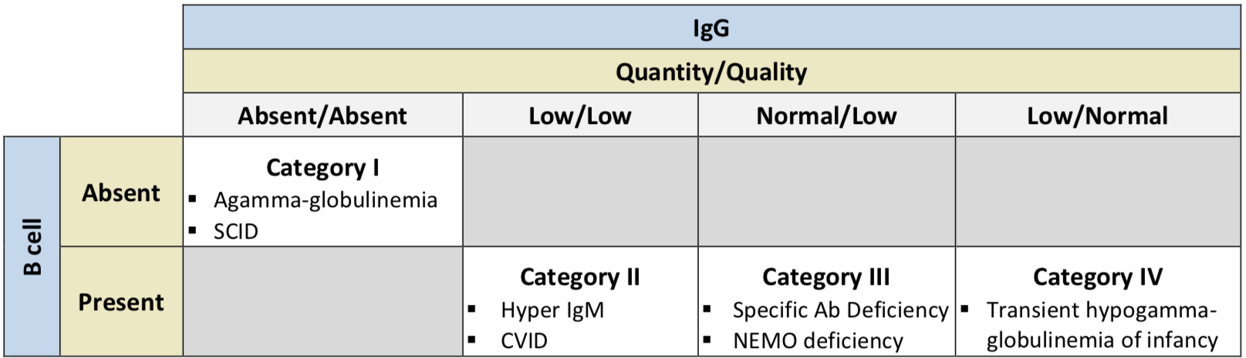
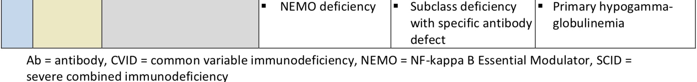
Immune Globulins

Slide 140
Immune Globulins
Exogenous immune globulin product has also been FDA approved for use in multifocal motor neuropathy (MMN), chronic inflammatory demyelinating polyneuropathy (CIDP), idiopathic thrombocytopenic purpura (ITP), Kawasaki disease, and B-cell chronic lymphocytic leukemia.
Therapeutic immune globulin is prepared from pooled plasma obtained from healthy donors at plasma donation centers in the US.
These products are purified to contain 95% to 99% IgG with trace amounts of IgA and IgM.
Each product has validated their production methods to ensure low risk of transmission of viruses.

Slide 141
Immune Globulins
Preparation for each product differs in purification, including production methods related to fractionation, exchange chromatography, and filtration.
The AAAAI and the Clinical Immunology Society both recommend product selection to be relied heavily on patient-specific characteristics.
The subcutaneous route is as efficacious as the intravenous route for the treatment of primary immunodeficiencies.
All the products in the class have similar efficacy and safety profiles.
Due to limited supply, the use of immune globulin products should be reserved for approved indications or conditions where the benefit has been clearly established and is consistent with clinical guidelines.

Slide 142
Immune Globulins
Product/Guideline Updates:
FDA approved expanded indication for Cutaquig to include pediatric patients 2 to 17 years of age for the treatment of primary humoral immunodeficiency.

Slide 143
Oncology Oral, Hematologic Cancers

Slide 144
Oncology Oral, Hematologic Cancers
Drug | Manufacturer | FDA-Approved Indications
acalabrutinib (Calquence®) | AstraZeneca | Treatment of adults with mantle cell lymphoma (MCL) treated with ≥ 1 prior therapy Treatment of adult patients with chronic lymphocytic leukemia (CLL) or small lymphocytic lymphoma (SLL)
asciminib (Scemblix®) | Novartis | Treatment of adult patients with chronic phase (CP) Philadelphia chromosome-positive (Ph+) chronic myeloid leukemia (CML) previously treated with ≥ 2 tyrosine kinase inhibitors Treatment of adult patients with Ph+ CML in CP with the T315I mutation
azacitidine (Onureg®) | Celgene/BMS | Continued treatment of adult patients with acute myeloid leukemia who achieved first complete remission (CR) or complete remission with incomplete blood count recovery (CRi) following intensive induction chemotherapy and are not able to complete intensive curative therapy
bosutinib (Bosulif®) | Pfizer | Newly diagnosed chronic phase (CP) Ph+ CML Treatment of chronic, accelerated, or blast phase Ph+ chronic myeloid leukemia (CML) with resistance or intolerance to prior therapy

Slide 145
Oncology Oral, Hematologic Cancers
Drug | Manufacturer | FDA-Approved Indications
busulfan (Myleran®) | Aspen/ Prasco LA | Palliative treatment of chronic myelogenous (myeloid, myelocytic, granulocytic) leukemia
chlorambucil (Leukeran®) | Aspen/ Prasco LA | Treatment of chronic lymphatic (lymphocytic) leukemia, malignant lymphomas, including lymphosarcoma, giant follicular lymphoma, and Hodgkin’s disease; chlorambucil is not curative in any of these disorders but may produce clinically useful palliation
dasatinib (Sprycel®) | Bristol-Meyers Squibb | Treatment of adults with chronic, accelerated, or myeloid or lymphoid blast phase Ph+ CML with resistance or intolerance to prior therapy including imatinib (Gleevec) Treatment of adults with Ph+ acute lymphoblastic leukemia (ALL) with resistance or intolerance to prior therapy Newly diagnosed adult patients with Ph+ CML in chronic phase Treatment of pediatric patients with Ph+ CML in chronic phase Treatment of pediatric patients with newly diagnosed Ph+ ALL in combination with chemotherapy

Slide 146
Oncology Oral, Hematologic Cancers
Drug | Manufacturer | FDA-Approved Indications
decitabine/ cedazuridine (Inqovi®) | Taiho Oncology | Treatment of adults with myelodysplastic syndromes (MDS), including previously treated and untreated, de novo and secondary MDS with the following French-American-British subtypes (refractory anemia, refractory anemia with ringed sideroblasts, refractory anemia with excess blasts, and chronic myelomonocytic leukemia [CMML]) and intermediate-1, intermediate-2, and high-risk International Prognostic Scoring System group
duvelisib (Copiktra®) | Verastem | Relapsed or refractory chronic lymphocytic leukemia (CLL) or small lymphocytic lymphoma (SLL) after ≥ 2 prior therapies Relapsed or refractory follicular lymphoma (FL) after ≥ 2 prior systemic therapies
enasidenib (Idhifa®) | Celgene/BMS | Relapsed or refractory acute myeloid leukemia (AML) with an isocitrate dehydrogenase-2 (IDH2) mutation, as determined with an FDA-approved test‡

Slide 147
Oncology Oral, Hematologic Cancers
Drug | Manufacturer | FDA-Approved Indications
fedratinib (Inrebic®) | Celgene | Intermediate-2 or high-risk primary or secondary post-polycythemia vera or post-essential thrombocythemia myelofibrosis (MF)
gilteritinib (Xospata®) | Astellas | Relapsed or refractory adults with AML with a FLT3 mutation, as detected by an FDA-approved test
glasdegib (Daurismo™) | Pfizer | In combination with low-dose cytarabine, for the treatment of newly diagnosed AML in adult patients who are ≥ 75 years old or who have comorbidities that preclude use of intensive induction chemotherapy
hydroxyurea (Hydrea®) | generic, Bristol-Myers Squibb | Resistant CML Locally advanced squamous cell carcinomas of the head and neck (excluding lip), in combination with concurrent chemoradiation

Slide 148
Oncology Oral, Hematologic Cancers
Drug | Manufacturer | FDA-Approved Indications
ibrutinib (Imbruvica®) | Pharmacyclics | Mantle cell lymphoma (MCL) in patients who have received ≥ 1 prior therapy* CLL/ SLL CLL/ SLL with 17p deletion Waldenström’s macroglobulinemia Marginal zone lymphoma (MZL) requiring systemic therapy and patient has had prior anti-CD20-based therapy Chronic graft versus host disease (cGVHD) after failure of ≥ 1 line of systemic therapy in adults and pediatric patients ≥ 1 year of age
idelalisib (Zydelig®) | Gilead | Relapsed chronic CLL in combination with rituximab in patients for whom rituximab alone would be considered appropriate therapy due to other comorbidities Relapsed follicular B-cell non-Hodgkin’s lymphoma in patients who have received ≥ 2 prior systemic therapies, (FDA withdrew indication in February 2022)* Relapsed SLL in patients who have received ≥ 2 prior systemic therapies Not recommended as first line for any patient; including patients with CLL, SLL, FL, and other indolent non-Hodgkin’s lymphoma

Slide 149
Oncology Oral, Hematologic Cancers
Drug | Manufacturer | FDA-Approved Indications
imatinib (Gleevec®) | generic, Novartis | Newly diagnosed adult and pediatric patients with Ph+ CML in chronic phase Patients with Ph+ CML in blast crisis, accelerated phase, or chronic phase after failure of interferon-alpha therapy Adult patients with relapsed or refractory Ph+ ALL Pediatric patients with newly diagnosed Ph+ ALL in combination with chemotherapy Adult patients with myelodysplastic/ myeloproliferative diseases associated with platelet-derived growth factor receptor (PDGFR) gene re-arrangements as determined with an FDA-approved test‡ Adult patients with aggressive systemic mastocytosis without the D816V c-Kit mutation, as determined with an FDA-approved test or with c-Kit mutational status unknown‡ Adult patients with hypereosinophilic syndrome and/or chronic eosinophilic leukemia who have the FIP1L1-PDGFRα fusion kinase (mutational analysis or FISH demonstration of CHIC2 allele deletion) and for patients with hypereosinophilic syndrome and/or chronic eosinophilic leukemia who are FIP1L1-PDGFRα fusion kinase-negative or unknown Adult patients with unresectable, recurrent, and/or metastatic dermatofibrosarcoma protuberans (DFSP) Patients with Kit (CD117)-positive unresectable and/or metastatic malignant gastrointestinal stromal tumors (GIST) Adjuvant treatment of adult patients following resection of Kit (CD117)-positive GIST

Slide 150
Oncology Oral, Hematologic Cancers
Drug | Manufacturer | FDA-Approved Indications
ivosidenib (Tibsovo®) | Agios | Adult patients with relapsed or refractory AML with a susceptible isocitrate dehydrogenase-1 (IDH1) mutation, as detected by an FDA-approved test‡ Adult patients with newly diagnosed AML who are ≥ 75 years old or who have comorbidities that preclude the use of intensive induction chemotherapy with a susceptible IDH1 mutation, as detected by an FDA-approved test In combination with azacitidine or as monotherapy in adult patients with newly diagnosed AML who are ≥ 75 years old or who have comorbidities that preclude the use of intensive induction chemotherapy with a susceptible IDH1 mutation, as detected by an FDA-approved test† Adult patients with previously treated locally advanced or metastatic cholangiocarcinoma with an IDH1 mutation as detected by an FDA-approved test
ixazomib (Ninlaro®) | Millennium | In combination with lenalidomide and dexamethasone for the treatment of multiple myeloma in patients who have received ≥ 1 prior therapy

Slide 151
Oncology Oral, Hematologic Cancers
Drug | Manufacturer | FDA-Approved Indications
lenalidomide (Revlimid®) | Celgene/BMS | In combination with dexamethasone for the treatment of multiple myeloma As maintenance therapy for multiple myeloma following autologous hematopoietic stem cell transplantation (auto-HSCT) Treatment of transfusion-dependent anemia due to low-or intermediate-1-risk myelodysplastic syndromes associated with a deletion of 5q cytogenetic abnormality with or without additional cytogenetic abnormalities Treatment of mantle cell lymphoma after relapse or disease progression after 2 prior therapies, 1 of which included bortezomib In combination with a rituximab product for the treatment of previously treated FL In combination with a rituximab product for the treatment of previously treated MZL
melphalan (Alkeran®) | generic, Apopharma | Palliative treatment of multiple myeloma Palliation of non-resectable epithelial carcinoma of the ovary

Slide 152
Oncology Oral, Hematologic Cancers
Drug | Manufacturer | FDA-Approved Indications
mercaptopurine (Purixan®), | generic (tablets); Nova (suspension) | ALL as a component of a combination maintenance therapy regimen
midostaurin (Rydapt®) | Novartis | Newly diagnosed AML that is FLT3 mutation-positive as detected by an FDA-approved test‡, in combination with standard cytarabine and daunorubicin induction and cytarabine consolidation** Aggressive systemic mastocytosis (ASM), systemic mastocytosis with associated hematological neoplasm (SM-AHN), or mast cell leukemia
nilotinib (Tasigna®) | Novartis | Accelerated phase and chronic phase Ph+ CML in adult patients resistant to or intolerant to prior therapy that included imatinib (Gleevec) Newly diagnosed adult and pediatric patients ≥ 1 year of age with Ph+ CML in chronic phase Treatment of chronic phase and accelerated phase Ph+ CML with resistance or intolerance to prior tyrosine kinase inhibitor (TKI) therapy in pediatric patients ≥ 1 year of age

Slide 153
Oncology Oral, Hematologic Cancers
Drug | Manufacturer | FDA-Approved Indications
panobinostat (Farydak®) | Novartis/ Secura | Treatment of multiple myeloma in combination with bortezomib and dexamethasone in patients who have received ≥ 2 prior regimens, including bortezomib and an immunomodulatory agent The FDA has withdrawn the approval per manufacturer voluntary request*
pomalidomide (Pomalyst®) | Celgene/BMS | For use in combination with dexamethasone for patients with multiple myeloma who have received ≥ 2 prior therapies including lenalidomide and a proteasome inhibitor and have demonstrated disease progression on or within 60 days of completion of the last therapy For the treatment of adults with acquired immunodeficiency syndrome (AIDS)-related Kaposi sarcoma (KS) after failure of highly active antiretroviral therapy (HAART), as well as for the treatment of KS in adults who are human immunodeficiency virus (HIV)-negative

Slide 154
Oncology Oral, Hematologic Cancers
Drug | Manufacturer | FDA-Approved Indications
pacritinib (Vonjo™) | CTI BioPharma | Treatment of adults with intermediate or high-risk primary or secondary (postpolycythemia vera or post-essential thrombocythemia) myelofibrosis with a platelet count below × 10⁹ /L
pomalidomide (Pomalyst®) | Celgene/BMS | For use in combination with dexamethasone for patients with multiple myeloma who have received ≥ 2 prior therapies including lenalidomide and a proteasome inhibitor and have demonstrated disease progression on or within 60 days of completion of the last therapy For the treatment of adults with acquired immunodeficiency syndrome (AIDS)-related Kaposi sarcoma (KS) after failure of highly active antiretroviral therapy (HAART), as well as for the treatment of KS in adults who are human immunodeficiency virus (HIV)-negative

Slide 155
Oncology Oral, Hematologic Cancers
Drug | Manufacturer | FDA-Approved Indications
ponatinib (Iclusig®) | Ariad/Takeda, Millennium | Treatment of adult patients with chronic phase (CP) CML with resistance or intolerance to ≥ 2 prior kinase inhibitors Treatment of adult patients with T315I-positive chronic myeloid leukemia (CML) (chronic phase, accelerated phase, or blast phase) or T315I-positive Philadelphia chromosome positive acute lymphoblastic leukemia (Ph+ALL) Treatment of adult patients with chronic phase, accelerated phase, or blast phase chronic myeloid leukemia or Ph+ALL for whom no other TKI is indicated
procarbazine (Matulane®) | Leadiant | For use in combination with other anticancer drugs for the treatment of stage 3 and stage 4 Hodgkin’s disease; used as part of the MOPP regimen (nitrogen mustard, vincristine, procarbazine, prednisone)

Slide 156
Oncology Oral, Hematologic Cancers
Drug | Manufacturer | FDA-Approved Indications
ruxolitinib (Jakafi®) | Incyte | Intermediate or high-risk MF, including primary MF, post-polycythemia vera MF and post-essential thrombocythemia MF Treatment of polycythemia vera in patients who have had an inadequate response to or are intolerant of hydroxyurea Treatment of steroid-refractory acute graft versus host disease (GVHD) in adult and pediatric patients ≥ 12 years of age Treatment of chronic GVHD (cGVHD) in adults and children ≥ 12 years old after failure of 1 or 2 lines of systemic therapy
selinexor (Xpovio™) | Karyopharm | In combination with bortezomib and dexamethasone for the treatment of adults with multiple myeloma who have received ≥ 1 prior therapy In combination with dexamethasone for the treatment of relapsed or refractory multiple myeloma (RRMM) who have received ≥ 4 prior therapies and whose disease is refractory to ≥ 2 proteasome inhibitors, ≥ 2 immunomodulatory agents, and an anti-CD38 monoclonal antibody Treatment of adults with relapsed or refractory diffuse large B-cell lymphoma (DLBCL), not otherwise specified, including DLBCL arising from follicular lymphoma, after ≥ 2 lines of systemic therapy

Slide 157
Oncology Oral, Hematologic Cancers
Drug | Manufacturer | FDA-Approved Indications
thalidomide (Thalomid®) | Celgene/BMS | Treatment of newly diagnosed multiple myeloma in combination with dexamethasone Acute treatment of cutaneous manifestations of moderate to severe erythema nodosum leprosum (ENL) Prevention and suppression of cutaneous manifestations of ENL recurrence as maintenance therapy
thioguanine (Tabloid®) | Aspen/ Prasco LA | For remission induction and remission consolidation of acute nonlymphocytic leukemias§
tretinoin | generic | For remission induction in patients with acute promyelocytic leukemia (APL), FAB classification M3 characterized by the presence of the t(15;17) translocation and/or presence of the PML/RARα gene who are refractory to, have relapsed from, or have a contraindication to anthracycline chemotherapy

Slide 158
Oncology Oral, Hematologic Cancers
Drug | Manufacturer | FDA-Approved Indications
thalidomide (Thalomid®) | Celgene/BMS | Treatment of newly diagnosed multiple myeloma in combination with dexamethasone Acute treatment of cutaneous manifestations of moderate to severe erythema nodosum leprosum (ENL) Prevention and suppression of cutaneous manifestations of ENL recurrence as maintenance therapy
umbralisib (Ukoniq™) | TG Therapeutics | Relapsed or refractory MZL who have received ≥ 1 prior anti-CD20-based regimen Relapsed or refractory FL who have received ≥ 3 prior lines of systemic therapy The FDA has withdrawn the approval per manufacturer voluntary request l following safety concerns from the UNITY-CLL clinical trial that demonstrated the potential for an increased risk of death in patients receiving umbralisib
venetoclax (Venclexta®) | AbbVie | Treatment of CLL or SLL in adult patients In combination with azacitidine, decitabine, or low-dose cytarabine for the treatment of newly diagnosed AML in adults who are age 75 years or older or who have comorbidities that preclude use of intensive induction chemotherapy*

Slide 159
Oncology Oral, Hematologic Cancers
Drug | Manufacturer | FDA-Approved Indications
vorinostat (Zolinza®) | Merck, Sharp & Dohme | Treatment of cutaneous manifestations of cutaneous T-cell lymphoma (CTCL) in patients who have progressive, persistent, or recurrent disease on or following 2 systemic therapies
zanubrutinib (Brukinsa™) | Beigene | Treatment of adult patients with mantle cell lymphoma (MCL) who have received ≥ 1 prior therapy* Treatment of adult patients with Waldenstrom’s macroglobulinemia (WM) Treatment of adult patients with relapsed or refractory marginal zone lymphoma (MZL) who have received ≥ 1 anti-CD20-based regimen

Slide 160
Ophthalmics, Anti-Inflammatory/Immunomodulator

Slide 161
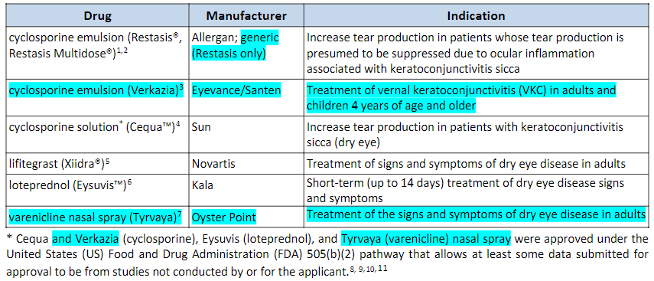
Ophthalmics, Anti-Inflammatory/Immunomodulator
PRODUCT LIST AND FDA-APPROVED INDICATIONS

Slide 162
Ophthalmics, Anti-Inflammatory/Immunomodulator
Dry eye disease (DES)/ Keratoconjunctivitis sicca (KCS) affects approximately 10% to 30% of the US population and occurs more commonly in patients over 40 years of age and in postmenopausal women.
According to the 2018 Preferred Practice Parameter on dry eye syndrome and the 2021 Cornea/External Disease Summary Benchmark from the American Academy of Ophthalmology (AAO), artificial tear substitutes are recommended for mild DES.

Slide 163
Ophthalmics, Anti-Inflammatory/Immunomodulator
Recommended measures for moderate dry eyes include use of anti-inflammatory agents, such as topical cyclosporine (Cequa, Restasis, Restasis Multidose), lifitegrast (Xiidra), topical corticosteroids, or systemic omega-3 fatty acids supplements, along with artificial tears.
For severe dry eye, in addition to the above-mentioned treatments, systemic cholinergics, systemic anti-inflammatories, mucolytic agents, autologous serum tears, contact lenses, permanent punctal occlusion, and tarsorrhaphy are recommended.
No clinical trials have been published comparing any of the agents in this class, but all have demonstrated efficacy against vehicle.

Slide 164
Otic Antibiotics

Slide 165
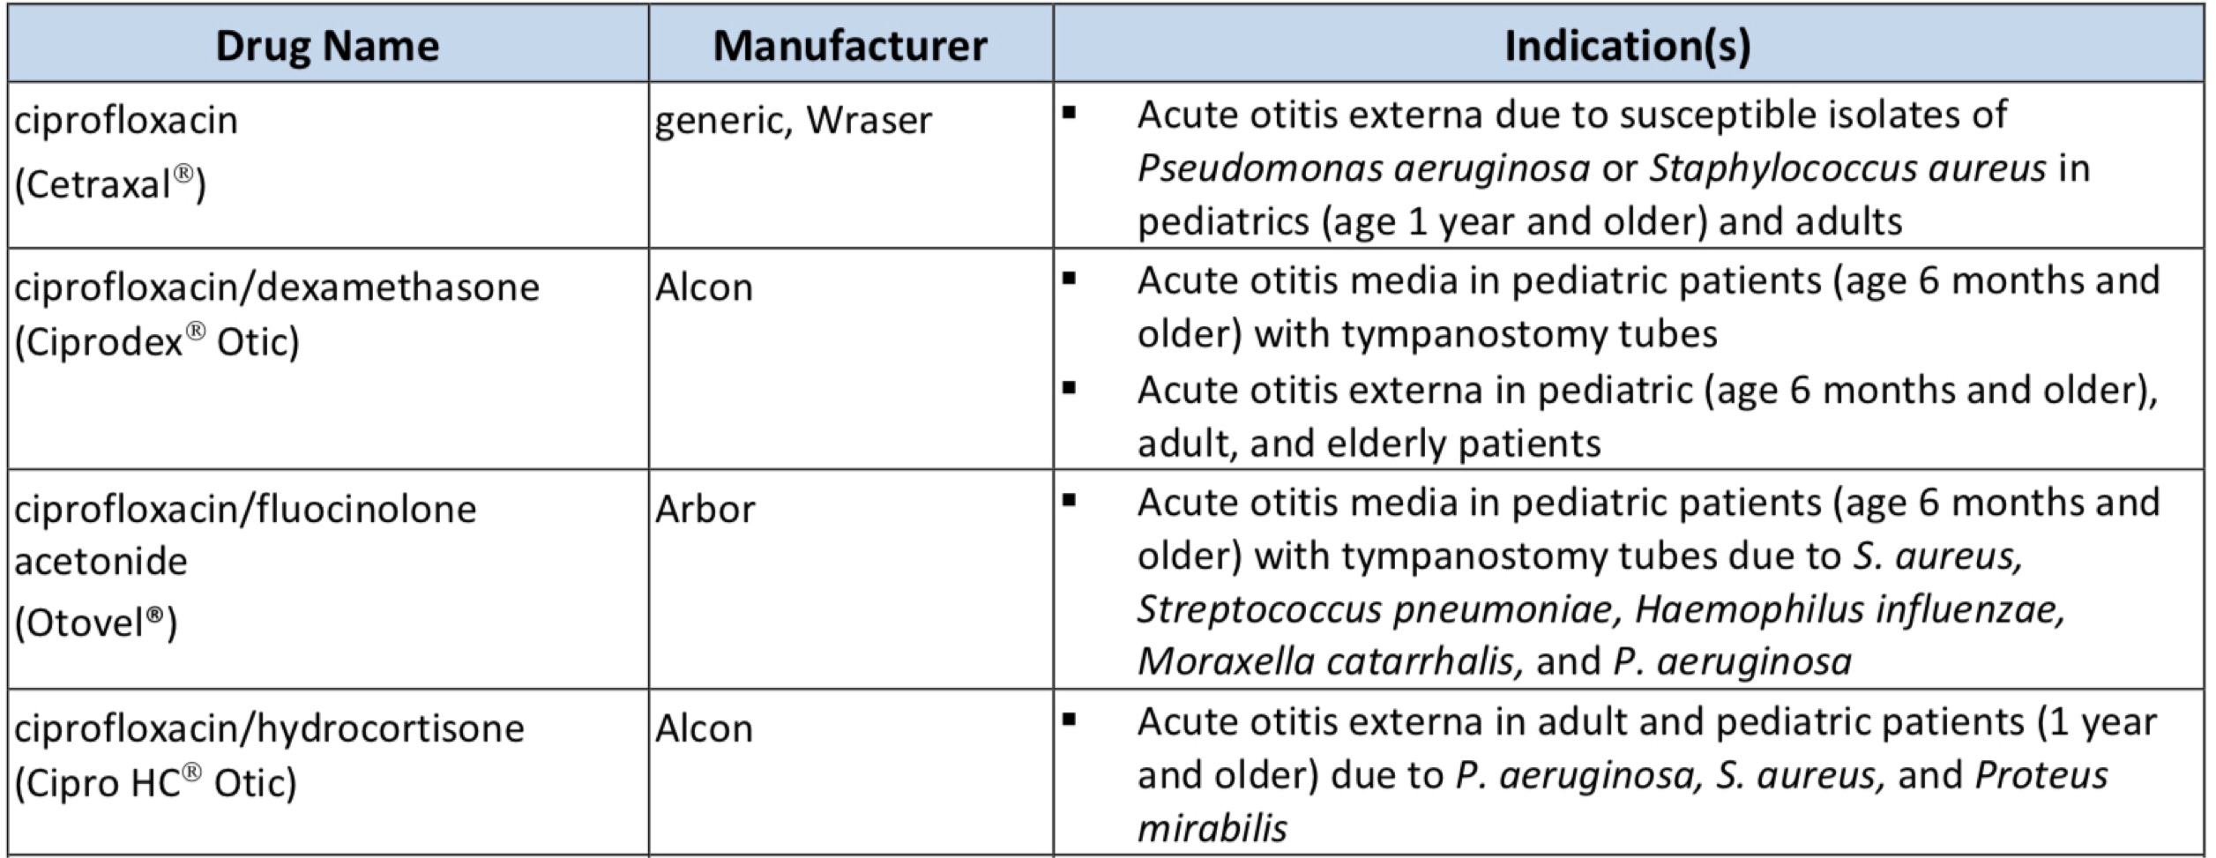
Otic Antibiotics
PRODUCT LIST AND FDA-APPROVED INDICATIONS

Slide 166
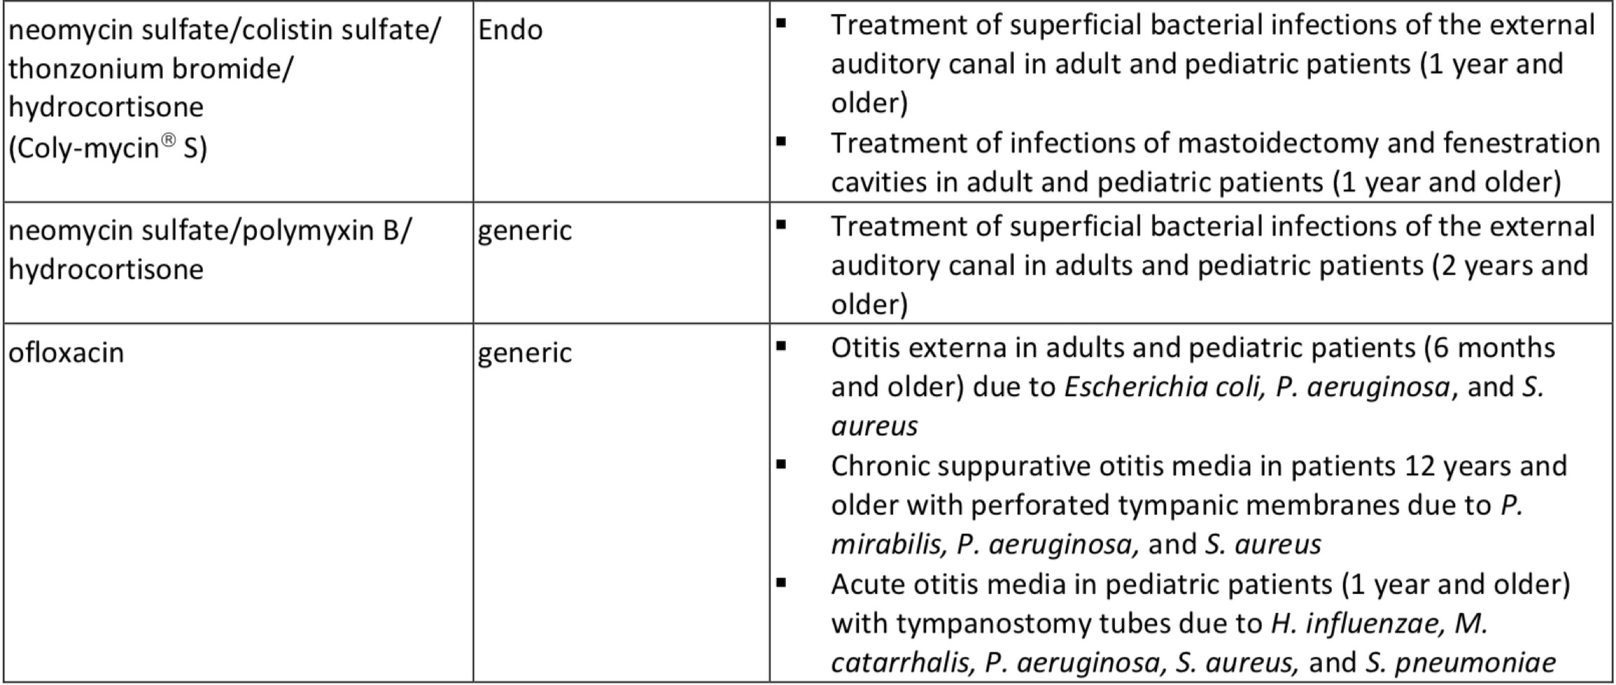
Otic Antibiotics
PRODUCT LIST AND FDA-APPROVED INDICATIONS

Slide 167
Otic Antibiotics
The American Academy of Otolaryngology – Head and Neck Surgery Foundation (AAO-HNSF) guidelines for the management of acute otitis externa (AOE) in patients over 2 years of age recommend topical preparations for initial therapy of diffuse, uncomplicated AOE.
A topical aminoglycoside combined with a second antibiotic and a topical steroid, such as the combination of neomycin, polymyxin B, and hydrocortisone is commonly prescribed to treat AOE.
While the addition of a corticosteroid may be of benefit in reducing inflammation, some consider the use of corticosteroids unnecessary.

Slide 168
Otic Antibiotics
For acute otitis media, consensus guidelines recommend systemic antibiotics, usually amoxicillin as first line therapy.
Otic antibiotics provide an alternative to other topical antibiotics in the treatment of acute otitis media in children with tympanostomy tubes.
For chronic suppurative otitis media (CSOM), aminoglycosides or fluoroquinolones can be used.
Aminoglycosides are not recommended to be used if the tympanic membrane is perforated; fluoroquinolones are not associated with ototoxicity, and ofloxacin is considered safe in cases of a perforated tympanic membrane.

Slide 169
Pulmonary Arterial Hypertension (PAH) Agents, Oral and Inhaled

Slide 170
Pulmonary Arterial Hypertension (PAH) Agents, Oral and Inhaled
Drug | Manufacturer | Indication(s)
Oral Agents
ambrisentan (Letairis®) | generic, Gilead | Treatment of pulmonary arterial hypertension (World Health Organization [WHO] Group I) to improve exercise ability and delay clinical worsening In combination with tadalafil to reduce the risks of disease progression and hospitalization for worsening PAH, and to improve exercise ability
bosentan (Tracleer®) | generic, Actelion | Treatment of pulmonary arterial hypertension (WHO Group I) in patients with WHO Class II to IV symptoms, to improve exercise ability and decrease clinical worsening Treatment of idiopathic or congenital PAH to improve pulmonary vascular resistance (PVR) in pediatric patients aged 3 years and older which is expected to result in an improvement in exercise ability
macitentan (Opsumit®) | Actelion | Treatment of pulmonary arterial hypertension (WHO Group I) to delay disease progression which includes death, initiation of intravenous (IV) or subcutaneous (SC) prostanoids, or clinical worsening; Opsumit also reduced hospitalization for PAH

Slide 171
Pulmonary Arterial Hypertension (PAH) Agents, Oral and Inhaled
Drug | Manufacturer | Indication(s)
riociguat (Adempas®) | Bayer | Persistent/recurrent chronic thromboembolic pulmonary hypertension (CTEPH) (WHO Group IV) after surgical treatment or inoperable CTEPH to improve exercise capacity and WHO functional class Pulmonary arterial hypertension (WHO Group I) to improve exercise capacity, improve WHO functional class and to delay clinical worsening
selexipag (Uptravi®) | Actelion | Treatment of pulmonary arterial hypertension (WHO Group I) to delay disease progression and reduce the risk of hospitalization for PAH
sildenafil (Revatio®) | generic, Pfizer | Treatment of pulmonary arterial hypertension (WHO Group I) to improve exercise ability and delay clinical worsening
tadalafil (Adcirca®) | generic, Eli Lilly | Treatment of pulmonary arterial hypertension (WHO Group I) to improve exercise ability

Slide 172
Pulmonary Arterial Hypertension (PAH) Agents, Oral and Inhaled
Drug | Manufacturer | Indication(s)
treprostinil (Orenitram®) | United Therapeutics | Treatment of pulmonary arterial hypertension (WHO Group I) to delay disease progression and to improve exercise capacity
Inhalation Agents
iloprost (Ventavis®) | Actelion | Treatment of pulmonary arterial hypertension (WHO Group I) to improve a composite endpoint consisting of exercise tolerance, symptoms (NYHA Class), and lack of deterioration
treprostinil (Tyvaso®, Tyvaso DPI®) | United Therapeutics | Treatment of pulmonary arterial hypertension (WHO Group I) to increase exercise ability Treatment of pulmonary hypertension associated with interstitial lung disease (PH-ILD; WHO Group 3) to improve exercise ability.

Slide 173
Pulmonary Arterial Hypertension (PAH) Agents, Oral and Inhaled
The treatment for pulmonary arterial hypertension (PAH) is complex
A trial of high dose oral calcium channel blockers (CCB), such as amlodipine, diltiazem, or nifedipine, is recommended in patients with a positive acute vasoreactive test.
Alternative or additional PAH therapy should be initiated if improvement to WHO FC I or II are not seen after the trial of a CCB.
The 2018 updated American College of Chest Physicians (CHEST) guidelines on therapy for pulmonary arterial hypertension in adults provide treatment recommendations based on World Health Organization (WHO) functional class (FC) for patients who are not candidates for, or who have failed, high-dose oral calcium channel blocker (CCB) therapy.

Slide 174
Pulmonary Arterial Hypertension (PAH) Agents, Oral and Inhaled
In treatment-naïve patients with WHO FC II or WHO FC III without rapid disease progression or poor prognosis, initial combination therapy with ambrisentan and tadalafil is suggested.
Monotherapy with ambrisentan, bosentan, sildenafil, macitentan, tadalafil, or riociguat is considered an alternative in patients who are unwilling to take or cannot tolerate combination therapy.
For treatment-naïve patients with WHO FC IV, initial therapy with a parenteral prostanoid agent is recommended.
If the patient cannot comply with parenteral administration, an inhaled prostanoid in combination with an oral endothelin receptor antagonist (ERA) or an oral phosphodiesterase type-5 (PDE-5) inhibitor are alternatives.

Slide 175
Pulmonary Arterial Hypertension (PAH) Agents, Oral and Inhaled
If symptoms remain during treatment with an oral ERA or PDE-5 inhibitor, addition of an inhaled prostanoid is suggested.
In patients with WHO FC III and continued disease progression while on oral mono- or combination therapy, addition of a parenteral or inhaled prostanoid may be considered.
In patients with WHO FC III or IV and an inadequate response to initial therapy with mono- or combination therapy, a second or third class of PAH agents should be added.

Slide 176
Pulmonary Arterial Hypertension (PAH) Agents, Oral and Inhaled
The European Society of Cardiology (ESC) and the European Respiratory Society (ERS) 2015 recommendations for the diagnosis and treatment of pulmonary hypertension include Selexipag as an option for monotherapy or in combination with an ERA and/or PDE-5 inhibitor in patients with WHO FC II or III.
ESC/ERS also include oral treprostinil as an option for monotherapy in patients with WHO FC III

Slide 177
Pulmonary Arterial Hypertension (PAH) Agents, Oral and Inhaled
Product/Guideline Updates:
Tyvaso (treprostinil) is now approved for the treatment of pulmonary hypertension associated with interstitial lung disease (PH-ILD; WHO Group 3) to improve exercise ability.
It is the only agent in this class approved for this indication.
Approval of treprostinil inhalation powder (Tyvaso DPI) was based on pivotal trials of treprostinil inhalation solution (Tyvaso).

Slide 178
Thrombopoiesis Stimulating Proteins

Slide 179
Thrombopoiesis Stimulating Proteins
Drug | Manufacturer | Indication(s)
avatrombopag (Doptelet®) | Akarx | Treatment of thrombocytopenia in adults with chronic immune thrombocytopenia (ITP) who have had an insufficient response to a previous treatment Treatment of thrombocytopenia in adult patients with chronic liver disease (CLD) who are scheduled to undergo a procedure Avatrombopag should not be used in an attempt to normalize platelet counts in patients with chronic liver disease (CLD)

Slide 180
Thrombopoiesis Stimulating Proteins
Drug | Manufacturer | Indication(s)
eltrombopag (Promacta®) | Novartis | Treatment of thrombocytopenia in adult and pediatric patients ≥ 1 year of age with persistent or chronic immune thrombocytopenia (ITP) who have had an insufficient response to corticosteroids, immunoglobulins, or splenectomy Eltrombopag should only be used in patients with ITP whose degree of thrombocytopenia and clinical condition increase the risk for bleeding Treatment of thrombocytopenia in patients with chronic hepatitis C (HCV) to allow the initiation and maintenance of interferon-based therapy Eltrombopag should be used only in patients with chronic HCV whose degree of thrombocytopenia prevents the initiation of interferon-based therapy or limits the ability to maintain interferon-based therapy Safety and efficacy have not been established in combination with direct acting antiviral agents approved for treatment of chronic HCV infection Eltrombopag should not be used in an attempt to normalize platelet counts In combination with standard immunosuppressive therapy for first-line treatment of adult and pediatric patients ≥ 2 years of age with severe aplastic anemia Treatment of patients with severe aplastic anemia who have had an insufficient response to immunosuppressive therapy Eltrombopag is not indicated for the treatment of myelodysplastic syndrome (MDS)

Slide 181
Thrombopoiesis Stimulating Proteins
Drug | Manufacturer | Indication(s)
fostamatinib disodium hexahydrate (Tavalisse™) | Rigel | Treatment of thrombocytopenia in adult patients with chronic immune thrombocytopenia (ITP) who have had an insufficient response to a previous treatment
lusutrombopag (Mulpleta®) | Shionogi | Treatment of thrombocytopenia in adult patients with CLD who are scheduled to undergo a procedure Lusutrombopag should not be used in attempt to normalize platelet counts in patients with CLD

Slide 182
Thrombopoiesis Stimulating Proteins
Drug | Manufacturer | Indication(s)
romiplostim (Nplate®) | Amgen | Treatment of pediatric patients ≥ 1 year of age with immune thrombocytopenia (ITP) for ≥ 6 months who have had an insufficient response to corticosteroids, immune globulins, or splenectomy Treatment of adults with chronic immune thrombocytopenia (ITP) who have an insufficient response with corticosteroids, immunoglobulins, or splenectomy To increase survival in adults and in pediatric patients (including term neonates) acutely exposed to myelosuppressive doses of radiation (Hematopoietic Syndrome of Acute Radiation Syndrome [HSARS]) Romiplostim is not indicated to treat thrombocytopenia due to myelodysplastic syndrome (MDS) or any cause of thrombocytopenia other than chronic ITP Romiplostim should only be used in patients with ITP whose degree of thrombocytopenia and clinical condition increases their risk for bleeding Romiplostim should not be used in an attempt to normalize platelet counts

Slide 183
Thrombopoiesis Stimulating Proteins
Thrombocytopenia occurs in 64% to 84% of patients with chronic liver disease (CLD) with cirrhosis or fibrosis and approximately 6% of CLD patients without cirrhosis.
In 2019, the international consensus report on primary ITP provided a review of updated therapies for the management of ITP in children and adults.
Per the consensus, treatment decisions should be individualized depending on the extent of bleeding, platelet count, patient age, presence of fatigue, assessment of risk factors for bleeding, patient preference, and access to care.
Corticosteroids continue to be first-line therapy for the treatment of ITP in adults.

Slide 184
Thrombopoiesis Stimulating Proteins
Subsequent treatments with strong evidence include rituximab, the thrombopoietin receptor agonists (TPO-RAs) eltrombopag (Promacta), avatrombopag (Doptelet), and romiplostim (Nplate), as well as fostamatinib (Tavalisse).
Subsequent therapies with less robust evidence include azathioprine, cyclophosphamide, cyclosporine, danazol, dapsone, mycophenolate mofetil, and vinca alkaloids.

Slide 185
Thrombopoiesis Stimulating Proteins
The 2019 updated American Society of Hematology (ASH) evidence-based practice guidelines for the management of immune thrombocytopenia recommends observation or corticosteroids based on platelet count.
Treatment decisions should consider the severity of thrombocytopenia, comorbid conditions, use of antiplatelet or anticoagulant drugs, upcoming procedures, and the patient’s age.
For adults with ITP for ≥ 3 months who are corticosteroid-dependent or unresponsive to steroids, treatment with eltrombopag or romiplostim is suggested (very low certainty).

Slide 186
Thrombopoiesis Stimulating Proteins
Either IVIG or anti-D may be used as a first-line therapy if corticosteroids are contraindicated (grade 2C).
Thrombopoietin receptor agonists may be considered for patients at risk for bleeding who have failed at least 1 other therapy and who relapse after splenectomy or have a contraindication to splenectomy (grade 1B).
Thrombopoietin receptor agonists may also be considered in patients at risk for bleeding who have not had a splenectomy and who have failed corticosteroids or IVIG (grade 2C).

Slide 187
Thrombopoiesis Stimulating Proteins
Pharmacotherapy for aplastic anemia includes immunosuppressive agents, hematopoietic growth factors, and fludarabine. Promacta is also indicated to treat first-line and refractory severe aplastic anemia (including in pediatric patients).
Monotherapy with hematopoietic growth factors is not recommended for newly diagnosed patients.
In newly diagnosed children with non-life-threatening mucosal bleeding and/or decreased health-related quality of life (HRQoL), prednisone is suggested rather than IVIG or anti-D.
If these patients are unresponsive to first-line treatment, TPO-RAs are suggested.

Slide 188
Ulcerative Colitis Agents

Slide 189
Ulcerative Colitis Agents
Drug | Manufacturer | Indication(s)
 |  | Treatment | Maintenance
Oral Prodrug Forms
balsalazide (Colazal®) | generic, Salix | Mild to moderately active ulcerative colitis (UC) in patients ≥ 5 years | --
olsalazine (Dipentum®) | Meda/Mylan | -- | Maintenance of remission of UC in patient's intolerant of sulfasalazine

Slide 190
Ulcerative Colitis Agents
Drug | Manufacturer | Indication(s)
 |  | Treatment | Maintenance
sulfasalazine (Azulfidine®, Azulfidine EN-tabs®) | generic*, Pfizer | Mild to moderately active UC Adjunctive therapy in severe UC | Maintenance of remission of UC
 |  | Other: Enteric-coated tablets are indicated in patients with UC who cannot take uncoated sulfasalazine tablets because of gastrointestinal (GI) intolerance Treatment of rheumatoid arthritis that has not responded adequately to salicylates or other nonsteroidal anti-inflammatory agents (NSAIDs) Treatment of pediatric patients with polyarticular juvenile rheumatoid arthritis who have not responded adequately to salicylates or other NSAIDs

Slide 191
Ulcerative Colitis Agents
Drug | Manufacturer | Indication(s)
 |  | Treatment | Maintenance
Oral Delayed-Release Forms
mesalamine delayed-release tablets (Asacol® HD) | generic, Allergan | Moderately active UC | --
mesalamine delayed-release capsules (Delzicol®) | generic, Allergan | Mild to moderately active UC in patients ≥ 5 years | Maintenance of remission of UC in adults
mesalamine MMX delayed-release tablets (Lialda®) | generic, Shire US | Mild to moderately active UC in pediatric patients ≥ 24 kg and adults | Maintenance of remission of mild to moderately active UC in adults

Slide 192
Ulcerative Colitis Agents
Drug | Manufacturer | Indication(s)
 |  | Treatment | Maintenance
mesalamine extended-release capsules (Pentasa®) | Shire US | Mild to moderately active UC | --
mesalamine extended-release capsules (Apriso®) | generic, Salix | -- | Maintenance of remission of UC in adults
Rectal Forms
budesonide rectal foam (Uceris®) | Salix | Mild to moderate active UC extending 40 cm from the anal verge | --

Slide 193
Ulcerative Colitis Agents
Drug | Manufacturer | Indication(s)
 |  | Treatment | Maintenance
mesalamine enemas (Rowasa®) | Meda/Mylan | Mild to moderately active distal UC, proctosigmoiditis, or proctitis | --
mesalamine enemas sulfite-free (sfRowasa®) | generic, Meda/Mylan | Mild to moderately active distal UC, proctosigmoiditis, or proctitis | --
mesalamine suppositories (Canasa®) | generic, Allergan | Active ulcerative proctitis | --
Oral Corticosteroids
budesonide extended-release tablets (Uceris®) | generic, Santarus | Mild to moderately active UC | --

Slide 194
Ulcerative Colitis Agents
Ulcerative colitis (UC) is a chronic inflammatory disease primarily affecting the colon and rectum.
It is characterized by superficial infiltration of the bowel wall by inflammatory white cells, resulting in multiple mucosal ulcerations and crypt abscesses.
Aminosalicylates remain first-line treatment options for mild to moderate active UC
The rectal mesalamine products achieve high luminal concentrations of the active component, 5-aminosalicylic acid (5-ASA, mesalamine), while minimizing adverse events from systemic absorption.
Labeling for balsalazide (Colazal), olsalazine (Dipentum), sulfasalazine (Azulfidine, Azulfidine EN-tabs), mesalamine delayed release (Asacol HD, Delzicol, Lialda), mesalamine extended release (Pentasa, Apriso), mesalamine enema (Rowasa), and mesalamine suppositories (Canasa) states that treatment should be discontinued if renal function deteriorates during use.

Slide 195
Ulcerative Colitis Agents
Second-line therapy with a course of oral or rectal steroids is indicated for induction therapy in patients with mild to moderate disease who do not respond to oral and rectal mesalamine agents or in patients with moderate to severe disease.
In patients with severe or refractory UC symptoms, oral corticosteroids are indicated.
Several injectable tumor necrosis factor (TNF)-inhibitors (infliximab [Remicade], adalimumab [Humira], and golimumab [Simponi Aria]) are approved for inducing and maintaining clinical response/remission in patients with moderate to severe active UC who fail conventional therapy or who are considered at high-risk for colectomy.

Slide 196
Ulcerative Colitis Agents
Vedolizumab (Entyvio) is an intravenous (IV) integrin receptor antagonist indicated in adults for the treatment of moderately to severely active UC and moderately to severely active Crohn’s disease.
Ustekinumab (Stelara) is approved for the treatment of adults with moderately to severely active UC.
The oral Janus kinase (JAK) inhibitor tofacitinib (Xeljanz, Xeljanz XR) is indicated for adults with moderately to severely active UC, specifically for patients with an inadequate response or intolerance to TNF inhibitors.

Slide 197
Ulcerative Colitis Agents
The FDA has approved Zeposia (fingolimod) for the treatment of moderately to severely active ulcerative colitis (UC) in adults.
Zeposia was already indicated for adults with relapsing forms of multiple sclerosis (MS), to include clinically isolated syndrome, relapsing-remitting disease, and active secondary progressive disease.

Slide 198
Ulcerative Colitis Agents
The 2013 American Academy of Family Physicians (AAFP) guidelines for the diagnosis and treatment of UC recommend 5-ASA (mesalamine) via suppository or enema as first-line for patients with proctitis or proctosigmoiditis, respectively.
Patients unable to tolerate rectally administered 5-ASA therapy may try oral preparations, although response times and remission rates may not be as favorable.
Budesonide (Uceris), adalimumab, golimumab, vedolizumab, ustekinumab, and tofacitinib were not FDA-approved to treat UC at the time these guidelines were developed.

Slide 199
Ulcerative Colitis Agents
The 2019 American College of Gastroenterology (ACG) clinical guidelines state treatment selection for UC should be based not only on inflammatory activity but also on disease prognosis.
In general, mildly active proctitis and distal UC are treated with rectal 5-ASA
Oral 5-ASA agents are used, if needed, as add-on for distal UC or to treat extensive disease.
In patients with mildly active UC who are intolerant or non-responsive to 5-ASA, oral budesonide MMX is recommended to induce remission.
Moderately active UC should be treated with oral 5-ASA or budesonide.
In patients with moderately to severely active UC, the ACG recommends induction of remission using systemic corticosteroids, anti-TNF therapy, vedolizumab, or tofacitinib.

Slide 200
Ulcerative Colitis Agents
Per the 2020 American Gastroenterological Association (AGA) practice guidelines, long-term management of patients with moderate to severe UC can include medications from the following classes: TNF-alpha antagonists, immunomodulators (e.g., thiopurines [azathioprine], methotrexate), the anti-integrin agent vedolizumab, and JAK inhibitors (e.g., tofacitinib).
With the exception of corticosteroids or cyclosporine, if the agent selected for inducing remission is effective, it is usually continued as maintenance therapy.
Methotrexate monotherapy is suggested against use for induction and maintenance of remission.

Slide 201
New Drug Reviews
Hind Douiki, Pharm.D.

Slide 202
New Drugs
Sotyktu (deucravacitinib)
Rolvedon (eflapegrastim-xnst)
Sunlenca (lenacapavir)

Slide 203
Sotyktu (deucravacitinib)
Indicated for the treatment of adults with moderate-to-severe plaque psoriasis who are candidates for systemic therapy or phototherapy
Recommended dosage is 6 mg orally once daily
Available as 6 mg tablets
Contraindicated in patients with known hypersensitivity to deucravacitinib or any of the excipients

Slide 204
Sotyktu (deucravacitinib)
Warnings:
*Hypersensitivity *Rhabdomyolysis and elevated CPK
*Infections *Laboratory Abnormalities
*Tuberculosis *Immunizations
*Malignancy *Potential Risks Related to JAK Inhibition
Adverse Reactions:
*Upper respiratory infections *Mouth ulcers
*Blood creatine phosphokinase increased *Folliculitis
*Herpes simplex *Acne

Slide 205
Sotyktu (deucravacitinib)
The FDA approval was based on the phase 3 POETYK PSO-1 and POETYK PSO-2 trials
The safety and efficacy of Sotyktu (6 mg once daily) were compared to placebo and Otezla (apremilast) (30 mg twice daily) in patients with moderate-to-severe plaque psoriasis
Both were multi-national, multi-center, randomized, double-blind, placebo- and active comparator-controlled 52-week Phase 3 studies
POETYK PSO-2 included a randomized withdrawal and retreatment period after Week 24
In total, 664 patients were enrolled in POETYK PSO-1 and 1,020 patients were enrolled in POETYK PSO-2

Slide 206
Sotyktu (deucravacitinib)
The co-primary endpoints of both trials were the percentage of patients who achieved PASI75 and the percentage of patients who achieved sPGA 0/1 at Week 16 versus placebo
In POETYK PSO-1 the rates were PASI75: Sotyktu (58%), placebo (13%) and Otezla (35%) and sPGA 0/1: Soyyktu (54%), placebo (7%) and Otezla (32%)
In POETYK PSO-2 the rates were PASI75: Sotyktu (53%), placebo (9%) and Otezla (40%) and sPGA 0/1: Soyyktu (50%), placebo (9%) and Otezla (34%)
Key secondary endpoints. which included the percentage of patients who achieved PASI 75, PASI 90 and sPGA 0/1 compared to Otezla at Week 16 and Week 24, also demonstrated superiority over placebo and Otezla

Slide 207
Sotyktu (deucravacitinib)
Responses persisted through Week 52, as 82% of patients who achieved PASI 75 with Sotyktu at Week 24 maintained their response at Week 52 in POETYK PSO-1
In POETYK PSO-2, 80% of patients who continued on Sotyktu maintained PASI 75 response compared to 31% of patients who were withdrawn from Sotyktu

Slide 208
Rolvedon (eflapegrastim-xnst)
Indicated to decrease the incidence of infection, as manifested by febrile neutropenia, in adult patients with nonmyeloid malignancies receiving myelosuppressive anti-cancer drugs associated with clinically significant incidence of febrile neutropenia
Recommended dose is 13.2 mg administered subcutaneously once per chemotherapy cycle
Available as 13.2 mg/0.6 mL injection solution in a single-dose prefilled syringe
Contraindicated in patients with a history of serious allergic reactions to human granulocyte colony stimulating factors such as eflapegrastim, pegfilgrastim or filgrastim products

Slide 209
Rolvedon (eflapegrastim-xnst)
Warnings:
*Fatal splenic rupture *Glomerulonephritis
*Acute respiratory distress syndrome *Leukocytosis
*Serious allergic reactions, including anaphylaxis *Thrombocytopenia
*Sickle Cell Crisis in Patients with Sickle Cell Disorders *MDS and AML
Adverse Reactions
*Fatigue *Anemia
*Nausea *Rash
*Diarrhea *Myalgia
*Bone pain *Arthralgia
*Headache *Back pain
*Pyrexia

Slide 210
Rolvedon (eflapegrastim-xnst)
The FDA approval of Rolvedon was based on two identically designed Phase 3, randomized, open-label, noninferiority clinical trials, ADVANCE and RECOVER
Evaluated the safety and efficacy of Rolvedon in 643 early-stage breast cancer patients for the management of neutropenia due to myelosuppressive chemotherapy
In both studies, Rolvedon demonstrated the pre-specified hypothesis of non-inferiority (NI) in mean duration of severe neutropenia (DSN) and a similar safety profile to pegfilgrastim
Rolvedon also demonstrated non-inferiority to pegfilgrastim in the mean DSN across all four cycles in both trials

Slide 211
Sunlenca (lenacapavir)
Indicated, in combination with other antiretroviral(s), for the treatment of HIV-1 infection in heavily treatment-experienced adults with multidrug resistant HIV-1 infection failing their current antiretroviral regimen due to resistance, intolerance, or safety considerations
After initiation, the maintenance dose is 927 mg by subcutaneous injection every 6 months from the date of the last injection +/-2 weeks
Available as 300 mg tablets and as 463.5 mg/1.5 mL injection in single-dose vials
Contraindicated with concomitant use of strong CYP3A inducers

Slide 212
Sunlenca (lenacapavir)
Warnings:
Immune reconstitution syndrome
Residual concentrations may remain in systemic circulation for up to 12 months or longer
Adverse reactions to drugs primarily metabolized by CYP3A
If discontinued, initiate an alternative, fully suppressive antiretroviral regimen where possible no later than 28 weeks after the final injection of Sunlenca
Injection site reactions
Adverse Reactions:
Nausea
Injection site reactions

Slide 213
Sunlenca (lenacapavir)
The approval of Sunlenca was based on data from the Phase II/III, global, multi-center, double-blinded, placebo-controlled, clinical trial (CAPELLA)
Lenacapavir was evaluated in combination with an Optimized Background Regimen (OBR) in heavily-treated patients living with multi-drug resistant HIV-1 infection
The study’s primary endpoint was the antiviral activity of lenacapavir, which was administered as an add-on to the failing functional monotherapy in patients

Slide 214
Sunlenca (lenacapavir)
When administered subcutaneously every six months in combination with other antiretrovirals, Sunlenca achieved high rates of virologic suppression and clinically meaningful increases in patients’ CD4 lymphocyte counts
In the multi-drug-resistant HIV patient population, 83% of patients receiving lenacapavir in combination with an OBR achieved an undetectable viral load (˂50 copies/ml) at week 52
The patients also achieved a mean increase of 83 cells/l in CD4 count

Slide 215
P&T Requests
Suzanne Berman, AHCCCS

Slide 216
P&T Requests
Preferred Drug Additions
Pregabalin
Lithium
Step Therapy Removal
Symbicort
Dulera
Advair

Slide 217
Executive Session

Slide 218
Public Therapeutic Class Votes

Slide 219
Biosimilar Update

Slide 220
P&T Meeting Dates
Future Meeting Dates:
  May 23, 2023
  October 25, 2023

