Slide 1
AHCCCS Pharmacy and Therapeutics Committee
January 22, 2020

Slide 2
Welcome and Introductions
Sara Salek, MD, Chief Medical Officer, AHCCCS
Meeting October 16, 2019
Review of P&T Minutes
Vote

Slide 3
Magellan Class Reviews
Classes for Review: Non-Supplemental Rebate Class Review
Antidepressants, Other
Antidepressants, SSRIs
Bronchodilators, Beta Agonists
Bone Resorption Suppression and Related Agents
Colony Stimulating Factors
Enzyme Replacement, Gaucher Disease
Erythropoiesis Stimulating Proteins
Hypoglycemics, Alpha-Glucosidase Inhibitors

Slide 4
Magellan Class Reviews
Classes for Review: Non-Supplemental Rebate Class Review
Hypoglycemics, Metformins
Hypoglycemics, SGLT2s
Immune Globulins
Oncology, Oral – Hematologic
Ophthalmics, Anti-inflammatory/Immunomodulators
Otic Antibiotics
PAH Agents, Oral and Inhaled
Thrombopoiesis Stimulating Agents

Slide 5
Magellan Drug Class Reviews
Hind Douiki, Pharm.D.

Slide 6
Antidepressants, Other

Slide 7
Antidepressants, Other
Drug | Manufacturer | Major Depressive Disorder (MDD) | Generalized Anxiety Disorder (GAD) | Social Anxiety Disorder (SAD) | Panic Disorder | Other Indications
bupropion HBr (Aplenzin®) | Valeant/Bausch | X | -- | -- | -- | --
bupropion HCl ER (Forfivo XL®) | generic*, Almatica | X | -- | -- | -- | --
bupropion HCl ER (Wellbutrin® XL) | generic, Valeant/Bausch | X | -- | -- | -- | prevention of major depressive episodes associated with seasonal affective disorder
bupropion HCl IR | generic | X | -- | -- | -- | --
bupropion HCl SR (Wellbutrin® SR) | generic, GlaxoSmithKline | X | -- | -- | -- | --
desvenlafaxine ER base | Ranbaxy/Sun | X | -- | -- | -- | --

Slide 8
Antidepressants, Other
desvenlafaxine ER base (Khedezla™)† | generic *, Pernix | X | -- | -- | -- | --
desvenlafaxine succinate ER (Pristiq®) | generic, Wyeth/Pfizer | X | -- | -- | -- | --
duloxetine (Cymbalta®) | generic, Eli Lilly | X | X | -- | -- | diabetic peripheral neuropathic pain; fibromyalgia; chronic musculoskeletal pain
duloxetine delayed-release (Drizalma Sprinkle™) | Sun | X | X | -- | -- | diabetic peripheral neuropathic pain; chronic musculoskeletal pain
esketamine‡ (Spravato™) | Janssen | X treatment-resistant depression (TRD) | -- | -- | -- | --
isocarboxazid (Marplan®) | Medilink/Validus | X 2nd line therapy | -- | -- | -- | --
levomilnacipran (Fetzima®) | Allergan/Forest | X | -- | -- | -- | --
mirtazapine tablet and ODT (Remeron®; Remeron SolTab), | generic, Organon | X | -- | -- | -- | --

Slide 9
Antidepressants, Other
nefazodone | Teva | X | -- | -- | -- | --
phenelzine (Nardil®) | generic, Pfizer | X 2nd line therapy | -- | -- | -- | --
selegiline (Emsam®) | Mylan Specialty | X | -- | -- | -- | --
tranylcypromine (Parnate®) | generic, Concordia | X 2nd line therapy | -- | -- | -- | --
trazodone | generic | X | -- | -- | -- | --
venlafaxine | generic | X | -- | -- | -- | --
venlafaxine ER capsule (Effexor XR®) | generic, Wyeth/Pfizer | X | X | X | X | --
[i] Nefazodone [package insert]. Sellersville, PA; Teva; January 2016September 2015.
[ii] Nardil [package insert]. New York, NY; Pfizer; August 2018.
[iii] Emsam [package insert]. Morgantown, WV; Mylan; July 2017.
[iv] Parnate [package insert]. St. Michael, Barbados; Concordia; May September 2019.
[v] Trazodone [package insert]. Weston, FL; Apotex; November 2018.
[vi] Venlafaxine [package insert]. Rockford, IL; Mylan; January 2019.
[vii] Effexor XR [package insert]. Philadelphia, PA; Wyeth; December 2018.

Slide 10
Antidepressants, Other
IR = immediate-release; ER = extended-release; SR = sustained release
* Authorized generic available
§ In 2016, the FDA approved a brand name change for Trintellix, previously Brintellix, due to errors related to name confusion with Brilinta® (ticagrelor).^{[iv]}
The use of duloxetine (Cymbalta, Drizalma Sprinkle) for the treatment of indications other than depression and anxiety are not addressed in this therapeutic class review.
Sage Therapeutics’ brexanolone (Zulresso™) is a neuroactive steroid gamma-aminobutyric acid (GABA) A receptor positive modulator indicated for the treatment of postpartum depression in adults.^{[v]}[FL2] It is supplied as a 100 mg/20 mL single-dose vial for continuous intravenous (IV) infusion over 60 hours. It must be administered in the presence of a healthcare provider in order to provide continuos monitoring during the infusion. Brexanolone is a Scheduled IV controlled substance and has a Risk Evaluation and Mitigation Strategies (REMS) program to address the risk of serious harm resulting from excessive sedation and sudden loss of consciousness. Due to its administration requirements, it is not detailed in this therapeutic class review.
[i] Venlafaxine ER [package insert]. Bridgewater, NJ; Trigen; November2017.
^{[ii]} Viibryd [package insert]. Madison, NJ; Allergan; May 2018.
^{[iii]} Trintellix [package insert]. Deerfield, IL; Takeda; October 2018July 2019.
[iv] FDA Drug Safety Communication: FDA approves brand name change for antidepressant drug Brintellix (vortioxetine) to avoid confusion with antiplatelet drug Brilinta (ticagrelor). Available at: https://www.fda.gov/drugs/drugsafety/ucm497942.htm. Accessed January 14, 2020July 22, 2019.
[v] Zulresso [package insert]. Cambridge, MA; Sage Therapeutics; June 2019.
venlafaxine ER tablet (Venlafaxine ER) | generic, Trigen | X | -- | X | -- | --
vilazodone HCl (Viibryd®) | Allergan | X | -- | -- | -- | --
vortioxetine (Trintellix®§) | Takeda | X | -- | -- | -- | --
[i] Nefazodone [package insert]. Sellersville, PA; Teva; January 2016September 2015.
[ii] Nardil [package insert]. New York, NY; Pfizer; August 2018.
[iii] Emsam [package insert]. Morgantown, WV; Mylan; July 2017.
[iv] Parnate [package insert]. St. Michael, Barbados; Concordia; May September 2019.
[v] Trazodone [package insert]. Weston, FL; Apotex; November 2018.
[vi] Venlafaxine [package insert]. Rockford, IL; Mylan; January 2019.
[vii] Effexor XR [package insert]. Philadelphia, PA; Wyeth; December 2018.

Slide 11
Antidepressants, Other
In the US, approximately 17.3 million adults, or 7.1% of the adult population, have reported the prevalence of depression in 2017
The 2010 American Psychiatric Association (APA) treatment guidelines for patients with MDD recommend an SSRI, SNRI, mirtazapine, and bupropion as appropriate for initial treatment of most patients
Adverse event and safety profiles of TCAs and MAOIs have greatly reduced their use as first-line agents
According to the World Federation of Societies of Biological Psychiatry (WFSBP) guidelines on unipolar depression from 2013 and 2015, no single class of antidepressants has proven to be more effective or have a more rapid onset than another
However, limited data suggest that select TCAs and venlafaxine may be slightly more effective in severely depressed hospitalized patients

Slide 12
Antidepressants, Other
Treatment-resistant depression (TRD) occurs in approximately 20% to 30% of patients with MDD.
When response is inadequate with trial of a first-line therapy, strategies for treatment include maximizing the dose, switching to another class or another drug within the class, combination therapy [e.g., multiple drugs or drug plus psychotherapy), augmentation, or other nonpharmacologic therapy (e.g., light therapy, electroconvulsive therapy in select patients]
Per the 2016 American College of Physicians (ACP) guidelines, treatment with either CBT or second-generation antidepressants for MDD is recommended
Non-SSRI antidepressants are most often used as first-line therapy in children in the presence of comorbidities, such as attention-deficit/hyperactivity disorder (ADHD), where bupropion may be more effective than an SSRI
In 2018, the North American Menopause Society and National Network on Depression Centers published consensus guidelines for the treatment of perimenopausal depression

Slide 13
Antidepressants, Other
These note that SSRIs and SNRIs, particularly desvenlafaxine, have been shown to improve menopause-associated symptoms [e.g., vasomotor symptoms, pain, sleep disturbances, night sweats); however, none of the agents in this class are approved for symptoms of menopause]
The 2008 WFSBP guidelines recommend SSRIs, SNRIs, and pregabalin as first-line therapies for the treatment of anxiety, obsessive-compulsive, and post-traumatic stress disorders [CBT and other variants of behavior therapy are recommended either alone or in combination with these medications]
The 2009 American Psychiatric Association (APA) treatment guidelines recommend SSRIs, SNRIs, TCAs, and benzodiazepines as first-line pharmacotherapy for panic disorder
For Seasonal Affective Disorder, the International Consensus Group on Depression and Anxiety (ICGDA) expert panel guidelines recommend SSRIs as first-line therapy

Slide 14
Antidepressants, Other
All of the antidepressants have a boxed warning regarding suicidality in children, adolescents, and young adults
Effectiveness is generally comparable among classes and within classes of antidepressants
Pharmacotherapy should be selected based on adverse event profiles, co-morbidities, drug interactions, pharmacokinetics, patient preference, cost, and historical patient response

Slide 15
Antidepressants, SSRIs

Slide 16
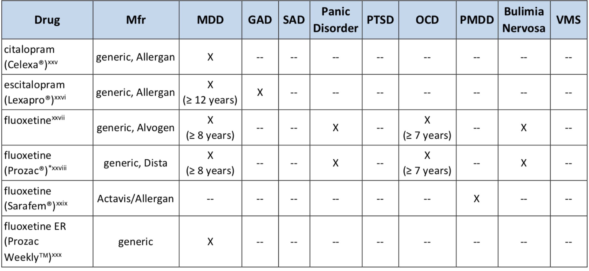
Antidepressants, SSRIs
PRODUCT LIST AND FDA-APPROVED INDICATIONS

Slide 17
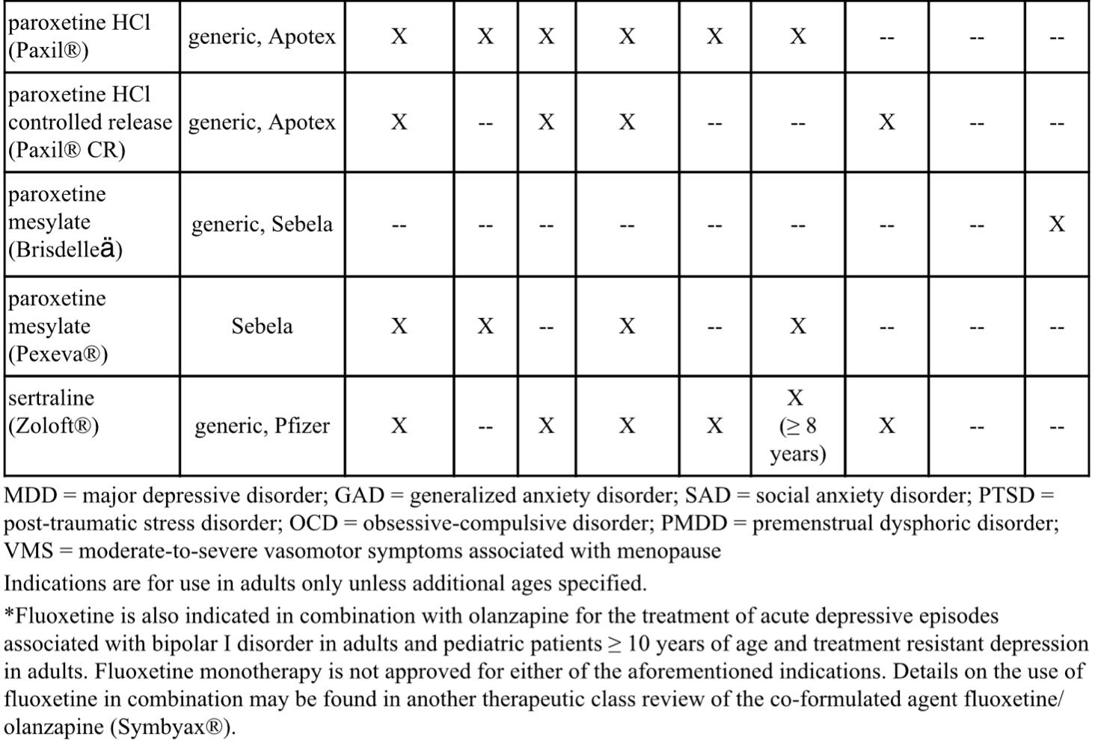
Antidepressants, SSRIs

Slide 18
Antidepressants, SSRIs
SSRIs are generally considered first-line therapy for their FDA-approved indications due to improved tolerability, lower lethality in overdose, safety in cardiovascular disease, and lesser incidence of weight gain
SSRIs have comparable efficacy and adverse event profiles for their FDA-approved indications
SSRIs are preferred as a first medication trial for OCD

Slide 19
Antidepressants, SSRIs
SSRIs are the recommended first-line medications for the treatment of PTSD
Fluoxetine (Prozac) is the only SSRI medication approved by the FDA for the treatment of bulimia and has been shown to reduce the episodes of binge-eating and purging behavior, and their chance of relapse
SSRIs are used most often for the treatment of children with MDD because studies of SSRIs were the first to show antidepressant efficacy in children
SSRIs are also first-line agents for the treatment of anxiety disorders in children. Four of the products are approved for pediatric use: escitalopram, fluoxetine, fluvoxamine, and sertraline

Slide 20
Bronchodilators, Beta Agonist

Slide 21
Bronchodilators, Beta Agonist
Class Overview: Long-Acting Agents
aformoterol tartrate - (Brovana Solution)
formoterol fumarate - (Perforomist Solution)
indacaterol maleate - (Arcapta Neohaler)
olodaterol HCl - (Striverdi Respimat)
salmeterol xinafoate - (Serevent Diskus)
Class Overview: Nebulized Agents
albuterol sulfate - (AccuNeb; albuterol neb soln 0.63mg & 1.25mg, 2.5mg/0.5ml, 2.5mg/3ml & 5mg/ml)
levalbuterol HCl – (levalbuterol neb soln; levalbuterol neb soln conc; Xopenex Neb Soln)

Slide 22
Bronchodilators, Beta Agonist
Class Overview: Oral Agents
albuterol sulfate - (albuterol ER, syrup & tablet)
metaproterenol sulfate - (metaproterenol syrup & tablet)
terbutaline sulfate - (terbutaline)
Class Overview: Short-Acting Agents
albuterol sulfate - (ProAir HFA; ProAir Respiclick; Proventil HFA; Ventolin HFA)
levalbuterol tartrate - (Xopenex HFA)

Slide 23
Bronchodilators, Beta Agonist
Prevalence and incidence of asthma in the U.S. continues to rise, affecting approximately 7.7% of adults and 8.4% of children (25.2 million Americans)
Beta₂-agonist bronchodilators are used for the treatment and prevention of bronchospasm associated with asthma, prophylaxis of exercise-induced bronchospasm (EIB), and in the treatment of Chronic Obstructive Lung Disease (COPD)
Mainstay of asthma therapy is the use of inhaled corticosteroids (ICS) alone or in combination with long-acting beta₂-agonists (LABAs) as controller medications
These agents lead to improvements in symptoms, reducing the need for short-acting beta₂-agonists (SABAs) for quick relief by relaxing airway smooth muscle

Slide 24
Bronchodilators, Beta Agonist
The 2019 GINA guidelines offer a control-based management plan which adjusts treatment through a continuous cycle of assessment and review of the patient’s response to therapy as it relates to symptom control, future risk of exacerbations, and side effects
The 2019 GOLD guidelines place a great focus on the assessment of inhaler technique and adherence to improve therapeutic outcomes
COPD pharmacotherapy of bronchodilators is intended to decrease symptoms, reduce the frequency and severity of exacerbations, improve health status and exercise tolerance
Bronchodilator medications are central to management of COPD. They improve emptying of the lungs, reduce dynamic hyperinflation at rest and during exercise, and improve exercise performance
Bronchodilators are given either on an as-needed basis for relief of persistent or worsening symptoms, or on a regular basis to prevent/reduce symptoms

Slide 25
Bronchodilators, Beta Agonist
Regular bronchodilation does not modify the decline of lung function in mild COPD or the prognosis of the disease
While short-acting beta agonists (SABAs) can be used on an as-needed basis in mild COPD, regular treatment with a long-acting beta agonist (LABA) is required as the disease progresses
Delivery system selection as well as the patients’ ability to properly use the device are important factors in the clinical success of bronchodilator therapy
Metered dose inhalers (MDIs) are pressurized spray inhalers, available in suspension and solution
Spacer chambers may be used with most MDIs to make them easier to use and help deliver a greater amount of medicine to the airway

Slide 26
Bronchodilators, Beta Agonist
Dry-powder inhalers (DPIs) are breath-actuated devices that release the medicine in the form of a dry powder upon inhalation
Nebulizers, may be the only viable alternative delivery system for certain children and those unable to use inhalers due to the inability to synchronize breaths and device actuation
Some of the newer delivery devices, (like Respimat devices), are not breath-activated, but still require coordination of actuation and inhalation
Oral dosage forms of albuterol are less utilized than the inhaled forms due to systemic beta-adrenergic stimulation, especially in patients sensitive to these effects, such as those with cardiovascular disease
Levalbuterol is the R-enantiomer form of albuterol. It has similar efficacy to albuterol and there are no significant differences in adverse effects
Salmeterol has a later onset of action than the rest of the LABAs

Slide 27
Bronchodilators, Beta Agonist
There are no comparative data to suggest that arformoterol (Brovana) or formoterol (Perforomist) are superior in efficacy or safety to the other agents.
Due to the increased risk of severe exacerbations and asthma-related death, short-acting beta agonist (SABA)-only treatment is no longer recommended
In May 2019, the FDA removed the boxed warning from the labeling for indacaterol (Arcapta Neohaler), arformoterol (Brovana), formoterol (Perforomist), and olodaterol (Striverdi). The warning still remains in the labeling of salmeterol (Serevent Diskus).
For most asthma patients, treatment can be initiated with an as-needed low dose ICS-formoterol, daily low dose ICS, or low dose ICS taken whenever SABA is taken

Slide 28
Bronchodilators, Beta Agonist

Slide 29
Bronchodilators, Beta Agonist

Slide 30
Bronchodilators, Beta Agonist

Slide 31
Bronchodilators, Beta Agonist
2019 GOLD Guidelines
Assessment of Airflow Limitation
Gold 1 | Mild, FEV1 ≥ 80% predicted
Gold 2 | Moderate, FEV1 50% to 79% predicted
Gold 3 | Severe, FEV1 30% to 49% predicted
Gold 4 | Very severe, FEV1 < 30% predicted

Slide 32
Bronchodilators, Beta Agonist
2019 GOLD Guidelines
Assessment of Exacerbation Risk and Symptoms
Patient Group A | Low Risk, Less Symptoms: 0 to 1 exacerbations per year (not leading to hospitalization); and CAT score < 10 or mMRC grade 0 to 1
Patient Group B | Low Risk, More Symptoms: 0 to 1 exacerbations per year (not leading to hospitalization); and CAT score ≥ 10 or mMRC grade ≥ 2
Patient Group C | High Risk, Less Symptoms: ≥ 2 exacerbations per year or ≥ 1 exacerbation leading to hospitalization; and CAT score < 10 or mMRC grade 0 to 1
Patient Group D | High Risk, More Symptoms: ≥ 2 exacerbations per year or ≥ 1 exacerbation leading to hospitalization; and CAT score ≥ 10 or mMRC grade ≥ 2
mMRC - Modified British Medical Research Council questionnaire used only to assesses breathlessness

Slide 33
Bone Resorption Suppression and Related Agents

Slide 34
Bone Resorption Suppression and Related Agents
^{[i]} Binosto [package insert]. San Antonio, TX; Mission Pharmacal; December 2016.
[ii] Fosamax [package insert]. Whitehouse Station, NJ; Merck; March 2016.
[iii] Fosamax Plus D [package insert]. Whitehouse Station, NJ; Merck; March 2016.
[iv] Didronel [package insert]. Rockaway, NJ; Warner Chilcott; April 2015.
[v] Boniva [package insert]. Nutley, NJ; Roche; December 2016.
[vi] Actonel [package insert]. Rockaway, NJ; Warner Chilcott; April 2015.
[vii] Atelvia [package insert]. Rockaway, NJ; Warner-Chilcott; April 2015.
Drug | Manufacturer | Indication(s)
Bisphosphonates
alendronate (Binosto®) | Mission | Treatment and prevention of osteoporosis in postmenopausal women Treatment to increase bone mass in men with osteoporosis
alendronate* (Fosamax®) | generic, Merck | Treatment and prevention of osteoporosis in postmenopausal women Treatment to increase bone mass in men with osteoporosis Treatment of glucocorticoid-induced osteoporosis in men and women receiving glucocorticoids in a daily dosage equivalent of 7.5 mg or greater of prednisone and who have low bone mineral density Treatment of Paget’s disease of bone in men and women
alendronate/ vitamin D (Fosamax® Plus D) | Merck | Treatment of osteoporosis in postmenopausal women Treatment to increase bone mass in men with osteoporosis
etidronate | generic | Treatment of Paget’s disease of bone Prevention and treatment of heterotopic ossification following total hip replacement or spinal cord injury
ibandronate (Boniva®) | generic, Roche | Treatment and prevention of osteoporosis in postmenopausal women
risedronate† (Actonel®) | generic, Actavis/Allergan | Treatment and prevention of osteoporosis in postmenopausal women Treatment to increase bone mass in men with osteoporosis Prevention and treatment of glucocorticoid-induced osteoporosis in men and women who are either initiating or continuing systemic glucocorticoids in a daily dosage equivalent of 7.5 mg or greater of prednisone for chronic diseases Treatment of Paget’s disease of bone in men and women
risedronate delayed-release (Atelvia®) | generic, Actavis/Allergan | Treatment of osteoporosis in postmenopausal women

Slide 35
Bone Resorption Suppression and Related Agents
Drug | Manufacturer | Indication(s)
Others
abaloparatide (Tymlos®) | Radius Health | Treatment of osteoporosis in postmenopausal women who are at high risk for fractures
denosumab (Prolia®) | Amgen‡ | Treatment of osteoporosis in postmenopausal women at high risk for fracture, defined as a history of osteoporotic fracture, or multiple risk factors for fracture, or in patients who have failed or are intolerant to other available osteoporosis therapy Treatment of osteoporosis associated with newly initiated or sustained systemic glucocorticoid therapy in men and women at high risk for fracture. Treatment of bone loss in men with prostate cancer on androgen deprivation therapy Treatment of bone loss in women undergoing breast cancer therapy with adjuvant aromatase therapy Treatment to increase bone mass in men diagnosed with osteoporosis and a high fracture risk who have failed or are intolerant to other potential therapies
raloxifene (Evista®) | generic, Eli Lilly | Treatment and prevention of osteoporosis in postmenopausal women Reduction in risk of invasive breast cancer in postmenopausal women who either have osteoporosis or are at high risk for invasive breast cancer
teriparatide (Forteo®) | Eli Lilly | Treatment of osteoporosis in postmenopausal women who are at high risk for fractures Increase of bone mass in men with primary or hypogonadal osteoporosis who are at high risk for fractures Treatment of men and women with osteoporosis associated with sustained systemic glucocorticoid therapy at high risk for fracture
romosozumab-aqqg (Evenity®) | Amgen | Treatment of osteoporosis in postmenopausal women at high risk for fracture, defined as a history of osteoporotic fracture, or multiple risk factors for fracture; or patients who have failed or are intolerant to other available osteoporosis therapy

Slide 36
Bone Resorption Suppression and Related Agents
Calcitonins
calcitonin-salmon | generic | Treatment of postmenopausal osteoporosis in females greater than 5 years postmenopause when alternative treatments are not suitable. Fracture reduction efficacy has not been demonstrated

Slide 37
Bone Resorption Suppression and Related Agents
Approximately 10 million Americans have a diagnosis of osteoporosis, and an additional 43 million have low bone mass, placing them at increased risk for this disease
The North American Menopause Society (NAMS), in its 2010 position statement, recommends bisphosphonates as first-line drugs to treat postmenopausal women with osteoporosis (defined as having a T-score ≤ -2.5)
The 2014 National Osteoporosis Foundation (NOF) Clinician’s Guide to Prevention and Treatment of Osteoporosis states that the treatment agent of choice should be based on available clinical information in addition to intervention thresholds
The American Association of Clinical Endocrinologists (AACE) and American College of Endocrinology (ACE) clinical practice guidelines for the diagnosis and treatment of postmenopausal osteoporosis (2016 update) recommend alendronate, risedronate, zoledronic acid, and denosumab as initial therapy for most patients at high risk of fracture

Slide 38
Bone Resorption Suppression and Related Agents
Per the AACE/ACE, teriparatide, denosumab, or zoledronic acid should be considered for patients unable to use oral therapy and as initial therapy for patients at especially high fracture risk
According to the American College of Physicians’ (ACP) published update in 2017 for the treatment of low bone density and osteoporosis to prevent fractures in men and women, pharmacologic treatment to reduce the risk for hip and vertebral fractures in women with known osteoporosis and treatment should occur for 5 years
ACP recommends against using menopausal estrogen or estrogen with progesterone or raloxifene for osteoporosis treatment in women

Slide 39
Bone Resorption Suppression and Related Agents
Regarding therapy in men, the ACP recommends that clinicians offer treatment with bisphosphonates to reduce the risk of vertebral fractures in those with clinical osteoporosis
According to the American College of Rheumatology’s (ACR) 2017 updated guidance on managing glucocorticoid-induced osteoporosis in adults and children, treatment should include optimal calcium and vitamin D intake and lifestyle changes consistent with good bone health
ACR’s recommendations on antiresorptive treatment are based on individual patient characteristics, including fracture risk, age, and special populations
In patients with moderate to high risk of fracture, oral bisphosphonates are generally recommended as first-line therapy, per ACR; subsequent treatments may include IV bisphosphonates, teriparatide, denosumab, and raloxifene

Slide 40
Bone Resorption Suppression and Related Agents
The Endocrine Society 2019 guidelines on osteoporosis recommends pharmacologic therapy for postmenopausal women at high risk of fracture, especially those with recent fracture
These patients should be treated initially with a bisphosphonate or denosumab to reduce fracture risk; however, ibandronate is not recommended to reduce the risk of nonvertebral or hip fracture
For postmenopausal women with a very high risk of fracture, these guidelines recommend starting with either teriparatide or abaloparatide for up to 2 years of treatment before switching to a bisphosphonate or denosumab to maintain bone density
Raloxifene, calcitonin, and hormone replacement therapy are only recommended if patients are not appropriate candidates for treatment with bisphosphonates or denosumab

Slide 41
Bone Resorption Suppression and Related Agents
Clinical trials have shown a decreased risk of fractures with alendronate (Fosamax), calcitonin- salmon, ibandronate (Boniva), raloxifene (Evista), risedronate (Actonel, Atelvia), denosumab (Prolia) and teriparatide (Forteo) in women with osteoporosis
Teriparatide (Forteo) showed the greatest increase in BMD in clinical trials, ranging from 5% to more than 10%; bisphosphonates increased BMD about 2% to 5%; calcitonin and raloxifene (Evista) trials showed BMD increases of approximately of 1% to 2%
When compared to once-weekly regimens, once-monthly dosing regimens do not appear to give rise to greater treatment adherence and persistence

Slide 42
Colony Stimulating Factors

Slide 43
Colony Stimulating Factors
Drug | Manufacturer | Cancer patients receiving myelosuppressive chemotherapy (To reduce incidence of infection (febrile neutropenia) | Acute Myeloid Leukemia (AML) patients receiving chemotherapy (Following induction or consolidation chemotherapy to reduce time to neutrophil recovery and the duration of fever in adults) | Bone Marrow Transplant (BMT) | Peripheral Blood Progenitor Cell Collection and Therapy | Severe Chronic Neutropenia (To reduce the incidence and duration of neutropenia in symptomatic patients with congenital neutropenia, cyclic neutropenia, or idiopathic neutropenia) | Hematopoietic Syndrome of Acute Radiation Syndrome (To Increase survival in patients acutely exposed to myelosuppressive doses of radiation)
filgrastim (Neupogen®) | Amgen | X | X | Xª | X | X | X
filgrastim-aafi (Nivestym™)* | Pfizer | X | X | Xª | X | X | --
filgrastim-sndz (Zarxio®)* | Sandoz | X | X | Xª | X | X | --
pegfilgrastim (Neulasta®) | Amgen | X | -- | -- | -- | -- | X
FDA-APPROVED INDICATIONS

Slide 44
Colony Stimulating Factors
pegfilgrastim-cbqv (Udenyca™)† | Coherus | X | -- | -- | -- | -- | --
pegfilgrastim-jmdb (Fulphila™)† | Mylan | X | -- | -- | -- | -- | --
pegfilgrastim-bmez (Ziextenzo™)† | Sandoz | X | -- | -- | -- | -- | --
sargramostim (Leukine®) | Sanofi | -- | X | X^{b} | X | -- | X
tbo-filgrastim (Granix®) | Teva | X | -- | -- | -- | -- | --

Slide 45
Colony Stimulating Factors
Colony stimulating factors (CSF) are hematopoietic growth factors that have been shown to decrease the likelihood of chemotherapy-induced neutropenic complications and to improve relative chemotherapy dose intensity
Prophylactic CSF use can reduce the severity, risk, and duration of febrile neutropenia and decrease rates of infection
Filgrastim (Neupogen), filgrastim-aafi (Nivestym), filgrastim-sndz (Zarxio), pegfilgrastim (Neulasta), pegfilgrastim-cbqv (Udenyca), pegfilgrastim-jmdb (Fulphila), pegfilgrastim-bmez (Ziextenzo), and tbo-filgrastim (Granix) are granulocyte colony-stimulating factors (G-CSF)
Sargramostim (Leukine) is a granulocyte-macrophage colony stimulating factor (GM-CSF).
Limited comparative data suggest that filgrastim (Neupogen) and pegfilgrastim (Neulasta) have similar efficacy, tolerability, and adverse drug reaction profiles

Slide 46
Colony Stimulating Factors
The administration frequency of pegfilgrastim and its biosimilars may be viewed as more favorable since these only require a single SC injection per chemotherapy cycle; whereas filgrastim, filgrastim-aafi (Nivestym), filgrastim-sndz (Zarxio), tbo-filgrastim (Granix), and sargramostim (Leukine) administration requires daily subcutaneous injection
Several biosimilars to the originator products, filgrastim (filgrastim-aafi and filgrastim-sndz) and pegfilgrastim (pegfilgrastim-cbqv, pegfilgrastim-bmez, and pegfilgrastim-jmdb), are now available
The v1.2020 NCCN practice guidelines for hematologic growth factors indicate there is higher level evidence supporting the use of filgrastim, filgrastim-aafi, filgrastim-sndz, tbo-filgrastim, and pegfilgrastim (category 1) for prophylactic use against febrile neutropenia
Pegfilgrastim-cbqv and pegfilgrastim-jmdb are rated a category 2A and sargramostim is no longer recommended in this setting

Slide 47
Colony Stimulating Factors
A recommendation for the recently approved pegfilgrastim-bmez (Ziextenzo) is not currently provided by NCCN
The guidelines note that biosimilars are biological products that are highly similar to their FDA-approved originator product with very small, clinically inactive differences but have no difference in efficacy, safety, or purity.
At this time there are insufficient head-to-head comparative studies on the clinical benefits of G-CSFs and GM-CSFs
The NCCN guidelines do not recommend CSF use in patients taking chemotherapy and radiation concurrently
NCCN guidelines recommend that high-risk patients receive prophylactic CSF regardless of the intent of treatment
For intermediate-risk patients, NCCN recommends individualized consideration of CSF based on the likelihood of developing febrile neutropenia, consequences of developing febrile neutropenia, and the implications of interfering with chemotherapy treatments
NCCN does not recommend the routine use of CSF in patients with low risk of developing febrile neutropenia

Slide 48
Gaucher Disease

Slide 49
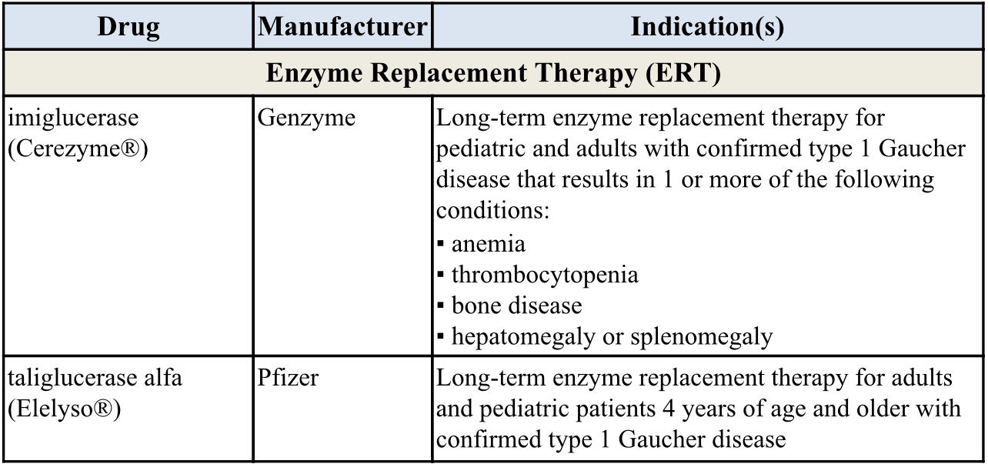
Gaucher Disease
PRODUCT LIST AND FDA-APPROVED INDICATIONS

Slide 50
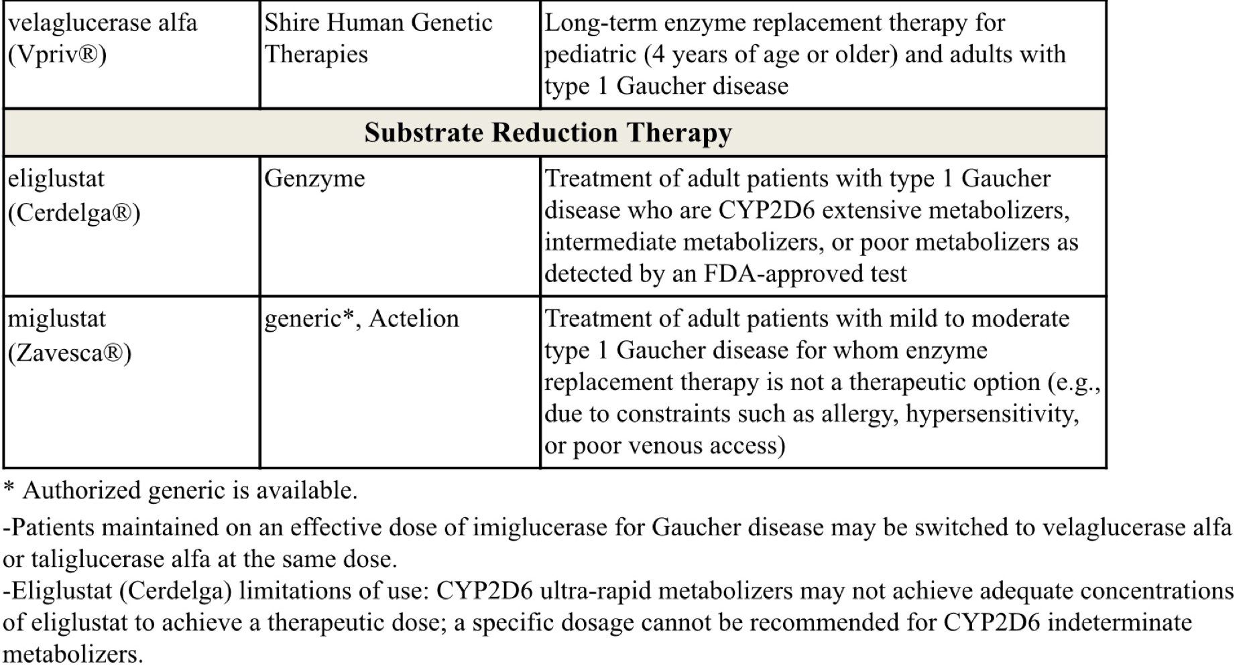
Gaucher Disease

Slide 51
Gaucher Disease
Gaucher disease (GD) is an autosomal recessive condition caused by deficiency of glucocerebrosidase
This deficiency results in abnormal accumulation of glycolipids in cell lysosomes, which can lead to skeletal disease , anemia, hemorrhage, thrombocytopenia, splenomegaly, hepatomegaly, and growth retardation
All IV enzyme replacement therapy (ERT) agents, imiglucerase (Cerezyme), velaglucerase alfa (Vpriv), and taliglucerase alfa (Elelyso) are forms of the enzyme glucocerebrosidase, whereas oral substrate reduction therapy (SRT) agents, eliglustat (Cerdelga) and miglustat (Zavesca), function as competitive and reversible inhibitors of the enzyme glucosylceramide synthase
Treatment should be individualized as response may vary

Slide 52
Gaucher Disease
The International Collaborative Gaucher Group (ICGG) Gaucher Registry guidelines developed from a consensus of international experts recommend ERT for symptomatic pediatric patients and for those with severe disease
Treatment is life-long, and therapy interruptions are not recommended
Anaphylaxis has been reported in patients treated with taliglucerase
The use of miglustat has been limited due to toxicity
In a systematic review, eliglustat and imiglucerase showed that both were effective for the treatment of type 1 GD

Slide 53
Erythropoiesis Stimulating Proteins

Slide 54
Erythropoiesis Stimulating Proteins
Drug | Manufacturer | FDA-Approved Indications
darbepoetin (Aranesp®) | Amgen | Treatment of anemia associated with chronic kidney disease (CKD) including patients on dialysis and patients not on dialysis Treatment of anemia in patients with non-myeloid malignancies where anemia is due to the effect of concomitant myelosuppressive chemotherapy and, upon initiation, a minimum of 2 additional months chemotherapy is planned Darbepoetin is not indicated for patients receiving myelosuppressive therapy when the anticipated outcome is cure or in in whom anemia can be managed by transfusion Darbepoetin is not indicated for use in patients receiving hormonal agents, therapeutic biologic products, or radiotherapy unless receiving concomitant myelosuppressive chemotherapy Darbepoetin is not indicated as a substitute for red blood cell (RBC) transfusion in patients who require immediate correction of anemia Darbepoetin use has not been demonstrated in controlled clinical trials to improve quality of life, fatigue, or patient well-being
luspatercept-aamt (Reblozyl®) | Celgene | Treatment of anemia in adult patients with beta thalassemia who require regular red blood cell (RBC) transfusions Luspatercept-aamt is not indicated for use as a substitute for RBC transfusions in patients who require immediate correction of anemia
PEG-EPO (Mircera®) | Roche/Vifor | Treatment of anemia associated with chronic renal failure (CRF) in adult patients on dialysis and adult patients not on dialysis Treatment of anemia associated with CRF in pediatric patients 5 to 17 years of age on hemodialysis who are converting from another ESA after their hemoglobin level was stabilized with an erythropoiesis stimulating agent (ESA) PEG-EPO use has not been demonstrated in controlled clinical trials to improve quality of life, fatigue, or patient well-being PEG-EPO is not indicated for treatment of anemia in patients receiving cancer chemotherapy PEG-EPO is not indicated as a substitute for red blood cell (RBC) transfusion in patients who require immediate correction of anemia

Slide 55
Erythropoiesis Stimulating Proteins
Drug | Manufacturer | FDA-approved Indications
rHuEPO (Epogen®) | Amgen | Treatment of anemia associated with CRF including patients on dialysis and patients not on dialysis to decrease the need for red blood cell (RBC) transfusion Treatment of anemia related to therapy with zidovudine (≤ 4,200 mg per week) in HIV-infected patients with endogenous serum erythropoietin levels of ≤ 500 mUnits/mL Treatment of anemia in patients with non-myeloid malignancies where anemia is due to the effect of concomitant myelosuppressive chemotherapy and, upon initiation, hemoglobin < 10 g/dL and there is a minimum of 2 additional months of planned chemotherapy Indicated to reduce the need for allogenic RBC transfusion among patients with perioperative hemoglobin > 10 to ≤ 13 g/dL who are at high risk for perioperative blood loss from elective, noncardiac, nonvascular surgery rHuEPO is not indicated for use in patients receiving hormonal agents, therapeutic biologic products, or radiotherapy unless receiving concomitant myelosuppressive chemotherapy rHuEPO is not indicated for patients receiving myelosuppressive therapy when the anticipated outcome is cure or in in whom anemia can be managed by transfusion rHuEPO is not indicated as a substitute for red blood cell (RBC) transfusion in patients who require immediate correction of anemia rHuEPO is not indicated in patients undergoing cardiac or vascular surgery ruEPO is not indicated for patients who are willing to donate autologous blood pre-operatively rHuEPO use has not been demonstrated in controlled clinical trials to improve quality of life, fatigue, or patient well-being
rHuEPO (Procrit®) | Amgen (distributed by Janssen)

Slide 56
Erythropoiesis Stimulating Proteins
Drug | Manufacturer | FDA-approved Indications
rHuEPO-epbx* (Retacrit®) | Pfizer (Hospira) | Treatment of anemia associated with CKD including patients on dialysis and patients not on dialysis to decrease the need for red blood cell (RBC) transfusion Treatment of anemia due to zidovudine administered at ≤ 4,200 mg per week in HIV-infected patients with endogenous serum erythropoietin levels of ≤ 500 mUnits/mL Treatment of anemia in patients with non-myeloid malignancies where anemia is due to the effect of concomitant myelosuppressive chemotherapy and, upon initiation, there is a minimum of 2 additional months of planned chemotherapy Reduce the need for allogeneic RBC transfusions among patients with perioperative hemoglobin > 10 to ≤ 13 g/dL who are at high risk for perioperative blood loss from elective, noncardiac, nonvascular surgery Epoetin alfa-epbx is not indicated for use in patients receiving hormonal agents, therapeutic biologic products, or radiotherapy unless receiving concomitant myelosuppressive chemotherapy Epoetin alfa-epbx is not indicated for patients receiving myelosuppressive therapy when the anticipated outcome is cure or in in whom anemia can be managed by transfusion Epoetin alfa-epbx is not indicated as a substitute for RBC transfusion in patients who require immediate correction of anemia Epoetin alfa-epbx is not indicated in patients undergoing cardiac or vascular surgery Epoetin alfa-epbx is not indicated for patients who are willing to donate autologous blood pre-operatively Epoetin alfa-epbx use has not been demonstrated in controlled clinical trials to improve quality of life, fatigue, or patient well-being

Slide 57
Erythropoiesis Stimulating Proteins
Anemia affects over 3 million Americans as it is a result of numerous diseases, as well as adverse effects of treatments
Erythropoietin is a glycoprotein produced in the kidneys that stimulates red blood cell production from bone marrow
The National Comprehensive Cancer Network (NCCN) guidelines state that erythropoiesis stimulating agents (ESAs) are associated with an increased risk of thrombosis, decreased survival, and shortened time to tumor; therefore, it is advised to use the lowest ESA dose possible to maintain hemoglobin (Hb) levels sufficient to avoid blood transfusions
The updated American Society of Clinical Oncology (ASCO) and the American Society of Hematology (ASH) joint clinical practice guidelines for the use of ESAs in patients with cancer also recommend minimizing ESA use, particularly in patients with malignancy being treated with curative intent

Slide 58
Erythropoiesis Stimulating Proteins
ESAs may be offered to patients with chemotherapy-associated anemia whose cancer treatment is not curative in intent and whose hemoglobin level is < 10 g/dL
This joint guideline recommends against the use of ESAs for the treatment of anemia associated with malignancy in patients who are not receiving concurrent myelosuppressive chemotherapy, except for patients with lower risk of myelodysplastic syndrome to avoid transfusions
Therapy with Epogen/Procrit, Mircera, and Aranesp for CKD should not exceed target hemoglobin of greater than 11 g/dL
The ASCO and ASH Update Committee maintains that all ESAs are equivalent with respect to effectiveness and safety
The international Kidney Disease: Improving Global Outcomes (KDIGO) group 2012 guidelines state that each ESA is effective in achieving and maintaining target Hb levels

Slide 59
Erythropoiesis Stimulating Proteins
Patients with endogenous serum erythropoietin levels ≤ 500 mUnits/mL, and who are receiving a dose of zidovudine ≤ 4,200 mg/week, may respond to rHuEPO therapy
Patients with endogenous serum erythropoietin levels > 500 mUnits/mL do not appear to respond to rHuEPO therapy
In 2011, the FDA published a safety communication regarding a more conservative dosing approach to ESAs in patients with CKD due to increased risks of cardiovascular (CV) events
Retacrit is the first FDA-approved biosimilar to Epogen/Procrit; Retacrit is neither considered interchangeable with nor does it carry the same indications as the reference products
Luspatercept-aamt (Reblozyl) is the first FDA-approved erythroid maturation agent, which reduces patient transfusion burden by regulating late-stage RBC maturation
It is approved for the treatment of anemia in adult patients with beta thalassemia who require regular red blood cell transfusions

Slide 60
Hypoglycemics, Alpha-Glucosidase Inhibitors

Slide 61
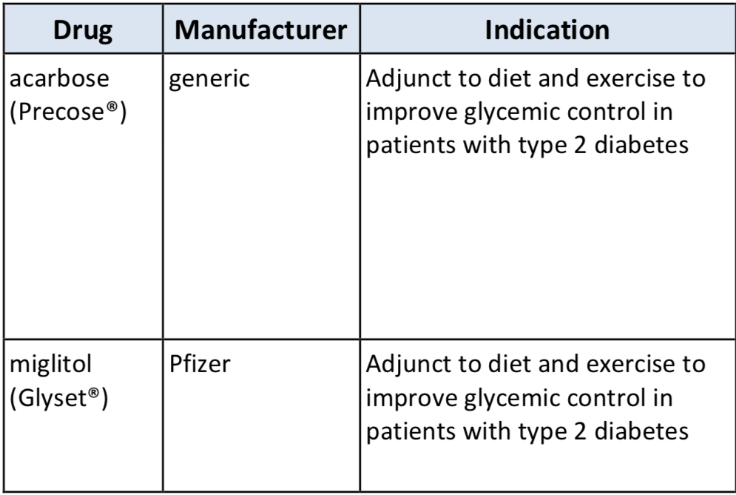
Hypoglycemics, Alpha-Glucosidase Inhibitors
PRODUCT LIST AND FDA-APPROVED INDICATIONS

Slide 62
Hypoglycemics, Alpha-Glucosidase Inhibitors
Miglitol is more potent than acarbose on a milligram-to-milligram basis
Alpha glucosidase inhibitors only have a modest effect on lowering HbA1c by about 0.4 to 0.7 percent
Alpha glucosidase inhibitors are relatively safe but GI side effects (e.g., bloating, flatulence, diarrhea) limit their use

Slide 63
Hypoglycemics, Metformins

Slide 64
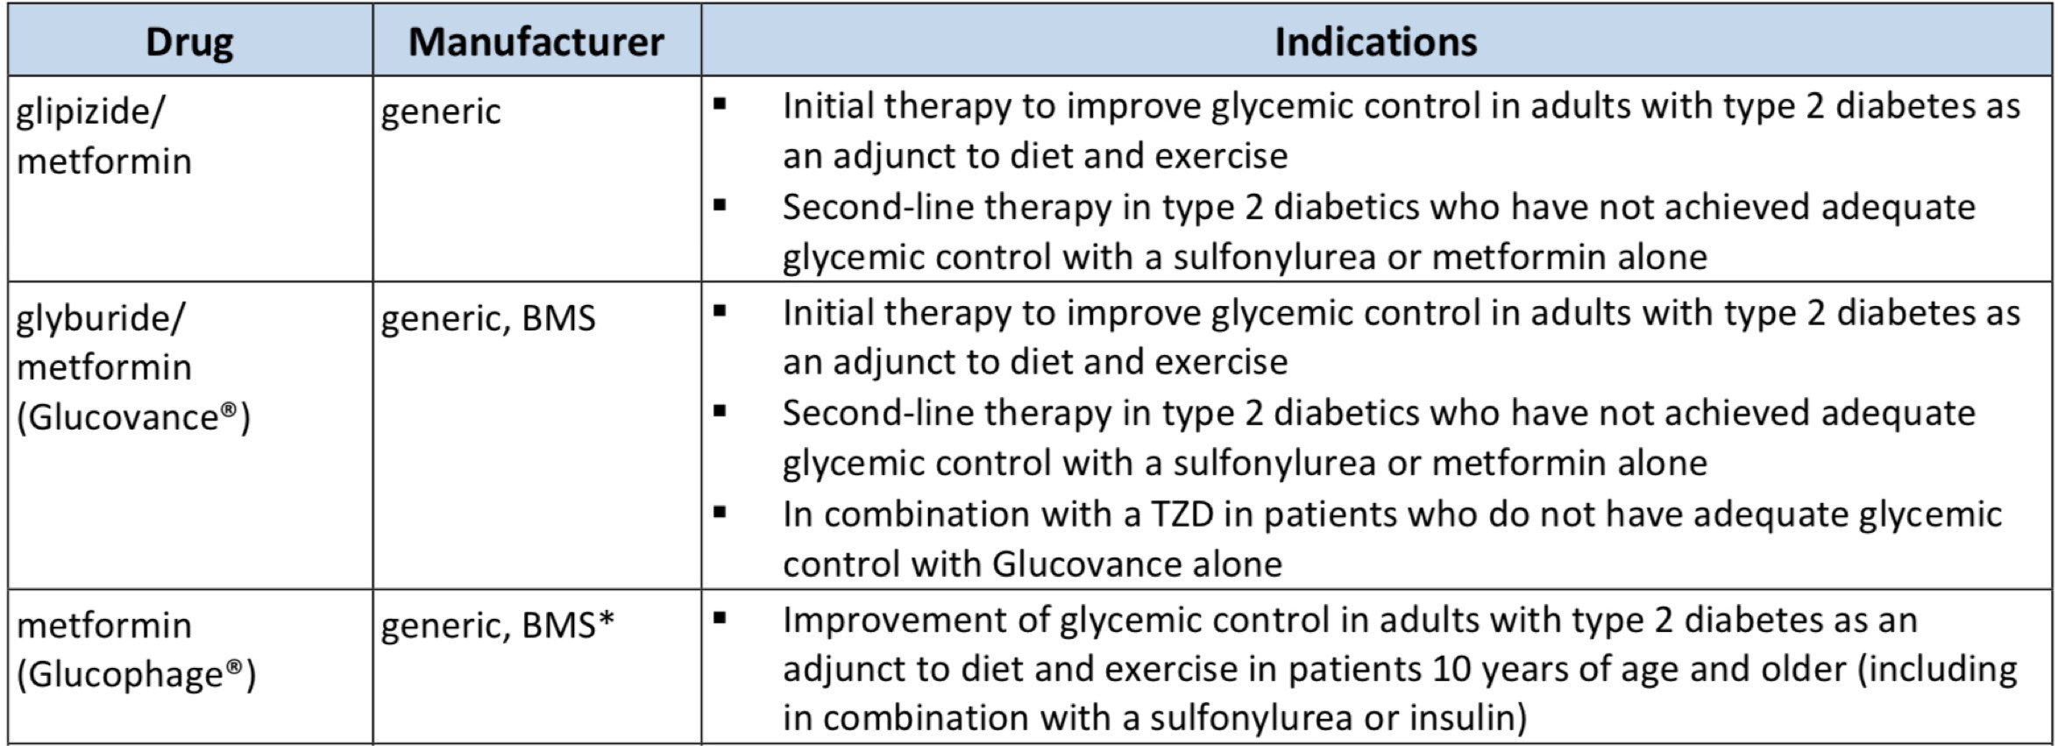
Hypoglycemics, Metformins
PRODUCT LIST AND FDA-APPROVED INDICATIONS

Slide 65
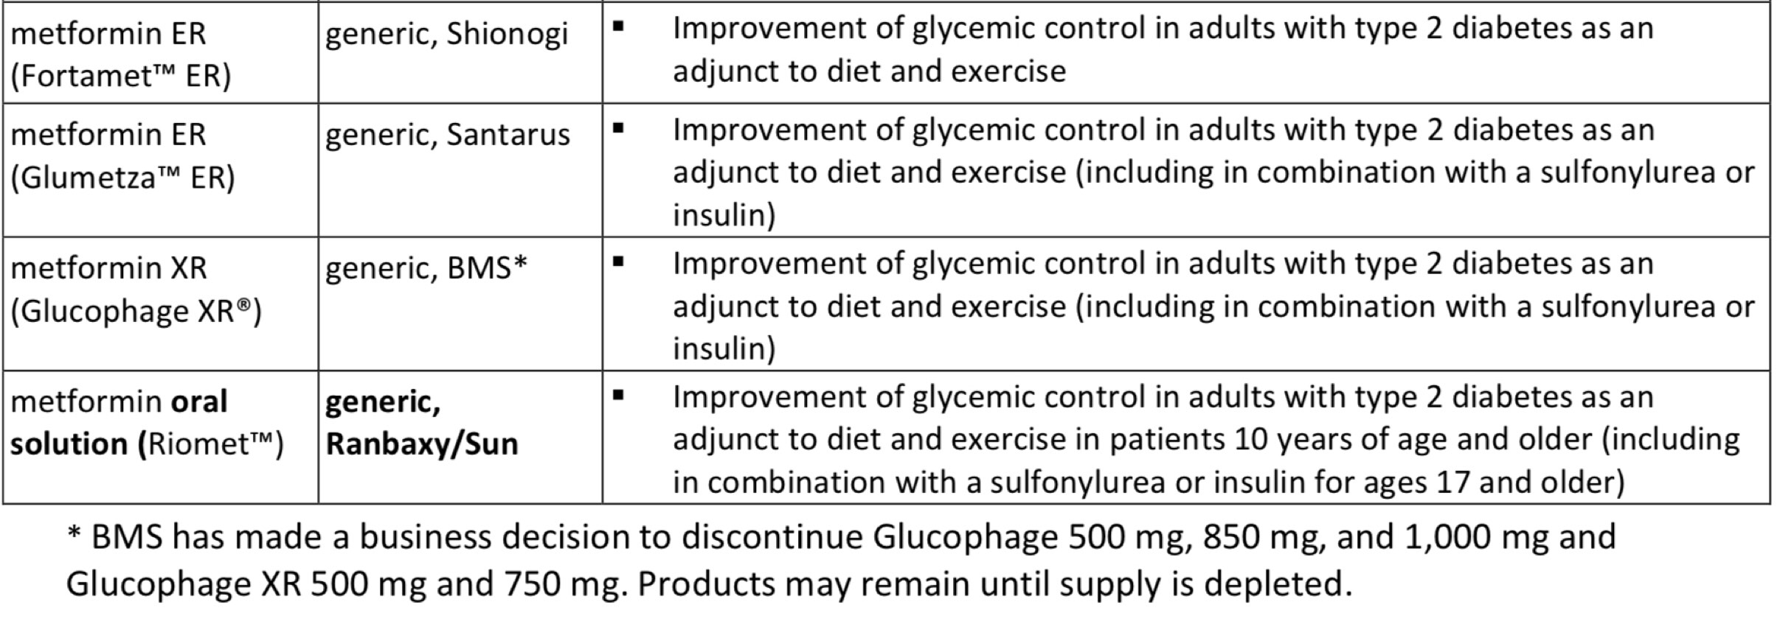
Hypoglycemics, Metformins

Slide 66
Hypoglycemics, Metformins
Findings from meta-analyses support metformin as first-line therapy, citing relative safety and beneficial effects on HbA1c, weight, and cardiovascular mortality
Per the 2019 American Diabetes Association (ADA) Standards of Medical Care in Diabetes, metformin is recommended as initial therapy for the treatment of T2DM, along with lifestyle interventions at the time of diagnosis, unless metformin is contraindicated
The American Association of Clinical Endocrinologists (AACE) and American College of Endocrinology (ACE) 2019 diabetes management algorithm and 2015 clinical practice guidelines for developing a diabetes care plan also recommend metformin as first-line therapy

Slide 67
Hypoglycemics, Metformins
The AACE/ACE guidelines lists metformin as the highest recommended agent among all anti-hyperglycemic medications for monotherapy
The American College of Physicians’ (ACP) revised 2017 guidelines for T2DM recommend metformin as first-line therapy
Metformin is contraindicated in patients with:
renal disease or severe renal dysfunction (estimated glomerular filtration rate
[eGFR] below 30 mL/minute/1.73 m2)
acute or chronic metabolic acidosis including diabetic ketoacidosis acute myocardial infarction
septicemia
pregnancy

Slide 68
Hypoglycemics, SGLT2

Slide 69
Hypoglycemics, SGLT2
Drug | Manufacturer | Indications
canagliflozin (Invokana®) | Janssen | Adjunct to diet and exercise to improve glycemic control in adults with type 2 diabetes mellitus (T2DM) To reduce the risk of major adverse cardiovascular events (MACE) in adults with T2DM and established cardiovascular disease (CVD) To reduce the risk of end-stage kidney disease, doubling of serum creatinine, cardiovascular death, and hospitalization for heart failure in adults T2DM and diabetic nephropathy with albuminuria > 300 mg/day
canagliflozin/ metformin (Invokamet®) | Janssen | Adjunct to diet and exercise to improve glycemic control in adults with T2DM when treatment with both canagliflozin and metformin is appropriate To reduce the risk of MACE in adults with T2DM and established CVD*
canagliflozin/ metformin (Invokamet® XR) | Janssen | Adjunct to diet and exercise to improve glycemic control in adults with T2DM when treatment with both canagliflozin and metformin is appropriate To reduce the risk of MACE in adults with T2DM and established CVD*
dapagliflozin (Farxiga®) | AstraZeneca | Adjunct to diet and exercise to improve glycemic control in adults with T2DM To reduce the risk of hospitalization for heart failure in adults with T2DM and established CVD or multiple cardiovascular (CV) risk factors

Slide 70
Hypoglycemics, SGLT2
dapagliflozin/ metformin ER (Xigduo® XR) | AstraZeneca | Adjunct to diet and exercise to improve glycemic control in adults with T2DM when treatment with both dapagliflozin and metformin is appropriate Dapagliflozin is indicated to reduce the risk of hospitalization for heart failure in adults with T2DM and established CVD or multiple CV risk factors.
empagliflozin (Jardiance®) | Boehringer Ingelheim | Adjunct to diet and exercise to improve glycemic control in adults with T2DM To reduce the risk of cardiovascular death in adults with T2DM and established CVD
empagliflozin/ metformin (Synjardy®) | Boehringer Ingelheim | Adjunct to diet and exercise to improve glycemic control in adults with T2DM when treatment with both empagliflozin and metformin is appropriate To reduce the risk of cardiovascular death in adults with T2DM and established CVD*
empagliflozin/ metformin ER (Synjardy® XR) | Boehringer Ingelheim | Adjunct to diet and exercise to improve glycemic control in adults with T2DM when both empagliflozin and metformin is appropriate To reduce the risk of cardiovascular death in adults with T2DM and established CVD*
ertugliflozin (Steglatro™) | Merck, Sharp & Dohme | Adjunct to diet and exercise to improve glycemic control in adults T2DM
ertugliflozin/ metformin (Segluromet™) | Merck, Sharp & Dohme | Adjunct to diet and exercise to improve glycemic control in adults with T2DM who are not adequately controlled on a regimen containing ertugliflozin or metformin, or in patients who are already treated with both ertugliflozin and metformin
^{[i]}

Slide 71
Hypoglycemics, SGLT2
It is estimated that over 30.3 million people in the United States (US) have diabetes; type 2 diabetes (T2DM) accounts for about 90% to 95% of all diagnosed cases of diabetes in adults
Studies evaluating the impact of SGLT2 inhibitors on macrovascular complications, (e.g., cardiovascular outcomes) include the EMPA-REG OUTCOME and CANVAS/CANVAS-R
The EMPA-REG OUTCOME trial reported approximately a one-third relative risk reduction for cardiovascular death, hospitalization due to heart failure, and all-cause death with use of empagliflozin (Jardiance) as compared to placebo
CANVAS and CANVAS-R trials demonstrated a 14% risk reduction (hazard ratio [HR], 0.86 [95% CI, 0.75 to 0.97]) in first occurrence of major adverse cardiovascular event (MACE) in patients with T2DM treated with canagliflozin (Invokana)

Slide 72
Hypoglycemics, SGLT2
Based on the DECLARE–TIMI 58 trial, dapagliflozin did not result in a lower rate of MACE compared to placebo; however, it did lead to reduced all-cause mortality and the composite of CV death, as well as a lower incidence of HF-related hospitalizations
The SGLT2 inhibitors are efficacious agents in reducing HbA1c, postprandial glucose, and fasting plasma glucose, as well as reducing systolic blood pressure and weight
The long-term safety of SGLT2 inhibitors remains to be established
Per the 2019 American Diabetes Association (ADA) Standards of Medical Care in Diabetes, metformin is recommended as initial therapy for the treatment of T2DM, along with lifestyle interventions at the time of diagnosis, unless metformin is contraindicated

Slide 73
Hypoglycemics, SGLT2
If metformin fails to produce the target HbA1c after 3 months of therapy, a thiazolidinedione (TZD), sulfonylurea (SU), dipeptidyl peptidase-4 (DPP-4) inhibitor, SGLT2 inhibitor, glucagon-like peptide-1 (GLP-1) receptor agonist, or basal insulin should be added in patients without atherosclerotic cardiovascular disease (ASCVD) or chronic kidney disease (CKD)
In patients with ASCVD or CKD, the addition of an agent with known cardiovascular (CV) or renal benefit (select GLP-1 agonist or select SLGT2 inhibitor) is preferred
The selection of medications should be patient-centric and prescribers should consider potential issues such as HbA1c target, impact on weight and hypoglycemia, side effects, the frequency and mode of administration, patient adherence, patient preference, and cost
Thiazolidinediones and sulfonylureas are generally considered less safe than glucagon- like peptide-1 (GLP-1) receptor agonists, sodium-glucose cotransporter type 2 (SGLT2) inhibitors, dipeptidyl peptidase 4 (DPP-4) inhibitors, or alpha-glucosidase inhibitors

Slide 74
Hypoglycemics, SGLT2
If there is a compelling need to minimize weight gain or promote weight loss, a GLP-1 agonist or SGLT2 inhibitor are recommended
The ADA prefers medications with proven CV and renal benefit in patients with CV and/or renal disease, respectively
In patients with ASCVD, the addition of empagliflozin (Class A recommendation), liraglutide (Class A recommendation), or canagliflozin (Class C recommendation) is preferred
In patients with heart failure (HF) or chronic kidney disease (CKD), empagliflozin, canagliflozin, or dapagliflozin is preferred
The American Association of Clinical Endocrinologists (AACE) and American College of Endocrinology (ACE) 2019 diabetes management algorithm and 2015 clinical practice guidelines for developing a diabetes care plan include the use of SGLT2 inhibitors as an alternative to metformin for monotherapy and as an appropriate add-on to metformin in dual therapy and triple therapy

Slide 75
Hypoglycemics, SGLT2
Per the AACE/ACE guidelines, agents for monotherapy are recommended in the following order (highest to lowest recommendation): metformin, GLP-1 receptor agonists, SGLT2 inhibitors, DPP-4 inhibitors, TZDs, alpha-glucosidase inhibitors, and sulfonylureas/secretagogue glinides
AACE/ACE recognizes that empagliflozin and canagliflozin are associated with significantly reduced cardiac mortality, hospitalization for heart failure, as well as secondary renal endpoints
Additionally, dapagliflozin demonstrated reduced all-cause mortality and the composite of CV death and HF hospitalization; however, it did not significantly lower the combined risk of CV death and nonfatal MI and stroke
The American College of Physicians’ (ACP) revised 2017 guidelines for T2DM recommend metformin as first-line therapy, and a sulfonylurea, TZD, SGLT-2 inhibitor, or a DPP-4 inhibitor as preferred second-line treatments

Slide 76
Hypoglycemics, SGLT2
In 2015, the Food and Drug Administration (FDA) issued a warning that use of SGLT2 inhibitors may lead to ketoacidosis
In May 2017, the FDA released a safety communication based on final safety data from the CANVAS and CANVAS-R studies, which revealed approximately a 2- fold increase in leg and foot amputations (primarily toes) in patients with T2DM who were treated with canagliflozin compared to placebo
In August 2018, the FDA issued another safety communication regarding the risk of Fournier’s gangrene with the use of the SGLT2 inhibitors
As a result, the FDA is requiring a new warning to be added to the labeling of all SGLT2 inhibitors and SGLT2 inhibitor-containing medications regarding this risk
The FDA also recently alerted prescribers of an increased risk of bone fracture in patients treated with canagliflozin (Invokana, Invokamet, Invokamet XR)

Slide 77
Hypoglycemics, SGLT2
The 2018 World Health Organization (WHO) guidelines for treatment intensification in patients with T2DM recommend addition of a DPP-4 inhibitor, a SGLT2 inhibitor, or a TZD if insulin is unsuitable in patients with T2DM who do not achieve glycemic control with metformin and/or a sulfonylurea
The Endocrine Society issued 2019 guideline recommendations for diabetes in patients aged ≥ 65 years
They recommend simplified outpatient medication regimens and glycemic targets tailored to improve compliance and prevent complications, such as hypoglycemia and falls, particularly in patients with cognitive impairment
When pharmacological therapy is indicated, metformin, in addition to lifestyle management, is recommended first-line
If glycemic targets are not attained with metformin and lifestyle management, oral and injectable therapies with low risk for hypoglycemia are suggested
The guidelines also have recommendations for management of common comorbidities in this population including hypertension, hyperlipidemia, congestive heart failure, retinopathy, neuropathy, and chronic kidney disease

Slide 78
Immune Globulins

Slide 79
Immune Globulins
Drug | Manufacturer | Indications
Intravenous
Bivigam® | Biotest | Primary humoral immunodeficiency
Flebogamma® DIF 5% and 10%, | Grifols | Primary (inherited) immunodeficiency Chronic primary immune thrombocytopenia (10% only)
Gammagard® S/D | Baxalta | Primary humoral immunodeficiency Prevention of bacterial infections in hypogammaglobulinemia and/or recurrent bacterial infections associated with B-cell chronic lymphocytic leukemia Chronic idiopathic thrombocytopenic purpura Prevention of coronary artery aneurysms associated with Kawasaki syndrome
Gammaplex® 5% and 10%, | Bio Products Laboratory | Primary humoral immunodeficiency Chronic immune thrombocytopenic purpura
Octagam® 5% and 10%, | Octapharma USA | Primary humoral immunodeficiency (5% only) Chronic immune thrombocytopenic purpura (10% only)
Panzyga® | Octapharma USA/ Pfizer | Primary humoral immunodeficiency Chronic immune thrombocytopenia
Privigen® | CSL Behring | Primary humoral immunodeficiency Chronic immune thrombocytopenic purpura Chronic inflammatory demyelinating polyneuropathy (Limitation of use: maintenance therapy has not been studied > 6 months)

Slide 80
Immune Globulins
Intravenous or Subcutaneous
Gammagard® Liquid | Baxalta | Primary humoral immunodeficiency Multifocal motor neuropathy
Gammaked™ | Kedrion Biopharm† | Primary humoral immunodeficiency Idiopathic thrombocytopenic purpura (IV use only) Chronic inflammatory demyelinating polyneuropathy (IV use only)
Gamunex®-C | Grifols Therapeutics | Primary humoral immunodeficiency Idiopathic thrombocytopenic purpura (IV use only) Chronic inflammatory demyelinating polyneuropathy (IV use only)

Slide 81
Immune Globulins
Subcutaneous
Cutaquig® | Octapharma USA | Primary humoral immunodeficiency
Cuvitru™ | Baxalta | Primary humoral immunodeficiency
Hizentra® | CSL Behring | Primary immune deficiency Maintenance therapy in patients with chronic inflammatory demyelinating polyneuropathy
immune globulin 10%/recombinant human hyaluronidase (Hyqvia®) | Baxalta | Primary immune deficiency‡
^{[i]} C

Slide 82
Immune Globulins

Slide 83
Immune Globulins
Exogenous immune globulin product has also been FDA approved for use in multifocal motor neuropathy (MMN), chronic inflammatory demyelinating polyneuropathy (CIDP), idioathic thrombocytopenic purpura (ITP), Kawasaki disease, and B-cell chronic lymphocytic leukemia
Therapeutic immune globulin is prepared from pooled plasma obtained from healthy donors at plasma donation centers in the US
These products are purified to contain 95% to 99% IgG with trace amounts of IgA and IgM
Each product has validated their production methods to ensure low risk of transmission of viruses
Preparation for each product differs in purification, including production methods related to fractionation, exchange chromatography, and filtration

Slide 84
Immune Globulins
The AAAAI and the Clinical Immunology Society both recommend product selection to be relied heavily on patient-specific characteristics
The subcutaneous route is as efficacious as the intravenous route for the treatment of primary immunodeficiencies
All the products in the class have similar efficacy and safety profiles
Due to limited supply, the use of immune globulin products should be reserved for approved indications or conditions where the benefit has been clearly established and is consistent with clinical guidelines

Slide 85
Oncology Oral, Hematologic Products

Slide 86
Oncology Oral, Hematologic Products
Drug | Manufacturer | FDA-Approved Indications
acalabrutinib (Calquence®) | AstraZeneca | Treatment of adults with mantle cell lymphoma (MCL) treated with ≥ 1 prior therapy*
bosutinib (Bosulif®) | Pfizer | Newly diagnosed chronic phase (CP) Ph+ CML Treatment of chronic, accelerated, or blast phase Ph+ chronic myeloid leukemia (CML) with resistance or intolerance to prior therapy
busulfan (Myleran®) | Aspen/ Prasco LA | Palliative treatment of chronic myelogenous (myeloid, myelocytic, granulocytic) leukemia†
chlorambucil (Leukeran®) | Aspen/ Prasco LA | Treatment of chronic lymphatic (lymphocytic) leukemia, malignant lymphomas, including lymphosarcoma, giant follicular lymphoma, and Hodgkin’s disease; chlorambucil is not curative in any of these disorders but may produce clinically useful palliation
dasatinib (Sprycel®) | Bristol-Meyers Squibb | Treatment of adults with chronic, accelerated, or myeloid or lymphoid blast phase Ph+ CML with resistance or intolerance to prior therapy including imatinib (Gleevec) Treatment of adults with Ph+ acute lymphoblastic leukemia (ALL) with resistance or intolerance to prior therapy Newly diagnosed adult patients with Ph+ CML in chronic phase Treatment of pediatric patients with Ph+ CML in chronic phase Treatment of pediatric patients with newly diagnosed Ph+ ALL in combination with chemotherapy
^{[i]} Calquence [package insert]. Wilmington, DE. AstraZeneca; November 2017.
^{[ii]} Bosulif [package insert]. New York, NY. Pfizer; October 2018.^{i]} Myleran [package insert] Mason, OH. Aspen Global; September 2017.
^{[iv]} Leukera [package insert] Mason, OH. Aspen Global; November 2017.
[v] Sprycel [package insert]. Princeton, NJ; Bristol-Meyers Squibb; December 2018.

Slide 87
Oncology Oral, Hematologic Products
duvelisib (Copiktra®) | Verastem | Relapsed or refractory chronic lymphocytic leukemia (CLL) or small lymphocytic lymphoma (SLL) after ≥ 2 prior therapies Relapsed or refractory follicular lymphoma (FL) after ≥ 2 prior systemic therapies*
enasidenib (Idhifa®) | Celgene | Relapsed or refractory acute myeloid leukemia (AML) with an isocitrate dehydrogenase-2 (IDH2) mutation, as determined with an FDA-approved test‡
fedratinib (Inrebic®) | Celgene | Intermediate-2 or high-risk primary or secondary post-polycythemia vera or post-essential thrombocythemia myelofibrosis (MF)
gilteritinib (Xospata®) | Astellas | Relapsed or refractory adults with AML with a FLT3 mutation, as detected by an FDA-approved test‡
glasdegib (Daurismo™) | Pfizer | In combination with low-dose cytarabine, for the treatment of newly diagnosed AML in adult patients who are ≥ 75 years old or who have comorbidities that preclude use of intensive induction chemotherapy§
^{[i]} Copiktra [package insert]. Needham, MA; Veastem; September 2018.
[ii] Idhifa [package insert]. Summit, NJ; Celgene; August 2017.
^{[iii]} Inrebic [package insert]. Summit, NJ; Celgene; August 2019.
^{[iv]} Xospata [package insert]. Northbrook, I; Astellas; May 2019.
^{[v]} Daurismo [package insert]. New York, NY; Pfizer; November 2018.

Slide 88
Oncology Oral, Hematologic Products
hydroxyurea (Hydrea®) | generic, Bristol-Myers Squibb | Resistant CML Locally advanced squamous cell carcinomas of the head and neck (excluding lip), in combination with concurrent chemoradiation‖
ibrutinib (Imbruvica®) | Pharmacyclics | Mantle cell lymphoma (MCL) in patients who have received ≥ 1 prior therapy* CLL/ SLL CLL/ SLL with 17p deletion Waldenström’s macroglobulinemia Marginal zone lymphoma (MZL) requiring systemic therapy and patient has had prior anti-CD20-based therapy* Chronic graft versus host disease (cGVHD) after failure of ≥ 1 line of systemic therapy
idelalisib (Zydelig®) | Gilead | Relapsed chronic CLL in combination with rituximab in patients for whom rituximab alone would be considered appropriate therapy due to other comorbidities¶ Relapsed follicular B-cell non-Hodgkin’s lymphoma in patients who have received ≥ 2 prior systemic therapies*,¶ Relapsed SLL in patients who have received ≥ 2 prior systemic therapies*,¶

Slide 89
Oncology Oral, Hematologic Products
imatinib (Gleevec®) | generic, Novartis | Newly diagnosed adult and pediatric patients with Ph+ CML in chronic phase Patients with Ph+ CML in blast crisis, accelerated phase, or chronic phase after failure of interferon-alpha therapy Adult patients with relapsed or refractory Ph+ ALL Pediatric patients with newly diagnosed Ph+ ALL in combination with chemotherapy Adult patients with myelodysplastic/ myeloproliferative diseases associated with platelet-derived growth factor receptor (PDGFR) gene re-arrangements as determined with an FDA-approved test‡ Adult patients with aggressive systemic mastocytosis without the D816V c-Kit mutation, as determined with an FDA-approved test or with c-Kit mutational status unknown‡ Adult patients with hypereosinophilic syndrome and/or chronic eosinophilic leukemia who have the FIP1L1-PDGFRα fusion kinase (mutational analysis or FISH demonstration of CHIC2 allele deletion) and for patients with hypereosinophilic syndrome and/or chronic eosinophilic leukemia who are FIP1L1-PDGFRα fusion kinase-negative or unknown Adult patients with unresectable, recurrent, and/or metastatic dermatofibrosarcoma protuberans (DFSP) Patients with Kit (CD117)-positive unresectable and/or metastatic malignant gastrointestinal stromal tumors (GIST) Adjuvant treatment of adult patients following resection of Kit (CD117)-positive GIST

Slide 90
Oncology Oral, Hematologic Products
Drug | Manufacturer | FDA-Approved Indications
ivosidenib (Tibsovo®) | Agios | Adult patients with relapsed or refractory AML with a susceptible isocitrate dehydrogenase-1 (IDH1) mutation, as detected by an FDA-approved test‡ Adult patients with newly diagnosed AML who are ≥ 75 years old or who have comorbidities that preclude the use of intensive induction chemotherapy with a susceptible IDH1 mutation, as detected by an FDA-approved test‡
ixazomib (Ninlaro®) | Takeda/ Millennium | In combination with lenalidomide and dexamethasone for the treatment of multiple myeloma in patients who have received ≥ 1 prior therapy
lenalidomide (Revlimid®) | Celgene | In combination with dexamethasone for the treatment of multiple myeloma As maintenance therapy for multiple myeloma following autologous hematopoietic stem cell transplantation (auto-HSCT) Treatment of transfusion-dependent anemia due to low-or intermediate-1-risk myelodysplastic syndromes associated with a deletion of 5q cytogenetic abnormality with or without additional cytogenetic abnormalities Treatment of mantle cell lymphoma after relapse or disease progression after 2 prior therapies, 1 of which included bortezomib In combination with a rituximab product for the treatment of previously treated FL In combination with a rituximab product for the treatment of previously treated MZL

Slide 91
Oncology Oral, Hematologic Products
melphalan (Alkeran®) | generic, Apopharma | Palliative treatment of multiple myeloma Palliation of non-resectable epithelial carcinoma of the ovary
mercaptopurine (Purixan®), | generic (tablets); Nova (suspension) | ALL as a component of a combination maintenance therapy regimen
midostaurin (Rydapt®) | Novartis | Newly diagnosed AML that is FLT3 mutation-positive as detected by an FDA-approved test‡, in combination with standard cytarabine and daunorubicin induction and cytarabine consolidation** Aggressive systemic mastocytosis (ASM), systemic mastocytosis with associated hematological neoplasm (SM-AHN), or mast cell leukemia
nilotinib (Tasigna®) | Novartis | Accelerated phase and chronic phase Ph+ CML in adult patients resistant to or intolerant to prior therapy that included imatinib (Gleevec) Newly diagnosed adult and pediatric patients ≥ 1 year of age with Ph+ CML in chronic phase Treatment of chronic phase Ph+ CML with resistance or intolerance to prior tyrosine kinase inhibitor (TKI) therapy in pediatric patients ≥ 1 year of age
panobinostat (Farydak®) | Novartis/Secura | Treatment of multiple myeloma in combination with bortezomib and dexamethasone in patients who have received ≥ 2 prior regimens, including bortezomib and an immunomodulatory agent*

Slide 92
Oncology Oral, Hematologic Products
Drug | Manufacturer | FDA-Approved Indications
pomalidomide (Pomalyst®) | Celgene | For use in combination with dexamethasone for patients with multiple myeloma who have received ≥ 2 prior therapies including lenalidomide and a proteasome inhibitor and have demonstrated disease progression on or within 60 days of completion of the last therapy
ponatinib (Iclusig®) | Ariad/Takeda, Millennium | Treatment of adult patients with T315I-positive chronic myeloid leukemia (CML) (chronic phase, accelerated phase, or blast phase) or T315I-positive Philadelphia chromosome positive acute lymphoblastic leukemia (Ph+ALL) Treatment of adult patients with chronic phase, accelerated phase, or blast phase chronic myeloid leukemia or Ph+ALL for whom no other TKI is indicated††
procarbazine (Matulane®) | Leadiant | For use in combination with other anticancer drugs for the treatment of stage 3 and stage 4 Hodgkin’s disease; used as part of the MOPP regimen (nitrogen mustard, vincristine, procarbazine, prednisone)
ruxolitinib (Jakafi®) | Incyte | Intermediate or high-risk MF, including primary MF, post-polycythemia vera MF and post-essential thrombocythemia MF Treatment of polycythemia vera in patients who have had an inadequate response to or are intolerant of hydroxyurea Treatment of steroid-refractory acute graft versus host disease (GVHD) in adult and pediatric patients ≥ 12 years of age
selinexor (Xpovio™) | Karyopharm | In combination with dexamethasone for the treatment of relapsed or refractory multiple myeloma (RRMM) who have received ≥ 4 prior therapies and whose disease is refractory to ≥ 2 proteasome inhibitors, ≥ 2 immunomodulatory agents, and an anti-CD38 monoclonal antibody*

Slide 93
Oncology Oral, Hematologic Products
thalidomide (Thalomid®) | Celgene | Treatment of newly diagnosed multiple myeloma in combination with dexamethasone Acute treatment of cutaneous manifestations of moderate to severe erythema nodosum leprosum (ENL)‡‡ ^{Pre}evention and suppression of cutaneous manifestations of ENL recurrence as maintenance therapy
thioguanine (Tabloid®) | Aspen/Prasco LA | For remission induction and remission consolidation of acute nonlymphocytic leukemias§§
tretinoin | generic | For remission induction in patients with acute promyelocytic leukemia (APL), FAB classification M3 characterized by the presence of the t(15;17) translocation and/or presence of the PML/RARα gene who are refractory to, have relapsed from, or have a contraindication to anthracycline chemotherapy‖‖
venetoclax (Venclexta®) | AbbVie | Treatment of CLL or SLL in adult patients In combination with azacitidine, decitabine, or low-dose cytarabine for the treatment of newly diagnosed AML in adults who are age 75 years or older or who have comorbidities that preclude use of intensive induction chemotherapy*
vorinostat (Zolinza®) | Merck, Sharp & Dohme | Treatment of cutaneous manifestations of cutaneous T-cell lymphoma (CTCL) in patients who have progressive, persistent, or recurrent disease on or following 2 systemic therapies

Slide 94
Ophthalmics Anti-Inflammatory & Immunomodulators

Slide 95
Ophthalmics, Anti-Inflammatory/Immunomodulators
PRODUCT LIST AND FDA-APPROVED INDICATIONS

Slide 96
Ophthalmics, Anti-Inflammatory/Immunomodulators
Dry eye disease (DES)/ Keratoconjunctivitis sicca (KCS) affects approximately 10% to 30% of the US population and occurs more commonly in patients over 40 years of age and in postmenopausal women
According to the 2018 Preferred Practice Parameter on dry eye syndrome and the 2018 Cornea/External Disease Summary Benchmark from the American Academy of Ophthalmology (AAO), artificial tear substitutes are recommended for mild DES
Recommended measures for moderate dry eyes include use of anti-inflammatory agents, such as topical cyclosporine (Cequa, Restasis, Restasis Multidose), lifitegrast (Xiidra), topical corticosteroids, or systemic omega-3 fatty acids supplements, along with artificial tears

Slide 97
Ophthalmics, Anti-Inflammatory/Immunomodulators
For severe dry eye, in addition to the above-mentioned treatments, systemic cholinergics, systemic anti-inflammatories, mucolytic agents, autologous serum tears, contact lenses, permanent punctal occlusion, and tarsorrhaphy are recommended
No clinical trials have been published comparing any of the 3 agents in this class, but all have demonstrated efficacy against vehicle
Significant adverse effects are similar between the 3 agents in this class

Slide 98
Otic Antibiotics

Slide 99
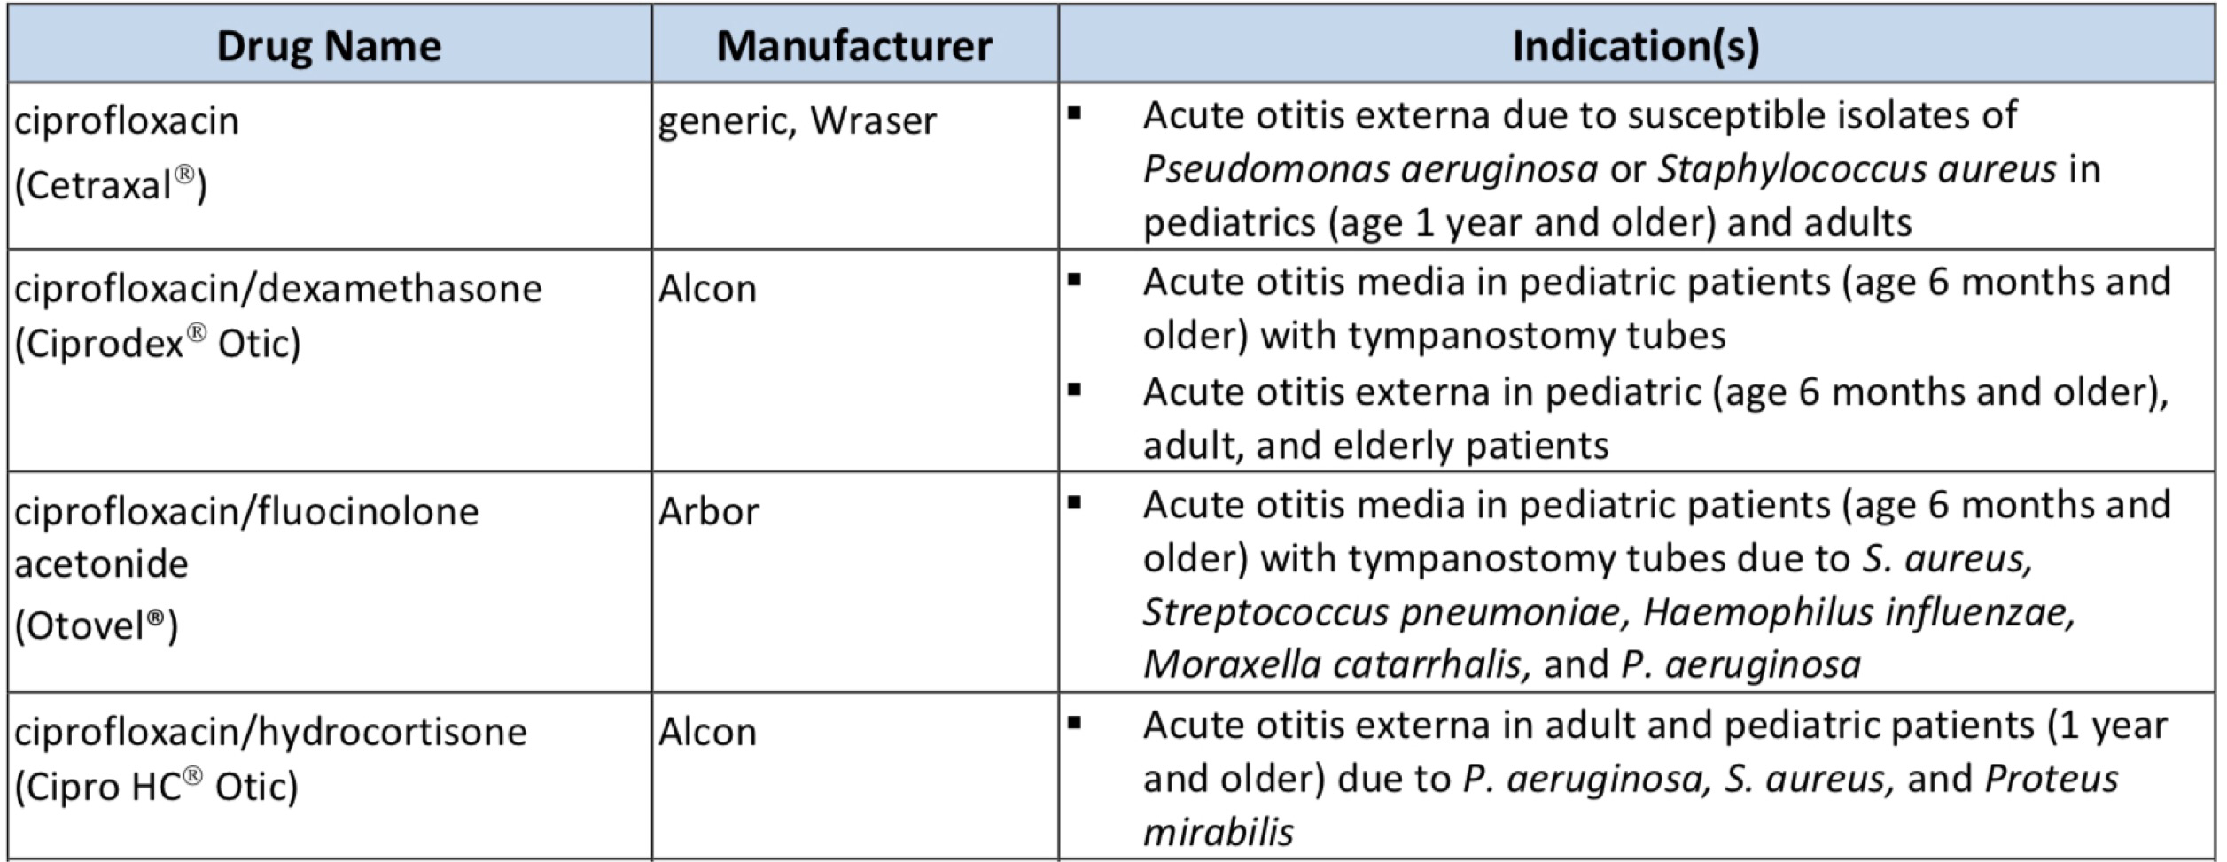
Otic Antibiotics
PRODUCT LIST AND FDA-APPROVED INDICATIONS

Slide 100
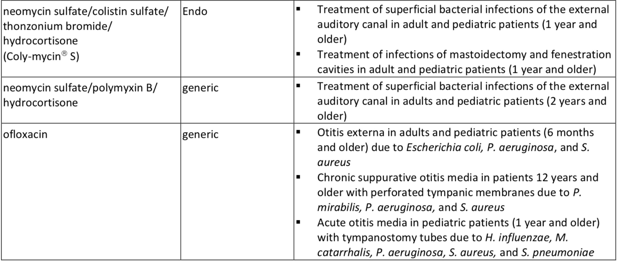
Otic Antibiotics

Slide 101
Otic Antibiotics
The American Academy of Otolaryngology – Head and Neck Surgery Foundation (AAO-HNSF) guidelines for the management of acute otitis externa (AOE) in patients over 2 years of age recommend topical preparations for initial therapy of diffuse, uncomplicated AOE
A topical aminoglycoside combined with a second antibiotic and a topical steroid, such as the combination of neomycin, polymyxin B, and hydrocortisone is commonly prescribed to treat AOE
While the addition of a corticosteroid may be of benefit in reducing inflammation, some consider the use of corticosteroids unnecessary

Slide 102
Otic Antibiotics
For acute otitis media, consensus guidelines recommend systemic antibiotics, usually amoxicillin as first line therapy
Otic antibiotics provide an alternative to other topical antibiotics in the treatment of acute otitis media in children with tympanostomy tubes
For chronic suppurative otitis media (CSOM), aminoglycosides or fluoroquinolones can be used
Aminoglycosides are not recommended to be used if the tympanic membrane is perforated; fluoroquinolones are not associated with ototoxicity, and ofloxacin is considered safe in cases of a perforated tympanic membrane

Slide 103
Pulmonary Arterial Hypertension (PAH) Agents, Oral and Inhaled

Slide 104
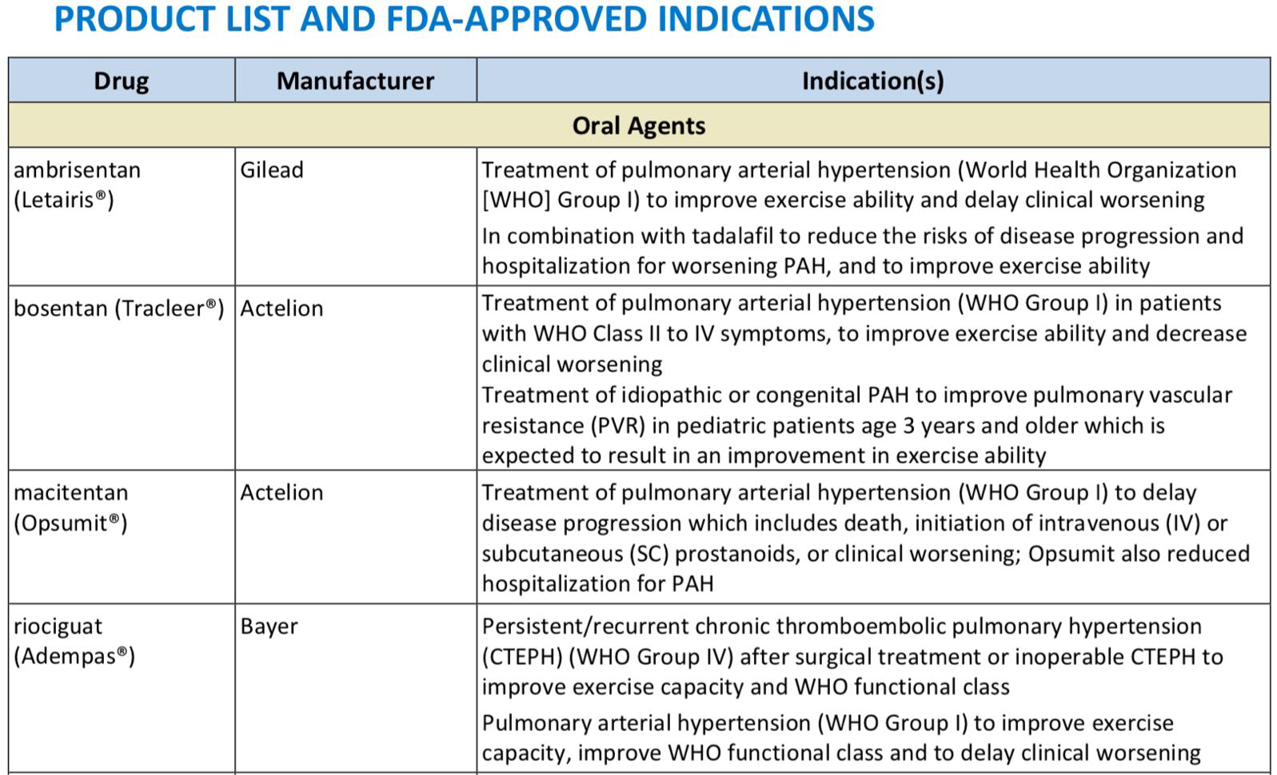
Pulmonary Arterial Hypertension (PAH) Agents, Oral and Inhaled

Slide 105
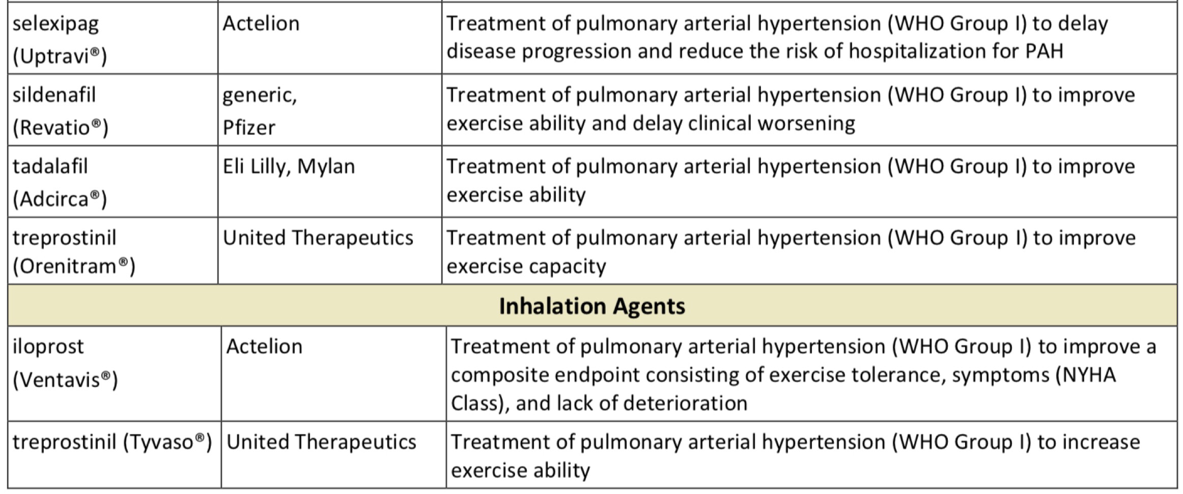
Pulmonary Arterial Hypertension (PAH) Agents, Oral and Inhaled

Slide 106
Pulmonary Arterial Hypertension (PAH) Agents, Oral and Inhaled
The treatment for pulmonary arterial hypertension (PAH) is complex
A trial of high dose oral calcium channel blockers (CCB), such as amlodipine, diltiazem, or nifedipine, is recommended in patients with a positive acute vasoreactive test
Alternative or additional PAH therapy should be initiated if improvement to WHO FC I or II are not seen after the trial of a CCB
The 2018 updated American College of Chest Physicians (CHEST) guidelines on therapy for pulmonary arterial hypertension in adults provide treatment recommendations based on World Health Organization (WHO) functional class (FC) for patients who are not candidates for, or who have failed, high-dose oral calcium channel blocker (CCB) therapy

Slide 107
Pulmonary Arterial Hypertension (PAH) Agents, Oral and Inhaled
In treatment-naïve patients with WHO FC II or WHO FC III without rapid disease progression or poor prognosis, initial combination therapy with ambrisentan and tadalafil is suggested
Monotherapy with ambrisentan, bosentan, sildenafil, macitentan, tadalafil, or riociguat is considered an alternative in patients who are unwilling to take or cannot tolerate combination therapy
For treatment-naïve patients with WHO FC IV, initial therapy with a parenteral prostanoid agent is recommended
If the patient cannot comply with parenteral administration, an inhaled prostanoid in combination with an oral endothelin receptor antagonist (ERA) or an oral phosphodiesterase type-5 (PDE-5) inhibitor are alternatives

Slide 108
Pulmonary Arterial Hypertension (PAH) Agents, Oral and Inhaled
If symptoms still remain during treatment with an oral ERA or PDE-5 inhibitor, addition of an inhaled prostanoid is suggested
In patients with WHO FC III and continued disease progression while on oral mono- or combination therapy, addition of a parenteral or inhaled prostanoid may be considered
In patients with WHO FC III or IV and an inadequate response to initial therapy with mono- or combination therapy, a second or third class of PAH agents should be added
The European Society of Cardiology (ESC) and the European Respiratory Society (ERS) 2015 recommendations for the diagnosis and treatment of pulmonary hypertension include Selexipag as an option for monotherapy or in combination with an ERA and/or PDE-5 inhibitor in patients with WHO FC II or III
ESC/ERS also include oral treprostinil as an option for monotherapy in patients with WHO FC III

Slide 109
Thrombopoiesis Stimulating Proteins

Slide 110
Thrombopoiesis Stimulating Proteins
Drug | Manufacturer | Indication(s)
avatrombopag (Doptelet®) | Akarx/Dova | Treatment of thrombocytopenia in adults with chronic immune thrombocytopenia (ITP) who have had an insufficient response to a previous treatment Treatment of thrombocytopenia in adult patients with chronic liver disease (CLD) who are scheduled to undergo a procedure
eltrombopag (Promacta®) | Novartis | Treatment of thrombocytopenia in adult and pediatric patients ≥ 1 year of age with chronic immune thrombocytopenia (ITP) who have had an insufficient response to corticosteroids, immunoglobulins, or splenectomy Eltrombopag should only be used in patients with ITP whose degree of thrombocytopenia and clinical condition increase the risk for bleeding Treatment of thrombocytopenia in patients with chronic hepatitis C (HCV) to allow the initiation and maintenance of interferon-based therapy Eltrombopag should be used only in patients with chronic HCV whose degree of thrombocytopenia prevents the initiation of interferon-based therapy or limits the ability to maintain interferon-based therapy Safety and efficacy have not been established in combination with direct acting antiviral agents approved for treatment of chronic HCV infection In combination with standard immunosuppressive therapy for first-line treatment of adult and pediatric patients ≥ 2 years of age with severe aplastic anemia Treatment of patients with severe aplastic anemia who have had an insufficient response to immunosuppressive therapy Eltrombopag is not indicated for the treatment of myelodysplastic syndrome (MDS)

Slide 111
Thrombopoiesis Stimulating Proteins
fostamatinib disodium hexahydrate (Tavalisse™) | Rigel | Treatment of thrombocytopenia in adult patients with chronic immune thrombocytopenia (ITP) who have had an insufficient response to a previous treatment
lusutrombopag (Mulpleta®) | Shionogi | Treatment of thrombocytopenia in adult patients with CLD who are scheduled to undergo a procedure
romiplostim (Nplate®) | Amgen | Treatment of pediatric patients ≥ 1 year of age with immune thrombocytopenia (ITP) for ≥ 6 months who have had an insufficient response to corticosteroids, immune globulins, or splenectomy Treatment of adults with chronic immune thrombocytopenia (ITP) who have an insufficient response with corticosteroids, immunoglobulins, or splenectomy Romiplostim is not indicated to treat thrombocytopenia due to myelodysplastic syndrome (MDS) or any cause of thrombocytopenia other than chronic ITP Romiplostim should only be used in patients with ITP whose degree of thrombocytopenia and clinical condition increases their risk for bleeding Romiplostim is not indicated for the treatment of thrombocytopenia due to MDS or any cause of thrombocytopenia other than chronic ITP Romiplostim should not be used in an attempt to normalize platelet counts

Slide 112
Thrombopoiesis Stimulating Proteins
Thrombocytopenia occurs in 64% to 84% of patients chronic liver disease (CLD) with cirrhosis or fibrosis and approximately 6% of CLD patients without cirrhosis
Per the 2010 international consensus report on primary immune thrombocytopenia (ITP) that provided a review of updated therapies for the management of ITP, corticosteroids, particularly prednisone, continue to be first-line therapy for the treatment of ITP in adults
Second-line therapies include azathioprine, cyclophosphamide, cyclosporine, danazol, dapsone, mycophenolate mofetil, rituximab, splenectomy, thrombopoietin agonists, and vinca alkaloids
The 2011 American Society of Hematology (ASH) evidence-based practice guidelines for the management of immune thrombocytopenia also recommends corticosteroids (such as prednisone)
Either IVIG or anti-D may be used as a first-line therapy if corticosteroids are contraindicated (grade 2C)

Slide 113
Thrombopoiesis Stimulating Proteins
Thrombopoietin receptor agonists may be considered for patients at risk for bleeding who have failed at least 1 other therapy and who relapse after splenectomy or have a contraindication to splenectomy (grade 1B)
Thrombopoietin receptor agonists may also be considered in patients at risk for bleeding who have not had a splenectomy and who have failed a corticosteroids or IVIG (grade 2C)
Pharmacotherapy for aplastic anemia includes immunosuppressive agents, hematopoietic growth factors, and fludarabine. Promacta is also indicated to treat first-line and refractory severe aplastic anemia (including in pediatric patients), but it carries a boxed warning regarding the increased risk for hepatic decompensation and death when used in combination with interferon and ribavirin
Monotherapy with hematopoietic growth factors is not recommended for newly diagnosed patients

Slide 114
New Drug Reviews
Hind Douiki, Pharm.D.

Slide 115
New Products
Nourianz (istradefylline)
Wakix (pitolisant)
Aklief (trifarotene)
Trikafta (elexacaftor/tezacaftor/ivacaftor)
Vumerity (diroximel fumarate)
Pretomanid (nitroimadazole)
Reblozyl (luspatercept-aamt)
Spravato (Esketamine)

Slide 116
Nourianz (istradefylline)
Indicated as adjunctive treatment to levodopa/carbidopa in adult patients with Parkinson’s disease (PD) experiencing “off” episodes
The recommended dosage is 20 mg orally once daily, up to a maximum of 40mg once daily
Available as 20 mg and 40 mg tablets
Warnings:
Dyskinesia
Hallucinations / Psychotic Behavior
Impulse Control / Compulsive Behaviors
Most common adverse reactions (incidence greater than 5%):
Dyskinesia, dizziness, constipation, nausea, hallucination, and insomnia

Slide 117
Nourianz (istradefylline)
No comparative data are available
The FDA approval of Nourianz was based on four randomized, multicenter, double blind, 12-week, placebo-controlled studies
Inclusion criteria:
Mean duration of Parkinson’s disease of 9 years
Hoehn and Yahr Stage II to IV
Experiencing at least 2 hours of “off” time per day
Were treated with levodopa for at least one year, with stable dosage for at least 4 weeks before screening
Primary efficacy endpoint was the change from baseline in the daily awake percentage of “off” time, or the change from baseline in total daily “off” time, based on 24-hour diaries completed by patients

Slide 118
Nourianz (istradefylline)
Study 1 was conducted in the U.S. and Canada; Study 2 was conducted in the U.S.
In these studies, patients were randomized to once-daily treatment with Nourianz 20 mg, 40 mg, or placebo
Patients treated with Nourianz 20 mg or Nourianz 40 mg once daily experienced a statistically significant decrease from baseline in percentage of daily awake “off” time, compared with patients on placebo
In Study 3 and Study 4, which were conducted in Japan, patients were randomized equally to treatment with Nourianz 20 mg, 40 mg, or placebo
Patients treated with Nourianz 20 mg or Nourianz 40 mg once daily experienced a statistically significant decrease from baseline in “off” time compared with patients on placebo

Slide 119
Wakix (pitolisant)
Indicated for the treatment of excessive daytime sleepiness (EDS) in adult patients with narcolepsy
The recommended dosage range is 17.8 mg to 35.6 mg daily
Available as 4.45 mg and 17.8 mg tablets
Contraindicated in patients with severe hepatic impairment
Carries a warning of QT Interval Prolongation
Adverse reactions (≥5% and twice placebo):
Insomnia
Nausea
Anxiety

Slide 120
Wakix (pitolisant)
No comparative data are available
The FDA approval of Wakix was based on two multicenter, randomized, double-blind, placebo-controlled studies
Patients ≥18 years of age who met the International Classification of Sleep Disorders (ICSD-2) criteria for narcolepsy and who had an Epworth Sleepiness Scale (ESS) score ≥14 were eligible to enroll in the studies
Study 1 and Study 2 included an 8-week treatment period, a 3-week dose titration phase followed by a 5-week stable dose phase
In Study 1, 95 patients were randomized to receive Wakix placebo, or active control
The dose of Wakix was initiated at 8.9 mg once daily and could be increased at weekly intervals to 17.8 mg or 35.6 mg, based on efficacy response and tolerability

Slide 121
Wakix (pitolisant)
Baseline ESS Score Mean for Wakix and placebo was 17.8 and 18.9, respectively; final ESS Score LS Mean at Week 8 of 12.4 and 15.5, respectively
In Study 2, 166 patients were randomized to receive Wakix, placebo, or active control
The dose of Wakix was initiated at 4.45 mg and could be increased at weekly intervals to 8.9 mg or 17.8 mg, based on efficacy response and tolerability
Baseline ESS Score Mean for Wakix and placebo was 18.3 and 18.2, respectively; final ESS Score LS Mean at Week 8 of 13.3 and 15.5, respectively

Slide 122
Aklief (trifarotene)
Indicated for the topical treatment of acne vulgaris in patients 9 years of age and older
Applied as a thin layer to the affected areas of the face and/or trunk once a day
Available as 0.005% Cream
Warnings:
Skin irritation
Ultraviolet Light and Environmental Exposure
Adverse reactions (incidence ≥ 1%):
Application site irritation
Application site pruritus
Sunburn

Slide 123
Aklief (trifarotene)
The FDA approval was based on data from two pivotal Phase 3 clinical trials of in patients with moderate acne on the face and trunk
The two identical 12-week, randomized, multicenter, parallel group, double-blind, vehicle-controlled clinical trials enrolled 2,420 patients
Results showed that Aklief Cream significantly reduced inflammatory lesions as early as two weeks on the face and four weeks on the back, shoulders and chest compared to vehicle

Slide 124
Trikafta (elexacaftor/tezacaftor/ivacaftor)
Indicated for the treatment of cystic fibrosis (CF) in patients aged 12 years and older who have at least one F508del mutation in the CFTR gene
If the patient’s genotype is unknown, an FDA-cleared CF mutation test should be used to confirm the presence of at least one F508del mutation
Morning dose is two elexacaftor 100 mg, tezacaftor 50 mg and ivacaftor 75 mg tablets; evening dose is one ivacaftor 150 mg tablet
Available as fixed dose combination containing elexacaftor 100 mg, tezacaftor 50 mg and ivacaftor 75 mg tablets, co-packaged with ivacaftor 150 mg tablets
Warnings:
Elevated liver function tests (ALT, AST or bilirubin)
Use with CYP3A inducers
Cataracts

Slide 125
Trikafta (elexacaftor/tezacaftor/ivacaftor)
The most common adverse drug reactions (occurring in ≥5% of patients and at a frequency higher than placebo by ≥1%)
Headache
Upper respiratory tract infection
Abdominal pain
Diarrhea
Rash
Alanine aminotransferase increased
.
Nasal congestion
Blood creatine phosphokinase increased
Aspartate aminotransferase increased
Rhinorrhea
Rhinitis
Influenza
Sinusitis
Blood bilirubin increased

Slide 126
Trikafta (elexacaftor/tezacaftor/ivacaftor)
The first pivotal trial was a 24-week, randomized, double-blind, placebo-controlled trial in 403 patients who had an F508del mutation and a mutation on the second allele that results in either no CFTR protein or a CFTR protein that is not responsive to ivacaftor or tezacaftor/ivacaftor alone
The second trial was a four-week, randomized, double-blind, active-controlled trial in 107 patients who had two identical F508del mutations
In each trial, the primary analysis looked at increases in the percent predicted forced expiratory volume in one second (ppFEV1) which is an established marker of cystic fibrosis lung disease progression
In the first trial, Trikafta increased mean ppFEV1 13.8% from baseline compared to placebo, and also resulted in improvements in sweat chloride, number of pulmonary exacerbations (worsening respiratory symptoms and lung function), and body mass index (weight-to-height ratio) compared to placebo
In the second trial, Trikafta increased mean ppFEV1 10% from baseline compared to tezacaftor/ivacaftor

Slide 127
Vumerity (diroximel fumarate)
Indicated for the treatment of relapsing forms of multiple sclerosis (MS), to include clinically isolated syndrome, relapsing-remitting disease, and active secondary progressive disease, in adults
Starting dose is 231 mg orally twice a day for 7 days; maintenance dose is 462 mg twice daily
Available as 231 mg delayed-release capsules
Blood tests are required prior to initiation
Contraindications:
Known hypersensitivity to diroximel fumarate, dimethyl fumarate, or to any of the excipients
Co-administration with dimethyl fumarate

Slide 128
Vumerity (diroximel fumarate)
Warnings:
Anaphylaxis and angioedema
Progressive Multifocal Leukoencephalopathy (PML)
Lymphopenia
Liver injury
Most common adverse reactions:
Flushing
Abdominal pain
Diarrhea
Nausea

Slide 129
Vumerity (diroximel fumarate)
The FDA approval of Vumerity was based on a New Drug Application (NDA) submitted under the 505(b)(2) filing pathway
It included data from pharmacokinetic bridging studies comparing Vumerity and Tecfidera to establish bioequivalence, and relied, in part, on the FDA's findings of safety and efficacy for Tecfidera
The NDA submission also included interim exposure and safety findings from EVOLVE-MS-1, an ongoing, Phase 3, single-arm, open-label, two-year safety study evaluating Vumerity in patients with relapsing-remitting MS
Additional exploratory efficacy endpoints in the ongoing EVOLVE-MS-1 study showed changes in clinical and radiological measures compared to baseline
The annualized relapse rate at a median follow-up of 0.93 patient-years (total, 497.1 patient-years) in 578 patients enrolled to date in the 2-year, open-label study was 0.16
A statistically significant 80% reduction from baseline was seen in the number of gadolinium-enhancing lesions in 374 patients who completed a 1-year MRI assessment (from a mean of 1.5 to 0.3)

Slide 130
Pretomanid (nitroimidazole)
Indicated, only as part of a combination regimen with bedaquiline and linezolid, for the treatment of adults with pulmonary extensively drug resistant (XDR), treatment-intolerant or nonresponsive multidrug resistant (MDR) tuberculosis (TB)
Approval of this indication is based on limited clinical safety and efficacy data
This drug is indicated for use in a limited and specific population of patients
Pretomanid Tablets are not indicated for patients with:
Drug-sensitive (DS) tuberculosis
Latent infection due to Mycobacterium tuberculosis
Extra-pulmonary infection due to Mycobacterium tuberculosis
MDR-TB that is not treatment-intolerant or nonresponsive to standard therapy

Slide 131
Pretomanid (nitroimidazole)
Dosage is 200 mg orally once daily for 26 weeks
Available as 200 mg tablets
Safety and effectiveness have not been established for its use in combination with drugs other than bedaquiline and linezolid as part of the recommended dosing regimen
Contraindicated in patients for whom bedaquiline and/or linezolid is contraindicated
Warnings (combination of Pretomanid Tablets, bedaquiline, and linezolid):
Hepatic adverse reactions QT prolongation
Myelosuppression Reproductive effects (Pretomanid only)
Peripheral and optic neuropathy Lactic acidosis

Slide 132
Pretomanid (nitroimidazole)
Most common adverse reactions (≥10%):
Peripheral neuropathy
Acne
Anemia
Nausea
Vomiting
Headache
Increased transaminases
Dyspepsia
Decreased appetite
Rash
Pruritus
Abdominal pain
Pleuritic pain
Increased gammaglutamyltransferase
Lower respiratory tract infection
Hyperamylasemia
Hemoptysis
Back pain
Cough
Visual impairment
Hypoglycemia
Abnormal loss of weight
Diarrhea

Slide 133
Pretomanid (nitroimidazole)
The Nix-TB trial was an open-label study conducted in 3 centers in South Africa in patients with XDR, treatment-intolerant MDR, or non-responsive MDR pulmonary TB
Participants received a combination regimen of Pretomanid Tablets, bedaquiline, and linezolid (starting dose was either 600 mg twice daily or 1200 mg once daily) for 6 months (extended to 9 months in 2 patients) with 24 months of follow-up
107 of the 109 patients enrolled were assessable for the primary efficacy analyses with 2 patients remaining in follow-up for the primary outcome assessment
Treatment failure was defined as:
The incidence of bacteriologic failure (reinfection – culture conversion to positive status with different M. tuberculosis strain)
Bacteriological relapse (culture conversion to positive status with same M. tuberculosis strain)
Clinical failure through follow-up until 6 months after the end of treatment
Outcomes were classified as success for 89% of the patients and failure for 11%

Slide 134
Reblozyl (luspatercept-aamt)
Indicated for the treatment of anemia in adult patients with beta thalassemia who require regular red blood cell (RBC) transfusions
The recommended starting dose is 1 mg/kg SC once every 3 weeks; hemoglobin (Hgb) results should be reviewed prior to each administration
Available as 25 mg and 75 mg lyophilized powder in a single-dose vial for reconstitution for injection
Warnings:
Thrombosis/Thromboembolism
Hypertension
Embryo-Fetal Toxicity

Slide 135
Reblozyl (luspatercept-aamt)
The most common adverse reactions (>10%):
Headache Cough
Bone pain Abdominal pain
Arthralgia Diarrhea
Fatigue Dizziness
The FDA approval was based on the phase 3 BELIEVE trial
The multicenter, randomized, double-blind, placebo-controlled trial enrolled 336 patients with beta thalassemia requiring regular red blood cell transfusions (6-20 RBC units per 24 weeks) with no transfusion-free period greater than 35 days during that period
Reblozyl was administered subcutaneously once every 3 weeks as long as a reduction in transfusion requirement was observed or until unacceptable toxicity

Slide 136
Reblozyl (luspatercept-aamt)
All patients were eligible to receive best supportive care, which included RBC transfusions; iron-chelating agents; use of antibiotic, antiviral, and antifungal therapy; and/or nutritional support, as needed
The trial showed a statistically significant improvement in the primary endpoint of erythroid response
This was defined as at least a 33 percent cut from baseline in RBC transfusion burden with a reduction of at least two units during a defined period of 12 consecutive weeks, from weeks 13 to 24, compared to placebo
The drug also met all key secondary endpoints of statistically significant improvements in RBC transfusion burden from baseline of at least 33 percent decrease during the weeks 37 to 48 period, and at least a 50 percent reduction from week 13 to week 24, at least a 50 percent decrease from weeks 37 to 48, and a mean change in transfusion burden from weeks 13 to 24

Slide 137
Spravato (esketamine)
A schedule III controlled substance indicated, in conjunction with an oral antidepressant, for the treatment of treatment-resistant depression (TRD) in adults
Not approved as an anesthetic agent; the safety and effectiveness of Spravato as an anesthetic agent have not been established
Should be administered intranasally under the supervision of a healthcare provider
Blood pressure should be assessed before and after administration
Evidence of therapeutic benefit should be evaluated at the end of the induction phase to determine need for continued treatment
Available as a nasal Spray; each device delivers two sprays containing a total of 28 mg of Esketamine

Slide 138
Spravato (esketamine)
Contraindications:
Aneurysmal vascular disease (including thoracic and abdominal aorta, intracranial and peripheral arterial vessels) or arteriovenous malformation
Intracerebral hemorrhage
Hypersensitivity to esketamine, ketamine, or any of the excipients
Boxed Warnings:
Risk for sedation and dissociation after administration
Potential for abuse and misuse
Only available through the SPRAVATO REMS
Increased risk of suicidal thoughts and behaviors in pediatric and young adult patients taking antidepressants

Slide 139
Spravato (esketamine)
Additional warnings:
Increases in Blood Pressure
Cognitive Impairment
Impaired Ability to Drive and Operate Machinery
Embryo-fetal Toxicity
Most common adverse reactions (≥5% and at least twice that of placebo plus oral antidepressant)
Dissociation Vertigo
Dizziness Hypoesthesia
Nausea Anxiety
Sedation Lethargy
Blood pressure increased Vomiting
Feeling drunk

Slide 140
Spravato (esketamine)
The FDA approval was based on three short-term (four-week) clinical trials and one longer-term maintenance-of-effect trial
In the three short-term studies, patients were randomized to receive Spravato or a placebo nasal spray
All patients in these studies started a new oral antidepressant at the time of randomization and the new antidepressant was continued throughout the trials
The primary efficacy measure was the change from baseline on a scale used to assess the severity of depressive symptoms

Slide 141
Spravato (esketamine)
In one of the short-term studies, Spravato demonstrated statistically significant effect compared to placebo on the severity of depression, and some effect was seen within two days
The two other short-term trials did not meet the pre-specified statistical tests for demonstrating effectiveness
In the longer-term maintenance-of-effect trial, patients in stable remission or with stable response who continued treatment with Spravato plus an oral antidepressant experienced a statistically significantly longer time to relapse of depressive symptoms than patients on placebo plus an oral antidepressant

Slide 142
Executive Session

Slide 143
Public Therapeutic Class Votes

Slide 144
Prior Authorization for Children Under the Age of 18 for Antipsychotics

Slide 145
Requests for Care1st
Angela Balascak RPh
Care1st Health Plan Pharmacy Director

Slide 146
Biosimilar Update
Hind Douiki, Pharm.D.

Slide 147
Biosimilar Update
Rituxan
Ruxience (rituximab-pvvr): FDA approved Juy 2019; anticipated availability is currently unknown
Truxima (rituximab-abbs): FDA approved November 2018; anticipated availability is currently unknown

Slide 148
Biosimilar Update
Humira
Abrilada (adalimumab-afzb): FDA approved November 2019; anticipated availability is currently unknown
Hadlima™ (adalimumab-bwwd): FDA approved July 2019; anticipated availability is currently unknown
Hyrimoz (adalimumab-adaz): FDA approved October 2018; anticipated availability is currently unknown
Amjevita™ (adalimumab-atto): FDA approved September 2016; anticipated availability is currently unknown

Slide 149
Biosimilar Update
Neulasta
Ziextenzo (pegfilgrastim-bmez): available
Udenyca (pegfilgrastim-cbqv): available
Fulphila™ (pegfilgrastim-jmdb): available
Remicade
Avsola (infliximab-axxq): FDA approved December 2019; anticipated availability is currently unknown
Ixifi™ (infliximab-qbtx): FDA approved December 2019; anticipated availability is currently unknown
Renflexis™ (infliximab-abda): Available
Inflectra® (infliximab-dyyb)

Slide 150
Biosimilar Update
As a reminder – per AHCCCS Policy 310-V: AHCCCS Contractors shall not transition to a biosimilar drug until AHCCCS has determined that the biosimilar drug is overall more cost-effective to the state than the continued use of the brand name drug

Slide 151
P&T Meeting Dates
2020 Meeting Dates:
May 19, 2020
October 14, 2020

