Slide 1



DIRECTING MEMBERS TO HIGH VALUE PROVIDERS
September 21, 2016

Slide 2
Steerage goals
Align members with appropriate providers based on outcomes
Increase quality outcomes
Increase member satisfaction
Reduce costs

Slide 3
Steerage targets
Primary Care Providers
Primary Dental Providers
Centers of Excellence

Slide 4
PCP Methodology
Each provider is assigned a Star Rating between 1 and 5
A provider’s rating is determined by weighting multiple factors
Overall Measure Compliance
Medical Loss Ratio
Performance on ‘PRI’ Measures
Value-Based Contract Partnership
Grievances/ non-clinical complaints
Quality of Care Concerns/ clinical complaints

Slide 5
PCP 5-star performance

Slide 6
PDP Methodology
Each dental group is assigned a Star Rating between 1 and 5
A group’s rating will be determined by performance on dental metrics
Resources to assist low rated providers to improve
Steerage to high value providers
Measure | MPS | 1 Star | 5 Star | Difference
Children's Dental Visits | 60% | 47.10% | 67.43% | 20.34%
Dental Sealants (ages 6-9) |  | 10.21% | 20.09% | 9.89%
Fluoride Varnish |  | 3.89% | 17.21% | 13.31%

Slide 7


PCP/PDP Steerage
Online display of 3, 4, and 5 Star providers
Auto Assignment for new members
Quarterly reassignment evaluation for existing members
Quarterly evaluation of low performing providers for network need

Slide 8
Centers of excellence
Diabetes
Targeting adult groups who serve and manage diabetics well
Data driven approach looking at:
  Medication adherence rates
  A1C testing
  Inpatient utilization
  Readmissions
Pediatric and Adult Integrated Physical and Behavioral Health
Have identified providers with unique approaches
Providers integrating social support services into their model
FQHCs
Identified clinics with specialized services for members with:
  Hepatitis C
  HIV
  COPD/Asthma
  Pain Management
Integration of pharmacy and social support services

Slide 9
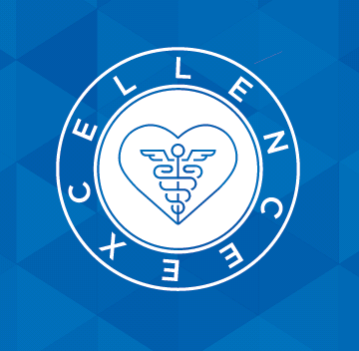
Centers of excellence
Member Steerage
Implementing streamlined processes which increase number of members treated for specific conditions by these providers
Referral process
PCP Education
Internal Education
Member Communication

Slide 10
THANK YOU!

