Slide 1
AHCCCS Update

Slide 2
Overview
Mission
  Reaching across Arizona to provide comprehensive, quality health care to those in need
Vision
  Shaping tomorrow’s managed care from today’s experience, quality, and innovation
Values
  Passion, Community, Quality, Respect, Accountability, Innovation, Teamwork, Leadership
Notes:
2

Slide 3
Select AHCCCS Initiatives
Active Thoughtful Purchaser
Integration efforts
Value Based Purchasing
Justice System transitions
Autism related services
Opioid Crisis
Program Integrity
Health Information Technology
American Indian care coordination and support

Slide 4
Potential Impact ACA Changes
 | GF Costs | Total $ Removed from Economy | Members Losing Coverage
1. Eliminate non-categorical adults 0-138% | $328 m | $3,239 m | (425,338)
2. Waiver at regular FMAP 0-100%, Eliminate 100-138% | $1,021 m | $599 m | (115,823)
3. Waiver at regular FMAP 0-100%, Freeze enroll. 100-138% | $1,032 m | $175 m | -

Slide 5
Funding Sources impacting GF
Hospital Assessment tied to provisions of ACA with automatic repeal
Prescription drug rebate for MCO pharmacy spend
Enhanced CHIP match for children’s expansion

Slide 6
Capitol Times – November 11th
All that, said Ducey, makes outright repeal without something else to take its place unacceptable.
“I’m not talking about repeal,” he said.
“I’m talking about repeal and replace,” Ducey continued. “I want to see all of our citizens have access to health care that’s affordable.”
With outright repeal unacceptable, the governor said it remains to be seen what Trump and Congress can come up with as an alternative.
“The devil is going to be in the details of a health care plan that allows accessibility to all of our citizens,” he said.
“That’s the discussion that we’re going to have,” the governor continued. “What we have currently isn’t working.”

Slide 7
Capitol Times – November 15th
Amid the discussion of the likely repeal-and-replace of Obamacare that will follow Trump’s inauguration, Brewer said she hopes the expansion of AHCCCS, which she shepherded through the Legislature in 2013, stays intact.
“They can implement AHCCCS in all 50 states. They probably will tweak it or revise it some, but it’s on the table, as far as I’m concerned, to be discussed. And I’m rooting for Arizona’s AHCCCS program,”

Slide 8
ACA provisions outside coverage
Essential benefits package
MAGI income calculations and new eligibility systems
Former foster youth who were in foster system for 6 months can stay on Medicaid until 25
CHIP FMAP
Hospital presumptive eligibility
Family planning extension
Drug rebates for managed care
Authority for dual demonstrations (no direct impact on AZ)
Program integrity requirements

Slide 9
Block Grant/PMPM discussion
What is in the base for federal grant? (e.g., A Better Way builds off 2016 and phases down enhanced ACA FMAP to regular FMAP.)
  Note less efficient states may have room to make program changes to save funding and avoid cutting populations; Arizona has little room on benefits or provider rates or utilization rates (things like leveraging home and community services)
What is the state match or maintenance of effort requirement?
How is the expansion incorporated?

Slide 10
Block Grant/PMPM discussion
What is in funding formula for growth and how is that calculated? What inflation factors are used?
How is population growth accounted for? Is the formula a per member?
What is the funding formula for recessions?
What is in statutory framework for requirements?
  Populations covered
  Services covered? (mandatory vs optional?)
  Payment levels? Access to care & network?
What happens with existing regulatory structure including but not limited to State plans and 1115 waivers?

Slide 11
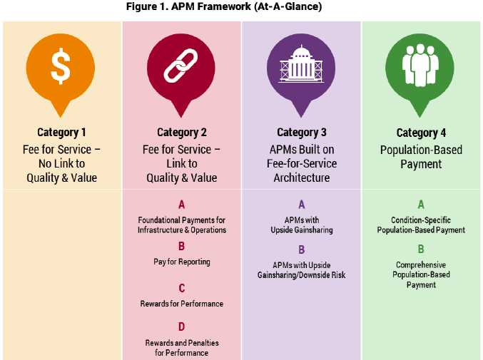
LAN Payment Reform Framework
Notes:
Can we do this one without the boxes/arrows? Concept is ok but leaves out a range of reform types
Done

Slide 12
Potential Future VBP Levels
 | Acute | ALTCS EPD | CRS | RBHA |  | DDD
 |  |  |  | SMI-Integrated | Non-Integrated | Sub-Contractors | LTSS
CYE 14 | 5%
CYE 15 | 10% | 5%/1.5% | 5%
CYE 16 | 20% | 15%/15% | 20% | 5%
CYE 17 | 35% | 25%/25% | 35% | 15%
CYE 18 Anticipated | 50% | 35%/35% | 50% | 25% | 10% | 20% | 5%
CYE 19 Anticipated | 60% | 50%/50% | 60% | 35% | 20% | 35% | 10%
CYE 20 Anticipated | 70% | 60%/60% | 70% | 50% | 35% | 50% | 20%

Slide 13
APM Proposed Targets
DSRIP Year | Percent Spend LAN 2-4 | Percent Spend LAN 3 & 4
CYE 2017 | 30% | NA
CYE 2018 | 40% | 5%
CYE 2019 | 50% | 10%
CYE 2020 | 60% | 20%

Slide 14
IMD and AHCCCS Care

Slide 15
Questions?

