Slide 1
New Deliverables Tracking System
Christina Quast
Operations Administrator
May 2017

Slide 2
Overview of SharePoint Tracking System
The SharePoint Tracking System is an online database system that allows the Contractor to select & upload deliverables that are listed in the Contractor’s Chart of Deliverables.
This process will replace uploading most Deliverables to the FTP Server, and sending a separate email notification.

Slide 3
Overview of SharePoint Tracking System
The SharePoint system automatically sends email alerts to AHCCCS staff when a deliverable is uploaded.
Responses from AHCCCS to the Contractor are also tracked and sent through this system.
Training will be provided to each Contractor on the new system.

Slide 4
Deliverable Master Lists & Submissions
The list of deliverables for each Contractor is prepopulated for the entire contract year, the list will be updated whenever there is a Contract amendment.
The name of the deliverable reflects the deliverable name as it is listed in the Contract + CY + due date.
  Example: Credentialing Quarterly Report for the first quarter of CY2018 will be named “Credentialing Quarterly Report CY2018Q1-1/30/2018”

Slide 5
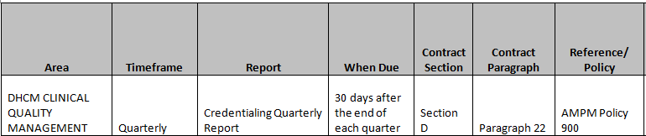
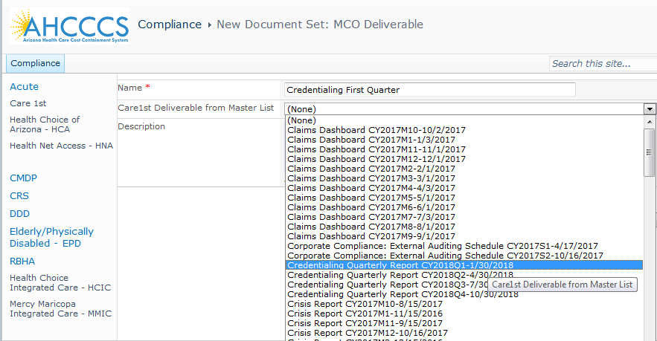

Slide 6
Deliverable Submissions
The SharePoint Tracking System can be found at the following web address:
  https://compliance.azahcccs.gov
Once security forms have been completed, you will be provided with a user name and password to log into the system.

Slide 7
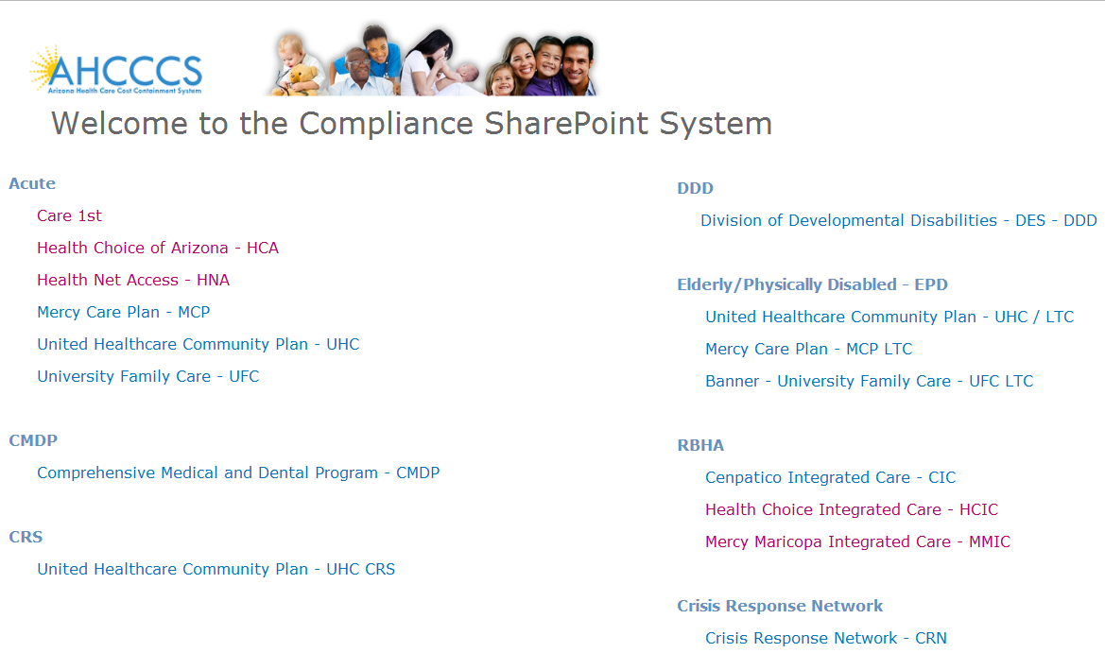

Slide 8
Deliverable Status after Submission/Review
Acknowledged: The deliverable is automatically acknowledged, the system sends out automatic emails to the Contractor; AHCCCS may request additional information for an acknowledged deliverable but there will be no formal approval.
Approved: The submission is approved.
Contingent Approval: The submission is approved but requires modification/revision or clarification prior to use or dissemination. A resubmission is not required.
Rejected: The submission is not approved, a resubmission is required. A reason for rejecting the deliverable and a resubmission date will be included in the email notification. A letter detailing the reasons why the deliverable was not approved may also be uploaded in SharePoint.

Slide 9
Next Steps
AHCCCS will be expanding the use of this SharePoint by individual Contractors, and line of business.
AHCCCS will be in contact with your Compliance folks to set up training for the new system.

Slide 10
Questions?

Slide 11
Thank You.

