Slide 1
AHCCCS Update

Slide 3
Current Status of Medicaid Expansion Decisions
VT
ME
WA
NH*
MT*
ND
MN
OR
MA
SD
WI*
NY
ID
MI*
CT
RI
WY
PA
NJ
NE
IA*
OH
DE
NV
CO
IL
IN*
MD
CA
UT
WV
VA
DC
KS
MO
KY
NC
AZ
TN
NM
OK
AR*
SC
MS
AL
GA
Adopted (32 States including DC)
AK
TX
LA
Not Adopting At This Time (19 States)
FL
HI
NOTES: Current status for each state is based on KCMU tracking and analysis of state executive activity. *AR, IA, IN, MI, MT, and NH have approved Section 1115 waivers. WI covers adults up to 100% FPL in Medicaid, but did not adopt the ACA expansion.
SOURCE: “Status of State Action on the Medicaid Expansion Decision,” KFF State Health Facts, updated July 7, 2016.
http://kff.org/health-reform/state-indicator/state-activity-around-expanding-medicaid-under-the-affordable-care-act/

Slide 4
Restoration and Expansion by the numbers
400,000
Expansion Adults
82,000
MH Service
47,000
Substance Use Disorder
26,700
Cancer Treatment
31% each
20-29 years old - >50
11,563
Individuals with SMI
17.3% to 11.1%
Uninsured rate 2013 to 2015

Slide 5
Age Distribution of ACA members

Slide 6
AHCA Impact Snapshot
 | FY 18 | FY 19 | FY 20 | FY 21 | FY 22 | FY 23
Freeze coverage losses (June) |  |  | 134,000 | 274,000 | 319,000 | 383,000
Decrease in Healthcare spending with Freeze |  |  | $118 m | $1.5 B | $2.0 B | $2.5 B
New State Costs +Restore Freeze at 100% | $30m | $92 m | $148 m | $319 m | $408 m | $478 m
State Costs Patient State Stability Fund |  |  | $9.8 m | $29.4 m | $49 m | $68.6 m

Slide 7
Marketplace Enrollment: Arizona

Slide 8
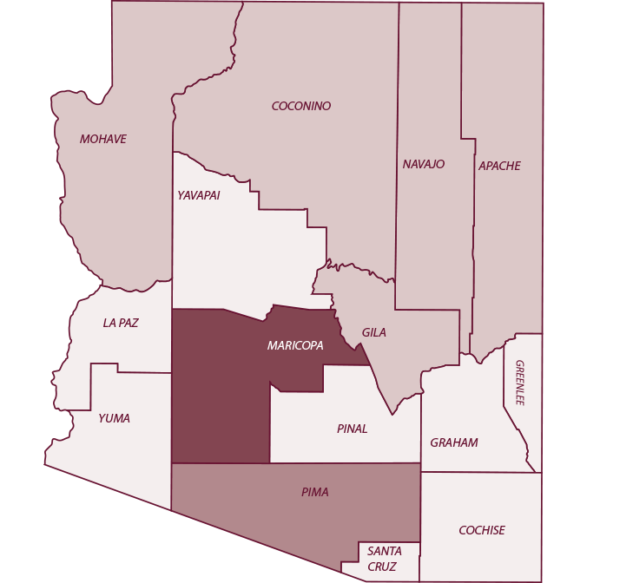
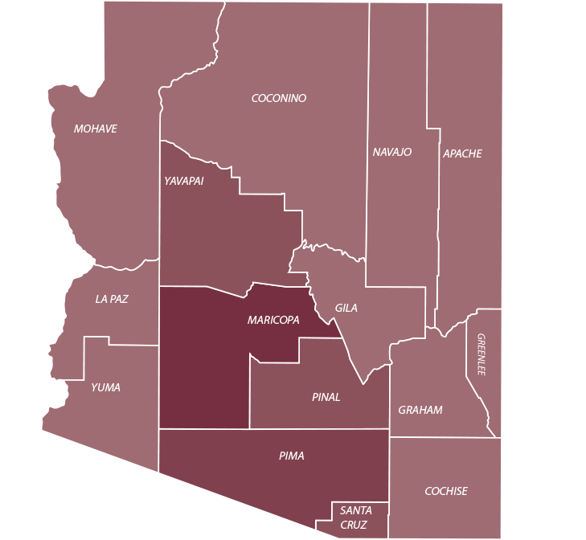
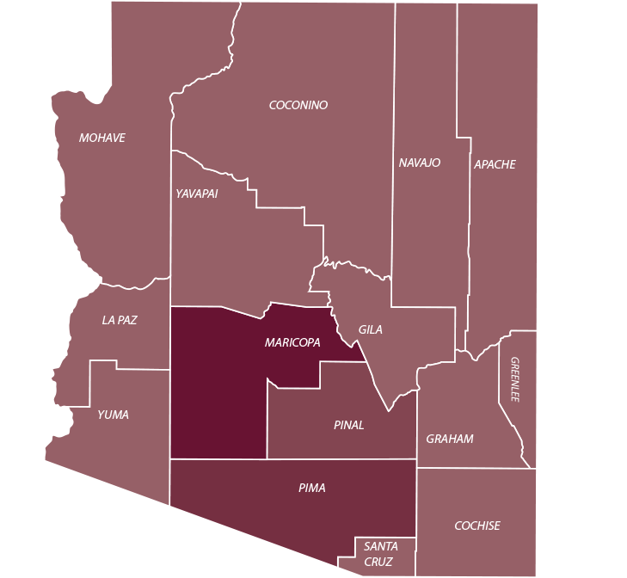
Marketplace Insurers 2014-2017
2014
2015
2016
Counties | 2014 | 2015 | 2016 | 2017
Apache | 6 | 7 | 3 | 1
Cochise | 6 | 7 | 2 | 1
Coconino | 6 | 7 | 3 | 1
Gila | 6 | 7 | 3 | 1
Graham | 6 | 7 | 2 | 1
Greenlee | 6 | 7 | 2 | 1
La Paz | 6 | 7 | 2 | 1
Maricopa | 9 | 10 | 8 | 1
Mohave | 6 | 7 | 3 | 1
Navajo | 6 | 7 | 3 | 1
Pima | 8 | 9 | 5 | 2
Pinal | 7 | 8 | 2 | 1
Santa Cruz | 7 | 7 | 2 | 1
Yavapai | 7 | 7 | 2 | 1
Yuma | 6 | 7 | 2 | 1

Slide 9
Secretary Tom Price & Administrator Seema Verma’s Letter to Governors
“We commit to ushering in a new era for the federal and state Medicaid partnership where states have more freedom to design programs that meet the spectrum of diverse needs of their Medicaid population.”
https://www.hhs.gov/sites/default/files/sec-price-admin-verma-ltr.pdf

Slide 10
Examples of Flexibility – McCarthy Letter
Freeze or cap certain eligibility group–ability to eliminate TMA
States should not have to cover all FDA approved drugs
Change FQHC reimbursements and statutes
Eliminate NEMT for certain populations
Increased cost sharing flexibility
Eliminate comparability and state-wideness
Eliminate Essential Health Benefits requirement
Allow more frequent eligibility redeterminations
Eliminate and reduce CMS regulatory burden
1115 path to permanency

Slide 11
Medicaid Portion of General Fund

Slide 12
Hospital Assessment Rebase
Hospital Assessment developed in 2013 to fund costs associated with Proposition 204 population and expansion.
  Guiding principle to limit negative impacts on systems.
  Used 2011 data
Rebase for SFY 2019 (July 1,2018–June 30,2019)
  Hospital workgroup created
  Rule update will include public comment

Slide 13
Uncompensated Care Trends
Source: Arizona Hospital and Healthcare Association)

Slide 14
Budget Update
Adult Emergency Dental
$1,000 limit
Target October 1, 2017
Occupational Therapy
Target October 1, 2017
Opioid Initiative
3 OIG Staff
2 Clinical Staff
Proposition 206
-Ongoing 1-1-17 -Flagstaff 7-1-17
-Network Adequacy Study
-Sick Leave 7-1-17 -Increase in Min. Wage 1-1-18

Slide 15
Other Legislative Items
HB 2493
SB 1434
SB 1440
Drug Overdose Review Team
Naloxone standing order
Limits the art therapists AHCCCS and its Contractors may use to nationally-certified art therapists or master’s level graduates under supervision of nationally-certified art therapist
Does not require contracting for art therapy
AHCCCS to establish internal clinical oversight review committee to review clinical data and analyze performance
Submit an annual report to Legislature in February of each year
Solicit external feedback

Slide 16
Arizona Management System
Arizona Management System
Governor’s Roadmap and Goal Council
Business Reviews & Strategic Plan
Leader Standard Work
Visual Management
Employee Development & Engagement

Slide 17
AMS Success Stories
OALS streamlined the processing of provider claims disputes, resulting in 90% processed in under 60 days (up from 26% in March 2016).
Collaborative efforts with DES resulted in 95% of Community Assistor requests addressed within 3 days, 75% same day.
Increased TPL workers’ compensation recovery by 140% in Q1 2017 (compared to 2016 avg).
Reduced DFSM provider claim backlog from 50,000 claims to <1,000. Instituted a same day processing policy.

