Slide 1
Arizona’s Opioid Epidemic
AHCCCS Strategic Plan

Slide 2
Strategic Plan
STRATEGY #1: Enhance Harm Reduction Strategies to Prevent Overdose
GOAL #1: Provide education and training on Naloxone to prescribers, pharmacists, members and the community
GOAL #2: Increase access to Naloxone.

Slide 3
What We’ve Done
Trainings conducted in every county and Pascua Yaqui, Fort McDowell, Salt River, San Carlos Apache
11,092 kits distributed since late January
899 reported reversals since late January
Maricopa, Pima, Yavapai, Gila, Graham, Pinal San Carlos Apache, Ft. McDowell
Coordination with retail pharmacies
Statewide Standing Order

Slide 4
What We Need
Help to increase outreach and sustainable distribution sites
PSA’s and ubiquitous messaging
Opioid STR activities
Unified co-prescribing campaign
Stigma
Training
Talking points
Identified MEDD thresholds and populations

Slide 5
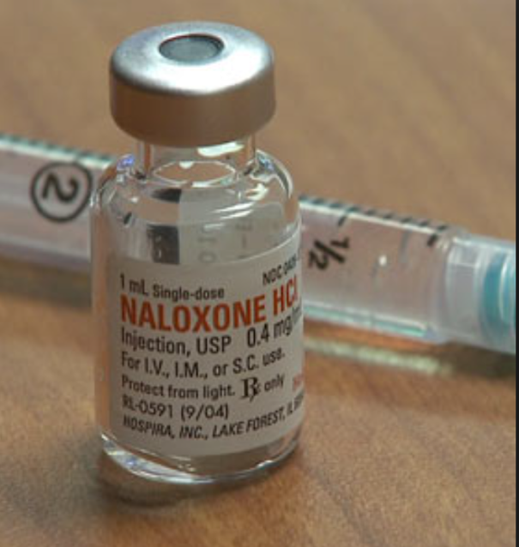
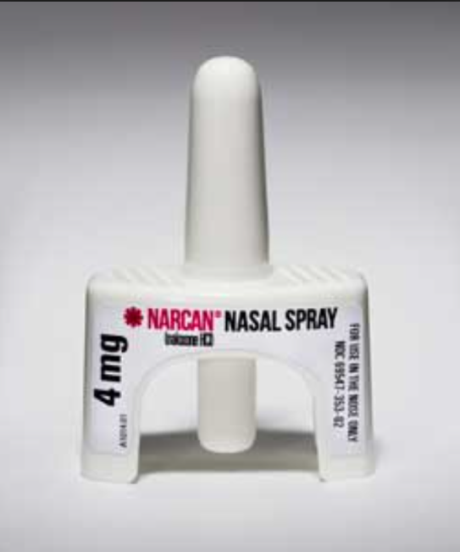
Co-Prescribing Naloxone
>90 MEDDs
Any combination of opioids with benzos, muscle relaxers and sleep medication
Education and instructions key

Slide 6
Strategic Plan
STRATEGY #2: Promote responsible prescribing and dispensing policies and practices
GOAL #1: Reduce the number of opioid-naïve patients unnecessarily started on opioid treatment
GOAL #2: Improve care processes for chronic pain and high-risk patients.

Slide 7
What We’ve Done
Quantity limit for first fills
Long-acting opioid policy changes
Preferred pharmacy 4x4x4
Movement towards identifying PM COE criteria
Movement towards integrated systems
Use of data to identify high utilizers
Non-opioid alternatives
Discussions on VBP

Slide 8
What We Need
Ubiquitous member and prescriber messaging - key messages that resonate
Relaunching professional association messaging and trainings
Complex case consults
“What Now” approach
Education
Care Coordination between PM, PCP, BH/MAT
Avoiding Unintended Consequences

Slide 9
Sign Up and USE the CSPMP
Ensure Patient Safety
Limit Liability
Now Easier than Ever with Delegate Option

Slide 10
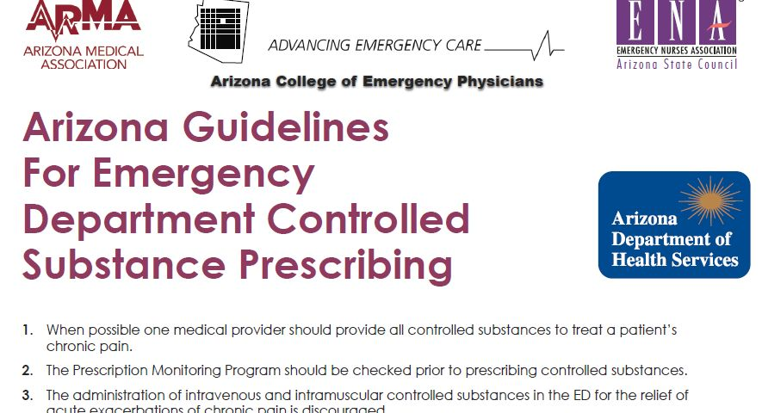
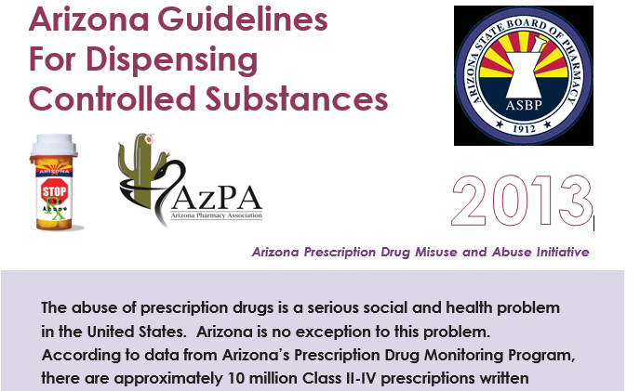
Facilitate Use of Best Practices

Slide 11
Register for FREE CME
www.VLH.com/AZPrescribing

Slide 12
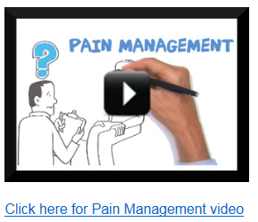
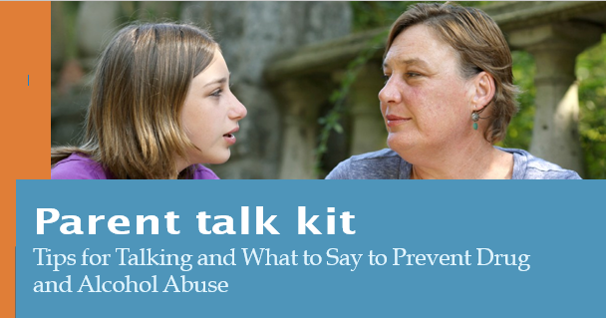
Educate Members http://rethinkrx.org/

Slide 13
Project ECHO

Slide 14
Screening and Assessment
Substance Use
Mental Health

Slide 15
Strategic Plan
STRATEGY #3: Enhance Access to Medication Assisted Treatment
GOAL #1: Assess statewide capacity of MAT providers
GOAL #2: Increase access to integrated MAT for members

Slide 16
What We’ve Done
Opioid STR activities
Education and Outreach
Stigma
Capacity
MAT COE for 24/7 access to care
Peer Supports
Care Coordination in High Risk CJ Populations
Hospital and ED Discharge
Residential and Recovery
Aligning Medicaid with STR

Slide 17
What We Need
Help with stigma reduction campaign and promotion of MAT across the state
Innovative ways to reach rural and underserved populations
Remove barriers so NPs, PAs and PCPs can help meet the demand – training and “right providers” the key
Use of telemedicine capabilities
Mobile service capacity

Slide 18
Pregnant, Parenting and NAS Members
3 key access points
Prevention – Primary and Secondary
Delivery
Post-Partum
SEN/NAS Learning Collaborative
Policy Change on CSPMP checks
PPW grant to pilot model system

Slide 19
Thank You Shana.Malone@azahcccs.gov

