Slide 1
SMAC Update

Slide 2
Senate Repeal and Replace Discussion

Slide 3
BCRA vs AHCA Annual Impact

Slide 4
Cumulative Costs

Slide 5
BCRA Impact Analysis
Impacts
Federal Match Change (includes early-expansion penalty) | $2.9 billion
Hospital Assessment Replacement (2022-2026) | $2.0 billion
Potential Per Capita Cap Inflation Impacts (2020-2026) | $2.2 billion
Potential Total State Impacts | $7.1 billion

Slide 6
Budget Update
Adult Emergency Dental
$1,000 limit
Target October 1, 2017
Occupational Therapy
Target October 1, 2017
Opioid Initiative
3 OIG Staff
2 Clinical Staff
Proposition 206
-Ongoing 1-1-17 -Flagstaff 7-1-17
-Network Adequacy Study
-Sick Leave 7-1-17 -Increase in Min. Wage 1-1-18

Slide 7
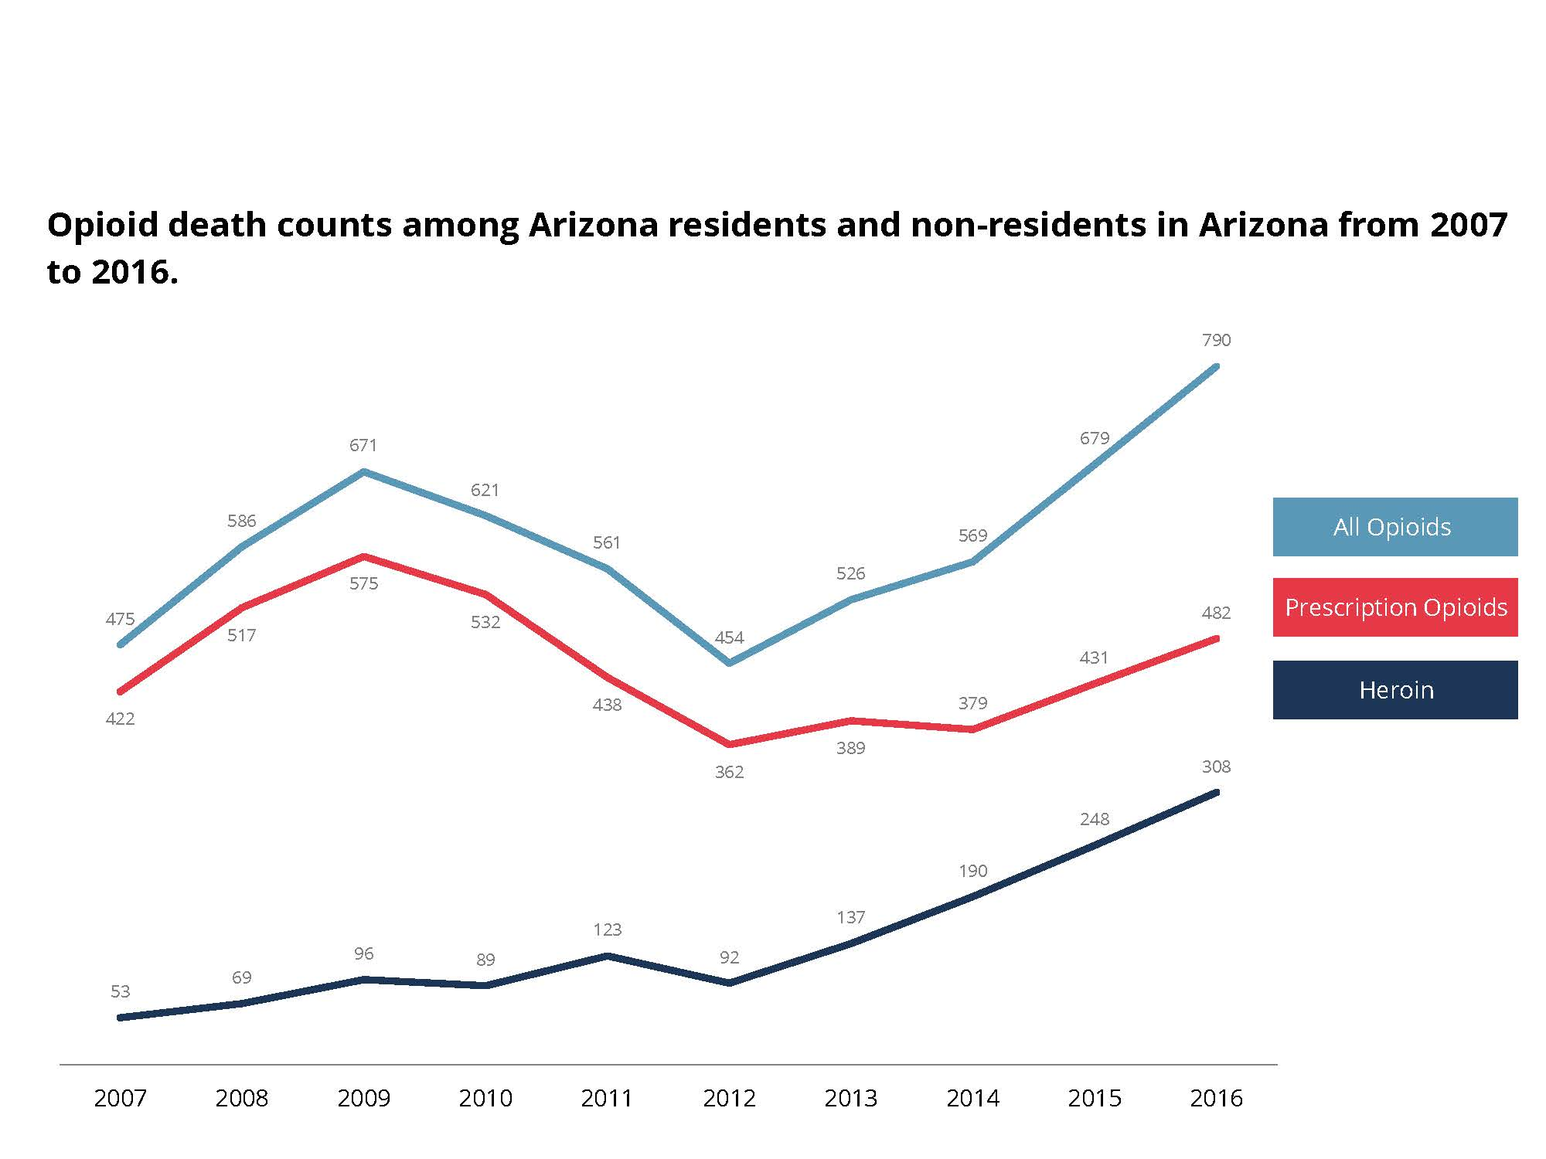

Slide 8
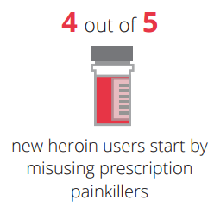
Notes:
Source: United States/National Statistics CDC

Slide 9
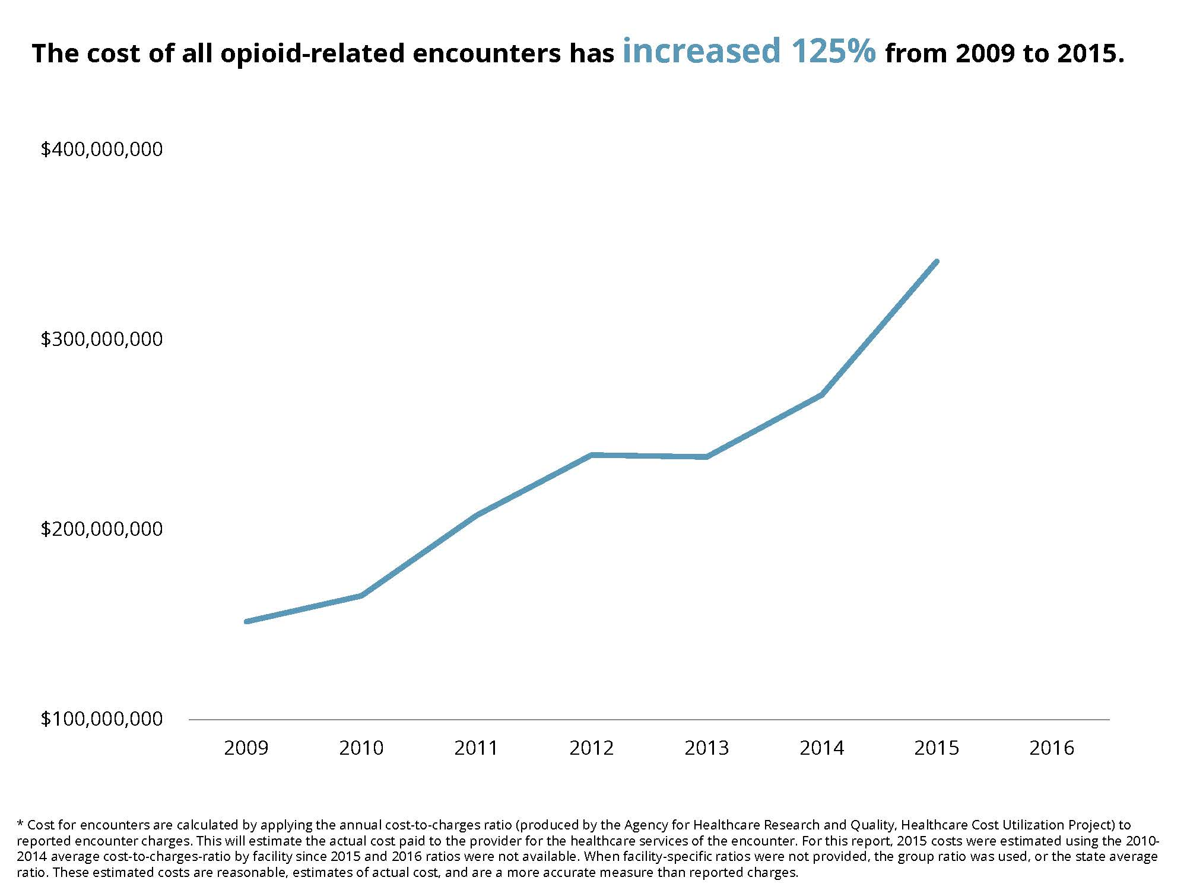

Slide 10
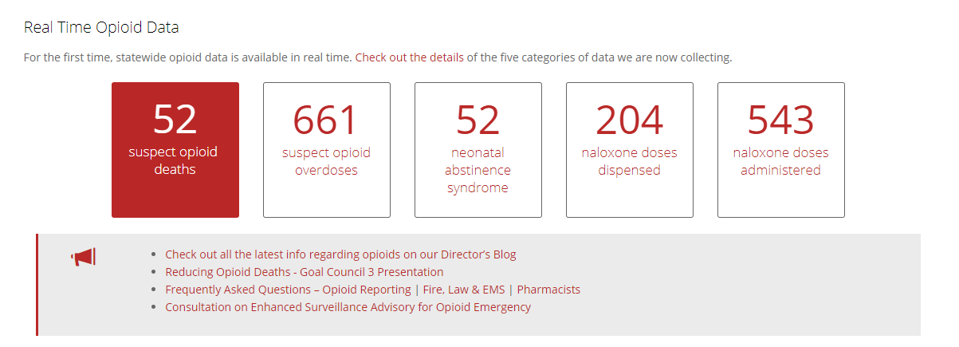
DHS Dashboard
Figures from 7/11/17 12:42 PM

Slide 11
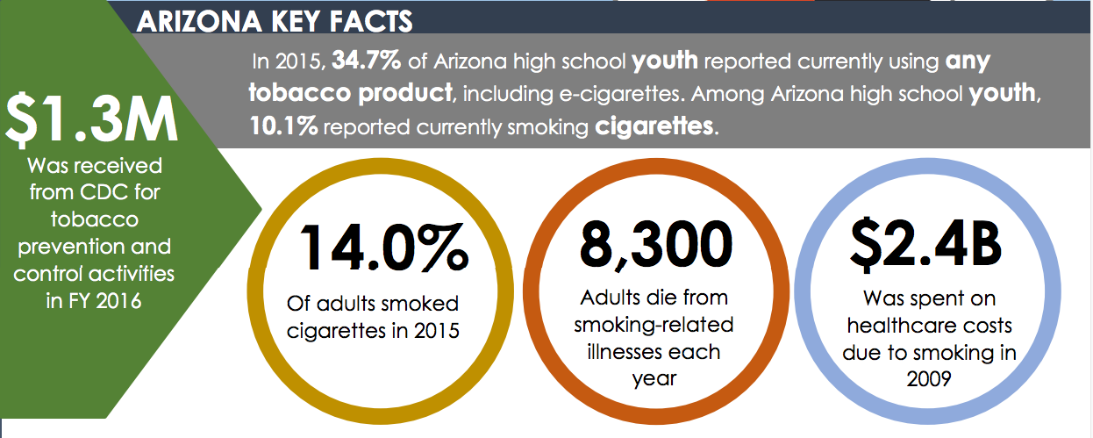

Slide 12
Percent

Slide 13
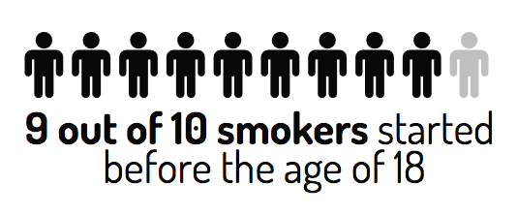
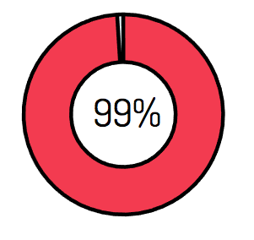
Youth Tobacco Prevention

Slide 14
Smoking Cessation Opportunities
2,200 individuals quarterly receiving services through the Arizona Smokers Help Line (ASHLine)
Roughly 40% are enrolled with AHCCCS
Opportunity to continue to educate members on cessation activities

Slide 15
Estimated Distribution of Funds Across Each Strategic Focus Area per Year
Focus Area | Year 1 | Year 2 | Year 3 | Year 4 | Year 5
TI Overall | 6.7% $19 M | 23.3% $66.5 M | 30.0% $85.5 M | 22.3% $66.5M | 16.7% $47.5M
Ambulatory (Primary Care & BH Services) | 92% $17,480,000 | 92% $61,180,000 | 92% $78,660,000 | 92% $61,180,000 | 92% $43,700,000
Justice | 5% $950,000 | 5% $3,325,000 | 5% $4,275,000 | 3% $3,325,000 | 3% $2,321,000
Hospital | 3% $570,000 | 3% $1,995,000 | 3% $2,565,000 | 3% $1,995,000 | 3% $1,425,000

Slide 16
Program Timeline (TI Year 1)
TIY 1
Waiver Effective Date
10/1/16
TI Waiver Approval
1/18/17
Public Meeting
6/9/17
TI Application
6/15/17 – 7/31/17
TI Participants Announcement
8/2017
9/30/17
Key:
TIY – Targeted Investments Year

Slide 17
Application Process
Applications timeline will be extended to 8-18
Will provide additional time to educate providers.
AHCCCS communicating through a number of different organizations
Have asked MCOs to
Broad notification for providers
Target top 10 provider organizations
Extended application allows more opportunities to notify larger provider groups

Slide 18
Waiver Update
IMD – working with CMS on path forward for SUD – no ability at this point on MH
Continue to look at potential flexibilities
AHCCCS Care and Work Requirements and Time limits awaiting Repeal and Replace discussion resolution

Slide 19
Value of Medicaid Coverage
Data: Kaiser Commission on Medicaid and the Uninsured analysis of 2015 NHIS data; Chart: Andrew Witherspoon / Axios

Slide 20
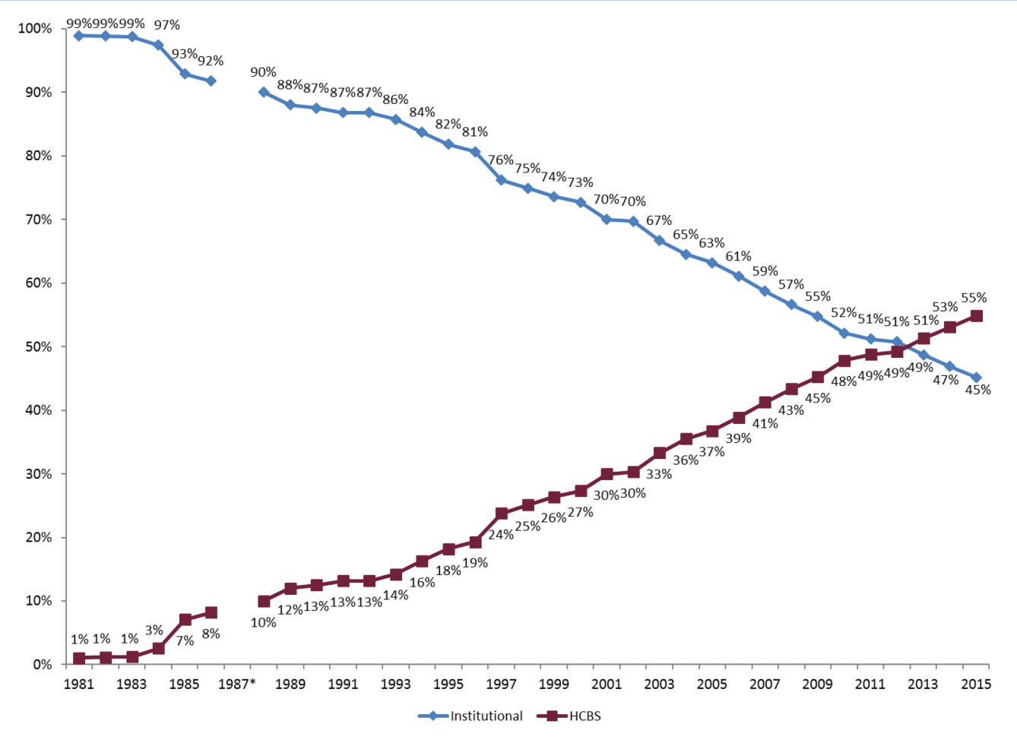
The Percentage of Total LTSS Spending for HCBS
Medicaid HCBS and Institutional LTSS Expenditures as a Percentage of Total Medicaid LTSS Expenditures, FY 1981–2015
* ICF/IID data for FY 1987 were nearly double expenditures for FY 1986 and for FY 1988. The reason for the one-time reported increase in expenditures is not known, and data from this outlier year are excluded.

Slide 21
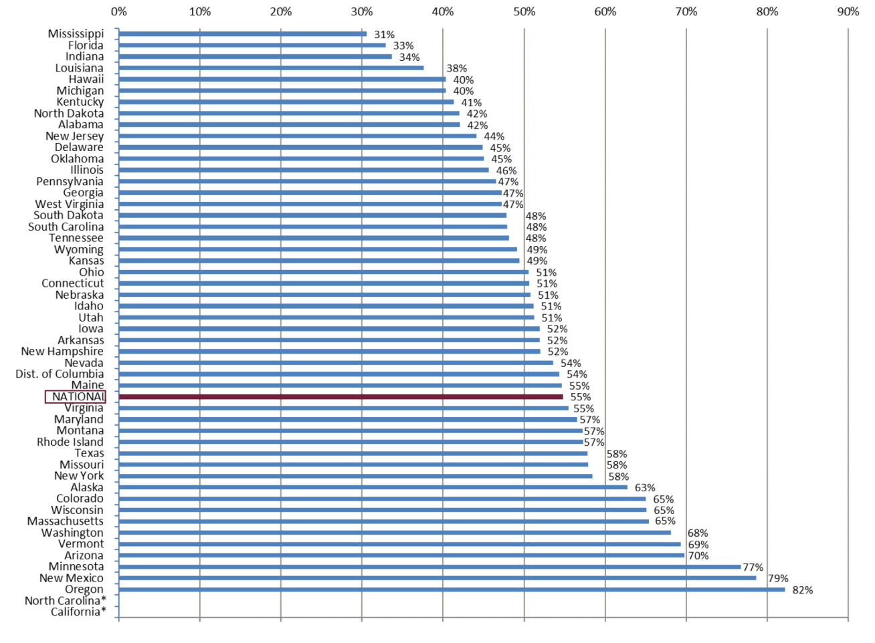
The Percentage of Total LTSS Spending for HCBS
Medicaid HCBS Expenditures as a Percentage of Total Medicaid LTSS Expenditures, by State, FY 2015
* California and North Carolina were excluded from this figure because a high proportion of LTSS were delivered through managed care and detailed managed care information was not available for FY 2015.

Slide 22
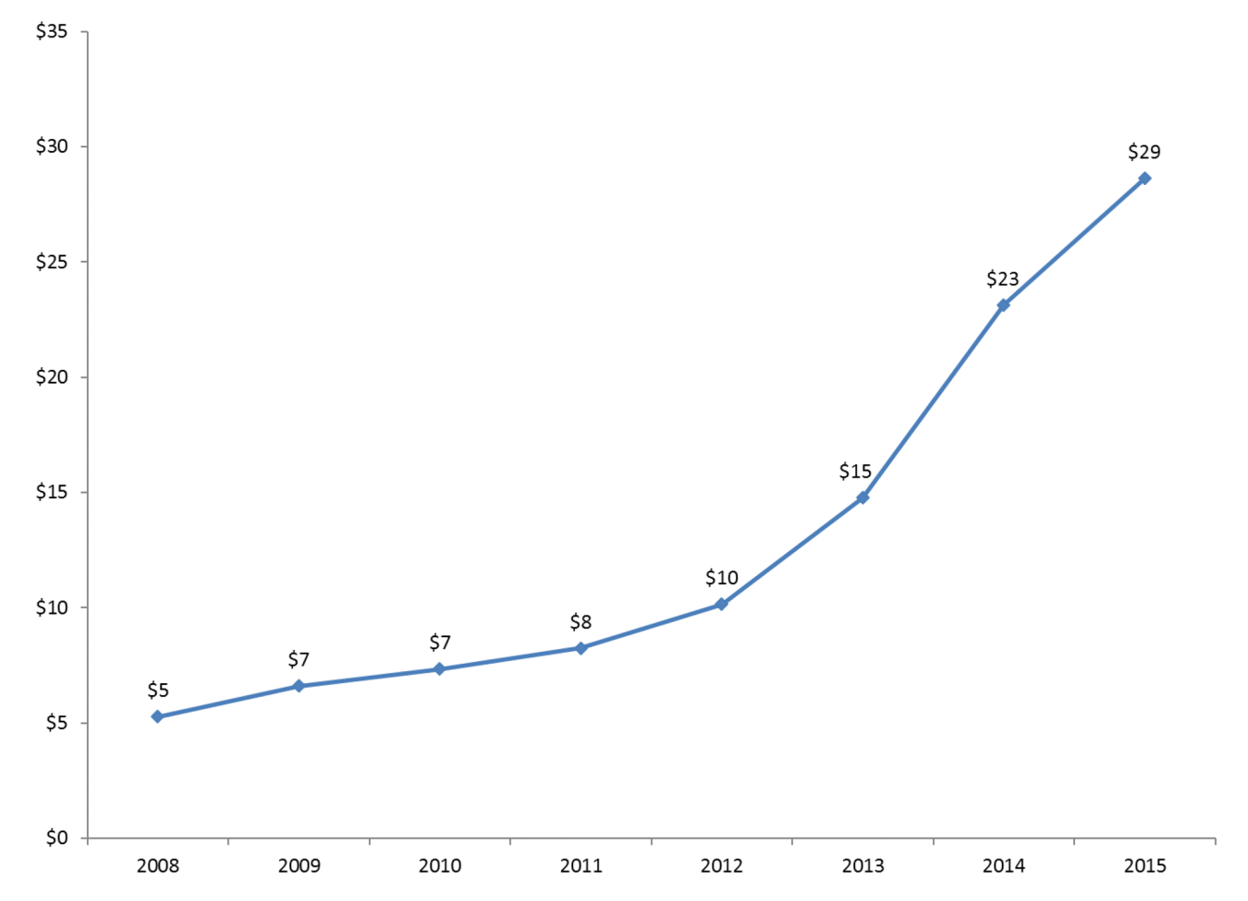
Growth of Managed Long-Term Services and Supports
Medicaid Managed LTSS Expenditures, in billions, FY 2008–2015
Managed LTSS includes the Program of All-Inclusive Care for the Elderly (PACE) and the following services provided through managed care organizations: nursing facilities, ICF/IID, personal care, home health, section 1915(c) waivers, and HCBS provided through managed care programs (e.g., a section 1115 demonstration or section 1915(b) waiver) that were not authorized under another state plan or waiver authority (called “HCBS – unspecified” in the data tables).

