Slide 1
AHCCCS Update

Slide 2
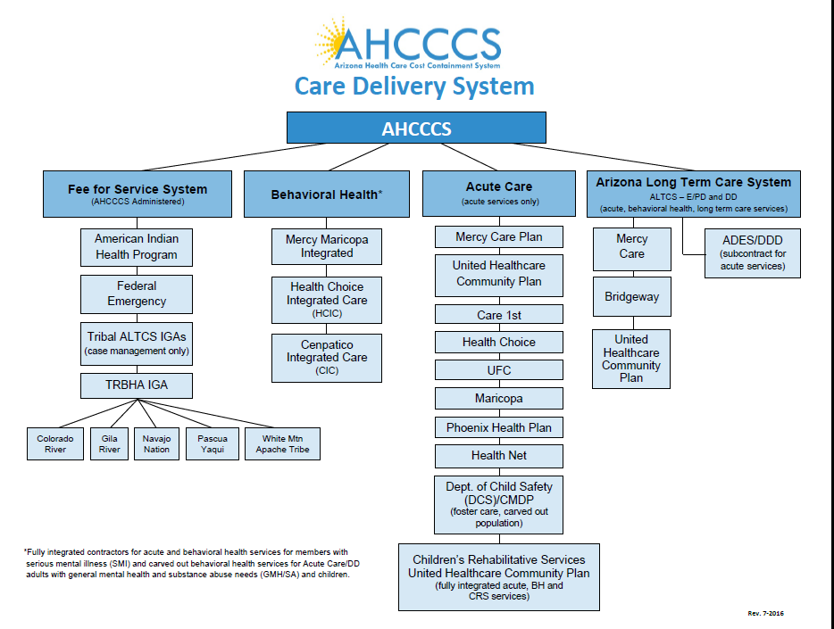

Slide 3
FY 2016 Accomplishments
BHS/AHCCCS Merger
Transitions:
  Greater AZ RBHAs
  Duals BH Integration
Initiative Expansions
  CRN – SMI Determination statewide
  DES Medicaid in HEAPlus
  Over 80 AIHP members in care coordination
Avoided 5% provider rate reductions
System Improvement Activities – Reports on:
  Children with or at risk of ASD
  CMDP
Federal Submissions:
  1115 Waiver Proposal
    AHCCCS Care
    DSRIP
  HCBS Plan

Slide 4
FY 2017 Opportunities
Merger:
  7-1-16 – Complete Formal Transition
  Ongoing activities
10-1-16 – New 1115 Waiver
Procurements:
  ALTCS EPD
  DD Subcontractors
  Begin work on Acute
Integration 2.0 Planning – Stakeholder Engagement
Value Based Purchasing
Health Information Exchange
Justice System Initiatives
Clinical initiatives:
  ASD
  Substance Use Disorder
New Federal MCO Regulations – Access Requirements
Mental Health First Aid Training

Slide 5
Ongoing Opportunities
Sustainability – including VBP
Employee Support
DCS System
Behavioral Health–Physical Health Integration
Social and Economic Determinants
Opioid Crisis

Slide 6
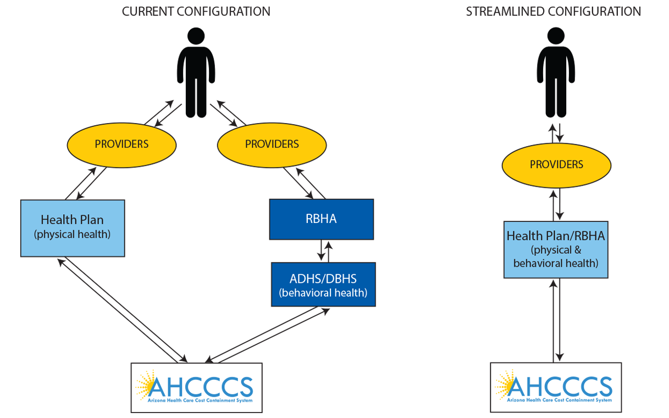
Policy – Payer – Provider Integration

Slide 7
Value Based Purchasing and Alternative Payment Models - Efforts to Date
AHCCCS role – establish broad goals for system
Overall progress is incremental
System Design Matters - True VBP requires integration to align incentives
Pursuing VBP requires resources and leadership
Creating a culture of learning is critical
Commitment to keep VBP $ in system
Requires improved access to actionable data
Defining measures is challenging

Slide 8
AHCCCS VBP Fee Schedule Changes
2014 – Hospital IP – APR-DRG
2015 - MCOs pay FQHC full rate
2016 - Hospitals bump for sharing data with HIE and meeting MU2
2016 - SNFs – increase for those above avg with pneumococcal vaccine
2016 - Integrated Clinics- physical health
2016 – Freestanding ED – new provider type
2016 – Treat and Refer
Notes:
a

Slide 9
ASD Recommendations
Have acute plans begin to take responsibility for ASD and at risk services
  No enrollment change until new contract cycle
  Open codes and formalize responsibility through contract
Network implications
Financial impact estimates

Slide 10
Institution for Mental Diseases
Federal statutory exclusion of Medicaid funding for IMDs
New managed care regulations allows only for IMD stays less than 15 days (adults)
  Eliminates existing in lieu option
If stay is longer, state must recoup ENTIRE capitation payment for the month (not just amount associated with IMD stay)
  Member still enrolled with plan - plan still responsible for care

Slide 11
What is an IMD?
42 C.F.R. 435.1010
“a hospital, nursing facility, or other institution of more than 16 beds that is primarily engaged in providing diagnosis, treatment or care of persons with mental diseases, including medical attention, nursing care and related services. Whether an institution is an institution for mental diseases is determined by its overall character as that of a facility established and maintained primarily for the care and treatment of individuals with mental diseases, whether or not it is licensed as such. An institution for Individuals with Intellectual Disabilities is not an institution for mental diseases.”

Slide 12
Definition of Institution
“an establishment that furnishes (in single or multiple facilities) food, shelter, and some treatment or services to four or more persons unrelated to the proprietor.”

Slide 13
SMM Guidelines for Determining What Constitutes an Institution
Determination of institutional status often black and white
Where less definitive, State Medicaid Manual offers guidelines:
  Components certified as different types of providers, such as NFs and hospitals, are considered independent from each other

Slide 14
SMM Guidelines for Determining What Constitutes an Institution (ctd)
  Are all components controlled by one owner or one governing body?
  Is one chief medical officer responsible for the medical staff activities in all components?
  Does one chief executive officer control all administrative activities in all components?
  Are any of the components separately licensed?
  Are the components so organizationally and geographically separate that it is not feasible to operate as a single entity?
  If two or more of the components are participating under the same provider category (e.g., NFs), can each meet the conditions of participation independently?

Slide 15
SMM Guidelines for Determining Whether Institution is an IMD
CMS uses the following guidelines to evaluate whether the overall character of a facility is that of an IMD
If any of these criteria are met, a thorough IMD assessment must be made - other relevant factors may also be considered
A final determination of a facility’s IMD status depends on whether an evaluation of the information pertaining to the facility establishes that its overall character is that of a facility established and/or maintained primarily for the care and treatment of individuals with mental diseases.

Slide 16
SMM Guidelines for Determining Whether Institution is an IMD (ctd.)
Criteria:
  The facility is licensed as a psychiatric facility;
  The facility is accredited as a psychiatric facility;
  The facility is under the jurisdiction of the State’s mental health authority. (This criterion does not apply to facilities under mental health authority that are not providing services to mentally ill persons.);
  The facility specializes in providing psychiatric/psychological care and treatment (through review of patient records or by the fact that an unusually large proportion of the staff has specialized psychiatric/psychological training or that a large proportion of the patients are receiving psychopharmacological drugs); and
  The current need for institutionalization for more than 50 percent of all the patients in the facility results from mental diseases.

Slide 17
Assessing Patient Population
In applying the 50 percent guideline, determine whether each patient’s current need for institutionalization results from a mental disease. It is not necessary to determine whether any mental health care is being provided in applying this guideline.
Mental disease/disorders include substance use disorders

Slide 18
Next steps
Working to identify complete list of IMDs – some obvious, others less clear
Options discussed include (but are not limited to):
  Prohibit IMD stays at all
  Prohibit IMD stays more than 15 days
Need to assure network capacity

Slide 19
AHCCCS Efforts to Address Prescription Drug Misuse/Abuse
Exclusive pharmacy assignment—Policy 310FF
  4x4x4 or 12 rx in 3 month period
Pharmacy and Therapeutics Committee
  Quantity limits
  Availability of MAT
CSPMP PIP
MCO Care Management Programs for pregnant women
Peer review
OIG CONG

Slide 20
Questions?

