Slide 1
AHCCCS Update

Slide 2
Enrollment Data
2014-2016 – increased 32 of 36 months
Overall increase of 618,000 members
Non-KidsCare Enrollment in 2017 down (33,000)
KidsCare growth of 11,000
Growth decreased 4 of past 5 months

Slide 3
Budget Update
FY 2019 Budget
Exec - $35 m higher hospital assessment
Exec includes savings for prior quarter and non-contracted IP psych rates
Modest differences on cap rate assumptions
More savings from Health Ins. Fee
CHIP/KidsCare will be a 2019 Legislative Issue

Slide 4
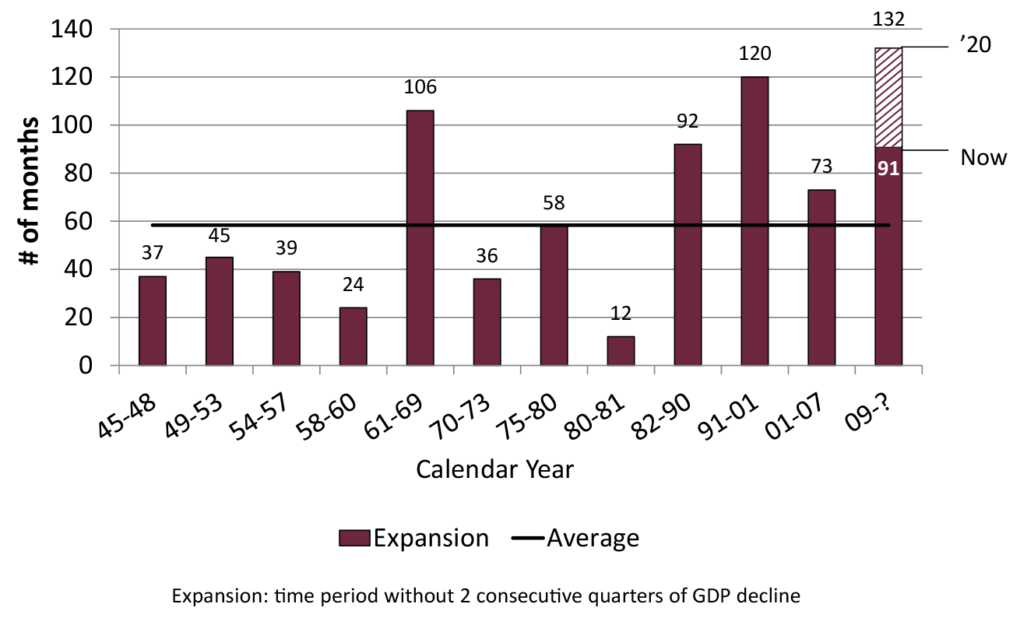
Length of US Economic Expansions

Slide 5
Opioid Epidemic Special Session
Working with RBHAs on allocation of $10m
$10 m targeted for Non TXIX population – TXIX services
Two Phases
First Phase looking to get dollars out quickly
Second phase will include stakeholder input

Slide 6
Targeted Investments
Year 1 payments
Thanks for quick turnaround on Payments
BH – 210 sites - $9.9 m
PH – 270 sites - $5.4 m
Hospitals – 27 sites - $1.0 m
Justice – 9 co-located integrated clinics - $2.7 m

Slide 7
ACC Actuarial Timeline
June – Member letters go out late in month with assignments - Actuarial team notified late in month of passive assignments - Actuarial team preliminary rates ready
July – 30 days member choice through end of month
July – Preliminary rates sent to MCOs based ONLY on passive assignment
August (early) – Actuarial team notified of choice decisions and member movement; adjust MCO rates for revised placement including acuity adjustment
September 1st-ish – Final rates sent to MCOs based on passive assignment and choice decisions

Slide 8
American Indian Enrollment for GMH/SA and Children Populations
Current Health Plan Enrollment/Assignment | Enrollment on 10/1/2018 with Choice
CRS (acute and CRS services), TRBHA | ACC Plan
AIHP, CRS (CRS services only) and TRBHA | AIHP and TRBHA
AIHP, CRS and RBHA | AIHP
AIHP and TRBHA | AIHP and TRBHA – No Change
AIHP and RBHA | AIHP
Acute MCO and TRBHA | ACC Plan
Acute MCO and RBHA | ACC Plan
CMDP and TRBHA | CMDP and TRBHA- No Change
DDD and TRBHA | DDD and TRBHA-No Change

Slide 9
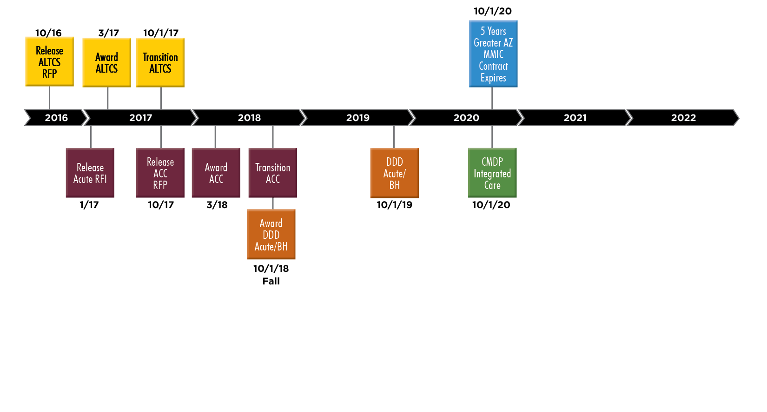
AHCCCS Contract Timeline

Slide 10
Other RFPs
Hemophilia – award any day
TPL RFP – award 6-1-18
FFS PBM – award 4-1-18
Electronic Visit Verification – award 5-31-18
SMI Eligibility Determination – award 7-2-18
Provider Management System – award 5-30-18
Asset Verification - ?

Slide 11
Prop 206 Study Findings
There was already variation in network adequacy prior to Prop 206. Limited access was found for just a few services impacting less than 5% of ALTCS members.
  Among services where provider owns the residence (NFs, assisted living, DDD group homes), only 9 of 48 geographic locations studied had no residential offering.
  Among in-home or community-based services, when examining county/service combinations, 5 of 104 had “very limited” access; another 5 had “limited” access; 92 had “sufficient” access.

Slide 12
Findings (continued)
Prop 206 and the Flagstaff Prop have added fiscal stress to providers.
  Respondents from both the EPD and DDD surveys stated that they had to raise their starting salaries for paraprofessionals to meet the minimum wage floor on Jan 1, 2017.
    HCBS providers for EPD services increased on average 9.4%
    Assisted living providers increased on average 12.4%
    Nursing facilities increased nurse aide wages 5.2%
    Providers for I/DD services increased wages 6.1% to 8.6% depending upon the labor category
  Respondents stated that they have leveraged all available options to cover the minimum wage increases.
    Reduce other staff benefits (to minimum wage and non-minimum wage staff)
    Reduce overall staffing

Slide 13
Prop 206 Impact Study

Slide 14
Uninsured Rate, 2012-2016

Slide 15
Percent of Spend in Managed Care
State | FFY2016 Medicaid Spending | FFY2016 Capitated Spending | Percent of Medicaid Spending Paid by Capitation, FFY2016 | State Rank in Percentage of Medicaid Expenditures Paid via Capitation
Kansas | $3,252,725,194 | $3,029,662,373 | 93.1% | 1
Hawaii | $2,156,012,061 | $1,938,658,711 | 89.9% | 2
Arizona | $11,118,985,133 | $9,683,119,933 | 87.1% | 3
Delaware | $1,883,220,982 | $1,616,107,823 | 85.8% | 4
New Mexico | $5,339,766,195 | $4,461,697,022 | 83.6% | 5
Florida | $21,689,957,388 | $15,706,906,241 | 72.4% | 6
Kentucky | $9,609,364,927 | $6,878,104,559 | 71.6% | 7
Michigan | $16,714,754,874 | $10,963,275,584 | 65.6% | 8
Tennessee | $9,463,742,287 | $6,119,439,351 | 64.7% | 9
Washington | $10,787,810,275 | $6,516,952,134 | 60.4% | 10
Oregon | $8,316,707,109 | $5,005,544,493 | 60.2% | 11
New Jersey | $14,319,021,372 | $8,528,400,366 | 59.6% | 12
Pennsylvania | $27,350,279,117 | $16,108,824,996 | 58.9% | 13
Rhode Island | $2,411,382,026 | $1,385,986,104 | 57.5% | 14
Ohio | $21,571,025,591 | $11,895,433,176 | 55.1% | 15
New York | $60,995,857,591 | $32,171,587,918 | 52.7% | 16
Louisiana | $8,536,666,882 | $4,450,521,745 | 52.1% | 17
Source: The Menges Group

Slide 16
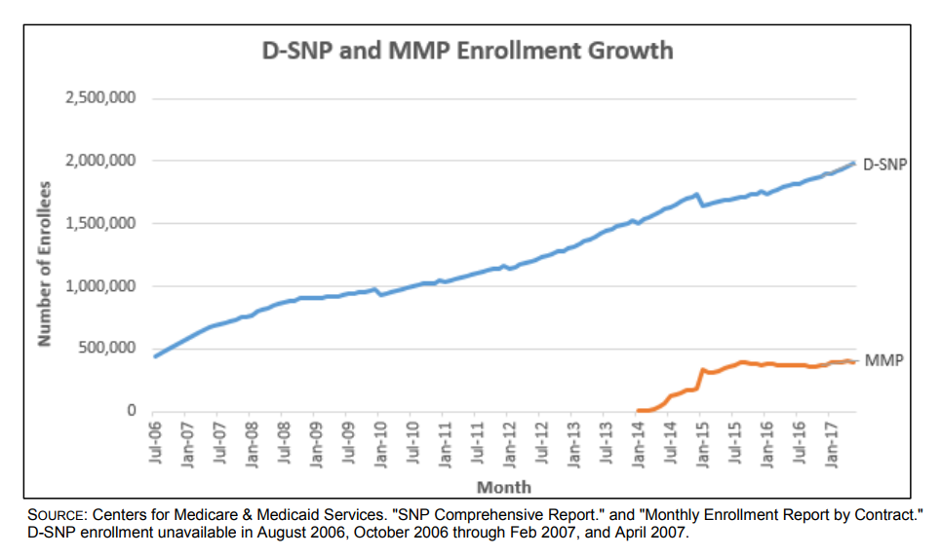
National Dual Alignment Efforts

Slide 17
MACStats Data
Medicaid National per enrollee spend
  $7,248
Arizona
  $5,867 – second lowest for expansion states
National Generic Rate - 82.7%
Arizona – 86.1% - second highest to RI
Rebates – TN and MA spend about the same on drugs before rebates - $100 m more in rebates

Slide 18
AHCCCS Generations in workplace (2013)

Slide 19
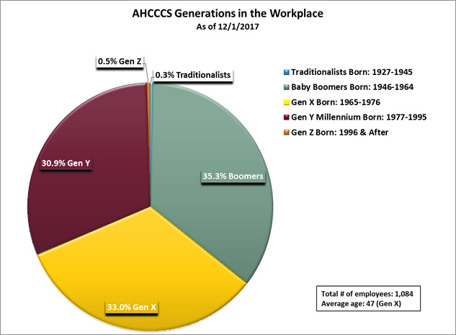
AHCCCS Generations in the Workplace 2017

