Slide 1
Integrated Contractors RFI for members in
Acute and CRS Program
AHCCCS Update Meeting
January 25, 2017
Notes:
Shelli

Slide 2
RFI INFORMATION
Published to AHCCCS website on January 25th
Questions due February 6
Responses due February 27th
https://www.azahcccs.gov/Resources/OversightOfHealthPlans/SolicitationsAndContracts
Notes:
Shelli

Slide 3
Integrated Contractor
Anticipated Procurement Timeline
Activity | Date and Time
Issue Request for Proposal | November 1, 2017
Prospective Offerors’ Conference and Technical Interface Meeting | November 8, 2017
Proposals Due | January 25, 2018
Contracts Awarded | By March 8, 2018
Transition Activities Begin | March 9, 2018
Contract Start | October 1, 2018
Note: Dates are subject to change

Slide 4
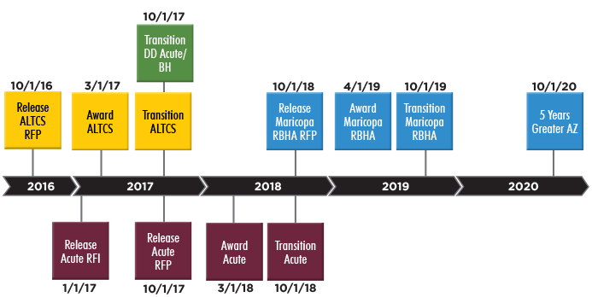
AHCCCS Contract Timeline

Slide 5
Current Contract Terms
RBHA, CRS, Acute
Contract Year | Maricopa RBHA | Greater AZ RBHAs | Acute/CRS
1 | 4/14-3/15 | 10/15-9/16 | 10/13-9/14
2 | 4/15-3/16 | 10/16-9/17 | 10/14-9/15
3 | 4/16-3/17 | 10/17-9/18 | 10/15-9/16*
4 | 4/17-3/18* | 10/18-9/19* | 10/16-9/17*
5 | 4/18-3/19* | 10/19-9/20* | 10/17-9/18*
6 |  | 10/20-9/21*
7 |  | 10/21-9/22*
New Integrated Contractor Term:
10/18-9/23 (5yr)
*Extension Year (CYE 9/16 applicable to CRS only)

Slide 6
Integration Efforts

Slide 7
Acute – Current Program
Acute Program
  Acute Plans provide physical health services
  Regional Behavioral Health Authorities (RBHAs)
    BH services for Children (CMDP & non-CMDP)
    GMH/SUD services for adults
    Integrated services for individuals with SMI
    Crisis services all populations
    Grant/other non-TXIX funding coordination
  Member choice of health plans statewide
Notes:
Melissa double-checked and LTSS does include HCBS but does not include Case Management.

Slide 8

Acute Enrollment
As of January 1, 2017
AHCCCS
GSA Number Acute
Health Plan Enrollment
COCONINO
APACHE
2
74,220
UHC, UFC
(4)
(4)
21,000
6,125
4
UHC, HCA
MOHAVE
106,546
(4)
59,632
NAVAJO
6
44,067
UHC, UFC
(4)
YAVAPAI
19,789
(6)
8
67,248
HCA, UFC
44,067
LA PAZ
UHC, HCA, UFC, Care1st, MCP
(2)
GILA
10
252,614
4,222
MARICOPA
(8)
(12)
11,063
GREENLEE
(14)
1,586
892,744
UHC, Care 1st, HCA, MHP, MCP, PHP, HNA
YUMA
PINAL
GRAHAM
12
892,744
(2)
(8)
(14)
69,998
56,185
9,516
PIMA
COCHISE
14
45,850
UHC, UFC
(10)
(14)
232,416
34,748
SANTA
CRUZ
Total Health Plan Enrollment = 1,483,289
(10)
20,198
8

Slide 9
Children’s Rehabilitative Services (CRS) – Current Program
Program for children with chronic conditions specified in rule
One statewide CRS Contracted Health Plan to provide:
  Physical (Acute & CRS) and BH services for most CRS members
  CRS and BH services to children in Foster Care and children determined Developmentally Disabled
  Various service options for American Indians
Required to have MSICs in network
Notes:
Melissa double-checked and LTSS does include HCBS but does not include Case Management.

Slide 10
CRS - Fully Integrated Enrollment
As of January 1, 2017
AHCCCS
GSA
Enrollment
COCONINO
APACHE
2
837
(4)
(4)
239
49
4
MOHAVE
904
(4)
433
NAVAJO
6
401
(4)
YAVAPAI
183
(6)
8
665
401
LA PAZ
(2)
GILA
10
3,186
32
MARICOPA
(8)
(12)
108
GREENLEE
(14)
12
10,323
YUMA
PINAL
GRAHAM
12
10,323
(2)
(8)
(14)
805
557
92
455
PIMA
COCHISE
14
(10)
(14)
2,944
351
Total Integrated Enrollment = 16,771
Total Enrollment/Assignment = 24,700
SANTA
CRUZ
(10)
242
10

Slide 11
RFI HIGHLIGHTS
RFI puts forth for consideration …
  Integration of Acute, CRS, and behavioral health programs in new Integrated Contractors (IC)
    Including BH for GMH/SA Adults, Non-CMDP Children
    Excluding Individuals with SMI
    Excluding Foster Children - CMDP
    Excluding Crisis Services provided by RBHAs
    Grant Funded Services - TBD
  GSA Alignment with ALTCS EPD GSAs effective Oct 1, 2017 (North, South, Central)

Slide 12
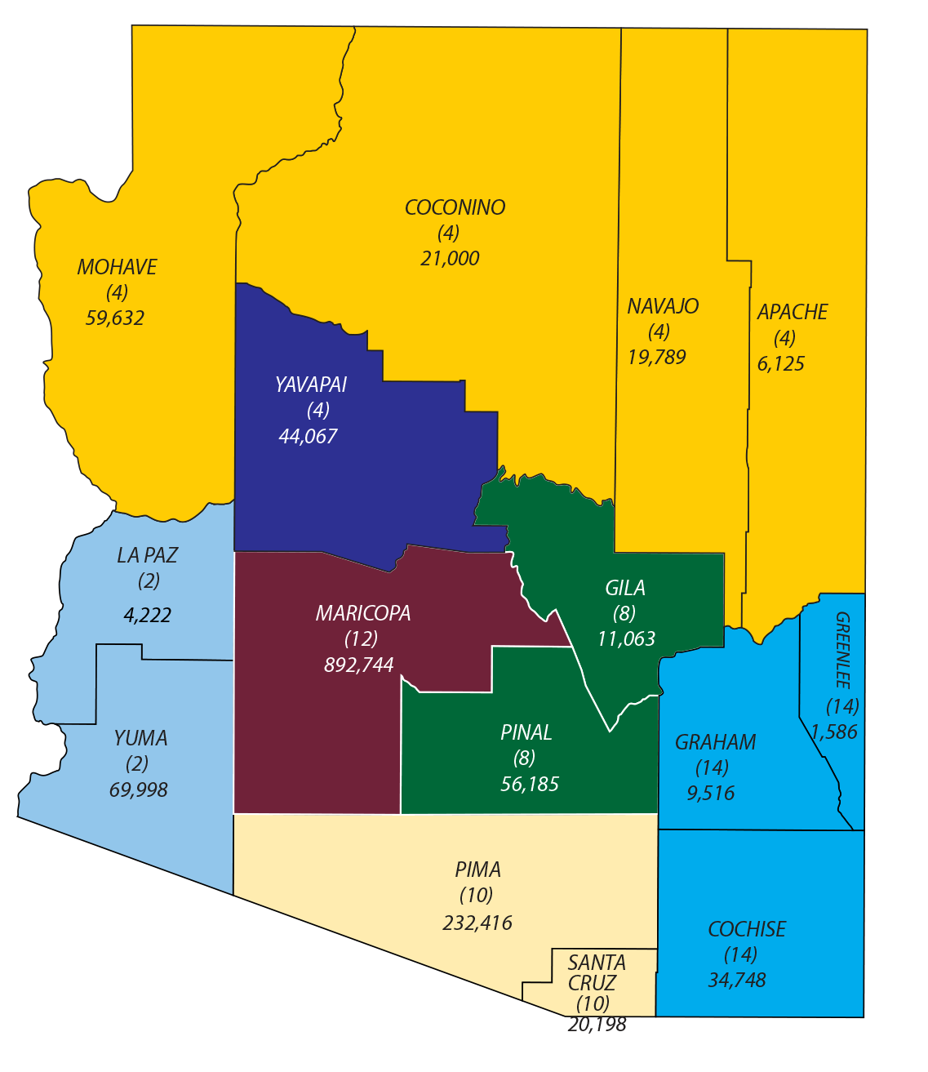
Acute Geographic Service Areas
As of January 1, 2017
12

Slide 13
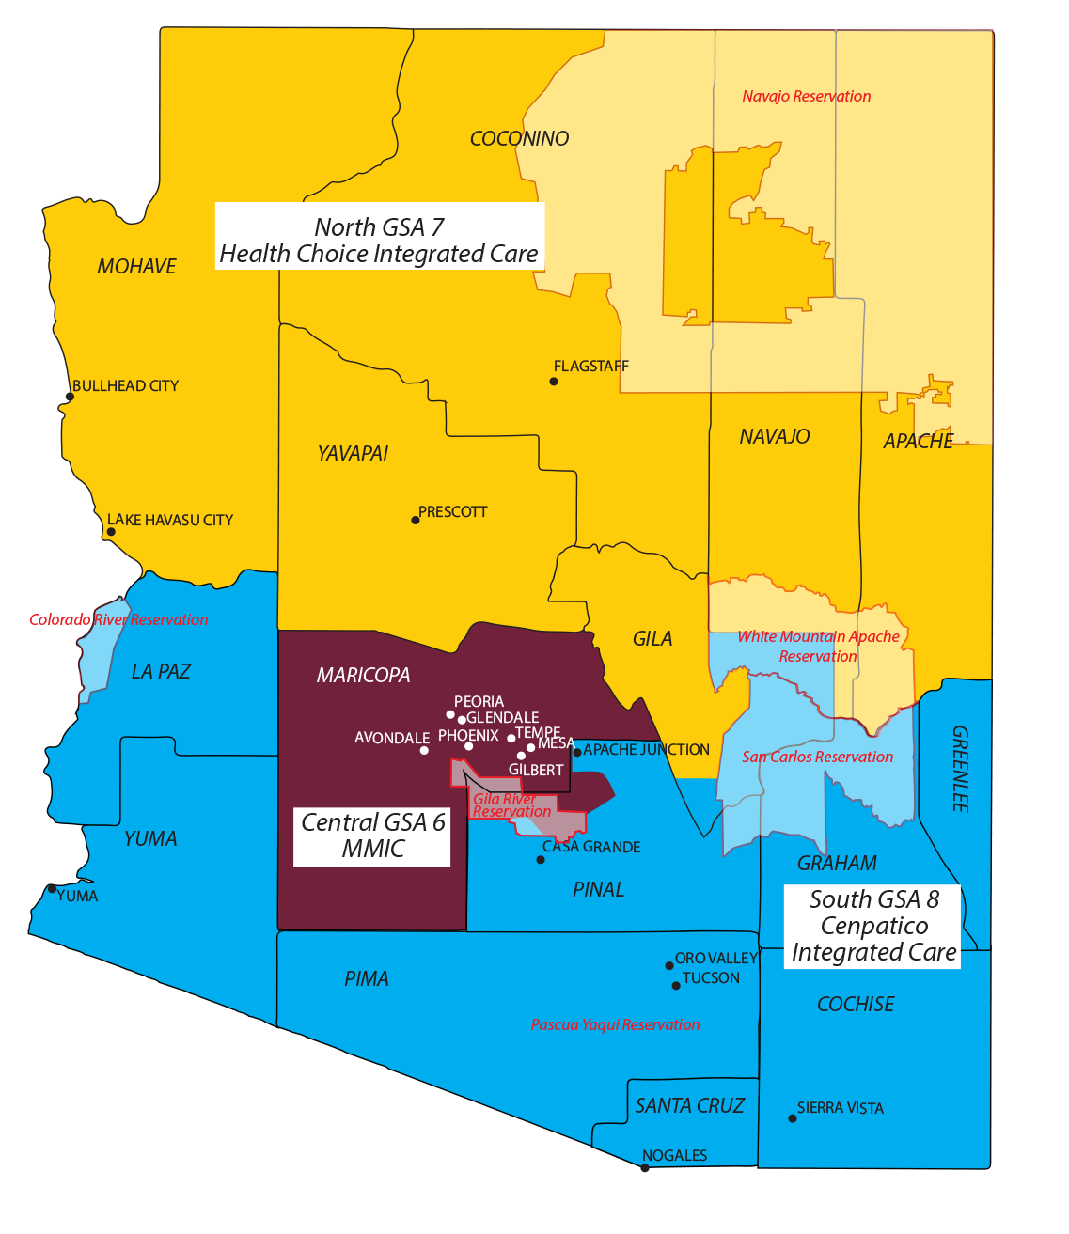
Current RBHA GSAs

Slide 14
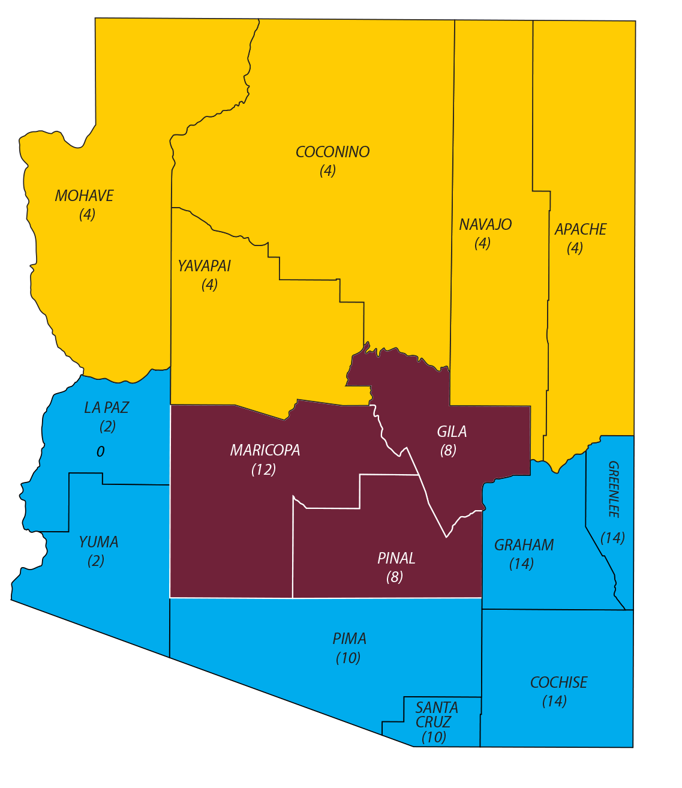
ALTCS-EPD Geographic Service Areas
Preferred GSA Structure

Slide 15
RFI HIGHLIGHTS continued
Recognizing complexities of Affiliated Organizations that exist with our Contractors
RFI defines an Affiliated Organization as:
  An entity bidding on the Integrated Contract which also has 50% or more ownership or control interest of a current RBHA, or is a current RBHA in Arizona
Potential for merging of Integrated Contractor and RBHA with awards to Affiliated Organizations

Slide 16
RFI HIGHLIGHTS continued
Awards to Affiliated Organizations with a RBHA and an incumbent Acute Contractor in same GSA (or county within GSA)
  Organization and branding (IC and RBHA) may be consolidated under single corporate entity and contract
  Incumbent Acute membership is moved under consolidated Integrated Contractor
  Unique RBHA functions retained by RBHA under consolidated Integrated Contractor (SMI, CMDP BH, Crisis)

Slide 17
Affiliated Organizations - North
 | Current
Proposed North GSA: | Acute Plan | Acute Plan | RBHA
Mohave | HCA | United | HCIC
Coconino | HCA | United | HCIC
Apache | HCA | United | HCIC
Navajo | HCA | United | HCIC
Yavapai | UFC | United | HCIC

Slide 18
Affiliated Organizations - Central
 | Current
Proposed Central GSA: | Acute Plan | Acute Plan | Acute Plan | Acute Plan | Acute Plan | RBHA
Maricopa | Care 1st | HCA | HNA | MCP | United | MMIC
Gila | HCA | UFC |  |  |  | HCIC
Pinal | HCA | UFC |  |  |  | CIC
Note: Due to movement of Gila and Pinal, need to put RBHAs on notice that they will be losing these counties and associated members/services effective 10/1/18.

Slide 19
Affiliated Organizations - South
 | Current
Proposed South GSA: | Acute Plan | Acute Plan | Acute Plan | Acute Plan | Acute Plan | RBHA
Pima | UFC | United | Care 1st | HCA | MCP | CIC
Cochise | UFC | United |  |  |  | CIC
Graham | UFC | United |  |  |  | CIC
Greenlee | UFC | United |  |  |  | CIC
LaPaz | UFC | United |  |  |  | CIC
Santa Cruz | UFC | United |  |  |  | CIC
Yuma | UFC | United |  |  |  | CIC
Note: Centene is defined as an Affiliated Organization, UFC is not due to less than 50% ownership in CIC.
Centene does not also have an incumbent Acute plan in the South so would not take any membership.
Centene or Affiliated Organization owned by Centene could consolidate with CIC if awarded in this GSA.

Slide 20
RFI HIGHLIGHTS continued
Affiliated Organization not awarded contract:
  Current RBHA remains until RBHA contract expiration
  Unique RBHA contract requirements remain with RBHA (SMI, CMDP BH, Crisis)
  RBHA may be available for choice to members for remaining RBHA contract term for integrated services for all populations
  Expansion of RBHA services to include physical health for non-dual, GMH/SA adults and non-CMDP children

Slide 21
RFI HIGHLIGHTS continued
  Additionally, soliciting feedback on:
    GSAs:
      Number of plans by GSA
      Plan limit on # of GSAs awarded
      Pima County differentiation
    Crisis System
      Statewide crisis vendor for system coordination
      Single statewide crisis line vendor
      Single statewide crisis phone number
    Timing of integrated services implementation
    Administration of grant funding

Slide 22
RFI HIGHLIGHTS continued
    RBHA RFP or expansion of IC scope of services
    Plan choice for individuals with SMI
    CRS
      Integration
      Designation
      MSICs
      American Indian choices
    ASD Advisory Committee recommendations
    Engaging community in development of RFP
    Length of contract term – 5 or 7 years

Slide 23
Questions

