Slide 1
AHCCCS Implementation of APR-DRG Payments
Shelli Silver
Assistant Director
AHCCCS
September 10, 2014

Slide 2
New Inpatient Rate Methodology
AHCCCS is implementing initiatives to improve patient safety and health outcomes of members, thereby reducing costs
Current tiered per diem methodology is inconsistent with this goal as it incentivizes quantity of care
A DRG-based payment methodology is aligned with the Agency’s focus on improving patient care and shifting the focus to the quality of the services provided

Slide 3
New Inpatient Rate Methodology, cont.
A DRG-based payment methodology will enhance AHCCCS’ ability to implement performance review and cost-saving measures, such as:
  Hospital acquired conditions
  Potentially preventable readmissions
AHCCCS is replacing its 20 year old tiered per diem methodology effective with dates of discharge on and after October 1, 2014

Slide 4
APR-DRG Model
AHCCCS, in conjunction with a workgroup of hospital representatives (urban and rural) and AzHHA, selected 3M’s All Patient Refined (APR) DRG model
The APR-DRG grouper is considered to be a superior model over MS-DRGs for payments targeted to the Medicaid (i.e., non-aged) population
  Over 1,200 DRGs total
  112 newborn DRGs (28 with 4 levels of severity each)

Slide 5
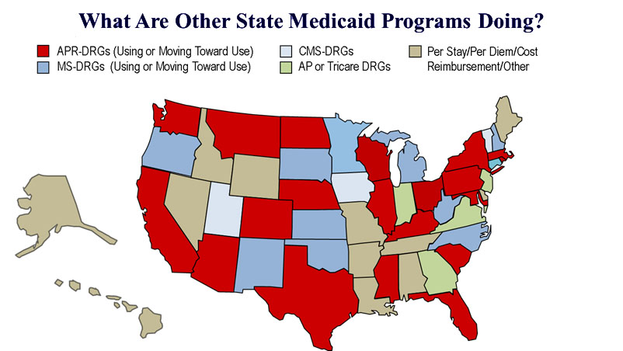
APR-DRG Implementation Nationwide

Slide 6
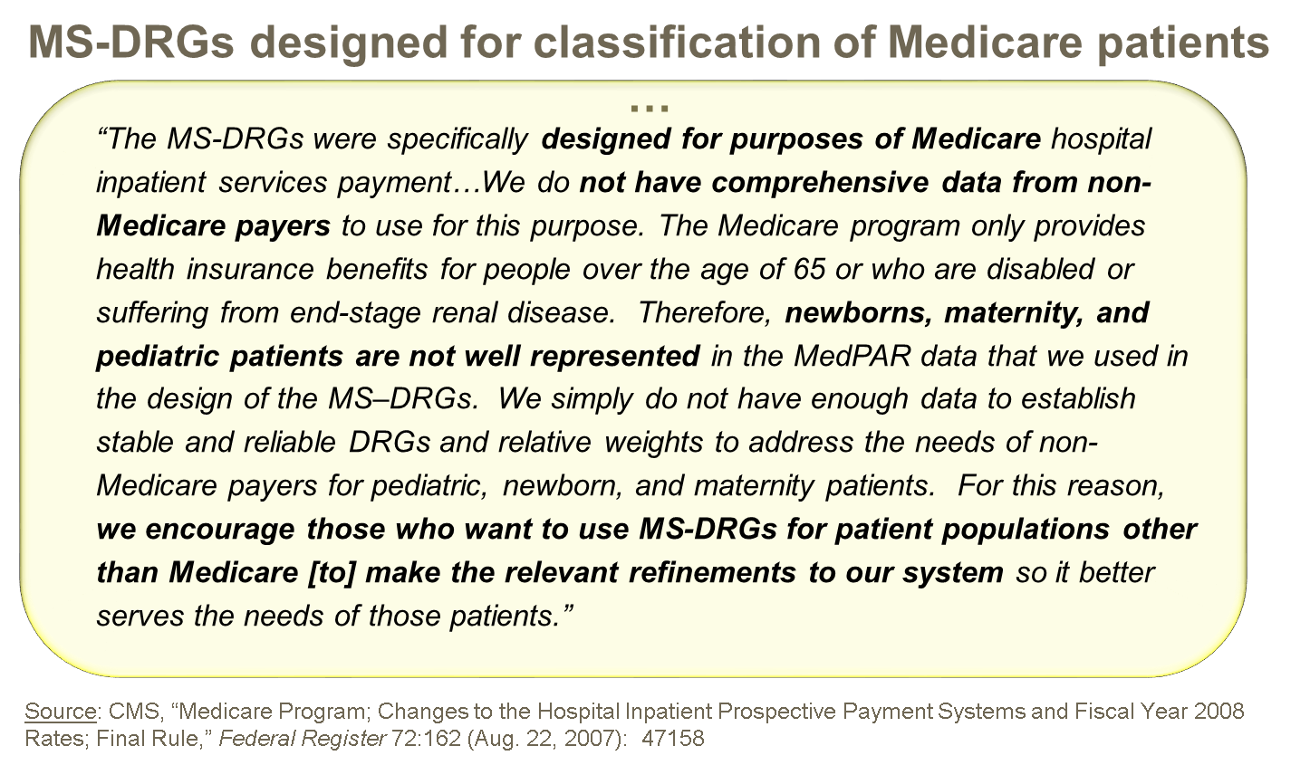
APR-DRG Model Benefits, cont.

Slide 7
AHCCCS Process
AHCCCS contracted with Navigant Consulting, Inc., which has experience implementing APR-DRG models in other state Medicaid programs
AHCCCS met with workgroup of urban and rural hospitals, including an AzHHA employee, six times from September 2012 through December 2013
All meeting materials posted to AHCCCS website

Slide 8
AHCCCS Process, cont.
AHCCCS DRG web page located at: http://www.azahcccs.gov/commercial/ProviderBilling/DRGBasedPayments.aspx
Final Rule posted at: http://www.azahcccs.gov/reporting/Downloads/UnpublishedRules/NOFRFinalDRG.pdf
Legislative authority found at
ARS §36-2903.01.G.12

Slide 9
APR-DRG Application
APR-DRG will be the payment methodology for AHCCCS FFS members
AHCCCS MCOs are not mandated to utilize AHCCCS’ methodology or rates except in absence of a contract
MCOs may enter into contracts with hospitals which specify alternative methodologies and/or rates

Slide 10
APR-DRG Application, cont.
Claims for inpatient services paid by CRS and ALTCS MCOs shall be paid using APR-DRGs regardless of diagnosis (dx)
Claims for inpatient services paid by a RBHA or TRBHA, where the primary dx upon admission is a behavioral health dx, shall be paid as prescribed by ADHS
Claims for inpatient services paid by an integrated RBHA, where the primary dx upon admission is a physical health dx, shall be paid using APR-DRGs

Slide 11
APR-DRG Application, cont.
Legislative mandates regarding certain payment terms remain in place including, but not limited to:
  Quick pay/slow pay discounts and penalties
  Urban Hospital Reimbursement Program for MCOs with 5% discount off AHCCCS FFS rates when no contract in place – applies to all inpatient services whether for non-emergency services or admitted from the emergency room

Slide 12
MCO Implementation
AHCCCS convened a technical workgroup of MCO representatives specific to DRG
MCOs have mandated reporting to AHCCCS regarding DRG implementation/progress
MCO testing in process – must produce pre-determined DRG assignment and payment on series of claims

Slide 13
Implementation Mitigation Strategies
AHCCCS is committed to ensuring no disruptions to hospital cash flow should any AHCCCS payer be delayed in implementation
MCOs will submit mitigation plans to AHCCCS to describe strategies that will be employed should such delay occur
PLEASE contact me directly with problems

Slide 14
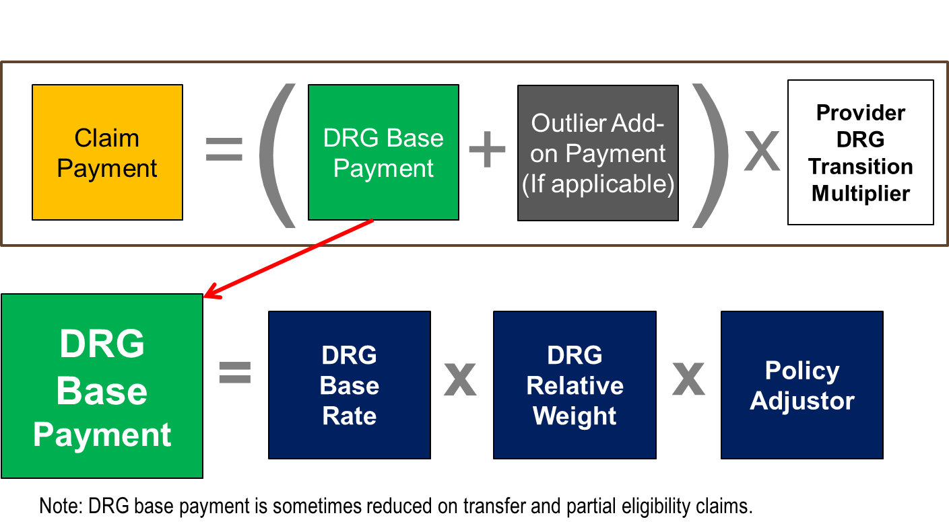
APR-DRG Rates – Focus on Base
DRG base payment formula

Slide 15
Base Rate
For majority of in-state hospitals, DRG base rates are based on a statewide standardized amount of $5,295.40
The labor portion of the statewide standardized amount is adjusted by each hospital’s Medicare wage index
  Wage index is a factor that represents differences the relative hospital wage level in the geographic area compared to the national average hospital wage level
  Example base rate calculation:
    ($5,295.40 X 0.696 labor portion X 1.0366 wage index) +
    ($5,295.40 X 0.304 non-labor portion) = $5,430.29 DRG base rate

Slide 16
Base Rate, cont.
For a limited group of in-state hospitals, DRG base rates are based on a standardized amount of $3,436.08
These hospitals include:
  Hospitals located in a city with a population greater than 1M, which on average have at least 15% of inpatient days for patients who reside outside of AZ, and at least 50% of discharges reported on the 2011 Medicare Cost Report are reimbursed by Medicare
  Specialty hospitals including those specializing in heart and orthopedics (Rule: hospitals designated as type: hospital, subtype: short-term that have license number beginning “SH” ... posted by the ADHS Division of Licensing Services on its website for March of each year)

Slide 17
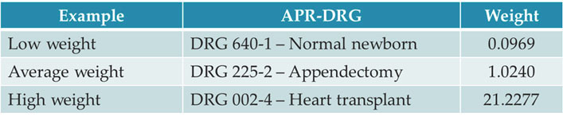
Relative Weights
DRG relative weight is a factor that represents the average resource requirements for each DRG
  DRG relative weight of 1.0 indicates average resource requirements (relative to all other inpatient services)
APR-DRG relative weights are based on the “National Weights” calculated annually by 3M using a national dataset of 15 million inpatient claims

Slide 18
Policy Adjustors
Key Medicaid providers/services targeted for enhanced payment to ensure access to care – applied to DRG base payments
Provider Policy Adjustor:
  Hold harmless applied to high volume provider who meets specific Medicaid volume criteria and is projected to incur a loss under APR-DRG: 1.055 factor
Service Policy Adjustors:
  Normal newborn DRGs: 1.55 factor
  Neonate DRGs: 1.10 factor
  Obstetric DRGs: 1.55 factor
  Psychiatric/Rehabilitation DRGs: 1.65 factor
  Other pediatric cases (age 18 and under): 1.25 factor

Slide 19
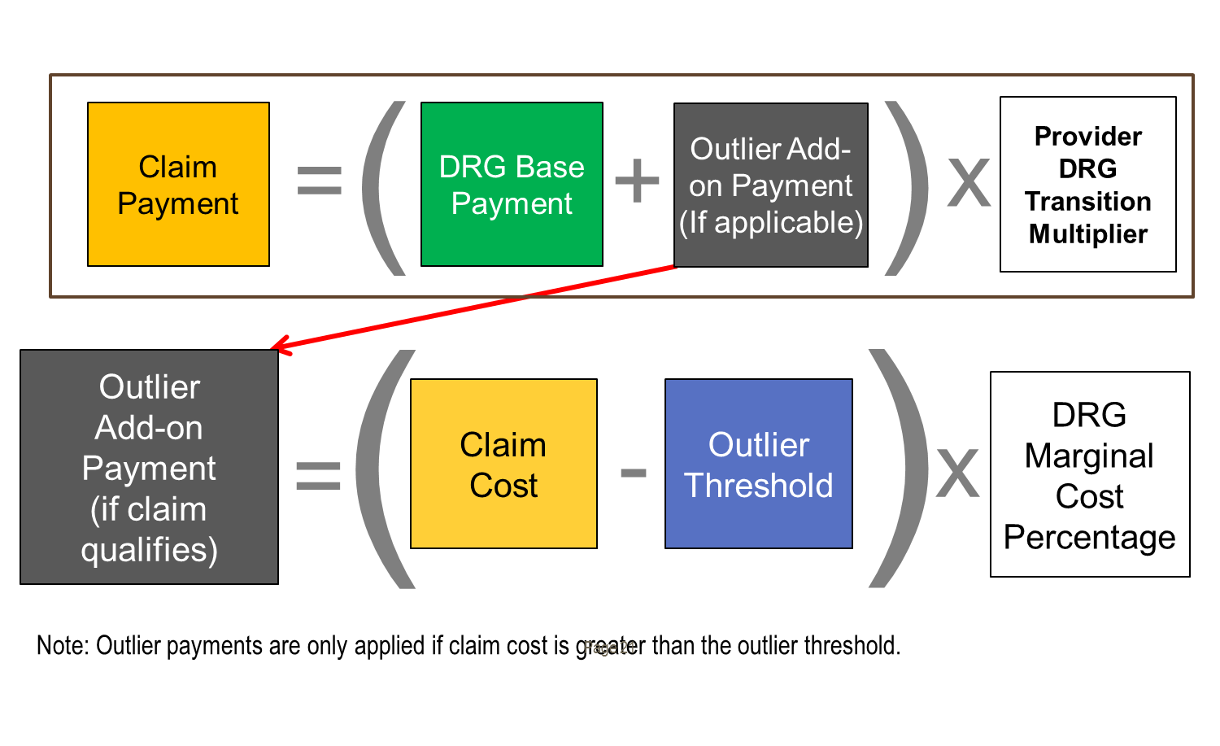
APR-DRG Rates – Focus on Outlier
Outlier add-on payment formula

Slide 20
Outlier Add-On Payment
For extraordinary cases where the claim cost exceeds the outlier threshold for a DRG
Outlier threshold = base DRG payment + fixed loss threshold
Provider must incur a “fixed loss” on the claim for costs exceeding the base DRG payment
Fixed Loss Amount is $5,000 for CAH; $65,000 for all other providers
Outlier add-on payment equals the cost exceeding the outlier threshold multiplied by the DRG marginal cost percentage
  DRG marginal cost percentage is 90% for burn DRGs and 80%
  for all other DRGs

Slide 21
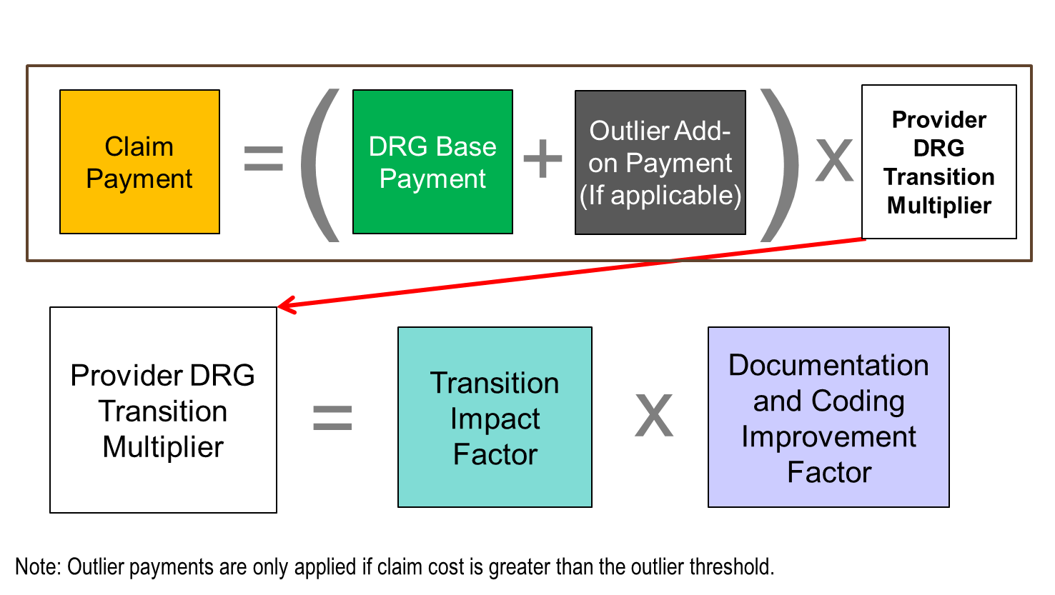
APR-DRG Rates –
Focus on Transition
Transition adjustment factor formula

Slide 22
Transition Factor
Temporary provider-specific factor that limits payment gain/loss based on Navigant payment simulation model
  Year 1 (FFY 2015) factor limits gain/loss to 33% of full estimated gain/loss
  Year 2 (FFY 2016) factor limits gain/loss to 66% of full estimated gain/loss
FFY 2017 no transition factor is applied and full gain/loss is realized
FFY 2018 rebase anticipated

Slide 23
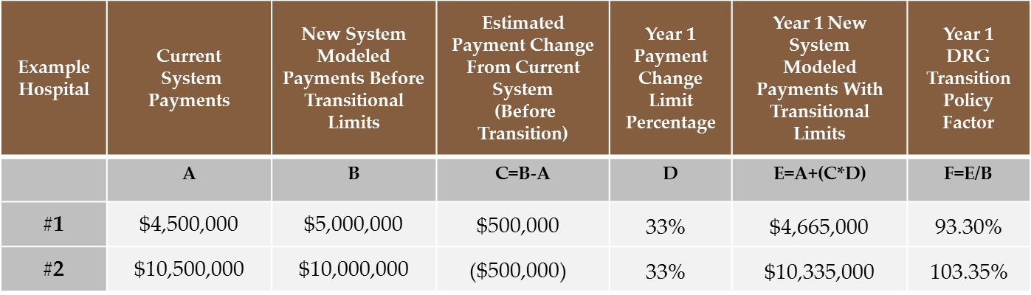
Transition Factor, cont.
Provider-specific factor based on the ratio of:
Modeled payments under the new system with transitional limits;
Modeled payments under the new system without transitional limits Example:

Slide 24
Documentation & Coding Improvement Factor
Because diagnosis coding rigor is not required for payment under per diem rates, case mix increase as a result of DCI coding – beyond actual increases in acuity – is anticipated
To maintain budget neutrality, it is necessary to incorporate an adjustment to offset increases in case mix after implementation
DCI factor is a statewide factor that is a preemptive adjustment for an expected 3 percent increase in DRG case mix over “real” case mix increases as a result of improved coding
  0.9739 factor in Year 1
  Adjustments in future periods may depend on actual trends

Slide 25
AHCCCS Payment Policy Decisions
AHCCCS payment policies related to APR-DRGs will be published in various documents:
  Some are in Rule
  Most will be in AHCCCS’ Fee-For-Service Provider Manual (anything specific to Managed Care Organizations – MCOs – will be excluded)
  All will be included in AHCCCS’ new document:
  APR-DRG Payment System Design: Payment Policies –posted on website

Slide 26
Payment Policy Highlights
APR-DRG payments based on date of discharge
The day of discharge is never paid unless the member expires on date of discharge
All same-day inpatient admit/discharge, admit/transfer claims will be paid using OPFS, including maternity and nursery
APR-DRG payments shall be sole reimbursement for all inpatient services
  Services provided in the ER, observation, or other outpatient department that are directly followed by inpatient admission to the same hospital are not paid separately
  No other services or supplies will be carved out or separately reimbursed

Slide 27
Payment Policy Highlights, cont.
Transfers
  Transferring hospital will be paid a prorated payment
  Base payment will be divided by National Average LOS
  Quotient will be multiplied by actual LOS + 1
  Transfer pricing applies to the following discharge status codes:
    02: Discharged/transferred to a short-term general hospital for inpatient care
    05: Discharged/transferred to a designated cancer center or children’s hospital
    66: Discharged/transferred to a critical access hospital

Slide 28
Payment Policy Highlights, cont.
Recipient may change payers during a single hospital stay, while still Medicaid eligible throughout entire stay
This may occur under a variety of scenarios including
  Enrollment change from FFS to MCO
  Enrollment change from MCO to FFS
  Enrollment change between MCOs within same program
  Enrollment change between MCOs in different programs (e.g. from an Acute MCO to an ALTCS MCO)
Services paid via APR-DRG will be paid by the payer with which the recipient is enrolled at the date of discharge

Slide 29
Payment Policy Highlights, cont.
Providers shall submit a claim to the appropriate payer
Unique to changing payer scenarios, providers shall submit a claim to the payer with the “From” date of service equal to the first day for which the recipient was enrolled with that payer in order to avoid denial based on eligibility/ enrollment edits
  The “From” date of service for the payer responsible on the Date of Discharge will be later than the Date of Admission
The “Through” date of service should be the date of discharge

Slide 30
Payment Policy Highlights, cont.
Also unique to changing payer scenarios:
  The claim may include all surgical procedures applicable for the hospital stay (admit through discharge), even if these procedures were performed prior to the recipient’s enrollment with the payer responsible for payment
  The claim should only include revenue codes, service units, and charges applicable to services performed during the covered days included on the claim (e.g. days between the “From” and “Through” dates )

Slide 31
Payment Policy Highlights, cont.
Recipients of the Federal Emergency Services Program (FES) are limited to hospital services that meet the Federal definition of emergency service
For each FES claim, AHCCCS will determine number of days that meet emergency definition
Claims will be prorated to pay emergency services only based on the number of AHCCCS covered days, when emergency days are less than full stay
Proration factor = [AHCCCS Covered Days + 1] / DRG National Average Length of Stay

Slide 32
Payment Policy Highlights, cont.
When a recipient exhausts Medicare Part A benefits during a single hospital stay, providers must submit a separate claim for the Medicaid covered portion of the stay
Providers shall submit a claim with the “From” date of service equal to the first day Medicaid is the primary payer (i.e. the day after Medicare benefits have been exhausted)
The “Through” date of service should be the date of discharge

Slide 33
Payment Policy Highlights, cont.
Unique to Medicare Part A benefits being exhausted:
  The claim shall only include charges associated with the Medicaid portion of the stay (i.e. the “From” date of service through the “Through” date of service reported on the claim)
  All diagnosis codes may be included on the claim
  The claim should only include those revenue codes, surgical procedures, service units, and charges for services those ICD surgical procedures performed between the “From” and “Through” dates of service
A full DRG payment will be paid for the Medicaid claim

Slide 34
Payment Policy Highlights, cont.
Administrative days may be covered for recipients occupying a bed who do not meet criteria for an acute inpatient stay
  Administrative days must be prior authorized by AHCCCS
  Administrative days will be paid a negotiated per diem rate
  Payment for administrative days will be separate from APR-DRG reimbursement for acute care services and providers must bill such days on a separate claim
  Hospitals shall use patient discharge status 70 (Discharged/ Transferred to Another Type of Health Care Institution not Defined Elsewhere in this Code List)

Slide 35
Payment Policy Highlights, cont.
For stays > than 29 days, interim billing will be permitted in 30 day increments
  Interim bills will be reimbursed at $500 per day
  Interim bills must be voided and a final replacement admission through discharge bill must be submitted at discharge encompassing all days billed as interim and covered by Medicaid
  Interim payments will be recouped and the final bill paid at APR-DRG
  Post-payment audits may be performed to ensure providers submit the final bill per these guidelines

Slide 36
Payment Policy Highlights, cont.
A recipient may be ineligible for Medicaid upon admission, however, may become eligible during the hospital stay
Providers will be paid for Medicaid covered days of the hospital stay
  The DRG payment will be prorated based on the number of AHCCCS covered days
Only claims with dates of service where the recipient is enrolled with the payer will be accepted

Slide 37
Payment Policy Highlights, cont.
Unique to recipients who gain eligibility after admission:
  Claims should include the “From” date of service as the first date the recipient is eligible for Medicaid
  The “Through” date of service will be the date of discharge
  The number of AHCCCS covered days will be calculated as the “Through” date of service less the “From” date of service
The proration factor = AHCCCS Covered Days / DRG National Average Length of Stay

Slide 38
Payment Policy Highlights, cont.
A recipient may be eligible for Medicaid upon admission but may lose eligibility for Medicaid prior to being discharged
Providers will be paid for Medicaid covered days of the hospital stay
  The DRG payment will be prorated based on the number of AHCCCS covered days
Only claims with dates of service where the recipient is an eligible member will be accepted

Slide 39
Payment Policy Highlights, cont.
Unique to recipients who lose eligibility before discharge:
  Claims should include the “From” date of service as the date of admission
  The “Through” date of service should be reported as the last date the recipient is enrolled with the Medicaid payer
  The number of AHCCCS covered days will be calculated as the “Through” date of service less the date of admission
The proration factor = [AHCCCS Covered Days + 1 Day] / DRG National Average Length of Stay

Slide 40
Payment Policy Highlights, cont.
AHCCCS will utilize DRG assignment to determine payment reductions in cases of health care acquired conditions (HCAC)
A present on admission (POA) indicator will continue to be required on all inpatient claims as the HCAC payment reduction policy only applies if the HCAC condition(s) were acquired in the hospital after admission
Under the APR-DRG methodology, two DRGs will be assigned to every claim (“pre-HCAC” and “post-HCAC”)
The DRG with the lower relative weight will be used to price the claim

Slide 41
Payment Policy Highlights, cont.
Potentially preventable readmissions will not be paid, as follows:
  Readmissions within 72 hours to the same hospital with the same base DRG assignment will be pended to medical review
  If the readmission is determined to have been preventable, payment will be disallowed
If upon the medical review it is determined the hospital would not have been able to prevent the readmission, the claim will be paid under APR-DRG methodology
If prior authorized, the readmission claim will be considered to have already gone through medical

Slide 42
Payment Policy Highlights, cont.
For claims submitted for newborns, providers will need to include the birth weight of the newborn on all claims in which the age of the newborn is 14 days or less, as follows:
  Report in a value amount field with associated value code = 54
  Report in number of grams
Hospitals need not report an APR-DRG group on a claim

Slide 43
Exceptions to APR-DRG Payments
APR-DRG will not apply to certain hospital types:
  Claims from a free-standing rehabilitation facility
  Claims from a free-standing long term acute care facility
    Claims for both paid a per diem rate with outlier provision
  Claims from a free-standing psychiatric facility
    These claims paid a per diem rate established by ADHS
  Claims from an Indian Health Service facility or tribally operated 638 facility
    These claims paid at the OMB rate
  Claims for transplant services under AHCCCS contract

Slide 44
Stay Informed
All updates posted to website:
http://www.azahcccs.gov/commercial/ProviderBilling/DRGBasedPayments.aspx
Subscribe to the AHCCCS List Serve at http://listserv.azahcccs.gov/cgi-bin/wa.exe?A0=APRDRG-L
Select “join” on the right side of the page
Questions and comments can be e-mailed to:
DRG@AZAHCCCS.gov

Slide 45
Stay Informed, cont.
AzHHA is collaborating with AHCCCS to educate hospitals about decisions regarding the procurement of 3M’s APR-DRG software
AzHHA has agreed to provide information to hospitals that are not members of the Association
Contact Jim Haynes at AzHHA (jhaynes@azhha.org) for more information

Slide 46
Please Note…
More detail on all items included in this presentation, and other issues not addressed, can be found on the AHCCCS website
In general, AHCCCS Rule prevails in the event of any discrepancy and, for policies not covered in Rule, AHCCCS policy documents prevail in the event of any discrepancy with other presentations (including this one) or documents

Slide 47
ICD -10 Latest Developments
AHCCCS is implementing 3Ms Version 31 of the APR-DRG software
Version 31 has both ICD-9 and ICD-10 code sets
AHCCCS will implement the ICD-9 code set
Version 31 code set currently uses the ICD-9 code set for 10/1/13 to 9/30/14
AHCCCS will update to the ICD-9 code set for 10/1/14 to 9/30/15 when available
AHCCCS is closely monitoring 3Ms ICD-10 decisions

Slide 48
Questions?

