Slide 1
A Year of Accomplishments

Slide 2
Tobacco
Partnership with ADC and ASHLine for follow up coaching of inmates after participation and release from the Second Chance Centers.
Completed pilots at 2nd Chance facilities, with a reported 50% reduction in tobacco use.
Both the inmate population and ADC staff received the program with great enthusiasm.
Two new pilots launching in January (both at Lewis), based on our review of the original pilots, which include a train-the-trainer model with select inmates.
The initiative has received rave reviews from the TRUST Commission, which advises ADHS on the use of tobacco tax revenues.

Slide 3
Second Chance Reentry Centers

Slide 4
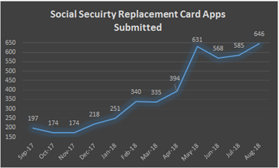
Second Chance Reentry Centers

Slide 5
Cost Avoidance
In State Fiscal Year 2018, AHCCCS avoided $42,433,657.00 in capitation for incarcerated members.

Slide 6
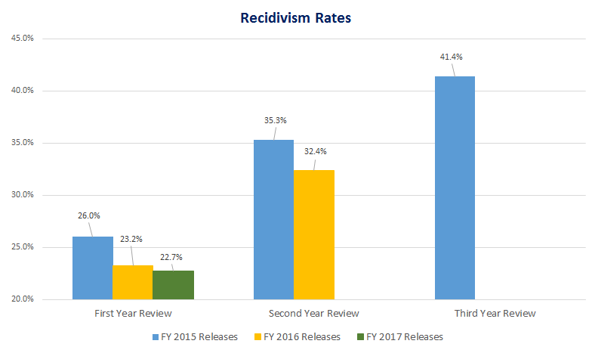
Reduced Recidivism
AZ Department of Corrections

Slide 7
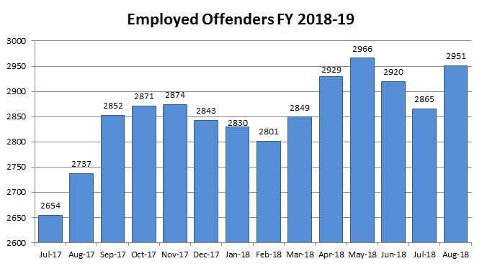
Employment
AZ Department of Corrections

Slide 8
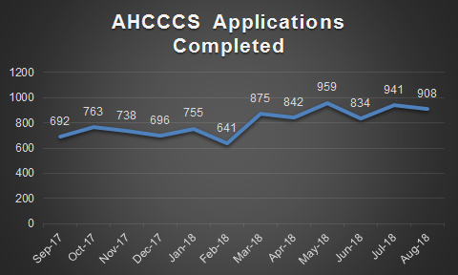
Pre-Release Applications
Department of Corrections-
Note: BOP (Federal) – Partnership established with AHCCCS and DES to support AHCCCS pre-release application processing of federal inmates.

Slide 9
Developmental Disabilities (DD)
Increased eligibility determinations:
Since program inception, several potential members have been identified by County and/or state re-entry personnel.
At least two DD-Only members’ eligibility was reassessed with one member qualifying for ALTCS and the other increased to Targeted Support Coordination.
One Targeted member’s services were reassessed qualifying member for ALTCS.
One non-member was referred to DDD and ALTCS qualifying for ALTCS Services.

Slide 10
Collaboration
DDD -Cooperation of various County Jail Health Teams in assisting with Continuity of Care for DDD LTC Members
Maricopa County Jail Community Health Services has played an integral part in modifying policy and procedures within the Jail Intake system to better identify DDD members.
Maricopa County Jail Community Health Services has a team dedicated to helping Health Plan and RBHA Liaisons meet their AHCCCS Requirements.
Yavapai County Jail Health Services has been very helpful with Continuity of Care when a DDD/LTC member is detained
Yavapai County Health Services and Courts played a fundamental role in coordinating member care between GSA Regions (North to Central) even providing transportation to Level 1 Treatment in Maricopa County.

Slide 11
Collaboration
DDD-Cooperation of Justice Liaisons:
Health Plan and RBHA Liaisons have really created a TEAM attitude in assisting DDD/LTC members who are detained.
Amy Kraus, MCP/MMIC, never fails to assist with DDD, family or member questions surrounding how coverages work through the RBHA.
Mary Krawczyk, UHC, stays quietly in the background, but never fails to do her part to ensure DDD/LTC members have their PCP appointments scheduled in an exceptionally timely manner prior to the actual release. (she gets the appointment on the PCPs schedule prior to member’s release, so they meet the 7-day requirement.)
All Liaisons assist each other with on-boarding new Liaisons and helping everyone understand the processes that have been established since program inception.

Slide 12
Collaboration
A probationer was in need of residential substance abuse treatment as he called his probation officer in a panic after having attempted overdose. His AHCCCS benefits were not active as he had been incarcerated for a period of time. He was directed to have a psych evaluation since he had attempted an overdose and then to work to re-enroll his AHCCCS benefits. After the application was completed, the probation officer called the same day to have it expedited as they hoped to admit the individual into residential treatment. AHCCCS expedited the application and the next day he was able to have his residential treatment funded and he successfully enrolled in treatment.

Slide 13
Collaboration
Earlier this year in April 2018, we had a very high profile, critical cancer patient release. The patient was very young. Health Net (at the time), was able to assign a medical clinical team. Meetings via teleconference were held, so that everyone was on the same page. John Deladillo was able to ensure through the Reach In program and his AHCCCS plan, that the member and his family had all their needs met. Health Net was able to put services in the home day one, which in turn put the family at ease. An RN case manager was assigned to this case and followed up with the member and family day one. What a success.

Slide 14
Collaboration
A patient with cancer was released over the holiday weekend in Oct 2018. Arizona Complete Health, again with the assistance of John Delgadillo, was able to assist and provide services. However, we had to wait due to the holiday for his AHCCCS to begin, but AZ Complete Health assisted both pre-release and post release with ADC parole office.

Slide 15
Collaboration
APD THANKS ALL Participating Agencies & Community Providers:
Participating Agencies: Mercy Care, Correctional Health services, Maricopa County Sheriff’s Office, AHCCCS, Maricopa County Superior Court, Keogh Health, Mercy Care, Arizona Complete Health, Banner University Family Care, Care First, Magellan Complete Care, Steward Health Choice Arizona, United Healthcare Community Plan.
Participating Community Providers: Crossroads, CPLC, Corazon, Lifewell, Native American Connections, National Council on Alcoholism and Drug Dependence Inc. (NCADD), Casa de Amigas, Unhooked Recovery Ebony House, Elba House, Destiny Sober Living, Calvary Healing Center, Valley Hospital
APD coordinates the release with Treatment providers, who transport the probationers from jail to treatment, and CHS provides a medical discharge summary, medications and medical equipment.
On a broader note, APD’s Community Reintegration Unit (CRU) captures the small population that doesn’t qualify for Reach Out or MOSAIC and we are bridging the gap for them in getting them immediate GMHSU services. FY18 over 54% of those referred attended their initial outpatient intake appointment, which generally occurs within 2 days of release from jail

Slide 16
Collaboration
Just recently, we had an urgent release of a patient who was receiving IV antibiotic releasing to Yuma. He was on AHCCCS AZ Complete Health plan. He was assigned an RN case manager and they were able to ensure the patient did not miss even one dose of antibiotics.

Slide 17
Collaboration
20 y.o. male, placed into residential treatment as part of Reach Out but was struggling in the program as a result of his mental health needs. The program manager contacted me and Case Manager coordinated a BH psych med appointment at Terros since he remained open with them and also a PCP appointment for 11/30/18 once he was approved to leave treatment for appointments.

Slide 18
Collaboration
Mercy Care with Andrew Wood, for medical has been so awesome. He is able to schedule PCP appointments for offenders on very short notice.

Slide 19
Collaboration
Banner University Care- Michael Gardner has been helpful, even though one of our patients was incarcerated during the change-over, he made the extra effort to contact the patients new AHCCCS plan.

Slide 20
Collaboration
For our SMI patients, the RBHA plans have all been great. Most patients leave with an appointment in hand for follow up care. In release planning, we work directly with all the RBHA health plans daily. It’s been awesome.

Slide 21
Collaboration
I would like to highlight two things that have been a success this year, especially during 10/1 ACC integration. During the buildup for the changes that would happen on 10/1, all the ACC Justice Liaison’s decided to come together as one team to brain storm and begin meeting with our Justice Partners in order to prepare for these changes. I wanted to highlight the team work, the hard work and the constant communication that has continued to happen between all the ACC Justice Liaisons.

Slide 22
Collaboration
I had an incarcerated member who was eligible for the Reach In process and was being released earlier then I expected. In getting all the coordination completed for this member to attend her PCP and BH appointment, I ran into an obstacle which was her AHCCCS eligibility suspended. The activation was taking a little more time than expected, once member was released, but with the help of AHCCCS and other Justice Liaisons I was able to send the “AHCCCS Notification of Adults in Detention” form to the AHCCCS Justice email. In doing this, not only was eligibility activated that same day I sent the form but she was able to establish care with the appropriate specialists.

Slide 23
Collaboration
Worked with La Paz Sheriff to establish the first MOU/Agreement between them and AHCCCS
Began work with La Paz Sheriff to build an efficient CRE process with La Paz County Detention
Began the process to develop a Veteran Court in Yuma County

Slide 24
Collaboration
In Graham / Greenlee
Developed a process to support Health Home enrollment and re-engagement
This bolsters the rigorous process of Graham County Drug Court which introduces and promotes a thoughtful alternate process to justice services through individualized interaction with Health Homes
Developed a line of communication between the Health Homes, Probation and the Justice systems to solidly engage the community
Organized regular Justice Meetings with Health Homes the Presiding Judge and the Chief of Probation

Slide 25
Collaboration
Collaboration with Pinal County Detention to the Housing Unit for Military Veterans (HUMV); a pod specifically housing veterans within Pinal County Detention.
Jail Liaisons have been trained by Arizona Coalition for Military Families (ACMF) to be Veteran Navigators
This training enabled the Jail Liaisons to work within this pod and identify key needs of the veterans in the HUMV pod; to include CRE submission for those seeking services with our Health home network or seeking a basis of treatment in the community.
Connect community services (Non-AHCCCS) organizations to support and help veterans within the HUMV program
They have been holding veteran’s peer- groups, many of these veterans advocates have become mentors within the pod and help these veterans transition re-entry.

Slide 26
Collaboration
Created a collaboration with multiple stakeholders to develop a referral process for neurological support services for members identified as having a potential lifetime history of Traumatic Brain Injury.
Included in collaboration Brain Injury Alliance of Arizona, Arizona Governor’s Council on Head and Spinal Cord Injuries, Barrow Neurological Institute Concussion and Brain Injury Clinic.

Slide 27
Collaboration
At the Supreme Court, the Subcommittee on Mental Health and the Criminal Justice System, a subcommittee of the Fair Justice Task Force, presented its final report to the Arizona Judicial Council in June 2018. It recommended that the Court continue the work by establishing a committee comprised of justice and mental health stakeholders to identify and recommend ways to address the issues and challenges faced by justice system involving individuals with mental and behavioral healthcare needs.
In August 2018, the Committee on Mental Health and the Justice System was formed with a charge to develop and recommend comprehensive, evidence-based best practices and cross-agency protocols to improve the administration of civil and criminal justice for persons with mental illness.

Slide 28
Data
Reach Out Program: (early release from jail to residential treatment)
61% graduated from treatment; outcomes: 52.6% of non- completers revoked; only 25% of graduates revoked
16 members have been identified for Reach Out since 10/1/18 and Case Manager has had successful coordination with the residential staff 100% of the time. Health assessments have been received 10/13 times (77%), the remaining 3 left RTC program prior to completing their intake process. For all who have left residential against recommendation, Case Management has successfully coordinated with probation.

Slide 29
Data
Targeted Investments Program:
Community Reintegration Unit (CRU) has referred 67 probationers who are in jail, to Terros for coordinated reach-in services. This is part of the Targeted Investments program. Terros Peer Support staff has successfully visited with 40 people in the jails and has scheduled 9 rides for the date of release

Slide 30
Data
Thinking For A Change (T4C) is cognitive restructuring, social skills and problem solving intervention for Medium –High and high risk probationers.
About 35% of the current T4C groups involve co-facilitation with APD and a community provider; Outcomes: Comparison Group revoked 25.6%; Some T4C completion revoked at 8.8% and T4C graduates revoked at 2.7%

Slide 31
Data
Juvenile Probation: 11 new enrollment referrals were received since 10/1/18 for members not already enrolled with a BH provider. 100% have had successful coordination with probation, parents, and BHH. 9 out of 11 have verified completions of intake and 2 have been scheduled for intakes and are still pending.

Slide 32
Success Stories
An individual with Opioid use Disorder was referred to the Department of Corrections Vivitrol program that is partnered with Community Medical Services (CMS) to provide continuation of care once client is released.
Since starting treatment with CMS the member has received 6 Vivitrol injections and has been working with their counselor each month. The member is now employed and this will be her first sober holiday with her ten-year-old daughter. She is excited to be able to provide gifts this year to her daughter. “No drug is worth going back to prison”.

Slide 33
Success Stories
In 2017, a mother of two adult children (one w/special needs) started treatment under the MAT-PDOA grant. She was sentenced to Maricopa County Drug Court Probation and she struggled in the beginning of her treatment.
She eventually completed 90 days of treatment and continued to comply with probation requirements. She successfully moved through the levels of Drug Court probation. This member has also received positive attention during court by getting to pick gift cards and leaving early, which is due to her complying 100% with probation requirements. Throughout this member’s treatment at Community Medical Services, peer support has been able to check in with her frequently and help her navigate obstacles she encountered in her recovery.

Slide 34
Success Stories
29 y.o. male, referred by Pinal County Superior Court Reach In contact. CM outreached member and coordinated with the PO to assist with both PCP appointment and BH intake for 10/11/18 after he was bonded out of jail early on 10/4/18. Member attended both appointments and has been active in services, seen for follow up x-rays 10/23/18 with specialists.

Slide 35
Inspiration
Message from a probationer:
I am 31 years old. I have spent most of my adult life in and out of jail and prison. I have a long history of drug use and used to believe I would do drugs for the rest of my life. I cared about nothing else including my children, who are now 12 and 3.

Slide 36
Inspiration
Up until my last incarceration in the county jail (2017), I had never even considered rehab, because I didn't believe I had a problem. When the chance of going was given to me through the Reach Out program, I decided to try it. That was the best decision of my life.

Slide 37
Inspiration
I entered CROSSROADS for women on Sept.13, 2017 and that day changed my life forever. I am so grateful that I learned things about myself that I had never known, things that kept me “sick”. Things that kept me going back to drugs. I dealt with those things in treatment and I was given the tools to change my thinking and to remain clean and sober.

Slide 38
Inspiration
I completed the typically 30 day program in 110 days and have remained sober and clean for 19 months. Because of the Reach Out program, I am now living a life with purpose. I am on my way to successfully completing probation for the very first time ever. I have my certification as a Peer Support Specialist and my hope is to be able to one day give back by "reaching out" to our at risk youth.

Slide 39
Inspiration
I now have relationships with my daughters and family. I did the work and continue to do so everyday, but I wouldn't have been able without the Reach Out program. It and places like Crossroads are saving lives since without them I would be dead or in prison. I hope that they continue to reach out because sometimes that's all someone needs, somebody to reach out and show them another way. I am forever grateful, thank you!

