Slide 1

School Based Services
Partnering with Families and Schools

Slide 2

School-Based Services
School Based Services (SBS) provides comprehensive behavioral services for youth and their families in the youth’s school through a partnership with the school district.
  Services can also be held in home, at office, or other location
The goal is to provide youth help to address behavioral and mental health concerns by bringing together the family and the school in how best to address and support the youth.
Addresses Tier 3 youth with therapeutic needs
Virtual Site of Touchstone
Reduces barriers to treatment
Establishes strong partnerships with schools

Slide 3


Service Implementation: School Components
  Memorandum of Understanding in place prior to beginning services
  Identify key contact person/persons at each site to coordinate care
  School to work with staff on appropriate times to see youth
  Identified private space on campus
  Summer programming: centralized site for district that will remain open over the summer to provide continuation of services during break

Slide 4
Communication/Partnerships with Schools
Orientation Meetings
Referral Tracking System
Quarterly Support Resource Team Meetings to review administrative/programming needs, successes, barriers
Weekly staffing on SBS enrolled youth at each site, Child and Family Team Meeting participation
Regular email summaries of care for schools
Year End Summary of the Program

Slide 5
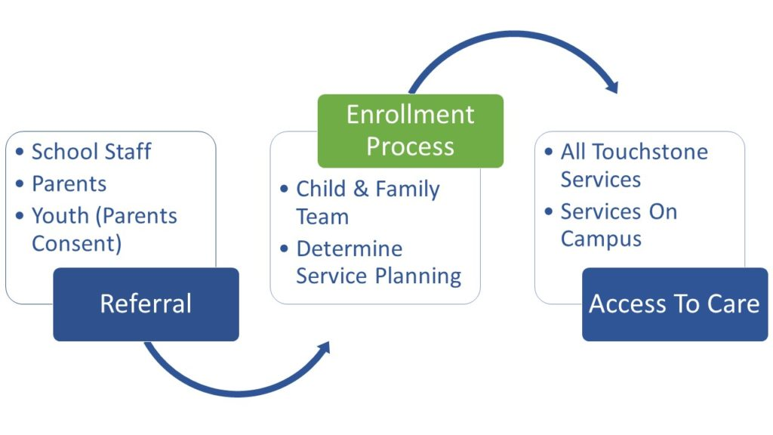
Service Implementation: Members/Youth
  Parent/guardian consent
  Assigned Care Coordinator and Therapist
  Intakes can be completed on campus
  Intensive Outpatient Programming
  Family engagement, family therapy
    Provided in office, home or at school
    Parenting Groups can be offered at the school site
  Funding options
    AHCCCS
    Private pay- sliding fee scale available
    Block grants

Slide 6
Evidence-Based Programming
Therapists can provide individual, family or group therapy
THS has specially designed evidence-based therapy groups for SBS:
  Dialectical Behavior Therapy (DBT) STEPS-A: address interpersonal effectiveness, emotional regulation, mindfulness, and distress tolerance.
  Cognitive Behavioral Interventions for Trauma in Schools is designed to reduce symptoms of post-traumatic stress disorder, depression, and behavioral concerns

Slide 7

Outcomes
Outcomes will be assessed at the start of treatment and upon discharge
Outcome measures include:
  Academic performance
  Truancy
  Following school rules- referrals/suspensions
  School attendance
  Healthy school behaviors
  Self harm/suicidal ideation
  Emotional distress/regulation
  Peer relationships
  Impulsivity/aggression
  Inattention
  Substance abuse
  Family functioning

Slide 8

Additional School Support & Trainings
Touchstone Health Services provides consultation and training to School Based Services partners to help address social and emotional needs of the youth at the campus.
This includes professional development training and strategies to address suicide prevention, self harm, bullying, mental health awareness, substance abuse (opioid, vaping, alcohol, marijuana), and other topics.
  Evidence-Based training offered:
    Youth Mental Health First Aid
    SafeTalk
    ASIST
THS operates the School Mental Health Task Force
  Provides peer support, identify effective strategies, and bring training to school officials

Slide 9
Summary of School Feedback
96% of all sites responded agreed/strongly agreed that they were satisfied with School Based Services Program (4.5 rating on a 5-point scale)
89% of all sites responded agreed/strongly agreed that they saw positive outcomes with youth enrolled in School Based Services (4.2 rating on a 5-point scale)
96% of all sites responded agreed/strongly agreed that they were satisfied with the School Based Services referral process (4.5 rating on a 5-point scale)
“Once a student is enrolled, they will visibly improve- sometimes extremely quickly. The therapist does a wonderful job making sure students feel seen and acknowledged and it makes an immediate difference… Quite often grades will improve… parent concerns are quickly addressed. “
“Knowledgeable, professional and most importantly passionate and dedicated staff. Students feel supported and loved”
“Overall, SBS had made a significant difference in the lives of our students and families. Providing them the opportunity to receive services with the convenience of supporting students in a school setting has made it possible for many barriers to be eliminated. “

Slide 10

Alhambra Elementary School District and Touchstone Health Services Collaboration
Longstanding partnership with Touchstone Health Services
SBS program addresses an invaluable need for the campuses

Slide 11
Creating a Bridge
Identify a point person on each campus to be the bridge between the school and the providers
SBS services aligns with PBIS and MTSS model and provides resources for Tier 3 youth
Help make school officials aware of the impact that poor mental health has on academic performance
Reduce resistance of staff through education and awareness

Slide 12
THS and Alhambra Collaboration
Teachers start to see the benefit and impact on behavior, attendance, and academics
School community champion should be open to sharing “their kids” with providers
Introducing providers to the teachers and to the classroom
Having them become part of the staff and school culture

Slide 13
Community Reception
Address stigma reduction and other barriers
Kids talk to each about the program and how it has helped them
Parents/community- parents encourage other parents to seek help due to impact on their own youth
Viewing and discussing mental health services as a friendly thing
Important to thoroughly explain the services to families
  Not linked as punitive
Notes:
Add closing slide with contact info

Slide 14

Contact Information
If interested in Touchstone’s School Based Services or for any questions regarding the program:
  Erica Chavez, MA, LAC, BHP
  Director of Prevention and School Based Services
  602.571.4835
  Erica.Chavez@touchstonebh.org

