Slide 1

School and Community-based Counseling Services:
A Collaborative Partnership in Support of Your Students

Slide 2
The Collaboration
School districts partner with Southwest Behavioral & Health Services in order to provide an additional level of support to the students and families.
Southwest Behavioral & Health Services provides a Master’s or Doctoral level, clinician who is located on the identified school campus.
The Southwest Behavioral & Health clinician is able to work collaboratively with the administration, teaching staff, paraprofessional staff, and families in order to provide a comprehensive level of support to students.
Skill-building groups (socialization skills, emotional regulation, anger management) are available to enrolled clients.
Counseling and additional services are available for students enrolled with Southwest Behavioral & Health.
Enrollment is available to every student at the school.

Slide 3
Who is eligible for services?
All students and their families are eligible for services.
Funding sources include:
  AHCCCS
  KidsCare
  Self Pay option on a sliding scale
  Some private insurance plans (based on individual clinician eligibility)
  District partnership funding opportunities
  Grant and foundation funding opportunities

Slide 4
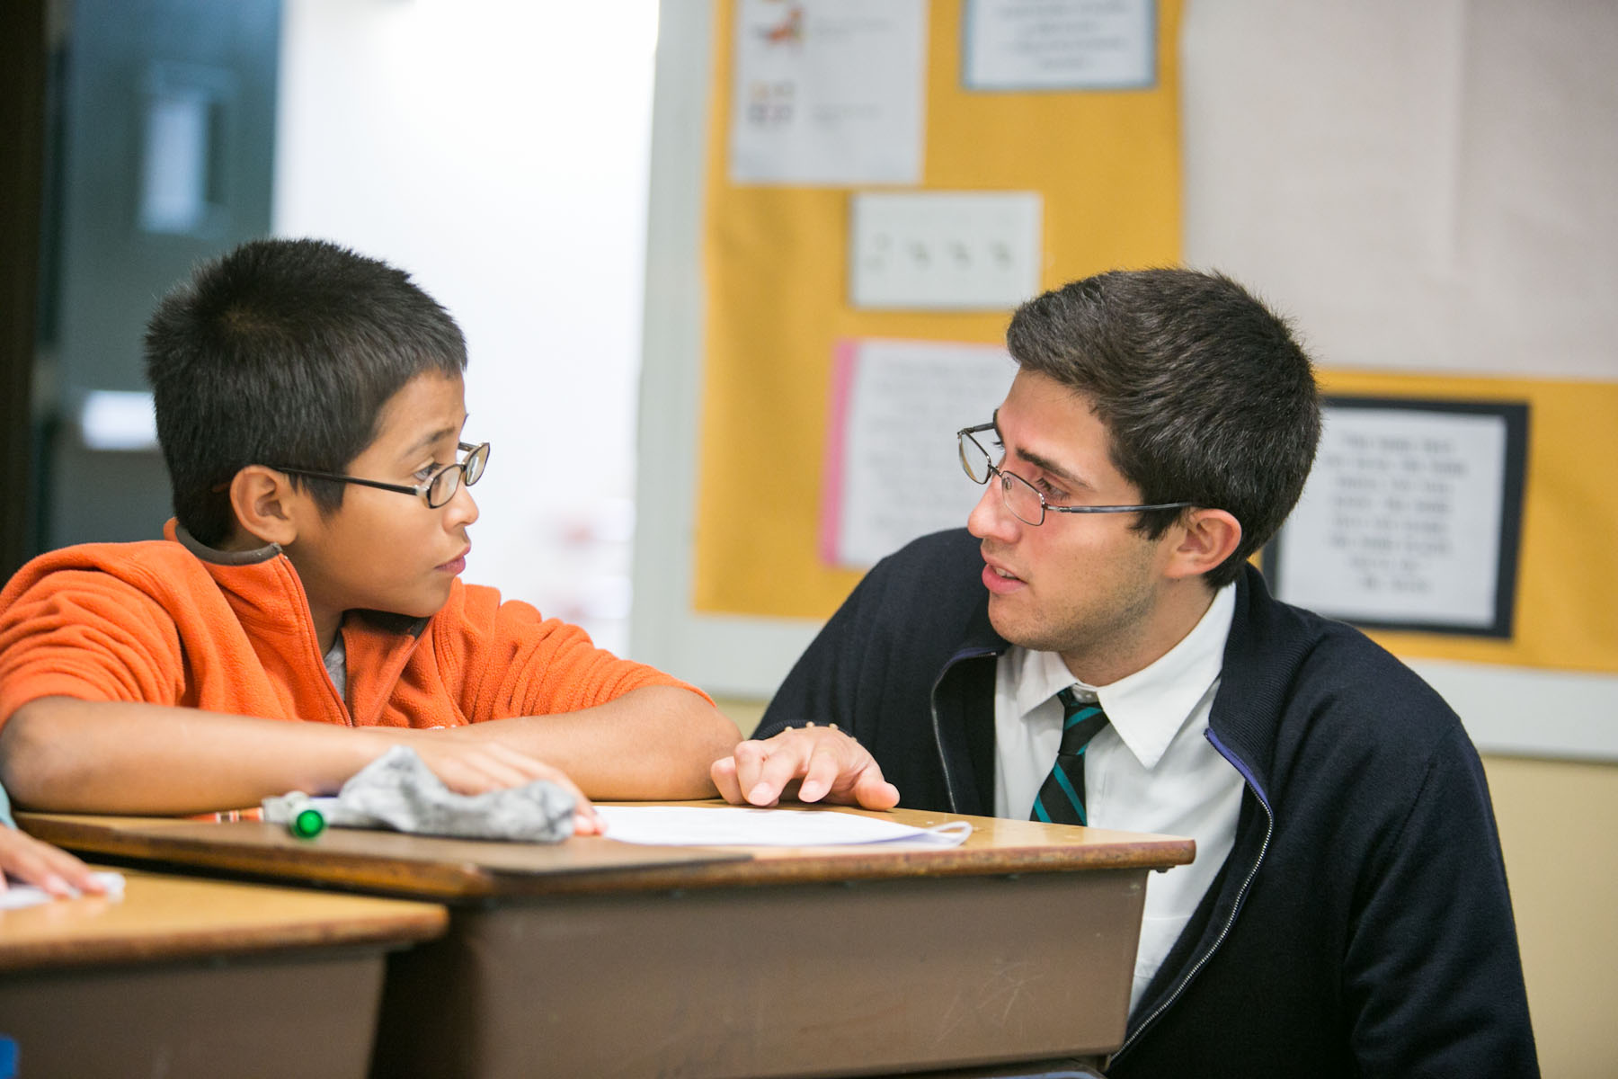
Who can refer for service?
School administrators
School psychologists
Teachers
Parents
Self-referring students

Slide 5
When to Refer a Student?

Slide 6
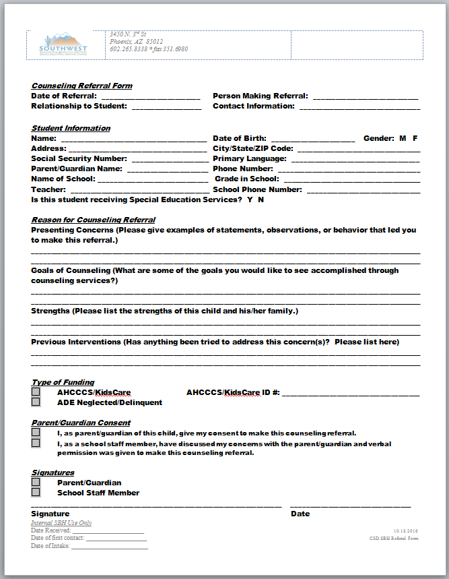
Referral Form
Identifying information
Reason for referral
Goals of Counseling
Strengths
Previous services
AHCCCS information
Parent Consent
Follow Up

Slide 7
What Behavioral Health Services are Provided and Available?
Individualized assessment
Individualized Services Plan (ISP) for each child receiving services
Individual and family counseling
Skill-building groups (socialization skills, anger management, emotional regulation)
Behavior coaching/modification
Psychiatric services
Coordination of care, community outreach, and resource development
Child and Family Team meetings

Slide 8
Child & Family Team Process
(CFT)
All of these services are coordinated through the Child and Family Team (CFT) process, which is an aspect of the Arizona Model for Children and Families.
This process identifies the key stakeholders in the life of the child and unites these stakeholders in the child’s needs and goals with the long-term objective of sustaining the successes the child attains through participating in behavioral health services.
The Child & Family Team can be comprised of: the child, parent/guardian, key school staff, DCS, Juvenile Probation, family friends and relatives, other support providers (case managers, behavior coaches), mentor, medical provider.
Child & Family Team
SBH
School
Other natural supports
Community

Slide 9

Counseling Services:
Flow of Services
What can a parent and student expect from counseling services with Southwest Behavioral & Health Services within Deer Valley Unified School Distrcit?
Initial outreach call from SBH staff:
Description of the program
Discuss presenting concerns and goal setting
Schedule the initial intake assessment
Services Begin
Individual counseling, in-class support, crisis management, emotional regulation, de-escalation
Family meetings to support strategies learned at school
Progress reviewed at each session
Regular contact and communication with teachers and school staff
CFT meetings at least every 90 days
Ongoing collaboration with SBH counselor, school staff, other family members and community members.
Already Enrolled with a Behavioral Health Provider?
SB&H can collaborate with existing behavioral health providers
SB&H can support skills and strategies your child is learning throughout the school day by collaborating with the existing counseling team

Slide 10

How do School-based Clinicians Work with your School?
How can schools support their school-based clinician?
  Access to consistent, confidential space
  Access to school email
  Access to school staff, teachers, administrators and student schedules
  Invitations to IEP/504 Plan meeting and parent/teacher meeting for enrolled clients

Slide 11

Contact Information
East Valley School Based Programming
Carrie Holmes
Program Director
602-696-4287
Email: CarrieH@sbhservices.org
Central Valley School Based Programming
Alysson Zatarga
Program Director
602-686-1016
Email: AlyssonZ@sbhservices.org
West Valley School Based Programming
Kathy Villa
Program Director
602-525-3329
Email: KathyV@sbhservices.org

