Slide 1
Suicide Prevention
Kelli Donley Williams, MPH
Suicide Prevention Specialist
Office of the Director

Slide 2
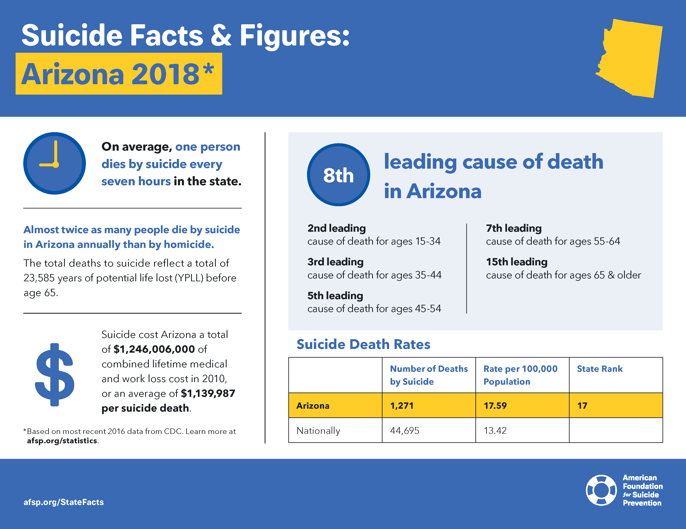
Notes:
1 person dies by suicide every 7hours
Suicide is the 8th leading cause of death in Arizona
State ranks 17 in the Country
Alarming 2nd leading cause of death amongst ages 15-34
Nationally average is 44,695 vs 1,271 deaths by Suicide
Environmental Factors
Access to lethal means including firearms and drugs
Prolonged stress, such as harassment, bullying, relationship problems or unemployment
Stressful life events, like rejection, divorce, financial crisis, other life transitions or loss
Exposure to another person’s suicide, or to graphic or sensationalized accounts of suicide
Health Factors
Mental health conditions
Depression
Substance use problems
Bipolar disorder
Schizophrenia
Personality traits of aggression, mood changes and poor relationships
Conduct disorder
Anxiety disorders
Serious physical health conditions including pain
Traumatic brain injury
Historical Factors
Previous suicide attempts
Family history of suicide
Childhood abuse, neglect or trauma

Slide 3
Suicide Prevention in Schools
New legislation goes into effect 2020
Trainings to be announced in October, posted to AHCCCS website in coordination with the Arizona Department of Education
Project AWARE – schedule your Youth Mental Health First Aid training

Slide 4
Teen LifeLine Badge Project
147 schools statewide currently participating
200,000 students
From the Navajo Nation to Bisbee
Interest by the legislature to have this implemented statewide
Notes:
Source: SAMHSA / Suicide Prevention Resource Center
Prevention strategies - such as educating medical providers on safe prescribing practices, conducting comprehensive and suicide risk screening and assessment and implementing non-medical strategies to address pain - exist that may mitigate these risks among patients
Research has shown that patients experiencing chronic pain may be at increased risk for opioid abuse, overdose, and death by suicide
Assess the problem
Incidence/Prevalence (what, when, where, why)
Demographics (age, gender, language, location, ethnicity)
Risk/Protective Factors (culture and social determinants of health)
Assess community readiness and resources
What has been done and implemented to reduce suicide
What resources are available (referrals to prevention and treatment)
Asses priorities
Identify high risk populations and contributing factors
Identify specific outcomes and/or behaviors to be change
Identify effective programs and campaigns to reduce suicide
Risk Factors
Risk factors are characteristics of a person or his or her environment that increase the likelihood that he or she will die by suicide (i.e., suicide risk).
Major risk factors for suicide include:
Prior suicide attempt(s)
Misuse and abuse of alcohol or other drugs
Mental disorders, particularly depression and other mood disorders
Access to lethal means
Knowing someone who died by suicide, particularly a family member
Social isolation
Chronic disease and disability
Lack of access to behavioral health care
Risk Factors Can Vary Across Groups
Risk factors can vary by age group, culture, sex, and other characteristics. For example:
Stress resulting from prejudice and discrimination (family rejection, bullying, violence) is a known risk factor for suicide attempts among lesbian, gay, bisexual, and transgender (LGBT) youth.
The historical trauma suffered by American Indians and Alaska Natives (resettlement, destruction of cultures and economies) contributes to the high suicide rate in this population.
For men in the middle years, stressors that challenge traditional male roles, such as unemployment and divorce, have been identified as important risk factors.
Protective Factors
Protective factors are personal or environmental characteristics that help protect people from suicide.
Major protective factors for suicide include:
Effective behavioral health care
Connectedness to individuals, family, community, and social institutions
Life skills (including problem solving skills and coping skills, ability to adapt to change)
Self-esteem and a sense of purpose or meaning in life
Cultural, religious, or personal beliefs that discourage suicide

Slide 5
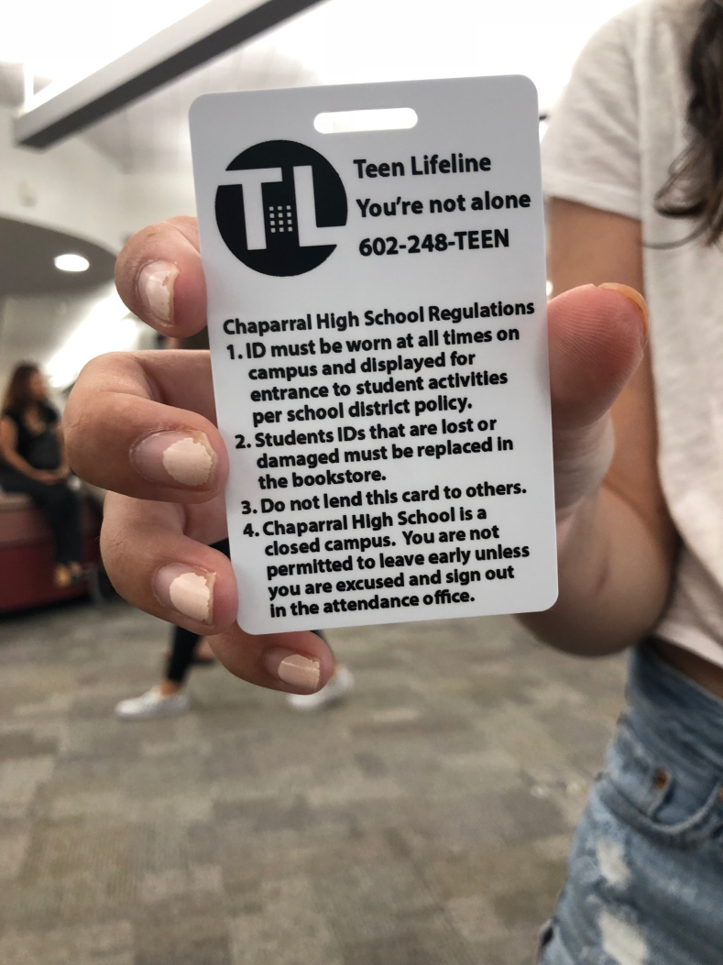
Examples:

Slide 6
Teen LifeLine Badge Project
Contacts:
  Nikki Kontz – Teen Lifeline
    nikki@teenlifeline.org
    Kelli Donley Williams – AHCCCS
    Kelli.williams@azahcccs.gov
    602-417-4493
Notes:
Source: SAMHSA (2018)
Talk
If a person talks about:
Killing themselves
Feeling hopeless
Having no reason to live
Being a burden to others
Feeling trapped
Unbearable pain
Behavior
Behaviors that may signal risk, especially if related to a painful event, loss or change:
Increased use of alcohol or drugs
Looking for a way to end their lives, such as searching online for methods
Withdrawing from activities
Isolating from family and friends
Sleeping too much or too little
Visiting or calling people to say goodbye
Giving away prized possessions
Aggression
Fatigue
Mood
People who are considering suicide often display one or more of the following moods:
Depression
Anxiety
Loss of interest
Irritability
Humiliation/Shame
Agitation/Anger
Relief/Sudden Improvement

Slide 7
Questions?

