Slide 1
Arizona Medicaid School Based Claiming Program
School Based Behavioral Health and Suicide Prevention Services Forums
September 2019

Slide 2
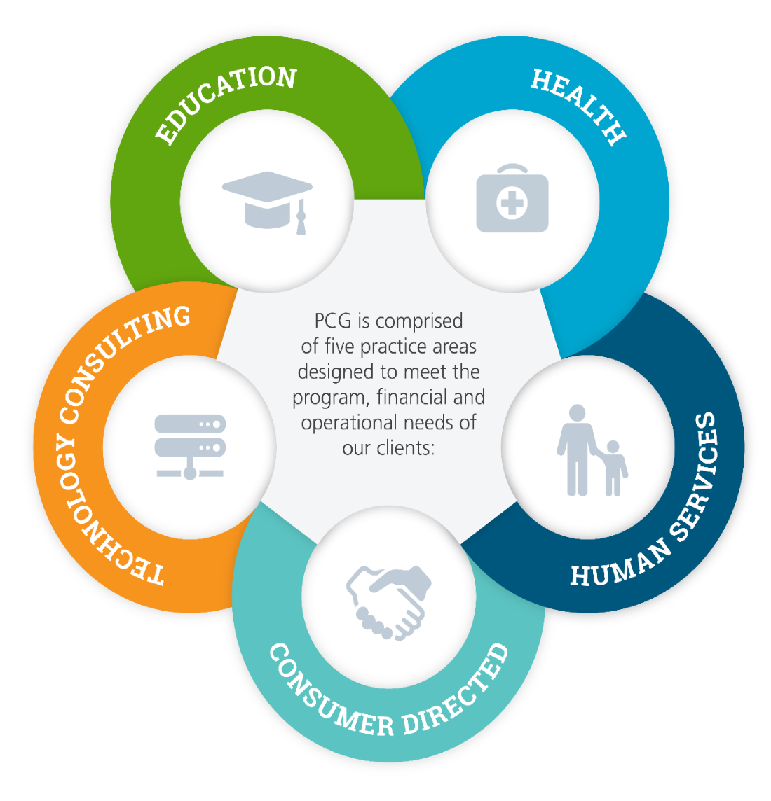
About PCG
Public Consulting Group, Inc. is a management consulting firm primarily serving public sector clients
Founded in 1986
Employs over 2,500+ professionals in 60+ offices located across the US, Canada, UK, Australia, and Poland
Target Markets: Health, Human Service, and Education in the Public Sector
Core Services: consulting, policy advising, information technology, and on-going operations support

Slide 3
Education’s hot topics
PCG has worked with many states and districts to better understand and capitalize on the national momentum around mental and behavioral health support for adolescence
Some states have elected to work with the federal government to expand policy to obtain additional funding for health services
Others have started using case management technology to identify students at risk of self-harm or school violence and provide intervention / prevention support

Slide 4

PCG’s work in Arizona
Support AHCCCS in administering the Medicaid School Based Claiming (MSBC) Program since 2009
Help Arizona Local Education Agencies (LEAs) recover over $48M in statewide Medicaid reimbursement annually for administrative / outreach, health-related and specialized transportation services prescribed in Individualized Education Plans (IEPs)
Health-related services: speech, occupation / physical therapy, mental / behavioral health, nursing, and personal care

Slide 5
MSBC Program by the Numbers

Slide 6

MSBC Program Participation in Arizona
MSBC Program Participants
Districts/Charters:
Districts: 94
Charters: 3
Accounts for ~78% of all AZ students
110 total Behavioral Health Providers in 34 of the 97 LEAs:
Marriage & Family Therapists: 1
Licensed Professional Counselors: 20
Psychologists, PhD: 36
Licensed Clinical Social Workers: 53

Slide 7
Behavioral Health Billed Services
Behavioral Health Claims
by the Numbers
1,220 students had a behavioral health service billed (3%) of the ~37,000 of all service types
94% of all billed BH services are “Behavioral Health Counseling”
Providers Billing:
68 of out 110 (62%)
On average, students received only 5.4 hours of services per school year
Notes:
Billed:
Marriage & Family Therapists: 1
Licensed Professional Counselors: 11
Psychologist, PhD: 15
Social Workers: 41

Slide 8
Compliance and Program Requirements

Slide 9
Establishment and Management of an IEP
Student suspected of requiring special education services must be evaluated to determine eligibility
Special education concerns noted during a screening must be communicated to parents
With parental consent, the student is referred for an initial evaluation
Multidisciplinary Evaluation Team (MET) meets to discuss evaluation results and determine eligibility
If eligible, the team must meet to write an IEP
Parental consent must be received prior to implementing the IEP
IEP team must review the IEP at least annually and revise as needed
Student must be reevaluated for eligibility every three years

Slide 10
Provision of Behavioral Health Services Under the MSBC program
A qualified behavioral health provider determines eligibility for behavioral health services based on medical necessity
Behavioral health services must be provided through psychological / developmental testing and therapy sessions
Services must be rendered by a qualified behavioral health provider
Situational or episodic events are not serviced through an IEP but still provided to the student in the school setting
Currently these services are not reimbursable under the MSBC program
Situational services may include short term support such as:
Grief counseling
Support for bullying
Addiction counseling
Domestic support
Notes:
QMPs: Licensed Clinical Social Workers, Licensed Marriage and Family Therapist, Licensed Professional Counselor, Licensed Psychiatrist, Licensed Psychologist

Slide 11
Curious to know more? PCG can…
Discuss your LEA’s specific MSBC Program reimbursement and if there’s opportunity for optimization?
Talk about what we are doing in other states and LEAs around the country with respect to policy work and identification / prevention / intervention technology

Slide 12


PCG Contact Information
Meghan Balmer – Program Manager
mbalmer@pcgus.com
(602) 324-5078

