Slide 1


Education & Behavioral Health Partnerships in Rural Communities
Lauren Lauder, MSW, MBA, LISAC, Chief Executive Officer
Trever Davis, DBH, LAC, Chief Clinical Officer Sept. 23, 2019

Slide 2
Key Attitudes for Partnership
Mutual desire for excellence in customer service
Willingness to maintain responsive outreach
Follow and support the most critical needs in the education system and resolve meeting those needs with frequent collaborative efforts
Communication!
Notes:
Customer Service: May require changing a (BH) systemic or agency-specific attitude from “determining what may be possible” to “finding the yes”
Maintain Responsive Outreach: At least monthly contact so community responses have a pre-identified protocol (informal or formal) and parties know who to call in the other agency in the event of a student/teacher death or other serious event
Critical Education System Needs: School districts have done a ton of work to identify specific school’s or district-wide needs and don’t need to be told what BH providers think is needed
Communication: Know who to call before it’s needed, engage frequently (monthly) for ongoing check-in when possible, have chains of command in place or at least primaries & backups for ongoing communication; “it takes a village” on both sides to make a successful overall team

Slide 3
Challenges in Early Development
FUSD Funding
TGC Engagement
Academic vs. School Counselors
Limited Scope: No Assessment
District’s Attempts to Spread Limited Resources
History of Community Withdrawal
Leadership Communication Difficulties
Focused on Billable Services over Community Response
Notes:
FUSD Funding
Academic vs. School Counselors: Funding limitations focused priorities on academic advising and overcoming access to resources instead of counseling
Limited Scope: Can provide screenings or evaluations, but not formalized mental health assessments to address all needs
Spread Limited Resources: No school has 1.0 FTE of a non-academic counselor
TGC Engagement
History of Community Withdrawal: Funding struggles led to focusing on maintaining internal programs and avoiding community requests for additional services or programs
Leadership Communication Difficulties: Present leaders spread too thin, unable to be as responsive as district needed when urgent issues arose
Focused on Billable Services…: Only saw students (or families) already engaged in services rather than attempting to bring additional individuals into crisis or other, ongoing services

Slide 4
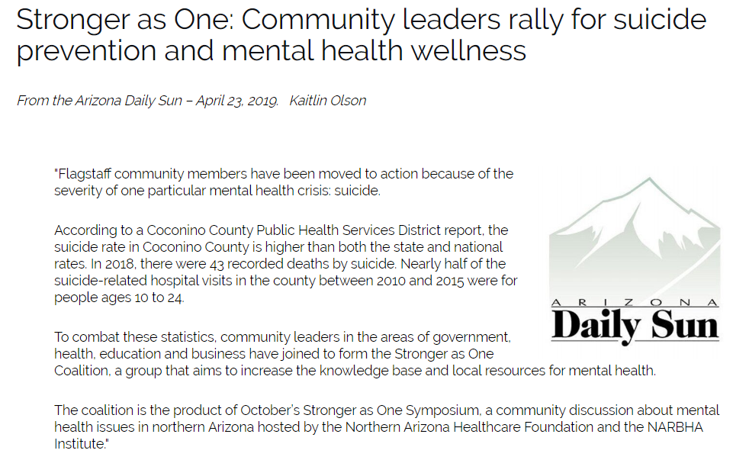
Takes More Than Two To Tango
Coconino County Public Health & Other Departments
Northern Arizona Healthcare & The NARBHA Institute
Coconino Community College
Flagstaff Police Department & Coconino County Sheriff’s Dept.
The Guidance Center, Terros & Native Americans for Community Action
Flagstaff City Council & County Board of Supervisors
Notes:
Stronger As One: Define it; mention partners on slide, not a full list and continuing to grow (add-on CJCC, NAH BH, NACA, CC Detention facilities, etc.)
One of the first initiatives on next slide (advance)

Slide 5


Mental Health First Aid Youth Module
Trained all 2018-2019 faculty & staff of Flagstaff Unified School District in a single in-service day (over 300 individuals)
Notes:
The NARBHA Institute helped FUSD, Steward Health Choice Arizona (AHCCCS health plan), TGC, NACA and other community partners create a new Instructor class of Youth Mental Health First Aid. After covering the significant cost and coordinating the event with the District, the only requirement was helping FUSD train its faculty and staff. The District Superintendent committed to providing an entire extra in-service day in the ‘18-’19 academic year (November, 2018) to provide this training.
YMHFA intends to bring comfort to people in the approach, offer an understanding ear with knowledge of needs and resources and improve individuals’ abilities to support students and other teachers.
The need was highlighted by learning of a student death by suicide during the latter portion of the training.

Slide 6


Catching Up & Offering Support
FUSD Initiated Training Plan
TGC & Terros Support Role
80-110 students per school offered post-training support following self-reports of concerns
School Counselor Leadership & Local BH Providers coordinated all support services over the days & weeks following student training & contacted parents/guardians

Slide 7
When The Unthinkable Happens
Proactive Protocols Already in Place
Response Times & Capacity
Dispatch Process
Single Points of Contact for Ongoing Coordination
Student or Teacher Death by Suicide: Know What You’ll Do
Notes:
Trever provide the story of the escalated female neighbor that showed up following Sinagua’s bullying suicide.

Slide 8


Slide 9
“Back to School” Open House Behavioral Health Service Offerings
Offered on-site AHCCCS Eligibility Screening & “Outreach for Services” Release of Information for both local child-serving BH agencies
Services advertisements for Child & Family Support Services & The Guidance Center offered to all attendees
Advertised Mental Health First Aid free trainings to Sinagua Middle School Parent-Teacher Organization

Slide 10
Community College Opportunities ALIGN & REINFORCE
Identify framework for current response protocol & capacity
Find the right collaborators in the leadership team
Maintain communication
BH Providers should make regular offers of new available resources, trainings & education
Notes:
Similar to starting with local school district, make good contacts
Learn what they’ve got and what they feel they need without subjecting opinion or judgment
Continuously offer up what BH has available, get creative to address gaps, call in community stakeholders
Respect the privacy of the CC as an independent organization while reinforcing their strengths instead of advising on vulnerabilities
CCC: REACH protocol for student referral & follow-up
Stronger As One / TNI
Baylor University partnership

