Slide 1
AHCCCS Update

Slide 2
100% Federal Poverty Level
(2013)

Slide 3
Medicaid and ACA Populations
400%
~
~
~
~
~
~
Medicare
100%
100%
100-133% FPL Estimated 57,000 to enroll
67%
67%
67%
67%
67%
67%
85%
Percentage of costs paid by federal government
30 Years of Medicaid Innovation
Our first care is your health care
Arizona Health Care Cost Containment System

Slide 4
AHCCCS Coverage History
Mid 1990s – Governor Symington proposed eligibility increase to 100% - leverage state only spending
1996 Initiative approved by voters after lack of support by legislature
2000 Initiative passed by voters after state unable to implement 1996 initiative
2001 – coverage up to 100% implemented
2010 – ACA passes with coverage up to 133%
2011 – State imposes freeze – insufficient resources
2012 – US Supreme Court ruling on ACA

Slide 5
Childless Adult Population
5

Slide 6
AHCCCS Coverage
In her State of the State Governor Brewer called for the legislature to restore Proposition 204 coverage and provide coverage up to 133%
This would provide coverage for about 300,000 statewide
Proposal would provide about $1.7 billion in federal funds to support healthcare in AZ
Circuit Breaker – proposal includes requirement that if federal funding decrease below 80% for childless adults coverage terminates
Funding Source – Executive proposal includes hospital assessment to cover state costs associated with Prop 204 – Replace City of Phoenix assessment
30 Years of Medicaid Innovation
Our first care is your health care
Arizona Health Care Cost Containment System

Slide 7
Childless Adult Expenditure Data
Diagnosis | Members | Cost
Injuries/Trauma | 65,095 | $163 m
Heart - circulatory | 53,087 | $147 m
Digestive system disease | 52,921 | $112 m
Cancer | 18,766 | $76 m
Diabetes and kidney disease | 28,981 | $49 m
Respiratory Disease | 73,047 | $85 m
30 Years of Medicaid Innovation
Our first care is your health care
Arizona Health Care Cost Containment System

Slide 8
Impact of Prop 204 Coverage Elimination
Based on FFY 2011 Spend (3 months of freeze) - $1.7 B
Hospitals $720 million – 38 Non Maricopa/Pima Hospitals - $160 m
Physicians/Clinicians - $283 million - $50 m greater AZ
Behavioral Health - $125 million - $27 m greater AZ
Emergency and Non-Emergency Transportation - $80 m
Radiology and Lab - $72 m
Waiver Authority Expiring 1-1-14
Hospital Uncompensated Care Funding – I.H.S Funding
Authority to cover Childless Adults

Slide 9
Relatively Minor Tweak to Populations Already Covered by Arizona Voters
30 Years of Medicaid Innovation
Our first care is your health care
Arizona Health Care Cost Containment System

Slide 10
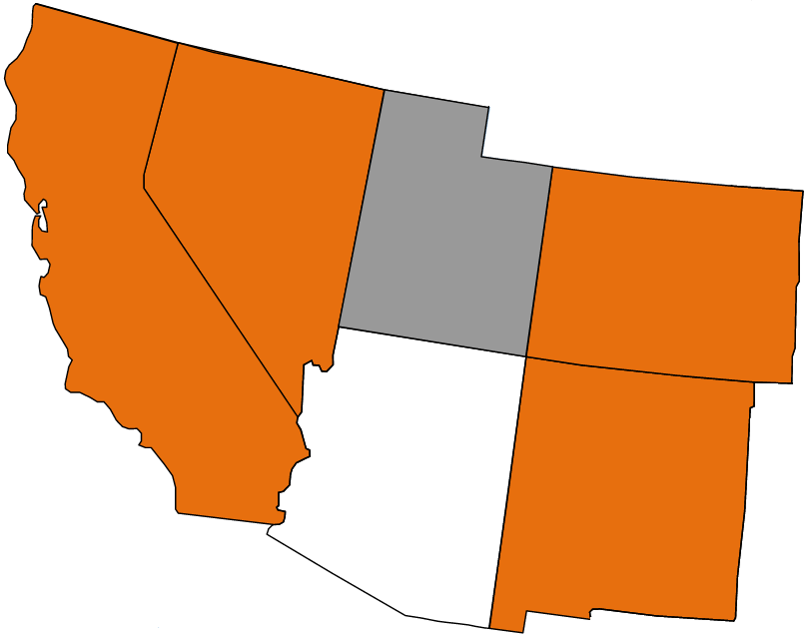
Expanding will Maintain Arizona’s
Economic Competitiveness
Almost all of Arizona’s neighboring states are expanding
Not expanding will expose Arizona to uncompensated care costs that will impact the cost and quality of care
This cost will hurt Arizona in economic competition with other states
Taxes from non-expanding states will fund Medicaid growth in expanding states creating a wealth shift
Expanding
Undecided
Expanding
Expanding
Expanding
30 Years of Medicaid Innovation
Our first care is your health care
Arizona Health Care Cost Containment System

Slide 11
Local Medicaid Efforts
Item | Local Match | Federal Match
Safety Net Care Pool Maricopa | $36.7 million | $70.2 million
Safety Net Care Pool UMC & PCH | $77.2 million | $147.8 million
Phoenix Provider Tax | $109.0 million | $208.6 million
Total | $222.9 million | $426.6 million
These efforts end on 12/31/13

Slide 12
Medicaid Expansion Funding Impacts
 | FY 2014 | FY 2015 | FY 2016
State Match Increase | $27 million | $154 million | $105 million
Provider Assessment | ($82 million) | ($256 million) | ($224 million)
Increase in Existing Premium Tax | ($7 million) | ($34 million) | ($36 million)
Net Impact on GF | ($62 million) | ($136 million) | ($155 million)
Federal Match | $337 million | $1.556 billion | $1.712 billion

Slide 13
Impact to Arizonans
Working Childless Adult age 55 – “I was born and raised in Arizona, lived here all my 55 years. I have worked and raised a family. I have come down with Hep C and if I don’t get treatment I will die. I can’t work full time any longer because of my illness. I can’t afford treatment. I guess I don’t have a choice but to die thanks to this state I have called home all my life. Still working part time paying into the system, just waiting to die.”
14 County Sheriffs sent a letter on Feb 11th – “Deputies in the field are also seeing the impacts of the untreated mental health conditions among those who no longer qualify for AHCCCS/Medicaid. Formerly stable people with mild to moderate mental health disorders are taxing the resources of deputies, often unnecessarily…“Making AHCCCS/Medicaid services more accessible to more Arizonans who are struggling economically will benefit the communities as a whole, as well as public safety in general. Thus we support your proposal…”

Slide 14
AHCCCS Prop 204 Restoration and Medicaid Coverage
Honor the will of the Voters – twice have approved coverage for low income Arizonans – up to 100%
Keeps Arizona Economically competitive – Arizona families and businesses have to support uncompensated care – states that expand Medicaid have competitive advantage
Protect rural, safety net and healthcare infrastructure - AHCCCS is an integrated system and the impact of a continued freeze will be dramatic on the delivery system all Arizonans enjoy
AHCCCS part of sustainability solution – Healthcare financing is a national policy dilemma that requires a federal solution – AHCCCS is nationally recognized system and similar efficiency levels should be achieved elsewhere
Achieve healthier Arizona – New England Journal of Medicine found AHCCCS expansion saved lives and coverage also supports lower costs of care for patients
30 Years of Medicaid Innovation
Our first care is your health care
Arizona Health Care Cost Containment System

Slide 15
AHCCCS is part of the Solution
Conservative managed care principles based on competition and choice
“Gold Standard” for managed care
Error rates well below national average
Quality performance measures above national averages
#1 ranking nationally for Medicaid Developmentally Disabled program – United Cerebral Palsy 2012 Report
High member satisfaction – less than 3% switch plans
Strong Competition to participate in the program
One of the highest rates of community placement nationally for those at risk of institutionalization
National leader in Integrated delivery system for Dual eligible
Very strong provider participation rates

Slide 16


