Slide 1
Communications Update
Heidi Capriotti
Public Information Officer
Notes:
Focus on right communication vehicle for the message (Twitter, blog, email, web story)
Effort to help MCOs amplify your messages

Slide 2
E-Newsletters
Subscribe on our website
Notes:
Moved to new email marketing tool
Updating all Division e-newsletters (OOD and DFSM)
OOD News will share MCO efforts – 600+ subscribers (internal and external)
Subscribe to all from AHCCCS Newsletters link on footer

Slide 3
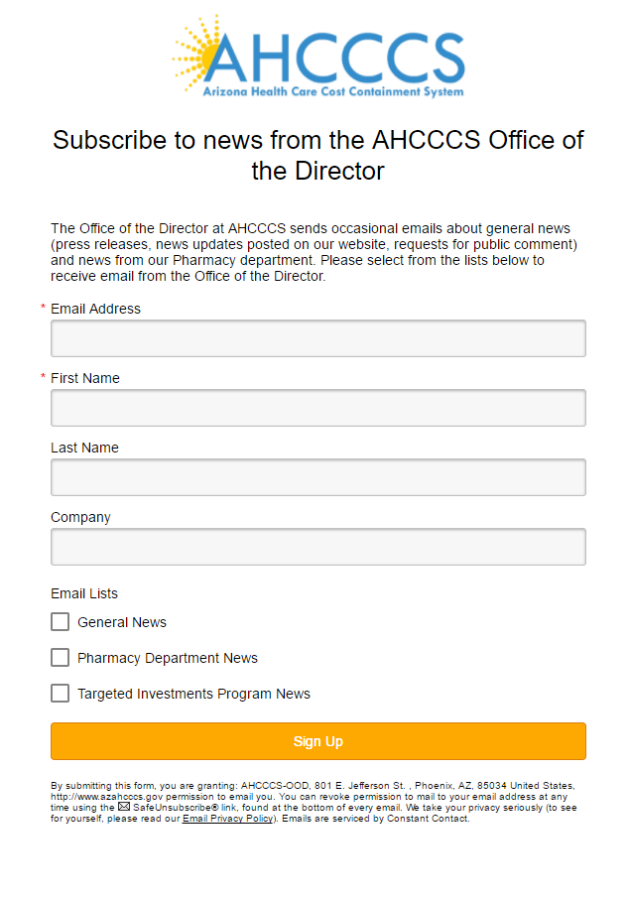
E-Newsletters
Notes:
Specific news by division

Slide 4
Web News Page
www.azahcccs.gov
Notes:
Sort features added to News & Updates

Slide 5
Blog
blogs.azahcccs.gov
Categories
Community Events
Human interest
Govt. Relations
Employees in Action
Behavioral Health

Slide 6
Social Media
@AHCCCSgov
Top May Tweets
#mentalhealthmonth
#OpioidEpidemic
Notes:
Actively working to grow social media outreach
Steady rise in impressions since Feb.
Want to help amplify your messages

Slide 7
The PIO’s role
Answer inquiries from the media
Coordinates with your PIOs/Communication teams
Shares our news & yours
Focus group for branding questions
Notes:
My job:
Answer reporter questions- 56 media inquiries since Feb. 27. Thanks AHCA!
Coordinate with your PIOs
mitigate negative
and push positive news
Tell the good news of the work that AHCCCS and our MCOs are doing
Use them for focus group work

Slide 8
Heidi.Capriotti@azahcccs.gov 602-417-4729

