Slide 1
Annual AHCCCS Reinsurance Workshop RI Contract Year 40
Presented by Tracy Thomas, Jorge Martinez, Elder Nevarez and Mercedes Hernandez – Wednesday, October 6th, 2021

Slide 2
Agenda
Welcome and Introductions
Review Reinsurance Manual Changes for 10/01/2021
Transplant Contract Changes
Recaps
Reminders
Questions

Slide 3
Introductions

Slide 4
Reinsurance Manual Changes
Changed reference from CMDP Comprehensive Medical and Dental Program to DCS/CHP - Department of Child Safety Comprehensive Health Plan throughout manual.

Slide 5
Reinsurance Manual Changes
Chapter One, Section II - Language change regarding RAC SNF Reinsurance.
Language is essentially the same but re-drafted by AHCCCS legal division to be concise.
Only 90 Days of SNF hospitalization can be reinsured per contract year.
SNF stay will only be reinsured if preceded within 30 days of an acute hospital stay.

Slide 6
Reinsurance Manual Changes
ACC and DCS CHP RAC cases deductible increasing to $50,000.
If member a is transitioning from one biological and/or High-Cost Specialty drug to another or if a member is to be receiving two or more biological and/or High-Cost Specialty drugs, each drug must be authorized by AHCCCS Medical Management separately.

Slide 7
Reinsurance Manual Changes
Addition of three new biological and/or High-Cost Specialty drugs effective 10/01/2021:
Ravicti – treats urea cycle disorders.
Procysbi – treats nephropathic cystinosis.
Novoseven – for treatment of Glanzman's Thrombasthenia.
Added language: All biological and/or High-Cost Specialty Drugs must be submitted on a Form C Pharmacy Claim to be eligible for Reinsurance.

Slide 8
Reinsurance Manual Changes
Chapter Four, Section VII - Clarification of submission of documentation for High Dollar Catastrophic Coverage $1,000,000.
Reinsurance Action Request form and Transfer form are posted to SFTP.
Notify AHCCCS Reinsurance Auditor of submission via email.

Slide 9
Reinsurance Manual Changes
Clarification Regarding transferring funds from regular case to High Dollar over $1,000,000 case when a CRN must be split to balance the regular case at $1,000,000.
This occurs when an entire CRN cannot be transferred because it will bring the regular case to below $1,000,000.
Designate the CRN the funds will be transferred from and the amount to be transferred to the Catastrophic case in the Reinsurance Action Request form.
The transferred amount will be seen in the CATSTR AMT $ field on the High Dollar $1,000,000 case.

Slide 10
Reinsurance Manual Changes
Clarification of when 61+ Inpatient stay must be split into two separate CRNs due to crossing contract years and qualifies for outlier.
The cost of charge ratio in effect at the end of the contract year will be used for the first CRN for the earlier contract year.
The cost of charge ratio in effect at the end of the stay will be used for second CRN for the later contract year.
Each CRN will be transferred to a RAC case for their respective contract years if deductible is met.

Slide 11
Reinsurance Manual Changes
Donor Leukocyte infusions using frozen cells are not paid under the transplant contract.
A CAD/VAD/TAH only qualifies for Transplant Reinsurance if it is a bridge to Transplant.
CAD/VAD/TAH as a destination therapy is not eligible for Transplant Reinsurance but can be eligible for RAC reinsurance if billed on an inpatient.

Slide 12
Reinsurance Manual Changes
Changed language from out of state Transplant Facilities to Non-Contracted Facilities and Non-Contracted Transplant Types.
The reason for this is that we now have multiple out of state Transplant contracts.

Slide 13
Reinsurance Manual Changes
Clarification regarding State-Only Transplants
With Option 1, member will have a ST1 case and possibly a Transplant case and will be enrolled under rate codes 3100 or 310Z.
With Option 2, member will have only a Transplant case and enrolled under rate codes 3200 and 320Z.

Slide 14
Transplant Contract Changes
Transplant Contract Rates
increased by 1.0264%.

Slide 15
Transplant Contract Changes
Added Heart (HRT) contract language to 7.5 scope of work section regarding Heart transplant staging and services. This language was formerly in the contract and has been added back to the contract.
Added Cadaveric Kidney CKY) contract language to 7.5 scope of work section regarding Cadaveric Kidney transplant staging and services.

Slide 16
Transplant Contract Changes
Hemopoietic Stem Cell (bone marrow, peripheral blood, or cord blood) Transplant language removed from Prep and Transplant: "Includes the inpatient stay up to 24 hours prior to the actual transplant surgery for the transplant recipient."
Yescarta added to Banner University Tucson contract.

Slide 17
Recaps
Why didn’t this CRN Associate to my case?
CRN should have gone through at least one Reinsurance Encounter association cycle.
Services must be reinsured per the RI325.
Acute Provider type 02 IP stays cannot be an interim bill.
Only Provider Type C4 and PT71 interim bills will associate to cases.
IP stays that cross contract years will not associate to reinsurance cases.

Slide 18
Recaps
Why didn't my CRNs Create a Case?
All CRNs must go through at least one case creation and encounter association cycle.
Check the RI150 INQUIRE CASE CREATION LEVEL BY Recipient screen.
The CRNs RI Approved must meet the deductible for the Case Type.
Medicare lessor of can change pricing of CRNs so the deductible is not met.
Services must be eligible per RI325.
Provider Type 02 IP stays must not be interim bills.

Slide 19
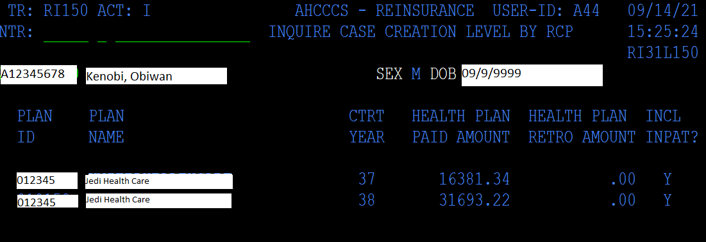
Recaps
What's the RI150 Screen?
It indicates how many dollars are eligible for a RAC Case.

Slide 20
Reminders
Shore up Transplant stage dates that go into following contract year.
Delete stages that are not in the contract year of the case.
Delete inactive stages or activate stages and shore up dates that go into the following contract year.
Not doing these things can create a lot of work for you and AHCCCS Reinsurance since CRNs that are not part of a stage can associate in error. This can require Reinsurance Action Requests and CRN transfers to correct which are very time consuming.

Slide 21
Reminders
Non-contracted Transplant types or Transplants performed at non-contracted facilities
AHCCCS must review all transplants at non-contracted facilities or for non-contracted case types.
The Letter of Agreement (LOA) for these cases must be received and reviewed by AHCCCS before the case can be created in PMMIS.

Slide 22
More Reminders
Please review your cases before submitting Reinsurance Action Requests and Transplant submissions.
Please use correct forms for submitting for reinsurance (e.g., Reinsurance Action Requests, Case Creation Form, Catastrophic or Transplant CRN Transfer Forms)
Complete forms completely.
Submit your SNF Grids by 11/1/2021.

Slide 23
More Reminders
Do not forget to monitor your cases over $1,000,000 so you can request to receive enhanced reinsurance.
Do not forget to request your catastrophic cases timely, (i.e., HEM, VON, GCC, BIO)
Do not forget to review your aged Transplant report AHCCCS Reinsurance provides monthly.

Slide 24
Reminders - Continued
There is no Transplant Reinsurance for Kidney Transplants as they are capitated.
All Transplant providers must be registered.
Notwithstanding the denial of reinsurance by AHCCCS, the Contractor is responsible for payment of claims for all services approved by the Contractor.

Slide 25
AHCCCS
Health Plans
Hospitals

